Slide 1
Public Diplomacy, Propaganda and PSYOPS
COMM 5500: Lecture 7
The Info-Sphere in Operations Other Than War in the 1990s: International News or International Propaganda?
Prof. Philip M. Taylor,
ICS, Leeds, UK

Slide 2
The United Nations Charter as frame-setter for the ‘old’ world order
Article 2.7 of UN Charter:
‘Nothing contained in the present charter shall authorize the UN to intervene in matters which are essentially within the domestic jurisdiction of any State …. But this principle shall not prejudice the application of enforcement measures under Chapter VII’.

Slide 3
State vs. Supranational
Chapter VII: Article 41:
‘The Security Council may decide what measures not involving the use of armed force to give effect to its decisions … these may include complete or partial interruption of economic relations and of rail, sea, postal, telegraphic, radio and other means of communication, and the severance of diplomatic relations’.

Slide 4
State vs. Supranational
Chapter VII: Article 42:
‘Should the Security Council measures in Article 41 prove inadequate, it may take such action by air, sea, or land forces as may be necessary to restore international peace and security’.

Slide 5
Specific International Crises of the 1990s
Gulf War
Somalia
Bosnia
Rwanda
Haiti
Kosovo
East Timor/Sierra Leone
Afghanistan

Slide 6
Why these and not…..?
Sudan
War of the Great Lakes
Guinea Bissau conflict
Algeria
Liberia
Cambodia
Etc etc…..
‘FORGOTTEN WARS’

Slide 7
The ‘New World (Information) Order’ after the Cold War
Operation Desert Storm: unfinished business, Saddam’s survival and the legacy of the covert PSYOPs campaign
Operation Provide Comfort, but no help for the Shi’ites – evidence of the ‘CNN Effect’?
‘news is the shocktroops of propaganda’ (for intervention? For war?)

Slide 8
Iraq and the Kurds 1991
‘I would be the very first to admit that I think TV probably had the greatest impact at this time in pushing us through the various phases of policy. The political and the human desire to respond to what was unfolding on the screen had a sizeable impact’ (Richard Haass, NSC, quoted in Strobel, p.128)
‘without Turkey factored in, with just television pictures, I don’t know what our response would have been. We were sensitive to Turkey’s anxiety about allowing the Kurds to stay. That was fundamentally what motivated us’ (Brent Scowcroft, NS Advisor to Bush Snr.).

Slide 9
The changing role of the military in the 1990s
OOTWs in N. Iraq, Somalia, Bosnia, Haiti, Kosovo 1999
Failing states, ideologically adrift after Cold War
New types of deployments, new skills required
Revolution in Communications technologies/Military Affairs
Democracies and non-democracies

Slide 10
Somalia, 1992
‘After the election, the media had free time and that was when the pressure started building up … We heard it from every corner, that something had to be done. Finally the pressure was too great … TV tipped us over the top … I could not stand to eat my dinner watching TV at night. It made me sick’ (Marlin Fitzwater to Nik Gowing, 1994: 68)
‘Television got us in and television got us out’

Slide 11
Somalia, 1992
‘Bush said that as he and his wife, Barbara, watched television at the White House and saw “those starving kids … in quest of a little pitiful cup of rice”, he phoned Defense Secretary Dick Cheney and Gen. Colin Powell, Chairman of the JCoS: “ Please come over to the White House”. Bush recalled telling the military leaders: “I – we – can’t watch this anymore. You’ve got to do something”’. (Craig Hines, The Houston Chronicle, 24 October 1999).

Slide 12
Operation Restore Hope in Somalia, 1992
Piers Robinson’s research (2000) showed that
November 5 – 25th (the day the decision was made to deploy ground troops) media coverage was scant (eg Washington Post ran only 4 articles in 21 days, only 1 on front page, NYT ran 13 with 1 on front page, CBS ran five news segments low down the order)
November 26 – December 4 (the day UN OK’s Restore Hope) coverage intensifies to 50 articles in 8 days and 46.5 mins of footage and mostly supportive
December 5 – 9: 76 articles and 85 mins of coverage

Slide 13
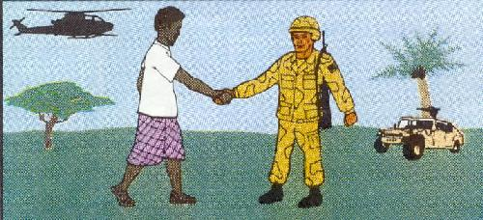
PSYOP in Somalia
‘United Nations Forces are here to assist in the international relief
effort for the Somali people. We are prepared to use force to protect
the relief operation and our soldiers. We will not allow interference
with food distribution or with our activities. We are here to help you.’

Slide 14
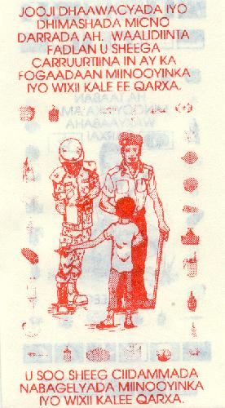
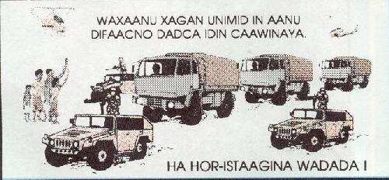
More Somali PSYOP
MEANINGLESS DEATH. PARENTS PLEASE TELL YOUR CHILDREN TO KEEP AWAY FROM MINES AND OTHER EXPLOSIVE THINGS.
TELL THE PEACE KEEPING FORCES ABOUT MINES AND OTHER EXPLOSIVE THINGS.
WE ARE HERE TO PROTECT
RELIEF CONVOYS!
DO NOT BLOCK ROADWAYS!

Slide 15
Crisis in the Balkans
1991-95: Bosnia and SFOR
1995: From the ‘safe havens’ to the Dayton Peace Agreement
1995-99: IFOR
1999: Kosovo Conflict
Post Kosovo: KFOR

Slide 16
1991-95: Bosnia and SFOR
‘The death of Yugoslavia’
Three sided civil war (Croatia, Bosnia, Serbia)
Media coverage: erratic, polarised, simplified – and anti-Serb!
Clinton administration policy – to resist the shocking images (from Europe!) especially post Somalia
Markele market place and safe havens

Slide 17
Srebrenica, 1995
‘We have a war by CNN. Our position is unsustainable. It’s killing the US position of strength in the world’ (Bill Clinton, 17 July)
‘we can’t be driven by images because there’s plenty of other places that aren’t being photographed where terrible things are going on. But we can’t ignore the images either..’ (Al Gore, 18 July)
‘Let’s be clear: the reason the West finally, belatedly, intervened was heavily related to news media coverage’ (Hal Holbrooke, 1996)

Slide 18
The Road to Dayton
Srebrenice and the humiliation of the ‘safe havens’ policy
Evidence suggests the CNN effect finally came to play in influencing air strikes
Especially after the failure to intervene in Rwanda genocide
Dayton establishes IFOR
Record since 1995

Slide 19
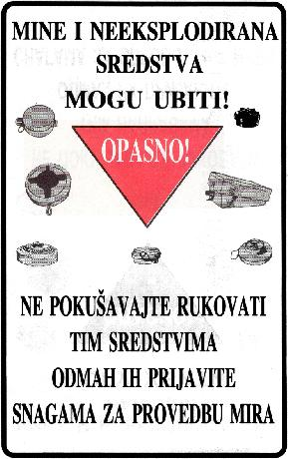
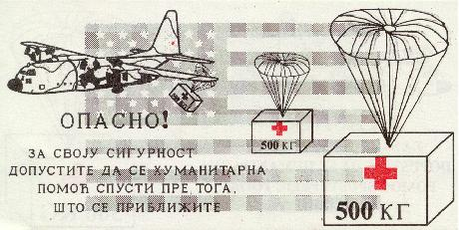
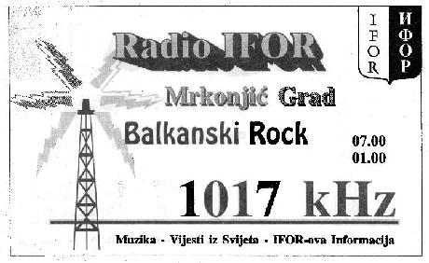
PSYOP in Bosnia

Slide 20
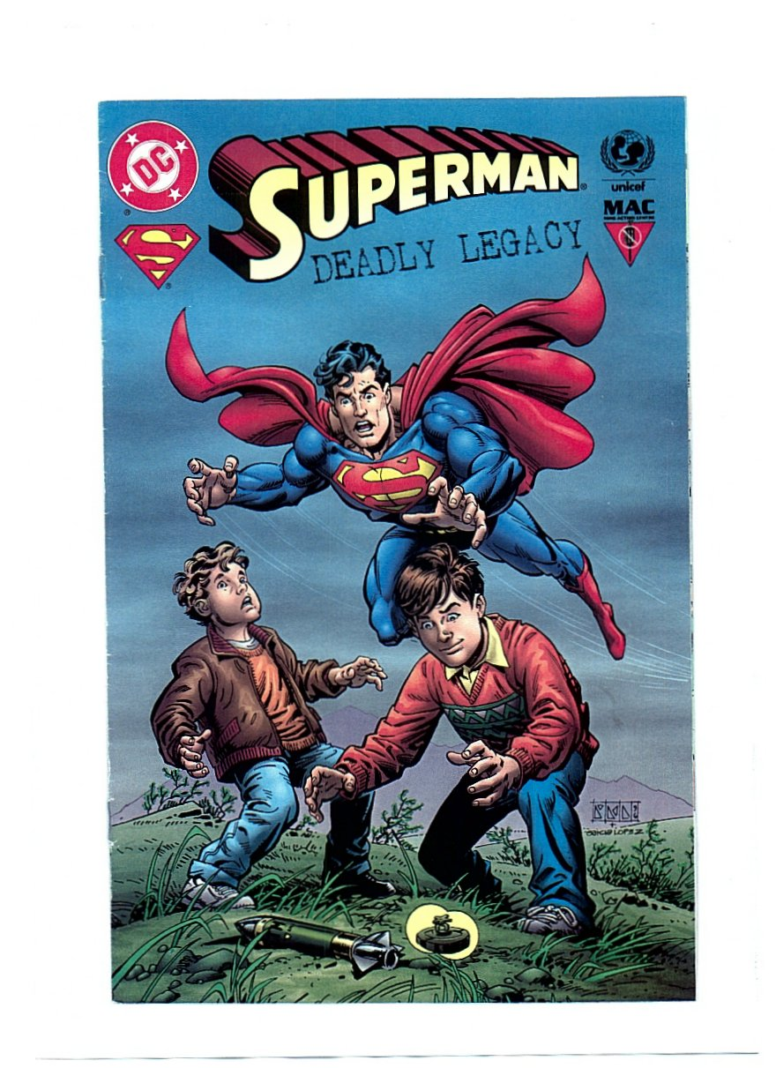
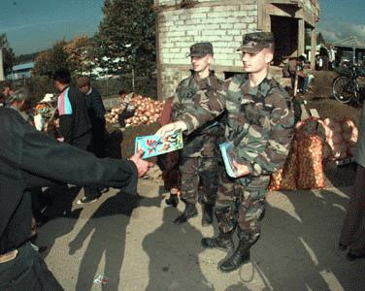
More Bosnia PSYOP

Slide 21

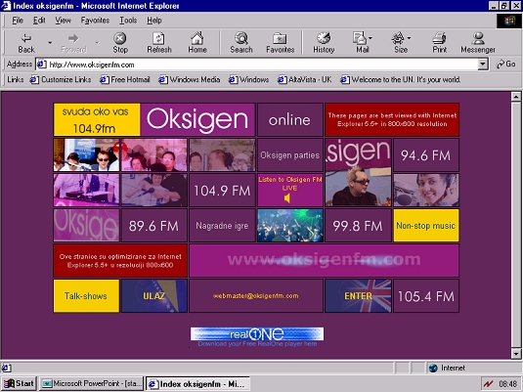
Consolidation PSYOP

Slide 22
Haiti 1993-96
1990 Aristide democratically elected with 67% of vote
1991 Coup against President Aristide
OAS Civilian presence established 1992
1993 SC imposed oil and arms embargo
October 1994 UN and OAS, led by US, threaten invasion, after expulsion of UN mission
Carter mission at the last minute avoided ‘invasion’
Elections Dec 95; President Aristide restored Feb 1996

Slide 23
Haiti
Coup period witnessed human rights issues come to fore
Boat people crisis
UN Resolution 940 (1994) authorised MNF to use ‘all necessary means’
Planned ‘invasion’ was fully televised
Military personnel from 24 countries landed unopposed

Slide 24
Haiti – Lessons Learned
A return to the old ‘proximity’ rule for US involvement post Somalia?
The media as a tool for sending messages to the military coup: showing of resolve (loudspeaker diplomacy)
Operation ‘Uphold Diplomacy’ – a shift in the role of the UN (and USA) to spreading democratic values?

Slide 25

Psyops in Haiti

Slide 26
CNN does not operate within a vacuum
Peter Jakobsen’s 5 causal motives for humanitarian intervention
Clear case under international law to justify intervention
If national interests are at stake
If domestic support exists
If there is a clear chance of success
If media coverage is pushing for it
(Journal of Peace Research, 1996)

Slide 27
The Road to Kosovo
Serbia removes autonomy in 1998
KLA vs. MUP and VJ forces: legacy of Bosnia media coverage identifies Serbs as villains
Serb ‘genocide’ mobilises media
Media coverage mobilises politicians to launch a war of ‘guilty conscience’ for not acting against Serbs over Bosnia

Slide 28
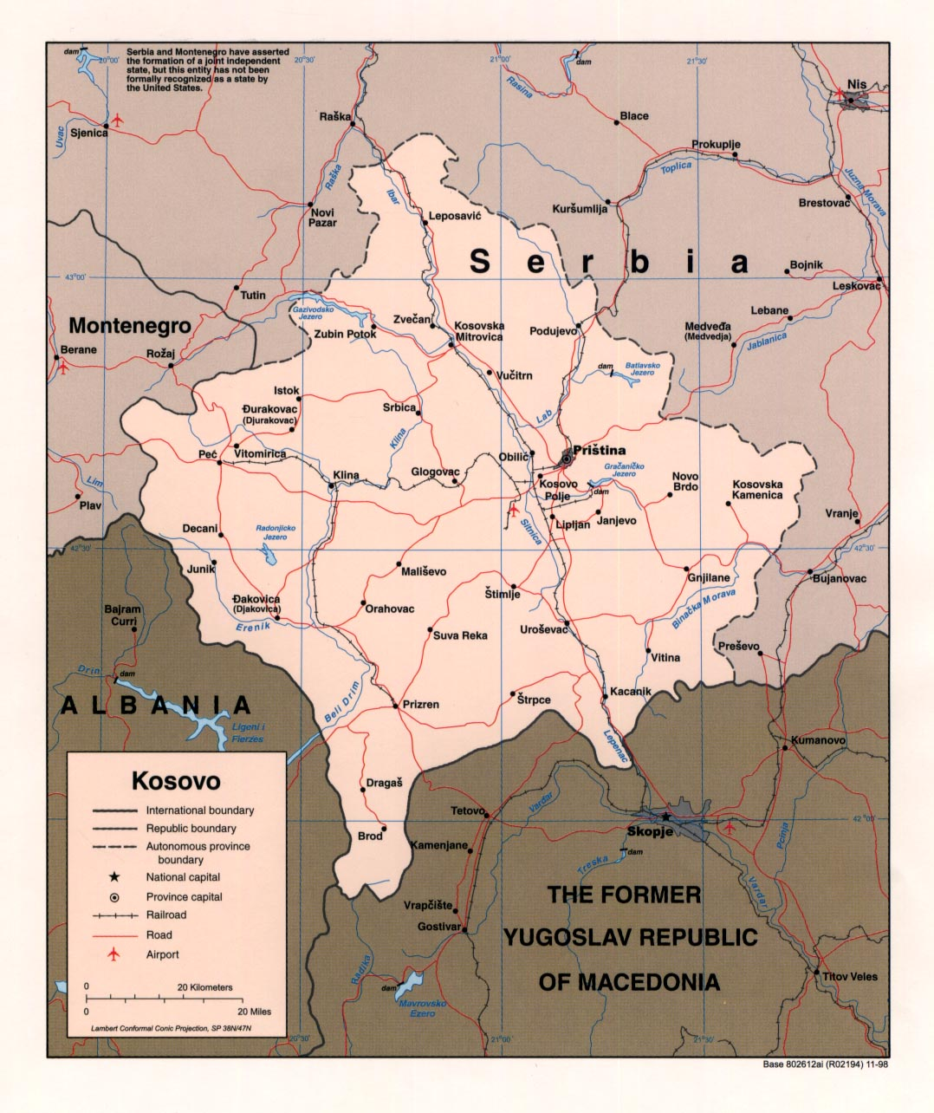

Slide 29
Kosovo: WWW1
Gulf War 2 without the ground war
The arrival of the Internet and the mobile phone
Asymmetrical warfare and the importance of propaganda (‘SOFTWAR’)
Information Warfare and 103 million leaflets

Slide 30
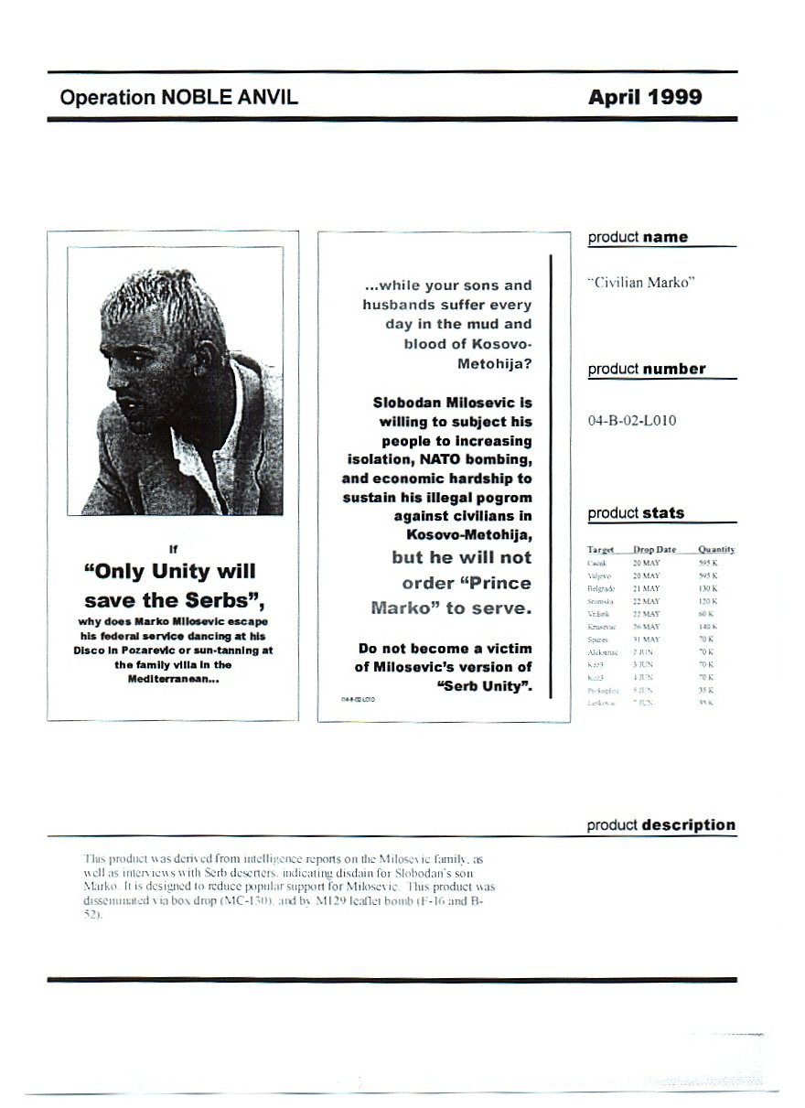
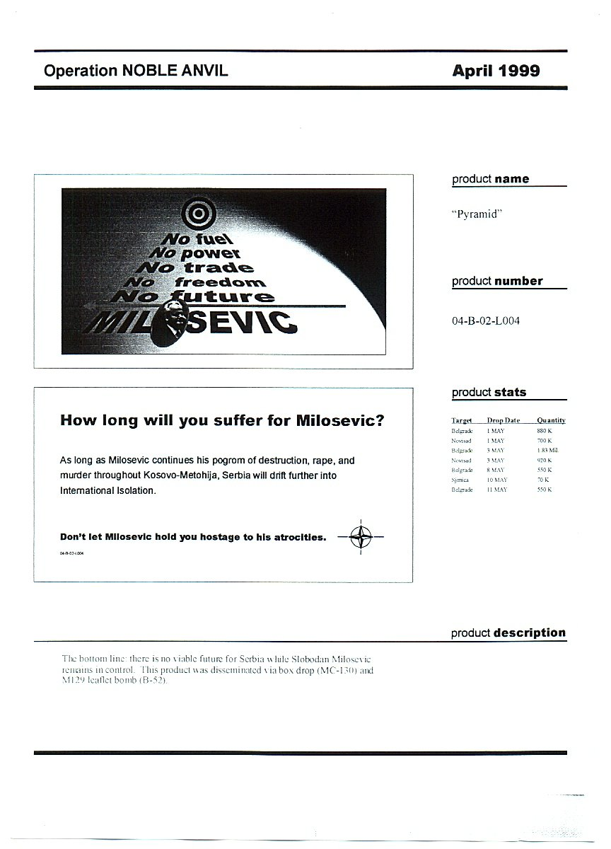
Kosovo PYSOPS

Slide 31
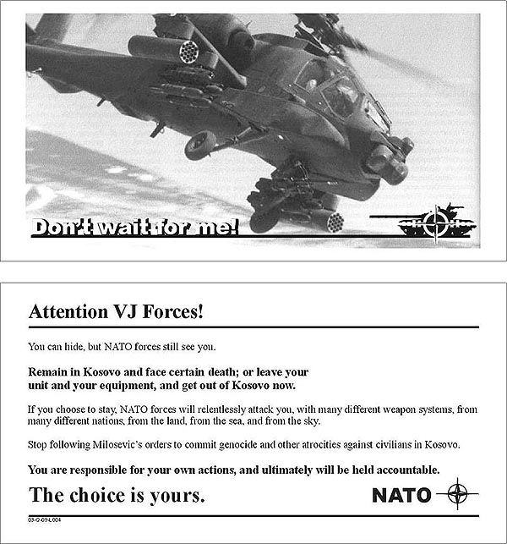
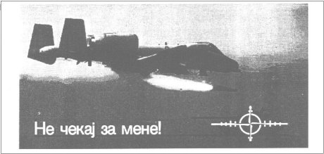
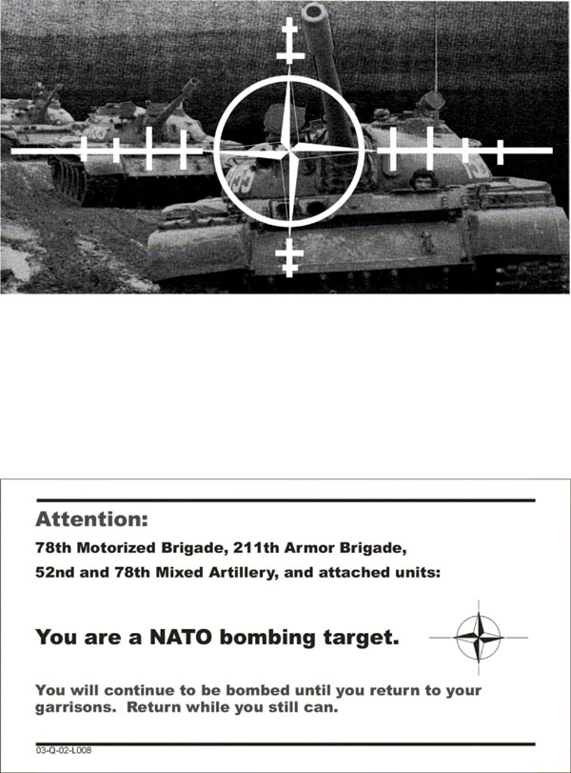

Slide 32

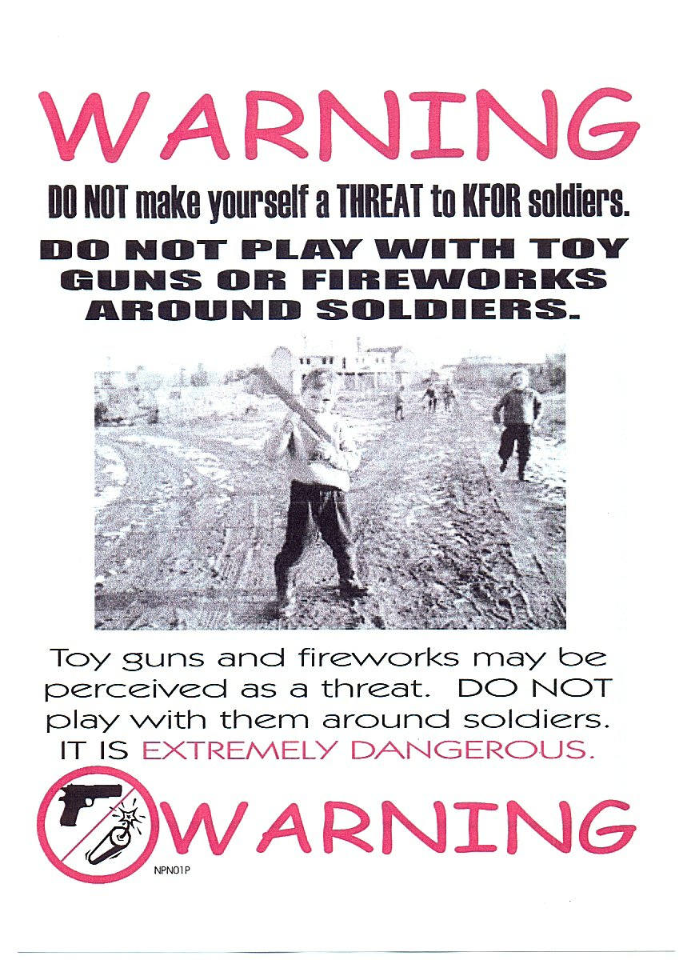
Consolidation PSYOP

Slide 33
Kosovo Conflict
Illegal?
‘Humanitarian intervention’ above international law
Media coverage characteristics
- western (Jamie Shae at NATO)
- Serb (bombing of RTS)
The arrival of the internet

Slide 34

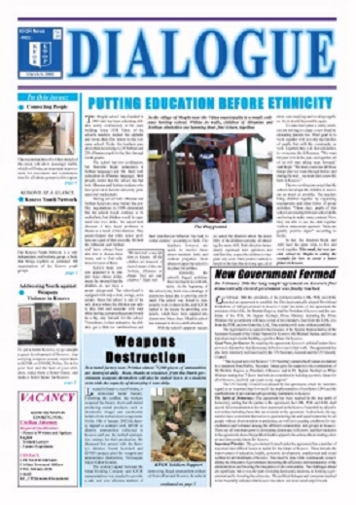
Nation Building?

Slide 35
Is this democracy building?
Rebuild of ‘civil society’
Restoration of ‘law and order’
With values comes cultural transmission
Cultural diplomacy or cultural imperialism?
Is this appropriate or realpolitik?
What is behind this? Democracies don’t fight democracies; triumph of free market liberal capitalism at end of Cold War

Slide 36
Old World Order vs.New?
Clear case under international law to justify intervention
If national interests are at stake
If domestic support exists
If there is a clear chance of success
If media coverage is pushing for it
New case for ‘regime change’ despite UN Article 2.7 vs. UN resolutions since 1991 including 1441?
National interests at stake over Iraq? (Oil! WMD/Iraq-Al Qaida link)
Domestic support vs. political resolve
Military success vs. aftermath
Media support?

