Slide 1
War and the Media
Dr. Philip M. Taylor
Professor of International Communications, University of Leeds, UK
p.m.taylor@leeds.ac.uk
www.leeds.ac.uk/ics/pmt

Slide 2
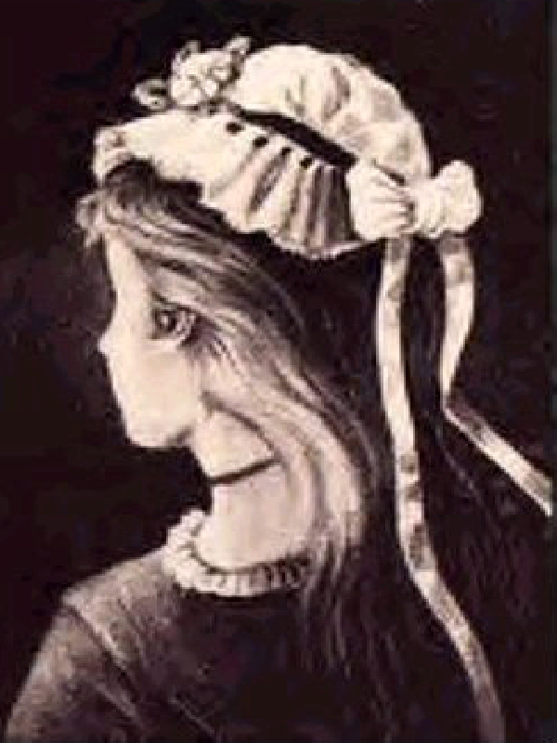
How do you see the world?
Old woman or young girl?
The media are the public’s ‘window on the world’

Slide 3
The (News) Media
Heterogeneous (print, radio, TV) but some generalisations possible, i.e….
Mediated view of (their) ‘reality’
Increasingly competitive, event (not issue) driven, globalised reach, MNCs
‘the tyranny of real-time’ and the ‘CNN Effect’
‘Infotainment’ and human interest stories
Pre 9/11, had lost interest in international and military affairs, except in time of crisis

Slide 4
‘Old’ Media and the Military
Elite media, elite audiences (perhaps 15% of a national audience)
Mass media in ‘our wars’ generally and historically more supportive of ‘our boys’
The ‘deal’: trading need to know/right to report for access + OPSEC restrictions
Old media understand the deal

Slide 5
Military-Media Dynamic
Military institutional suspicion of media
Civilians on the battlefield!
Response was censorship
But look at the historical record – far more co-operation than conflict in ‘our wars’ (including Vietnam)
Yet there is a clash of cultures…..

Slide 6
The Clash of Cultures
THE MILITARY RESPECT….
Authority
Order
Hierarchy
Co-operation
Team-work
Continuity/Tradition
Togetherness
Institutions
THE MEDIA VALUES…
Hate authority
Chaos is a good story
Dog eat dog
Competition
Individualism
That’s history, not news
Dog eat cat
Human Interest

Slide 7
Military control freakery
Falklands antidote to the ‘Vietnam Syndrome’
Grenada
The Pool System
The Gulf War of 1991 as ‘model’
OOTW – ‘our wars’ vs. ‘other people’s wars’
The rise of the CNN Effect
Kosovo cock-ups

Slide 8
One Lesson Learned - the rise and rise of Public Affairs/PI
The triumph of TV - ‘seeing is believing’
The troubles of the world in either 3 minute segments or 24/7
The disingenuity of ‘we are not in the influence business’
But ‘information provision’ needs speed, accuracy and credibility to pre-empt enemy propaganda

Slide 9
The News Media and the New Media: New Kids on the Block!
The scale of the problem?
From 450 to 1500 to 3800
Who are those guys?
The new media brigade
The rise of the ‘citizen journalist’
How do you do a ‘deal’ with these players?

Slide 10
www.1 and the New Media
TV/Korea – Internet/Kosovo
Asymmetrical warfare & ‘Softwar’
An ‘electronic Pearl Harbour’?
1990s IW obsession with systems not people
9/11 and the rise of Perception Management

Slide 11
Enduring Freedom - A new kind of ‘war’
Cold War + Internet + New Kids
Old Media true to form (at least so far in US – Fox TV – but less so in Europe – Camp X-Ray)
International media require more attention, even if decision is made to go it alone
New emphasis on Public Diplomacy

Slide 12
Perception Management
Long-term campaign for hearts and minds
Not a clash of civilisations but a conflict of competing ‘truths’ or ‘perceived realities’ about how the world should be in the age of a sole superpower
Media – old and new – have to be in this loop…..
But where?
The old media see the old woman; the new media see the young girl

Slide 13
The conundrum
Can the old media be expected to stay ‘on message’ for a prolonged ‘war’?
How reliable have they become anyway?
What about the new media?
The danger of information vacuums (Jenin)
The dangers of domestic media control (Al Jazeera and the bin Laden tapes)
Democracies always on the defensive?

Slide 14
The Options
Ignore them – and be crucified! (Jenin)
Control them – and be crucified! (Grenada)
Deceive them – and be crucified! (‘The Wave’, the OSI)
Educate them – and you have a chance (‘Always look on the bright side of life’)
Think hard about the new info-players

Slide 15
The Real Wars – The Differences
1991
2003
Was about the liberation of Kuwait
Month-long air war, followed by 100 ground war
The ‘first’ information war/video game war
Saddam survives
Was about regime change in Iraq
3 week ‘blitzkrieg’ (EBO – Effects Based Operation)
‘Shock and Awe’
Whither Saddam?

Slide 16
The Media Wars – The Similarities
1991
2003
It was about oil
It was about Bush Senior getting re-elected (he didn’t)
Saddam was ‘the new Hitler’
Media war and real war not the same thing
It was about oil
It was about unfinished Bush family business
Saddam was a ‘new Stalin’
Media war and real war not the same thing

Slide 17
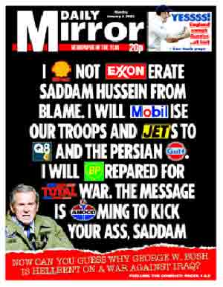
6th January 2003

Slide 18
The Media Wars – The Differences
1991
2003
Pool system
Air war and the distancing power of the media
CNN
Amiriya bombing and ‘collateral damage’
‘The Highway of Death’
Embedded journalists
Southern front well covered, less so northern and western fronts
Al Jazeera and other Arab satellite stations

Slide 19
Desert Storm & the Media
1500 journalists ‘not an unmanageable number, but a number that cries out for management’ (General Dugan)
Pools and Press Conferences
The ‘unilaterals’
The Baghdad loophole
The first live television war (but…..)
Media support reflected majority public support

Slide 20
Iraqi Freedom and the Media
2,600 journalists, only 600 of whom ‘embedded’, the rest unilateral (unembedded) – 14 dead, 2 still missing
Central Command (Dohar) less the centre of gravity
Technology and alternative sources from Arab side made censorship harder
Media divisions (in UK/Europe at least) reflected public divisions

Slide 21
So what did we see?
In 1991, a ‘smart’, clean, clinical, precise war with few civilian casualties when in reality….
In 2003, a controversial intervention which was sold as a liberation but interpreted by opponents as an invasion
A fog of war or a snowstorm of information?
And what about the weapons of mass destruction?

Slide 22
The impact of 1991 upon 2003
Why didn’t the coalition ‘finish the job’ in 1991?
Covert propaganda deviated from official line and encouraged an anti-Saddam revolt in 1991
The lack of coalition support in 1991 discouraged an internal uprising in 2003

Slide 23
So what happened in between?
9/11 and the ‘war’ against terrorism
The Bush ‘Doctrine’
- Pre-emptive war
- Regime change and the ‘axis of evil’
- aggressive promotion of democracy, US style
This makes Iraqi Freedom the 2nd battle of the war (Afghanistan was the first) against terrorism

Slide 24
Some questions
Will the media be able to sustain interest in a war in which only the military battles are visible?
Will democratic governments be able to sustain their commitments to nation-building?
Will the public tolerate US foreign policy in a climate of ‘you are with us or against us’?

