Slide 1
Propaganda, PD and PSYOPS
Prof Philip M. Taylor
Lecture 8 – The Kosovo Crises in 1999

Slide 2
Crisis in the Balkans
1991-95: Bosnia and SFOR
1995: From the ‘safe havens’ to the Dayton Peace Agreement
1995-99: IFOR
1999: Kosovo Conflict
Post Kosovo: KFOR

Slide 3
The Road to Kosovo
Serbia removes autonomy in 1998
KLA vs. MUP and VJ forces: legacy of Bosnia media coverage identifies Serbs as villains
Serb ‘genocide’ mobilises media
Media coverage mobilises politicians to launch a war of ‘guilty conscience’ for not acting against Serbs over Bosnia [???]

Slide 4
Kosovo Media Coverage
Regardless of whether it was ‘good’ or ‘bad’, we need to understand the operational constraints upon journalism at war
‘Real War’ and ‘Media War’ not - and never have been - the same thing
What is surprising is that anyone should be surprised by this

Slide 5
Operational Constraints
Access - military operations generate extremely dangerous situations for journalists (insurance!)
Each journalist has only an ant’s eye view of the conflict (John Simpson’s analogy as a football match)
‘Fog of war’ generated by warring factions trying to control global media agenda

Slide 6
Operational Constraints
Satellite time and pressure of speed over accuracy and context
Public Service tradition of reporting both sides - accusations of reporting enemy ‘propaganda’
‘Parachute journalism’ and the decline of the specialized foreign and defense correspondent
Media as participants, not observers (RTS) and even as catalysts (initial intervention)

Slide 7
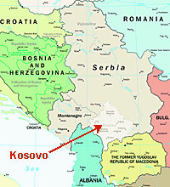
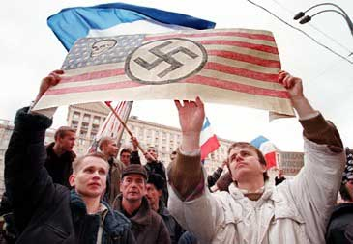
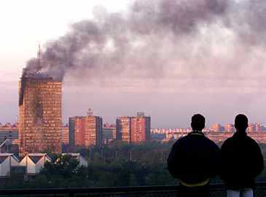

Slide 8
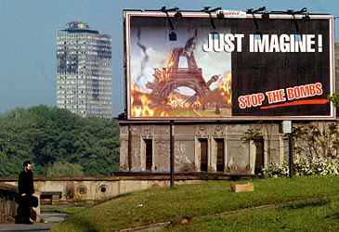

Slide 9
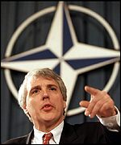
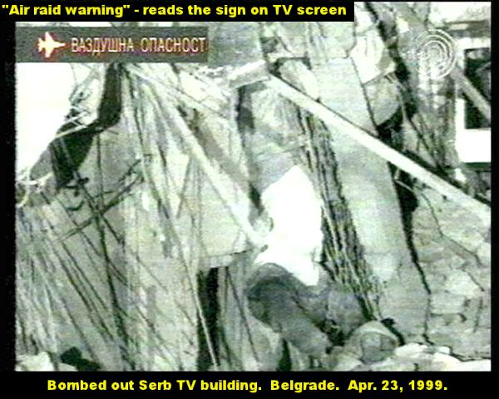
Kosovo Conflict
Illegal?
‘Humanitarian intervention’ above international law
Media coverage characteristics
- western (Jamie Shae at NATO)
- Serb (bombing of RTS)
The arrival of the internet

Slide 10
Any Surprises, 1999?
Not really - many similar characteristics to Gulf War (1991) reporting
Restrictions on access for western correspondents in ‘enemy’ country under fire
Pro-NATO, anti-Serb
Largely supportive because greater access to NATO spokesmen than Serb
When UK government criticized media, it’s a clue that media are doing a reasonable job in reporting both sides

Slide 11
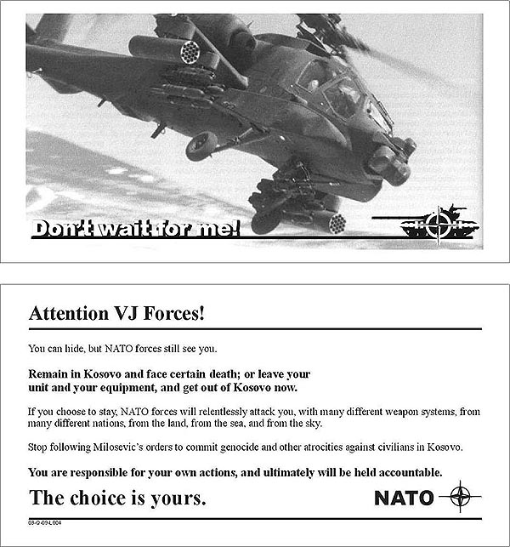
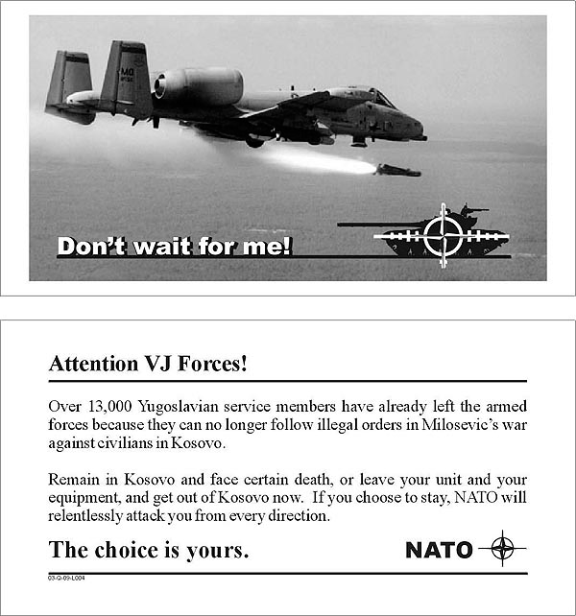
103 million leaflets in PSYOP campaign

Slide 12
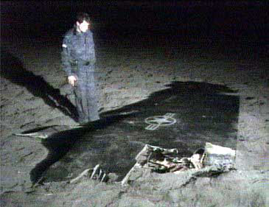
Some Kinetic Victories

Slide 13
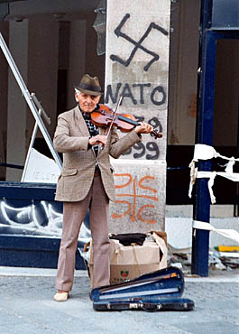
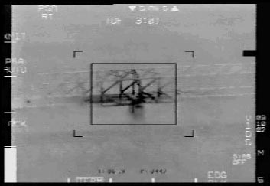
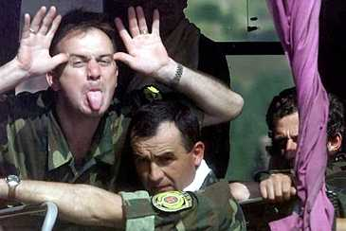
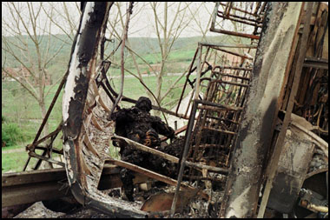
Asymmetric Warfare
and
‘Softwar’

Slide 14
KFOR - Is this democracy building?
Rebuild of ‘civil society’
Restoration of ‘law and order’
With values comes cultural transmission
Cultural diplomacy or cultural imperialism?
Is this appropriate or realpolitik?
What is behind this? Democracies don’t fight democracies; triumph of free market liberal capitalism at end of Cold War

Slide 15
Kosovo = WWW.1
In October 1999, General Shelton admitted for the first time that NATO had conducted ‘information warfare’ against Serbia.
‘information warfare’, or ‘information operations’ as it is now more commonly being described, was gradually penetrating the military planning process in advanced information societies.
Essentially, this is a new concept of warfighting against new types of adversaries in new forms of battlefields (or battle ‘spaces’) that forms part of the so-called Revolution in Military Affairs (RMA).

Slide 16
WWW.1
IW requires the application of new technologies, especially new communications technologies, to improve military ‘command and control’ capabilities in defeating an enemy by ‘smart’ applications, intelligent systems such as computers and satellites, and by applying other advanced technological assets.
It is all the more surprising therefore that the main protagonists of such theorising did not practice what they preached in Kosovo.

Slide 17
Internet usage 1999
In Serbia, it was estimated that a maximum of 50,000 of its ten million population had access to the internet, with less than 1,000 in Kosovo itself.
During the conflict with NATO, television remained the main source of information for 60% of Serbs, followed by newspapers, word of mouth and radio.
Four in ten Serbs listened to foreign radio stations (with Radio Free Europe being the most popular) and slightly less foreign television.
Only one in ten Serbs used the internet ‘frequently’ (2%) or ‘sometimes’ (7%) for information, but over half of the ‘sometimes’ users believed that the information they gained was inaccurate. In the first post-conflict survey of Serb media usage, the internet – in terms of usage and credibility – was remarkably placed above NATO television (deployed by flying TV platforms known as the Commando Solo) but actually below the 103 million NATO leaflets that were dropped over the country.

Slide 18
Serb ‘asymmetric warfare’
The Serbs devoted considerable resources towards internet communications during the Kosovo conflict.
They saw the World Wide Web as a unique instrument for waging their own ‘information warfare’ against NATO countries and for getting their message across to global elite, if not public, opinion while refuting or challenging the arguments of their adversaries.
Indeed, from the moment the NATO bombing commenced on 24 March 1999, and as it extended into targeting Serbia’s military-civil infrastructure, including Serbian television and radio transmitters and stations, it was perhaps their only weapon of retaliation.

Slide 19
Serb cyberwar
Serb attacks on NATO’s own home page or anti-NATO hackers disrupting the website of the White House.
One individual in Belgrade was able to cause considerable damage by e-mailing 2000 messages a day, some containing the Melissa and more pernicious Papa macro viruses, to NATO’s website using ‘ping’ bombardment strategy to cause line saturation.
The website of the British Ministry of Defence, which translated its website into Serbian to counter Belgrade censorship, at once stage was receiving 150,000 hits per day, 1400 of which were from inside Yugoslavia.

Slide 20
Serb infowar
The Serb infowar nerve centre was based on the 13th floor of the Beogradjanka building where volunteers – mainly students – linked with more than 1000 other computer volunteers at six other centres in Belgrade.
Day and night, they debated in chat rooms, translated articles into English and linked with other anti-NATO groups and individuals world-wide.
They were led by ‘Captain’ Dragan Vasiljkovic, who ran unsuccessfully against President Milosovic in 1992.
This 44 year old former paramilitary veteran of Croatia and Bosnia redirected the funds he had set up for Serbian veterans into the psychological warfare computer centre.
‘We are all targets’ was the principal slogan deployed to show the outside world that the Serb people were united behind their government under the rain of NATO bombs.

Slide 21
What impact?
Probably very little, except to sow seeds of doubt about credibility of western media and NATO press conferences
The internet was to Kosovo what TV was to the Korean War

