Slide 1
Strategic Communication and the ‘War’ against terrorism
Lectures 9 & 10
Prof. Philip M. Taylor
Institute of Communications Studies,
University of Leeds, UK

Slide 2
What kind of propaganda?
That conducted by governments against their terrorist adversaries (Psychological Operations or PSYOPS)
Public Diplomacy/’Strategic Information’ to friendly, neutral and hostile audiences
That conducted through the media

Slide 3
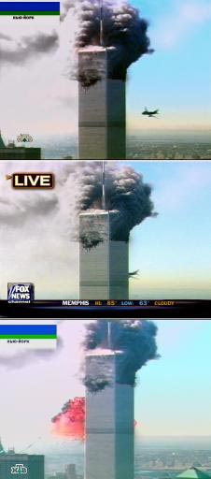
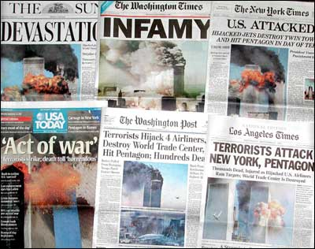
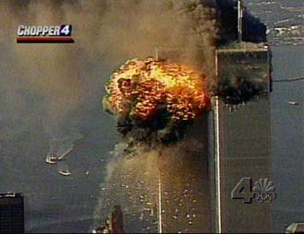
‘Propaganda of the Deed’
New York targeted because its media rich environment ensured maximum, spectacular, global media coverage

Slide 4
Caught on the back foot: A new kind of ‘war’?
‘war’ is usually defined as armed conflict between two or more nation states
This conflict began as a manhunt against an individual (although the ‘dead or alive’ line was backed off from on 25/10/01) and his organisations which transcend traditional geo-spatial boundaries
Mistake to use the word ‘crusade’ in early days because this sent the wrong signal in the Muslim world
Also Original Campaign Plan title: ‘Infinite Justice’!!!!

Slide 5
So what kind of ‘war’ is this?
Analogy with the ‘war on drugs’
War against an idea or a ‘concept’ by a non-state actor
‘Cold War’ of ideas/ideologies
How long will this last?: ‘we’re in this for the long haul’
Military front only one element; where next after Iraq– information warfare)
Has the public got the stomach for the casualties (‘collateral damage’) and the longevity?

Slide 6
Enduring Freedom: A ‘war’ on Six Fronts
The Diplomatic Front – i.e. coalition building
The Intelligence Front – the arrest and detention of terrorists and their supporters
The Financial Front – tracking and freezing money assets and laundering operations
The Law Enforcement Front – including counter-terrorist acts
The Military Front – first Afghanistan, then Iraq
The Humanitarian Front – post-conflict nation-building

Slide 7
The Propaganda War
Plays out on all six fronts
Usually conducted through global media
On the military front, psychological operations (leaflets and radio) in support of military operations deployed.
‘Information warfare’ includes strikes against Taliban radio and supplanting of internal communications messages by outside military media (including Commando Solo aircraft)

Slide 8
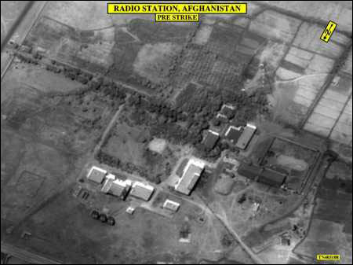
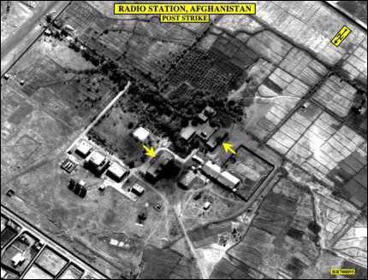
Information Warfare
Kabul, Voice of Shari’a radio Station before (left) and after air strike (below) 8 October 2001. Restored 26 Oct., destroyed hours later
Monitor latest developments
at
http://www.clandestineradio.com

Slide 9
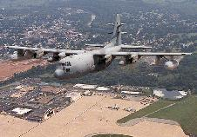
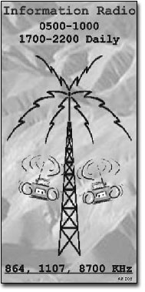
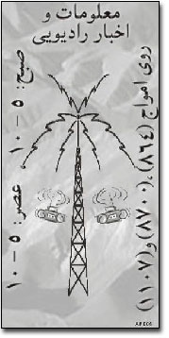
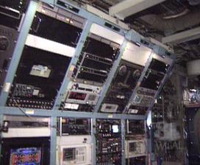
PSYOPS - Commando Solo

Slide 10
Commando Solo broadcasts
‘We have no wish to hurt you, the innocent people of Afghanistan. Stay away from military installations, government buildings, terrorist camps, roads, factories or bridges. If you are near these places, then you must move away from them. Seek a safe place, and stay well away from anything that might be a target. We do not wish to harm you.
With your help, this conflict can be over soon. And once again, Afghanistan will belong to you, and not to tyrants or outsiders. Then, you will reclaim your place among the nations of the world, and return to the honored place your country once held. Remember, we are here to help you to be free from this terrorism, despotism and the fear and pain they bring with them’.

Slide 11
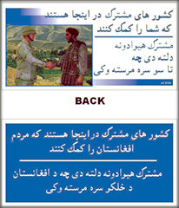
‘The Partnership of Nations is Here to Help You’

Slide 12
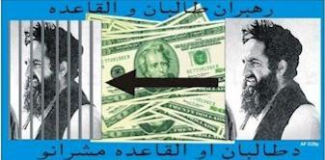
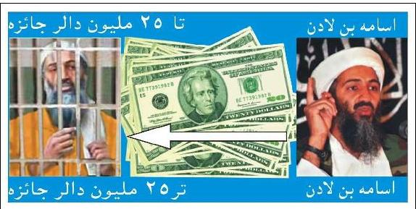
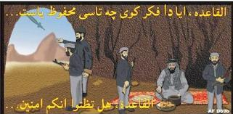
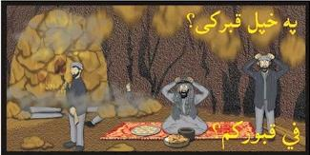
Psyops leaflets
Top - $25 million reward
Al Qaida – do you think you are safe?

Slide 13
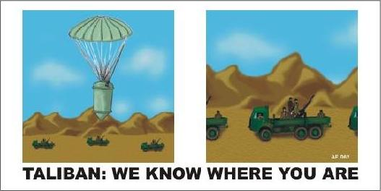
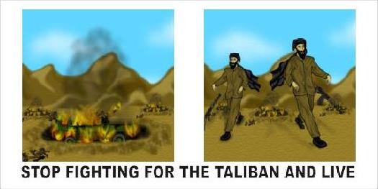
Enduring Freedom Psyops leaflets – pre-translation
Left - front
Right - back

Slide 14

PSYOP Leaflet in support of Humanitarian Aid
Left – Front & Back
"People of Afghanistan"
"Eid Mubarakm [end of Ramadan].
We wish that God will accept
your prayers and fast.
Have a blessed holiday"
People of America

Slide 15
Main world-wide themes of anti-USA propaganda
US ‘sponsorship’ of Israeli ‘terrorism’
US ‘hypocrisy’ of selective military interventions and selective targeting of terrorists (‘why not go after the Real IRA?’ ‘Why not wage war against Basque terrorists?’ BUT mainly Israeli terrorism)
‘Globalisation’ = ‘coca-colonialism’
Initial use of word ‘crusade’ indicates ‘reality’ of a Christian war against Islam (e.g. sanctions against Iraq, military bases in Saudi Arabia)

Slide 16
Why do they ‘hate’ the USA/West?
“September 11 was not mindless terrorism for terrorism’s sake. It was reaction and revenge, even retribution.” Pakistani newspaper, The Nation.
Betrayal, poverty, western support for corrupt royal families, fear of modernity
US support for Israel, bombing of Iraq, presence of US troops in Holy Land of Mecca

Slide 17
Is the US losing the propaganda war?
Public Opinion polls around the world still indicate strong support for US action, with opposition in a minority
As the military campaign continues, ‘collateral damage’ inevitable, fuelling opposition
Time differences mean overnight bombing and Taliban version dominated Global news cycle until CICs set up
Politicians in the west keep insisting that this is NOT a war against Islam whereas everything they ‘do to Islam’ is interpreted as exactly this by militants

Slide 18
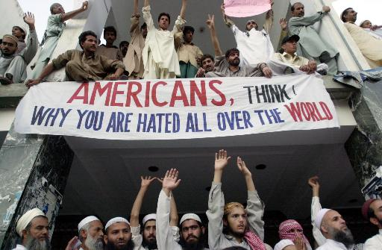

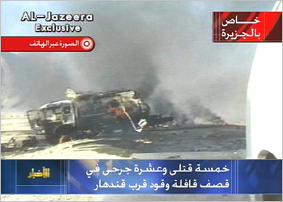

Slide 19
Propaganda themes which sow seeds of doubt in the Middle East
The US had planned to attack Afghanistan long before September 11
Long-term US covert plans to kill bin Laden
Taliban not ‘so bad’ as west claims
Missiles are cowardly; suicide hijackers are not
‘Evidence’ against bin Laden ‘unconvincing’
5 of the 19 hijackers still alive
No cell phone call from the hijacked planes mentioned ‘Arabs’
Followers of bin Laden in a Florida ‘strip bar’?
Passport of one found at the WTC?
Mohamed Ata’s suitcase never made the plane?

Slide 20
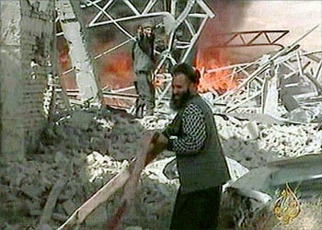
The ‘Arab CNN’ – Al Jazeera TV
Staff prefer to think of themselves as the ‘BBC World Service TV’ of the Middle East (many BBC trained)
Quatar based, it has upset just about every Middle Eastern leader by its ‘western’ style of allowing debate on any issue
Broadcast of bin Laden taped messages upsets west as well – accusation that they may contain ‘coded messages’ to terrorists ‘sleeping’ around the world.
The very fact that ‘Spin Laden’ has communications specialists indicates his value of ‘the oxygen of publicity’
Debate now extended to democratic countries – but if networks ‘self censor’ themselves, isn’t this more propaganda ammunition about western ‘hypocrisy’?

Slide 21
Caught on the back foot
Since the last presidential election, themes about the merits of democratic systems are on shaky ground.
International Public Information (i.e. ‘public diplomacy’) programmes, especially since PDD 68, clearly failing. Why?
Probably because they are targeted at elite foreign audiences, not at the street-level
Foreign elites, especially in non-democracies, not transferring US ‘justifications’ to their own people for fear (?) of being deposed at the street level.

Slide 22
Other nuts to crack
The belief that the US is ‘arrogant’, hypocritical and imperialist
The belief that this IS a clash of civilisations (e.g. attacks on mosques and Muslims in the west)
The belief that the US is using the ‘war against terrorism’ as a cover for other objectives (e.g. that Mossad was behind the September 11 attacks)

Slide 23
Meeting the post Sept 11th propaganda challenge
The west has to confront the widespread view in some parts of the world that USA ‘got what it deserved’. Yes, but how?
Provide more convincing ‘evidence’ for bin Laden and Al Qaeda’s involvement (without jeopardising HUMINT sources). Keep the evidence coming and cumulative.
Emphasise nature of terrorism
Emphasise bin Laden’s recent ‘conversion’ to the Palestine cause and the source of his wealth (building US military bases in Saudi Arabia)

Slide 24
Weapons of Mass Communication
Emphasise, with examples, that US is a ‘force for good’ in the world and that terrorism is the opposite
Address the apparent anomalies in US foreign policy, especially in the Middle East: image is shallow and unconvincing without substance
Stress US support for Muslim populations in Bosnia, Kuwait, Kosovo and East Timor
Clamp down on domestic anti-Muslim attacks in western countries; they only provide more ‘evidence’ in the Middle East of western ‘hatred’ of Arabs

Slide 25
Will this work?
Probably not in the short term because we are seeing Arab street-level public opinion for the first time as expressed on stations like Al Jazeera
Clamping down on Arab media will set back democratisation
Besides, will removal of bin Laden end terrorism or merely create more?

Slide 26
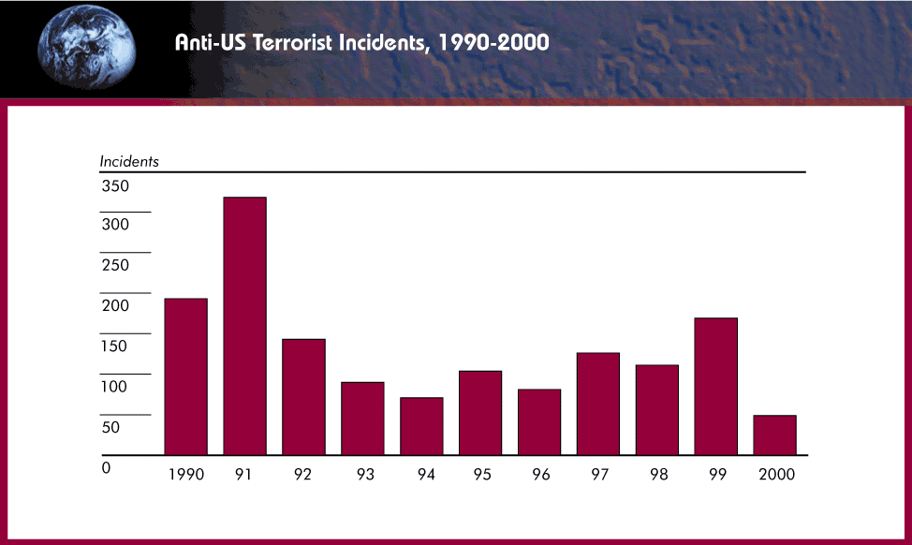
Terrorism in the 1990s
Note: increases in the years of the Gulf War and Kosovo conflict

Slide 27
Long-term vs. Short-term strategy
The military front may be a short conflict but the ‘battle for hearts and minds’ is critical
This requires a long-term strategy for ‘information’ and ‘education’
Propaganda needs to be hand-in-hand with policy and not precede it
If anything, policy needs addressing first, but with presentation in mind (not vice versa)
Only then can image reflect ‘reality’

Slide 28
Beefing up the US propaganda machine
Coalition Information Centres
Office of Strategic Influence
Office of Global Diplomacy
Freedom Promotion Act of 2002
Radio Free Afghanistan
Increased Voice of America output

Slide 29
Information Age Conflict
INFORMATION
IN WARFARE
Intelligence
Surveillance
Reconnaissance
Weather
Geographic
Other
INFORMATION
WARFARE
Influence Attitudes
Deny/Protect
Deceive
Exploit/Attack

Slide 30
Emerging US IO ‘doctrine’
Information Operations
PA/PI
Influence Operations
Cyber Operations
PSYOP Deception
CNA CND

Slide 31
INFORMATION WARFARE
Influence Attitudes
Deny / Protect
Deceive
Exploit / Attack
(‘Strategic Communications’)
Public Diplomacy
Private Diplomacy
PSYOP
Media Relations (PA/PI)
Education (‘soft’)
Counter Influence/ propaganda
OPSEC
Info Assurance
CI
Spoofing
Imitation
Distortion
EW
CNA
Ballistic
EMP
Deception
There may be trouble ahead – the Office of Strategic Influence

Slide 32
Preliminary conclusions – more questions than answers
Can democracies wage long wars with public support in the ‘information age’?
What are the military objectives in Afghanistan? If it is a ‘manhunt’, then remember Somalia
How long can the media sustain their interest, especially after the military phase gets overtaken by the other fronts?
Are the media part of the problem or part of the solution?

Slide 33
Battle 2 – Iraqi Freedom
The pre-war search for a casus bellum
The IO campaign, March 20 – April 15
The PSYOP campaign
The ‘Media War’
Post-war challenges

Slide 34
Unfinished business?
From Desert Storm: ‘why didn’t we finish the job in 1991?’
From UN resolutions about WMD
From 9/11, Enduring Freedom and the ‘war’ against terrorism
Bush Doctrine of pre-emptive war and regime change
The ‘axis of evil’ and the dangers of appeasement

Slide 35
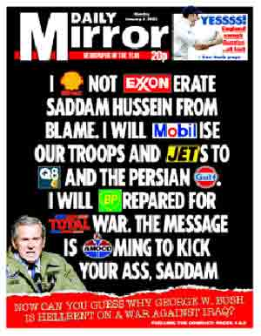
Counter-themes
Oil
Israel
Bush family revenge
Project for the New American Century
Link between Saddam and 9/11, Al Qaeda?
More time needed for weapons inspectors

Slide 36
A world unconvinced
Percentage drops in favourable views of US since start of year 2003 (Pew Centre, 18 March)
- France: from 63% to 31%
- Italy: from 70% to 34%
- Russia: from 61% to 28%
- Turkey: from 30% to 12%
- UK: from 75% to 48%

Slide 37
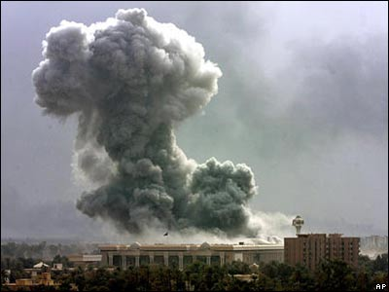
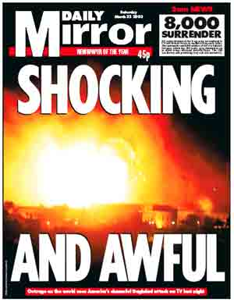
‘Shock and Awe’

Slide 38
The Battle for Iraqi ‘Hearts and Minds’, 2003
No mass surrenders on a scale similar to 1991 – why?
No wide-scale uprisings against SH, unlike 1991 – why?
Widely regarded in Arab world as ‘invaders’ not liberators – why?
= a serious failure of perception management at tactical and strategic levels (except in USA. But for how long?)

Slide 39
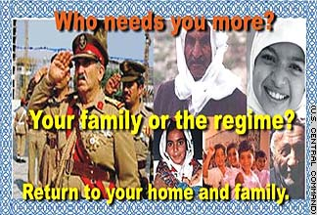
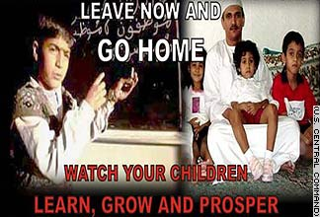
White PSYOPS, 2003
Go home/Stay at home campaign
This looks to have been a successful part of the campaign

Slide 40
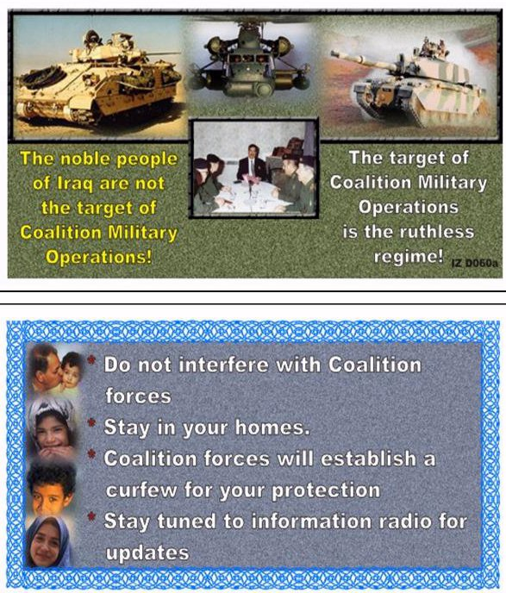
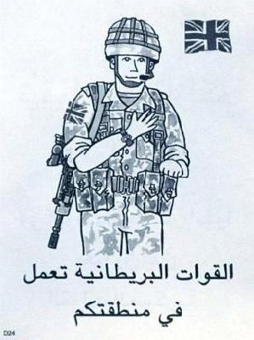
Regime change products

Slide 41
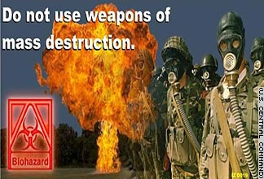

Other successes

Slide 42
IO and PSYOPS
Integration of Perception Management themes from top to bottom
‘I urge the Iraqi people being threatened in the cities to try to remember the faces and the names of the death squad enforcers. Their time will come, and we will need your help and your testimony.’ (Donald Rumsfeld, Pentagon news briefing, 28 March)
Had a press conference become a psychological operation?

Slide 43
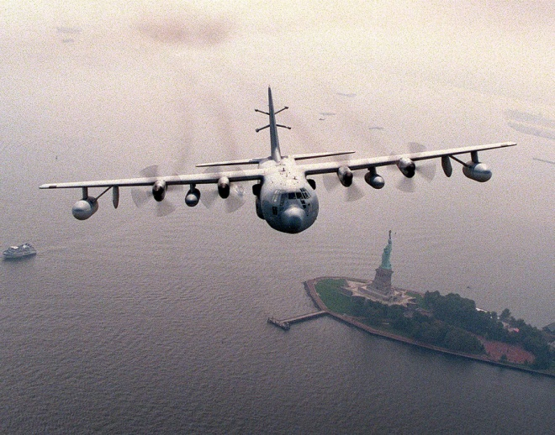
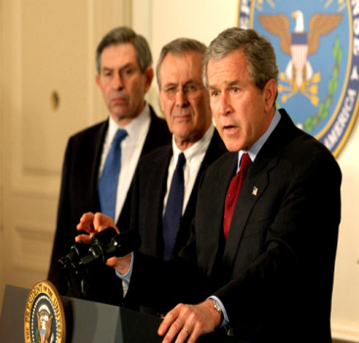
‘Towards Freedom TV’
‘The nightmare that Saddam Hussein has brought to your nation will soon be over. You are a good and gifted people – the heirs of a great civilisation that contributes to all humanity. You deserve better than tyranny and corruption and torture chambers. You deserve to live as free people. And I assure every citizen of Iraq: your nation will soon be free’ (President George W. Bush, 10 April 2003).

Slide 44
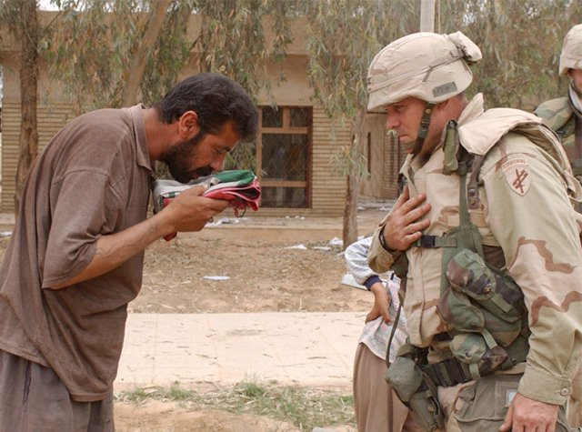
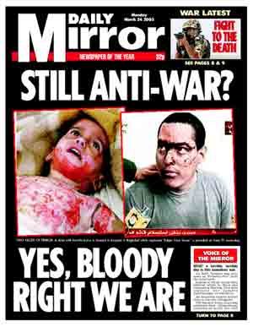
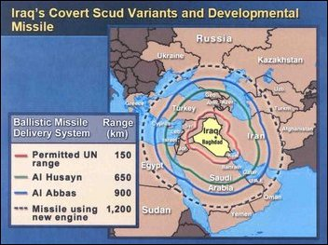

Slide 45
The legacy of 1991’s black campaign
In 1991, covert propaganda strayed from official line about liberation of Kuwait
No coalition help for Kurdish and Shi’ite uprisings
Overt 2003 policy was about regime change in Iraq - but the white PSYOPS suffered from the legacy of black PSYOPS in 1991
‘This time we won’t let you down’ (UK)
Why should Iraqis trust ‘coalition of the willing’ now when no Arab military contributions?
Anglo-USA invasion/conquest rather than liberation

Slide 46
The Media War
Embedded journalists and the snowstorm of information
Arab satellite channels as new players/alternative viewpoints (c.f. 1991 as the ‘first CNN war’)
National media support/opposition reflected national governmental positions
What about US/UK public’s morale as casualties mount?

Slide 47
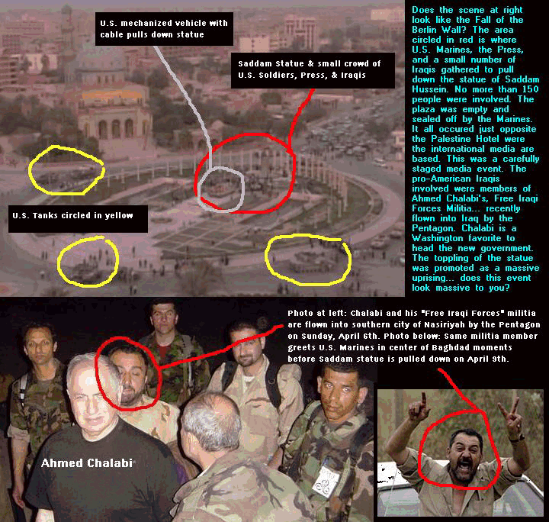
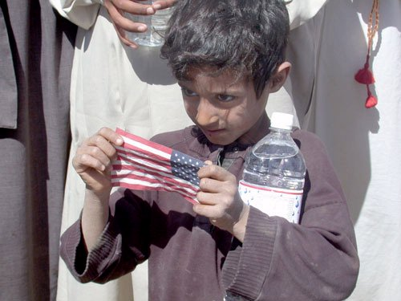
Media performance
Umm Qsar reported fallen 8 times in first week
Baghdad and elsewhere
casualties (14 killed)
Private Jessica
Toppling of Saddam statue

Slide 48
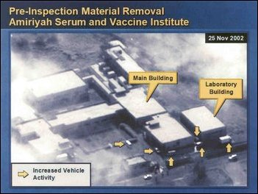
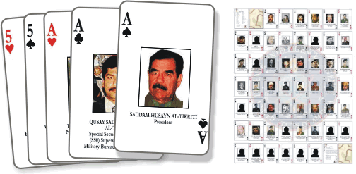
The hunt for Saddam Hussein ….
……and the WMD!
…. and bin Laden?

Slide 49
Conclusions
The go-home campaign had only short-term military benefits, but long-term unconventional warfare consequences
The ‘hearts and minds’ campaign had long-term roots of failure from 1991
Publicised wartime stunts damaged credibility of ‘liberation’ themes
Policy and presentation must go hand in hand but the presentation won’t sell the policy if the policy (‘product’) is incredible

Slide 50
Are we getting this right?
‘…in the wake of this conflict, we should ask ourselves whether we have made the mistake of believing our own propaganda, and whether we have been fighting the war on terror against the wrong enemies, in the wrong places, with the wrong weapons’.
(Rampton and Stauber, Weapons of Mass Deception – Centre for Media and Democracy, 2003).

