Slide 1
Crisis Management, The Media and International Crises
Lecture 2
The Media and International Crises
Prof. Philip M. Taylor

Slide 2
Agenda
The media as observer, participant or catalyst?
The operational constraints on the media in the reporting of war and crises
‘Real war’ and ‘Media War’
‘Our wars’ and ‘Other Peoples’ Wars’
The problems of Crisis Management (next week….)

Slide 3
What is news?
N
W
E
NEWS
S

Slide 4
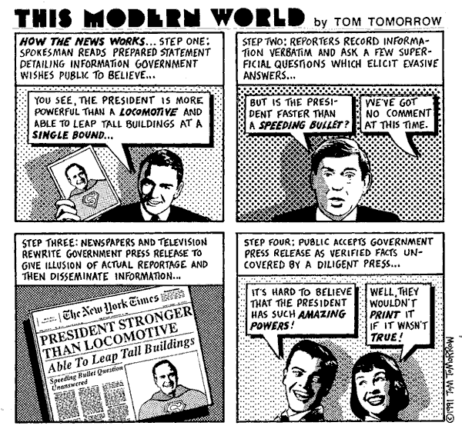

Slide 5
It is a process of selection
Therefore can ‘objectivity’ ever be achieved?
People decide what to include/omit
Their choice determined by their individual profiles, training, ‘instinct’ operating within a commercial (or public service) context
Presentations vary: print, radio and TV

Slide 6
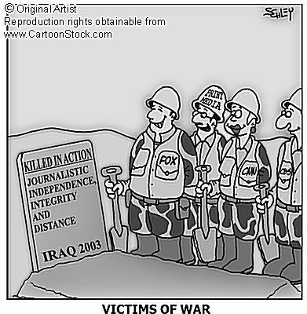
Is War
Different?

Slide 7
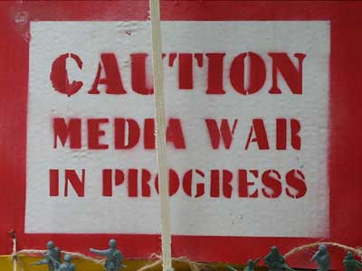
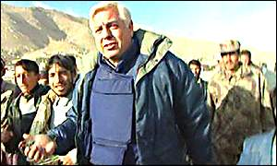
Observer, Participant or Catalyst?
“Voyeurs of strangers’ miseries”
Parachute journalism
The Heisenberg Principle – observation changes movement
“The tyranny of real-time” (Nik Gowing)
The “CNN Effect”
What can be shown? What should be shown?

Slide 8
Role of the International Media
Increasingly competitive, deregulated ‘infotainment’ market
Human Interest stories and the decline of the specialist/rise of the freelancer
Easier to ‘manipulate’ within certain ground rules (Gulf War 1, Kosovo, Embeds in GW2)
More difficult to control access to communications technologies

Slide 9
What can be reported?
Operational constraints of journalism in the field
Matters of ‘taste and decency’
Matters of ‘operational security’
Questions of access vs. safety
Communications and technology
A mediated event

Slide 10
What should be reported?
Events vs.context
‘The whole truth?’
Reporting from the ‘enemy’ side?
Patriot or Propagandist?
Bad News
Disasters and their consequence (from the Crimea to Vietnam)

Slide 11
TV - Why some things and not others?
‘Taste and decency’
Tension between reporters and editors
Government pressure
The public service tradition vs. competition
‘Armchair generals’ and speculation
The “tyranny” of 24/7 rolling news

Slide 12
The War Correspondent
William Howard Russell: the exception or the rule?
WW1 & 2: Patriotism or propaganda?
Vietnam: the first TV war (?)
‘Managing’ the media: the rise of Military Public Affairs
1991 Gulf War: the first ‘real-time’ TV war – but what did we see?

Slide 13
Real War and Media War
Do we expect too much of war reporters?
Mediation or desensitisation?
Public support for military rather than media (‘tell us the truth, but it’s OK to tell it when it’s all over’)
How wide is the gap between image and reality?

Slide 14
Our wars and Other Peoples’ Wars
The historical record and the reporting of our wars
OPWs – why some and not others?
Differences for reporters (seen as ‘spies’): safety vs. access denial
‘The journalism of attachment’
When OPWs become Our Wars…..

Slide 15
Journalism of attachment?
In Our Wars, isn’t this propaganda?
How does this work? (Gulf War)
In OPWs, isn’t this propaganda?
When OPWs become Our Wars (Kosovo)
‘News is the shocktroops of propaganda’ (Reith)
So what’s the difference between war and peace?

Slide 16
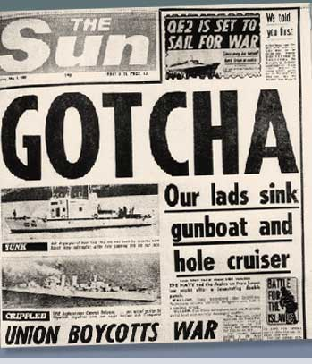
Wartime reporting
Access – to the story AND to communications – is pivotal (Falklands 1982, Grenada 1983)
Controlling access has become an obsession since Vietnam. Why?
Is this possible anymore with
NCT’s?
Was it necessary anyway?

Slide 17
‘Peacetime’ reporting
Media less interested in defence and military matters since end of Cold War
When war breaks out, the issues which caused it are subordinated to the event
Diplomacy difficult to report on, especially on TV
Who is interested in foreign policy anyway?

Slide 18
