Slide 1
Crisis Management, The Media and International Crises
Lecture 3
Crisis Management and the Media
Prof. Philip M. Taylor

Slide 2
Real War and Media War
(continued from last week)
Do we expect too much of war reporters?
Mediation or desensitisation?
Public support for military rather than media (‘tell us the truth, but it’s OK to tell it when it’s all over’)
How wide is the gap between image and reality?

Slide 3
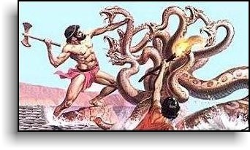
The hydra headed media monster – the ‘meeeja’
Each head has no
loyalty to the other
Few controls or
regulations
Highly competitive and technology-driven
Multi-skilling and decline of specialised correspondents

Slide 4
Old media and new….
‘Old’ media understood the rules of the military-media dynamic
The ‘deal’ was in providing access and protection in return for some restrictions (OPSEC)
Civilians on the battlefield and censorship
From observer to participant….

Slide 5
Vital Questions
What can be reported when the nation is at war?
What should be reported?
Why can some things be reported and not others?
Difference between ‘our wars’ and ‘other peoples’ wars’
Difference between ‘real war’ and ‘media war’

Slide 6
What can be reported?
Operational constraints of journalism in the field
Matters of ‘taste and decency’
Matters of ‘operational security’
Questions of access vs. safety
Communications and technology
A mediated event

Slide 7
What should be reported?
Events vs.context
‘The whole truth?’
Reporting from the ‘enemy’ side?
Patriot or Propagandist?
Bad News
Disasters and their consequence (from the Crimea to Vietnam)

Slide 8
Our Wars and Other Peoples’ Wars
The historical record and the reporting of our wars
OPWs – why some and not others?
Differences for reporters (seen as ‘spies’): safety vs. access denial
‘The journalism of attachment’
When OPWs become Our Wars…..

Slide 9
Journalism of attachment?
In Our Wars, isn’t this propaganda?
How does this work? (Gulf War)
In OPWs, isn’t this propaganda?
When OPWs become Our Wars (Kosovo)
‘News is the shocktroops of propaganda’ (Reith)
So what’s the difference between war and peace?

Slide 10
The media do not operate within a vacuum
Peter Jakobsen’s 5 causal motives for humanitarian intervention
Clear case under international law to justify intervention
If national interests are at stake
If domestic support exists
If there is a clear chance of success
If media coverage is pushing for it
(Journal of Peace Research, 1996)
THIS SEEMS TERRIBLY OUTDATED SINCE 9/11

Slide 11
Military control freakery
…..despite the historical record
The myth of Vietnam
From the Falklands & Grenada to the Pool System of Desert Storm
The ‘CNN Effect’
The arrival of the ‘embedded’ reporter in 2003.

Slide 12
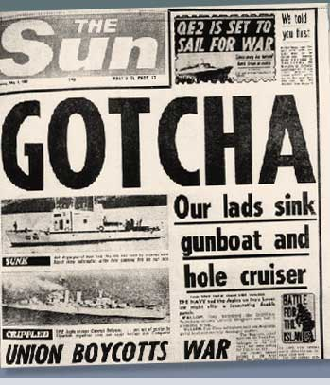
Wartime reporting
Access – to the story AND to communications – is pivotal (Falklands 1982, Grenada 1983)
Controlling access has become an obsession since Vietnam. Why?
Is this possible anymore with
NCT’s?
Was it necessary anyway?

Slide 13
‘Peacetime’ reporting
Media less interested in defence and military matters since end of Cold War
When war breaks out, the issues which caused it are subordinated to the event
Diplomacy difficult to report on, especially on TV
Who is interested in foreign policy anyway?

Slide 14
STRATEGIC COMMUNICATIONS
PUBLIC DIPLOMACY
PUBLIC
AFFAIRS
INFORMATION
OPERATIONS
CULTURAL
DIPLOMACY
INTERNATIONAL
BROADCASTING
HUMAN
FACTORS
CNO
DOMESTIC
FOREIGN
PSYOPS
CIMIC
MEDIA
INFO ASSURANCE
OPSEC, EW
DECEPTION

Slide 15

PUBLIC AFFAIRS
DOMESTIC
FOREIGN
Home local,
Regional &
National Media
News agencies,
In-country media
Media Monitoring
News agencies,
Foreign Press
Corps in situ
Responsibility of all ministries
and their public affairs officers
Responsibility of Ambassadors
and their press officers

Slide 16
Public Affairs
“Those public information and community relations activities directed toward the domestic general public by various elements of the USG, as well as those activities directed to foreign publics, including the media, by official U.S. spokesmen abroad.”

Slide 17
Media in Conflict Management – key questions
Do the media influence policy or vice versa?
To what extent are governments influenced by media coverage and, if so, how do they balance this ‘pressure’ against national interests?
What can governments do to affect the media agenda on foreign policy issues?
What can/should the media do to resist this ‘media management’?

Slide 18
The case for the CNN effect
‘in the absence of a post Cold War doctrine … televised events that stir emotions have an unprecedented ability to manipulate policy’ (Jessica Mathews, ‘Policy vs. TV’, Washington Post, 8-3-94)
‘the technical capacity to cover the entire globe in real-time … and in ever sharper clarity and colour means that “elite dissensus”, or even “official conflict” matters less in the shaping of foreign policy news than the fully opened eye of the television camera’ (Bernard Cohen, in Bennett and Paletz, Taken by Storm, 1994, p. 10)

Slide 19
The case for the CNN effect
‘the televised pictures of starving people in Northern Iraq, Somalia and Bosnia created a political clamour to feed them, which propelled the US military into those three distant parts of the world’ (Michael Mandelbaum, ‘The Reluctance to Intervene’, Foreign Policy [1995] p. 16)
Politicians had to fend off ‘the danger of letting wherever CNN roves be the cattle prod to take a global conflict seriously’ (Tony Blair, speech in Chicago, 22 April 1999)

Slide 20
The case against the CNN effect
Most academic literature emphasizes how governments influence the news media, not the other way round
Gulf War is shining example of this
Media content conforms with and reflects official agenda setting – even Vietnam (Dan Hallin’s work)
‘mass media news is indexed implicitly to the dynamics of government debate’ (Lance Bennett, 1990)
Loch Ness Monsters and Corn Circles

Slide 21
Military ‘control freakery’
Why control ‘images of battle’? Operational security (OPSEC) or civilian morale?
How to control (censor?) the media?
From 450 to 1500 to 3800
New media, new technologies, new reporters….
The rise of the ‘citizen journalist’

Slide 22
A Clash of Cultures?
THE MILITARY RESPECT….
Authority & Order
Tradition & Hierarchy
Co-operation and teamwork
Institutions and country
Loyalty and duty
Honour and Courage
If the military make a mistake – people die
THE MEDIA RESPECT…
No authority
Bad news
Competition
Individualism & Human Interest
Dog eat dog
Dog eat cat
If the media make a mistake – publish a correction

Slide 23




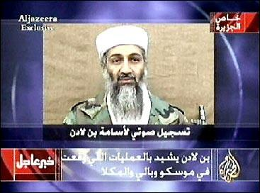
Taking Command & Control of the Information Space
Can it be done in an age of mobile phones, internet access and ‘civilian reporters’?
Is it desirable in a global information space - the Jenin/Gaza vacuums?
What about the new alternative players – eg Al Jazeera?
What about the ‘new kids on the block/blog’?

Slide 24
The Options
Ignore them – and be crucified! (Jenin, Gaza)
Try to control them – and be crucified! (Grenada)
Deceive them – and be crucified! (‘The Wave’
Shoot at them – and be crucified! (Palestine Hotel)
Educate them – and there might be a chance…

Slide 25
Old vs.New?
Clear case under international law to justify intervention
If national interests are at stake
If domestic support exists
If there is a clear chance of success
If media coverage is pushing for it
New case for ‘regime change’ despite UN Article 2.7 vs. UN resolutions since 1991 including 1441?
National interests at stake over Iraq? (Oil! WMD/Iraq-Al Qaida link)
Domestic support vs. political resolve
Military success vs. aftermath
Media support?

Slide 26
Conclusions
When a nation is at war, media usually supportive (c.f. USA already ‘at war’ e.g Fox News; Europe going to war e.g. The Mirror)
Media speculation means government policy decisions have to remain firm
If they are, then ‘spin’ inevitable, as is media resistance
A healthier democracy than media compliance?

