Slide 1

Crisis Management, The Media and International Crises
Lecture 3
Crisis Management and the Media
Prof. Philip M. Taylor

Slide 2
Real War and Media War
(continued from last week)
Do we expect too much of war reporters?
Mediation or desensitisation?
Public support for military rather than media (‘tell us the truth, but it’s OK to tell it when it’s all over’)
How wide is the gap between image and reality?

Slide 3
Our Wars and Other Peoples’ Wars
The historical record and the reporting of our wars
OPWs – why some and not others?
Differences for reporters (seen as ‘spies’): safety vs. access denial
‘The journalism of attachment’
When OPWs become Our Wars…..

Slide 4
Journalism of attachment?
In Our Wars, isn’t this propaganda?
How does this work? (Gulf War)
In OPWs, isn’t this propaganda?
When OPWs become Our Wars (Kosovo)
‘News is the shocktroops of propaganda’ (Reith)
So what’s the difference between war and peace?

Slide 5
The media do not operate within a vacuum
Peter Jakobsen’s 5 causal motives for humanitarian intervention
Clear case under international law to justify intervention
If national interests are at stake
If domestic support exists
If there is a clear chance of success
If media coverage is pushing for it
(Journal of Peace Research, 1996)
THIS SEEMS TERRIBLY OUTDATED SINCE 9/11

Slide 6
Military control freakery
…..despite the historical record
The myth of Vietnam
From the Falklands & Grenada to the Pool System of Desert Storm
The ‘CNN Effect’
The arrival of the ‘embedded’ reporter in 2003.

Slide 7
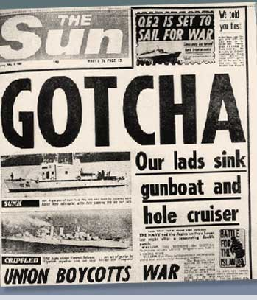
Wartime reporting
Access – to the story AND to communications – is pivotal (Falklands 1982, Grenada 1983)
Controlling access has become an obsession since Vietnam. Why?
Is this possible anymore with
NCT’s?
Was it necessary anyway?

Slide 8
‘Peacetime’ reporting
Media less interested in defence and military matters since end of Cold War
When war breaks out, the issues which caused it are subordinated to the event
Diplomacy difficult to report on, especially on TV
Who is interested in foreign policy anyway?

Slide 9
Media in Conflict Management – key questions
Do the media influence policy or vice versa?
To what extent are governments influenced by media coverage and, if so, how do they balance this ‘pressure’ against national interests?
What can governments do to affect the media agenda on foreign policy issues?
What can/should the media do to resist this ‘media management’?

Slide 10
The case for the CNN effect
‘in the absence of a post Cold War doctrine … televised events that stir emotions have an unprecedented ability to manipulate policy’ (Jessica Mathews, ‘Policy vs. TV’, Washington Post, 8-3-94)
‘the technical capacity to cover the entire globe in real-time … and in ever sharper clarity and colour means that “elite dissensus”, or even “official conflict” matters less in the shaping of foreign policy news than the fully opened eye of the television camera’ (Bernard Cohen, in Bennett and Paletz, Taken by Storm, 1994, p. 10)

Slide 11
The case for the CNN effect
‘the televised pictures of starving people in Northern Iraq, Somalia and Bosnia created a political clamour to feed them, which propelled the US military into those three distant parts of the world’ (Michael Mandelbaum, ‘The Reluctance to Intervene’, Foreign Policy [1995] p. 16)
Politicians had to fend off ‘the danger of letting wherever CNN roves be the cattle prod to take a global conflict seriously’ (Tony Blair, speech in Chicago, 22 April 1999)

Slide 12
The case against the CNN effect
Most academic literature emphasizes how governments influence the news media, not the other way round
Gulf War is shining example of this
Media content conforms with and reflects official agenda setting – even Vietnam (Dan Hallin’s work)
‘mass media news is indexed implicitly to the dynamics of government debate’ (Lance Bennett, 1990)
Loch Ness Monsters and Corn Circles

Slide 13
Military ‘control freakery’
Why control ‘images of battle’? Operational security (OPSEC) or civilian morale?
How to control (censor?) the media?
From 450 to 1500 to 3800
New media, new technologies, new reporters….
The rise of the ‘citizen journalist’

Slide 14
A Clash of Cultures?
THE MILITARY RESPECT….
Authority & Order
Tradition & Hierarchy
Co-operation and teamwork
Institutions and country
Loyalty and duty
Honour and Courage
If the military make a mistake – people die
THE MEDIA RESPECT…
No authority
Bad news
Competition
Individualism & Human Interest
Dog eat dog
Dog eat cat
If the media make a mistake – publish a correction

Slide 15



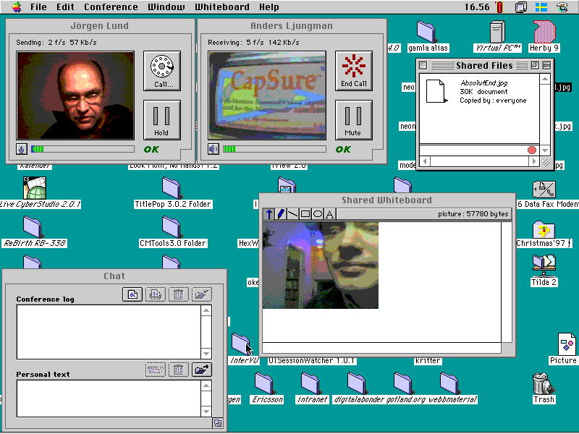
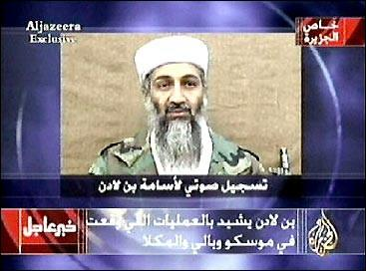
Taking Command & Control of the Information Space
Can it be done in an age of mobile phones, internet access and ‘civilian reporters’?
Is it desirable in a global information space - the Jenin vacuum?
What about the new alternative players – eg Al Jazeera?
What about the ‘new kids on the block’?

Slide 16
The Options
Ignore them – and be crucified! (Jenin)
Try to control them – and be crucified! (Grenada)
Deceive them – and be crucified! (‘The Wave’
Shoot at them – and be crucified! (Palestine Hotel)
Educate them – and there might be a chance…

Slide 17
Old vs.New?
Clear case under international law to justify intervention
If national interests are at stake
If domestic support exists
If there is a clear chance of success
If media coverage is pushing for it
New case for ‘regime change’ despite UN Article 2.7 vs. UN resolutions since 1991 including 1441?
National interests at stake over Iraq? (Oil! WMD/Iraq-Al Qaida link)
Domestic support vs. political resolve
Military success vs. aftermath
Media support?

Slide 18
Conclusions
When a nation is at war, media usually supportive (c.f. USA already ‘at war’ e.g Fox News; Europe going to war e.g. The Mirror)
Media speculation means government policy decisions have to remain firm
If they are, then ‘spin’ inevitable, as is media resistance
A healthier democracy than media compliance?

