Slide 1

International Crises, Crisis Management & the Media
Prof. Philip M Taylor
Lecture 5
Case Study 2: Somalia (Operation Restore Hope)

Slide 2
The aftermath of Desert Storm
‘New World Order’ gets a ‘good start’ to the beginning of ‘the end of history’
The advent of CNN and the rise of the ‘CNN Effect’
Template for military-media relations in ‘Our Wars’
But what about OPWs and ‘humanitarian interventions’?

Slide 3
Iraq and the Kurds 1991
‘I would be the very first to admit that I think TV probably had the greatest impact at this time in pushing us through the various phases of policy. The political and the human desire to respond to what was unfolding on the screen had a sizeable impact’ (Richard Haass, NSC, quoted in Strobel, p.128)
‘without Turkey factored in, with just television pictures, I don’t know what our response would have been. We were sensitive to Turkey’s anxiety about allowing the Kurds to stay. That was fundamentally what motivated us’ (Brent Scowcroft, NS Advisor to Bush Snr.).

Slide 4
Wider Context
George Bush replaced by Bill Clinton
Gorbachev replaced by Yeltsin
Start of Yugoslavia’s collapse
US owed $414m to UN, including £120 for peacekeeping missions
End of Cold War sponsorship prompts factions into civil (‘warlord’) rivalry after overthrow of Siad Barre regime in Jan 1991

Slide 5
Role of the International Media
Increasingly competitive, deregulated ‘infotainment’ market
Human Interest stories and the decline of the specialist/rise of the freelancer
Easier to ‘manipulate’ within certain ground rules (Gulf War and Kosovo)
More difficult to control access to communications technologies

Slide 6
The Media and Crisis
Bad news is good news
Plenty of Human Interest
Other People’s Wars and Our Wars
Ability/inability to report from dangerous places
Event driven rather than issue driven
Decline of specialised reporters

Slide 7
Television: its limitations and its power
Picture-driven snapshots (bulletins)
The tyrannical growth of real-time (and speculation)
The CNN Effect (push vs. pull)
‘Real’ crises and ‘media crises’
Audio-visual mediation not actual reality
Hence the media as a target in information warfare (RTS Serbia)

Slide 8
Media War and Real War
Real war is the nasty, brutal, terrifying business of people killing people
Media War is not the same thing: it is a mediated event, second-hand, even remote, safe, viewed from a distance
The role of the media in bridging this image-reality gap – or not – is therefore crucial to our understanding of media performance, in war but also in peace as well, and increasingly important to the success of ‘military’ operations

Slide 9
Some warnings for the future
Knowledge explosion
Internet has seen 8% of world population log-on WITHIN LAST TEN YEARS
Computer power up six orders of magnitude by 2025
Global interconnectivity The developed world is moving to an information based economy---BUT

Slide 10
What about the Less Developed World?
5.7 billion current population will double in our lifetime
  4.5 billion live in poor countries (average per capita GNP about $1K)
  35% of population under age 15
Population in LDCs up 143% by 2025
  Population under age 15 may exceed 50% in some countries
  Radio and TV still predominant media

Slide 11
Increasing Urbanization
Half of world population now is urban; two thirds by 2025
27 mega-cities (10M+) by 2015, 24 in less developed world
  Of 325 cities of 1M+ today, 213 are in less developed world
By 2025, Latin America 85%, Africa 58% and Asia 53% urban

Slide 12
Increasing instability, especially in the Developing World
Traditional national sovereignties eroding
Religious, tribal and ethnic conflict spreading
Guerrilla, paramilitary and criminal groups proliferating
Numbers of displaced persons growing
The ‘war’ against Terrorism

Slide 13
Crisis!
Crisis? What Crisis?
A crisis that the media covered/created?
A crisis that politicians responded to?
Media coverage of a crisis that politicians responded to?
I.e. image or reality?
What kind of world is this?

Slide 14
The Whole World is Watching!
More Complex Humanitarian Crises Are Almost Certain
Traditional infrastructures (administrative, health & sanitation, water, power, etc.) will continue to erode in third world
The global information infrastructure will continue to expand and become more robust
Urban centers in the second and third world will function as communication nodes

Slide 15
Information Age
The ability of any central authority to control information flow will diminish
First world policy makers will be increasingly unable to ignore LDC events
Global telecommunications will provide scenes that result in policy shifts and turn military operations into improvisational theater

Slide 16
How do you manage those crises?
An integrated information policy (hence IO)
Long-term communication of (‘soft’) power
Short-term but planned PSYOP and PA/PI activity close to the centre of decision-making
Professionalised information activity AND crisis management scenarios
Keep within the democratic tradition: a strength and a weakness

Slide 17
Impending tragedy in Somalia
In January 1991, the major Relief Agencies warned that 20 million Africans, mainly in the horn of Africa, faced starvation but the US left the country after Mohammed Aideed seized Mogadishu
1 million Somalis fled the country, another 1 million to urban centres
In all of 1991, Somalia got three minutes of attention on the three evening American network news shows.
From January to June 1992, Somalia got 11 minutes.

Slide 18
‘US intervention was the only way’
Jan 1992, Bhoutros Bhoutros-Ghali (an Egyptian) became SG of UN
But it was an election year in the US…
April 1992, UNSCR 751 authorises 50 man (1) UNOSOM
By July, when the news media began to pay attention, 25 percent of Somalia's children under five may already have died from famine, according to Medicins Sans Frontieres.

Slide 19
The media ‘push’
During the 1991-92 time frame, there were more congressional hearings, bills, resolutions and floor statements about Somalia, than any other country.
Media follows this, not pushes it
August 1992 – Hurricane Andrew
‘if you liked Beirut, you’d love Mogadishu’.
3rd December 1992 - UN Resolution 794 authorises US-led intervention

Slide 20
Somalia, 1992
‘After the election [November 1992], the media had free time and that was when the pressure started building up … We heard it from every corner, that something had to be done. Finally the pressure was too great … TV tipped us over the top … I could not stand to eat my dinner watching TV at night. It made me sick’ (Marlin Fitzwater to Nik Gowing, 1994: 68)

Slide 21
Somalia, 1992
‘Bush said that as he and his wife, Barbara, watched television at the White House and saw “those starving kids … in quest of a little pitiful cup of rice”, he phoned Defense Secretary Dick Cheney and Gen. Colin Powell, Chairman of the JCoS: “ Please come over to the White House”. Bush recalled telling the military leaders: “I – we – can’t watch this anymore. You’ve got to do something”’. (Craig Hines, The Houston Chronicle, 24 October 1999).
9 December - when the US Marines stormed the beaches in December 1992, the media were waiting for them…

Slide 22
Somalia, 1992
Robinson’s research (2000) showed that
November 5 – 25th (the day the decision was made to deploy ground troops) media coverage was scant (eg Washington Post ran only 4 articles in 21 days, only 1 on front page, NYT ran 13 with 1 on front page, CBS ran five news segments low down the order)
November 26 – December 4 (the day UN OK’s Restore Hope) coverage intensifies to 50 articles in 8 days and 46.5 mins of footage and mostly supportive
December 5 – 9: 76 articles and 85 mins of coverage

Slide 23
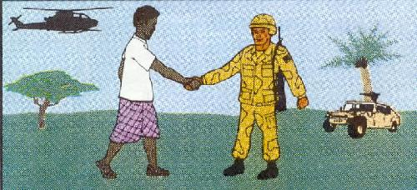
PSYOP in Somalia
‘United Nations Forces are here to assist in the international relief
effort for the Somali people. We are prepared to use force to protect
the relief operation and our soldiers. We will not allow interference
with food distribution or with our activities. We are here to help you.’

Slide 24
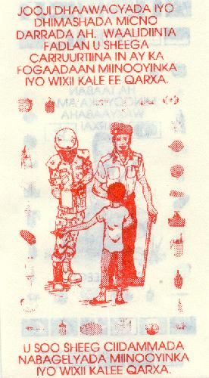
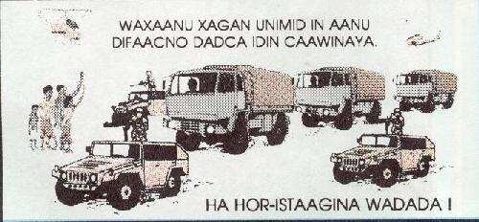
More Somali PSYOP
MEANINGLESS DEATH. PARENTS PLEASE TELL YOUR CHILDREN TO KEEP AWAY FROM MINES AND OTHER EXPLOSIVE THINGS.
TELL THE PEACE KEEPING FORCES ABOUT MINES AND OTHER EXPLOSIVE THINGS.
WE ARE HERE TO PROTECT
RELIEF CONVOYS!
DO NOT BLOCK ROADWAYS!

Slide 25
Mission Creep
Efforts to re-establish a central government were unsuccessful, and international troops became enmeshed in the tribal conflicts that had caused the nation to collapse.
Failed attempts in 1993 by U.S. forces to capture Aidid, in reaction to an ambush by Somalis in which 23 Pakistani peacekeepers were killed, produced further casualties.
Authority for the peacekeeping effort was transferred from U.S. to UN forces on May 1, 1993.
3 October: ‘Black Hawk Down’
US combat troops leave 25 March 1994

Slide 26
Bill Clinton addresses the nation, 7 October, 1993
“A year ago, we all watched with horror as Somali children and their families lay dying by the tens of thousands -- dying the slow, agonizing death of starvation. A starvation brought on not only by drought, but also by the anarchy that then prevailed in that country.
“This past weekend we all reacted with anger and horror as an armed Somali gang desecrated the bodies of our American soldiers and displayed a captured American pilot. All of the soldiers who were taking part in an international effort to end the starvation of the Somali people themselves.
“I want to bring our troops home from Somalia...It is my judgment and that of my military advisors that we may need up to six months to complete these steps and to conduct an orderly withdrawal... All American troops will be out of Somalia no later than March 3lst, except for a few hundred support personnel in non-combat roles.”

Slide 27
Conclusions
600 journalists from 60 countries covering the war from all sides
Many killed and many left because it was too dangerous
Shock of worst media images since Vietnam (and certainly after the ‘clean’ war in the Gulf) – but taken by a ‘stringer’
Media MAY have got the US out, but it didn’t push them in.

