Slide 1

Crisis Management and the Media
Prof Philip M. Taylor
Lecture 6 – Crises in the Balkans, 1991-99

Slide 2
Crisis in the Balkans
1991-95: Bosnia and SFOR
1995: From the ‘safe havens’ to the Dayton Peace Agreement
1995-99: IFOR
1999: Kosovo Conflict
Post Kosovo: KFOR

Slide 3
1991-95: Bosnia and SFOR
‘The death of Yugoslavia’
Three sided civil war (Croatia, Bosnia, Serbia)
Media coverage: erratic, polarised, simplified – and anti-Serb!
Clinton administration policy – to resist the shocking images (from Europe!) especially post Somalia: the journalism of attachment
Markele market place and safe havens

Slide 4
The Road to Dayton
Screbenice and the humiliation of the ‘safe havens’ policy
Evidence suggests the CNN effect finally came to play in influencing air strikes
Especially after the failure to intervene in Rwanda genocide
Dayton establishes IFOR
Record since 1995

Slide 5
The Road to Kosovo
Serbia removes autonomy in 1998
KLA vs. MUP and VJ forces: legacy of Bosnia media coverage identifies Serbs as villains
Serb ‘genocide’ mobilises media
Media coverage mobilises politicians to launch a war of ‘guilty conscience’ for not acting against Serbs over Bosnia

Slide 6
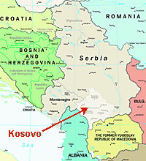
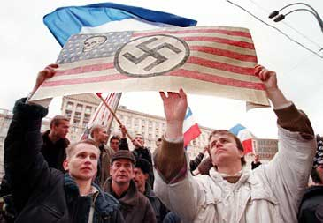
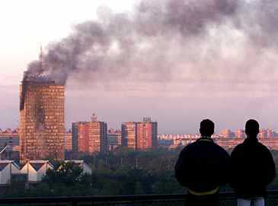

Slide 7
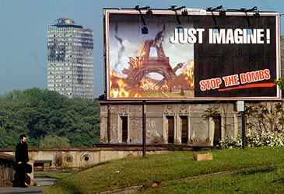

Slide 8
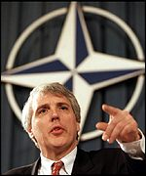
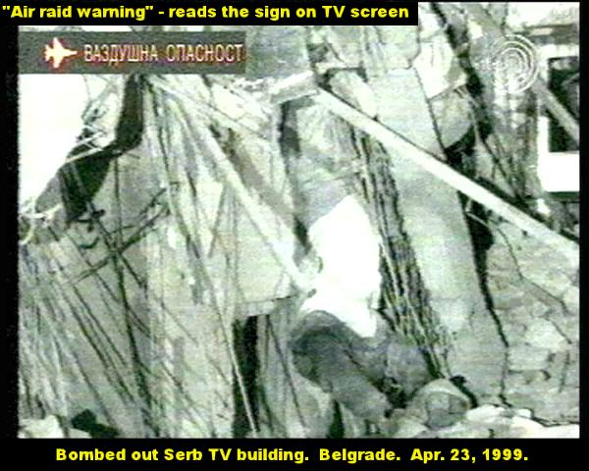
Kosovo Conflict
Illegal?
‘Humanitarian intervention’ above international law
Media coverage characteristics
- western (Jamie Shae at NATO)
- Serb (bombing of RTS)
The arrival of the internet

Slide 9
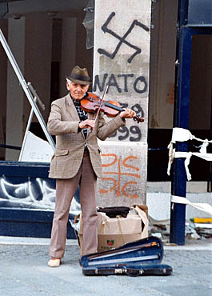
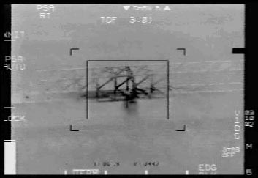
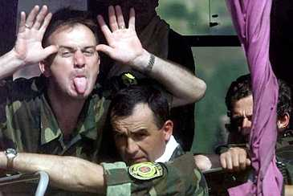
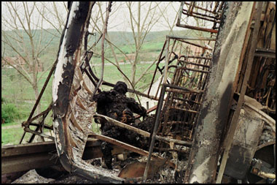

Slide 10
Is this democracy building?
Rebuild of ‘civil society’
Restoration of ‘law and order’
With values comes cultural transmission
Cultural diplomacy or cultural imperialism?
Is this appropriate or realpolitik?
What is behind this? Democracies don’t fight democracies; triumph of free market liberal capitalism at end of Cold War

