Slide 1

Crisis Management and the Media
Prof Philip M. Taylor
Lecture 7 – The Kosovo Crises in 1999

Slide 2
Crisis in the Balkans
1991-95: Bosnia and SFOR
1995: From the ‘safe havens’ to the Dayton Peace Agreement
1995-99: IFOR
1999: Kosovo Conflict
Post Kosovo: KFOR

Slide 3
The Road to Kosovo
Serbia removes autonomy in 1998
KLA vs. MUP and VJ forces: legacy of Bosnia media coverage identifies Serbs as villains
Serb ‘genocide’ mobilises media
Media coverage mobilises politicians to launch a war of ‘guilty conscience’ for not acting against Serbs over Bosnia [???]

Slide 4
Operational Constraints
Access - military operations generate extremely dangerous situations for journalists (insurance!)
Each journalist has only an ant’s eye view of the conflict (John Simpson’s analogy as a football match)
‘Fog of war’ generated by warring factions trying to control global media agenda

Slide 5
Operational Constraints
Satellite time and pressure of speed over accuracy and context
Public Service tradition of reporting both sides - accusations of reporting enemy ‘propaganda’
‘Parachute journalism’ and the decline of the specialized foreign and defense correspondent
Media as participants, not observers (RTS) and even as catalysts (initial intervention)

Slide 6
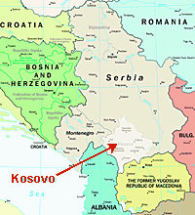
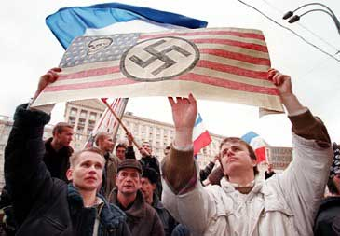
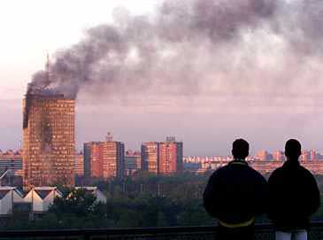

Slide 7
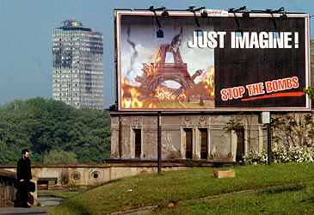

Slide 8
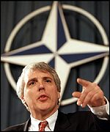
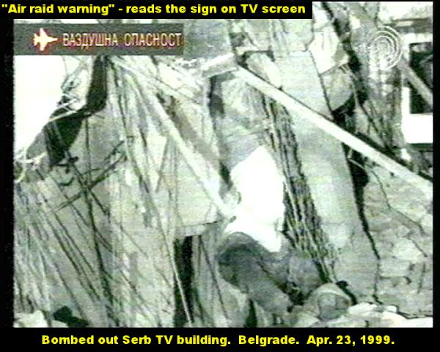
Kosovo Conflict
Illegal?
‘Humanitarian intervention’ above international law
Media coverage characteristics
- western (Jamie Shae at NATO)
- Serb (bombing of RTS)
The arrival of the internet

Slide 9
Any Surprises, 1999?
Not really - many similar characteristics to Gulf War (1991) reporting
Restrictions on access for western correspondents in ‘enemy’ country under fire
Pro-NATO, anti-Serb
Largely supportive because greater access to NATO spokesmen than Serb
When UK government criticized media, it’s a clue that media are doing a reasonable job in reporting both sides

Slide 10
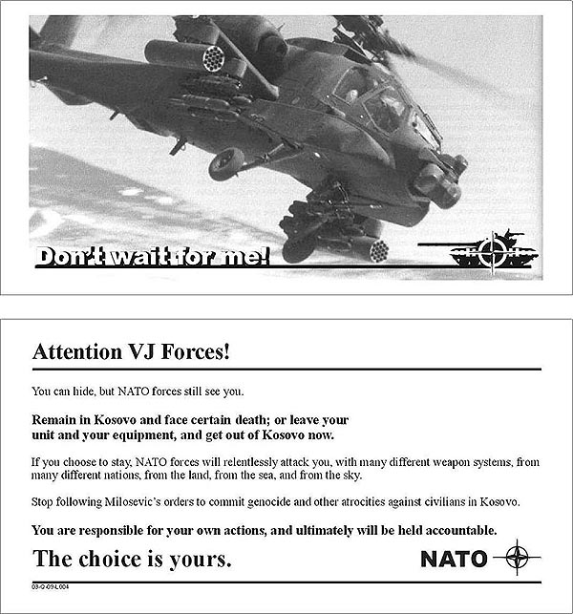
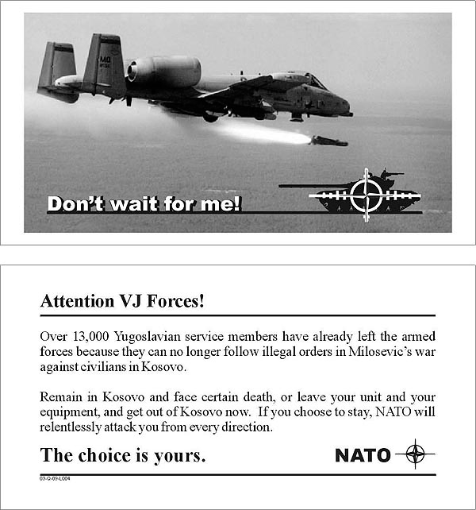
103 million leaflets in PSYOP campaign

Slide 11
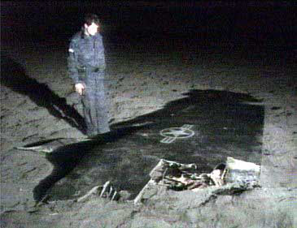
Some Kinetic Victories

Slide 12
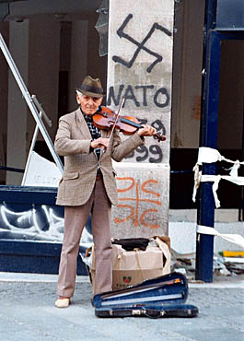
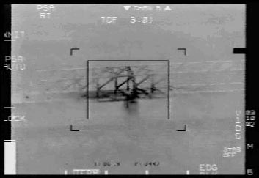
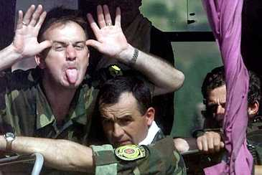
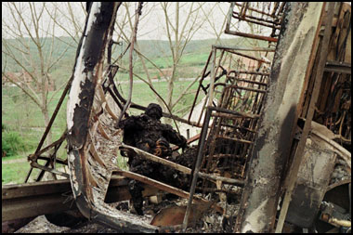
Asymmetric Warfare
and
‘Softwar’

Slide 13
KFOR - Is this democracy building?
Rebuild of ‘civil society’
Restoration of ‘law and order’
With values comes cultural transmission
Cultural diplomacy or cultural imperialism?
Is this appropriate or realpolitik?
What is behind this? Democracies don’t fight democracies; triumph of free market liberal capitalism at end of Cold War

