Slide 1

Propaganda in the World Wars (1914-18 & 1939-45)
Prof. Philip M Taylor,
ICS, University of Leeds

Slide 2
The Great War of 1914-18
Propaganda emerges as an ‘art’ and a ‘science’
International propaganda and the cutting of German cables
Wellington House & the battle for American neutrality, 1914-17
Home Front propaganda

Slide 3
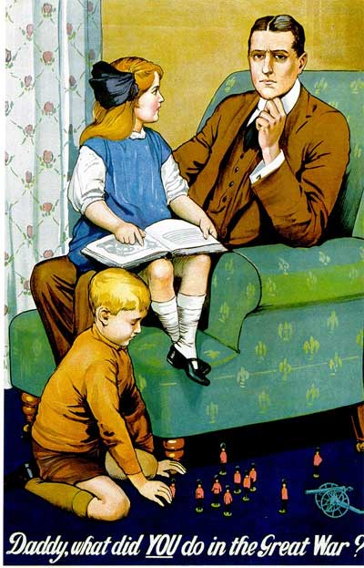


Slide 4
Britain – the masters of the new craft
Enter the Press Barons (Beaverbrook & Northcliffe) 1918
Crewe House and the campaign against the Central Powers
Demonisation of the Enemy
Hitler & Ludendorff
Policy & Propaganda

Slide 5
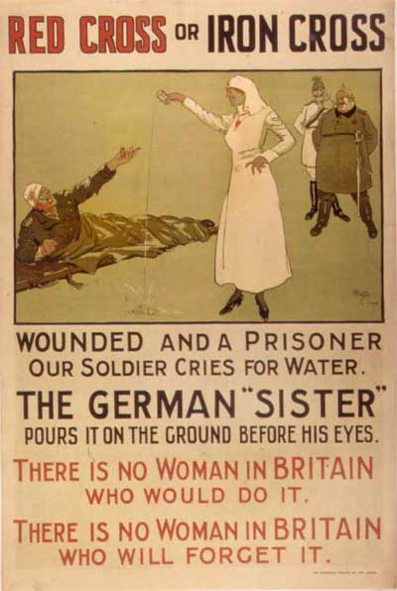
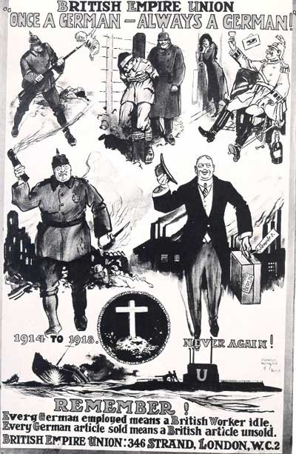

Slide 6
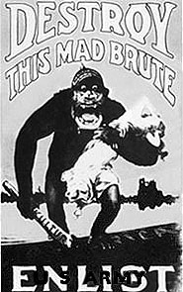
America enters the war, 1917

Slide 7
The inter-war years, 1919-39
The advent of ‘Bolshevism’
The advent of radio
The rise of fascism and Nazism and the peacetime adoption of wartime propaganda techniques
‘The Big Lie’ and Goebbels
The discrediting of propaganda by democracies

Slide 8
World War Two
War declared on the radio, leaflets dropped on the first night – and the cinemas closed!
With fall of Europe to Nazis, propaganda was one of the only weapons to fight back
BBC & credibility; the MoI and ‘the truth’
Psychological Warfare and the Political Warfare Executive

Slide 9
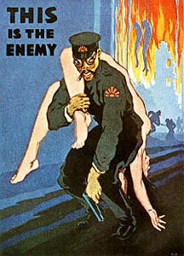
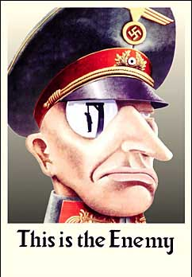

Slide 10
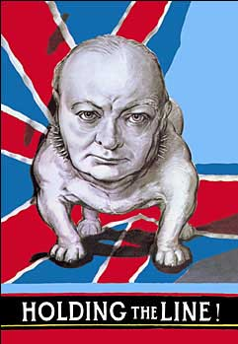
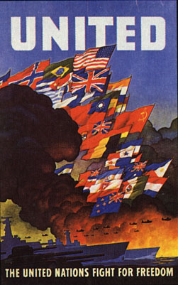

Slide 11
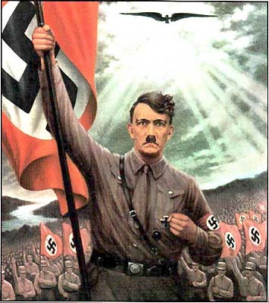
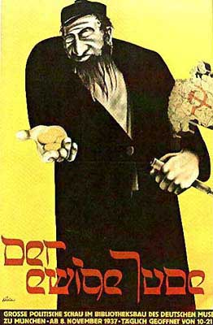

Slide 12

