Slide 1
From World War Two to Vietnam:
Philip M Taylor
ICS, University of Leeds

Slide 2
Summary of WW2 themes
‘Slave World versus Free World’ (transferred to Cold War)
Unconditional Surrender
‘New Jerusalem’ (another ‘land fit for heroes – and now voting heroines)
Political ‘Re-education’

Slide 3
Cold War propaganda
House un-American Activities Committee
Berlin Air Lift and Korean War
Hollywood movies of the 1950s
‘Campaign for Truth’
Death of Stalin
Hungary 1956
Space Race

Slide 4
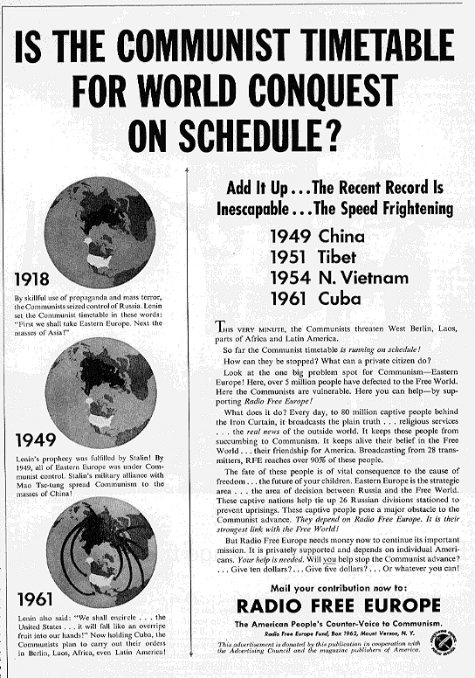
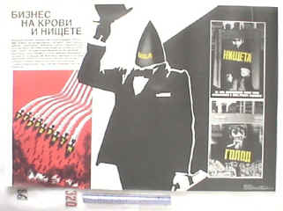
‘Business through blood and
Poverty’ (above)

Slide 5
Key points
United States Information Agency
Advent of Television + satellites
Soviet jamming
Nuclear issues and MAD
Cuban Missile Crisis

Slide 6
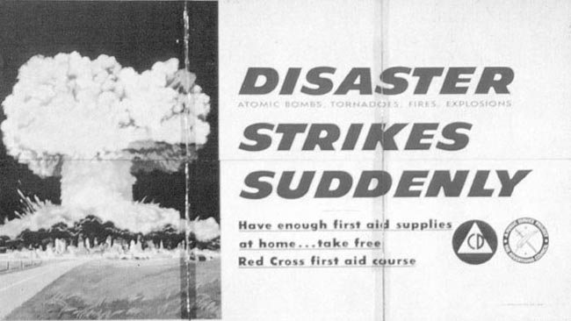
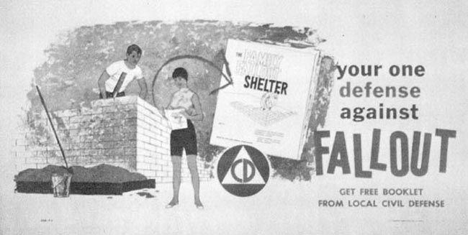

Slide 7
Vietnam: ‘The First Television War’
No, (1950-53) Korea actually
Colour TV, not live
‘5 O’clock Follies’
1963-68 coverage
1968 Tet Offensive
1968-73 (75) Coverage

Slide 8
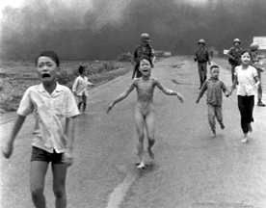
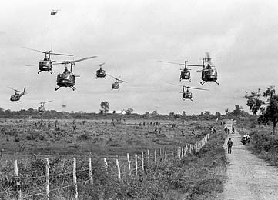
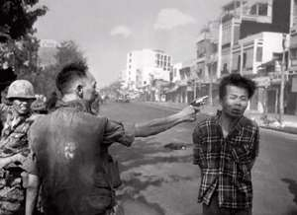

Slide 9
A Media ‘stab-in-the-back’ theory
‘The media lost us the war’ – does this stand up to analysis?
Used to justify reporting restrictions in later wars
Grenada, 1983 – Panama 1989
Desert Storm 1991

