Slide 1

The Revival of Public Diplomacy since 9/11
Prof. Philip M. Taylor,
Institute of Communications Studies, University of Leeds
Brussels, January 2005

Slide 2
Public Diplomacy Definitions
PD ‘deals with the influence of public attitudes on the formation and execution of foreign policies. It encompasses dimensions of international relations beyond traditional diplomacy; the cultivation by governments of public opinion in other countries; the interaction of private groups and interests in one country with those of another; the reporting of foreign affairs and its impact on policy; communication between those whose job is communication, as between diplomats and foreign correspondents; and the processes of inter-cultural communications’.

Slide 3
Public & Cultural Diplomacy
PUBLIC DIPLOMACY
CULTURAL
RELATIONS
INTERNATIONAL
BROADCASTING
(Long-term)
PSYCHOLOGICAL
OPERATIONS
(Short-term)

Slide 4
Current US official international radio ‘services’
Radio Free Europe – Eastern Europe
Radio (and TV) Marti – Cuba

Slide 5
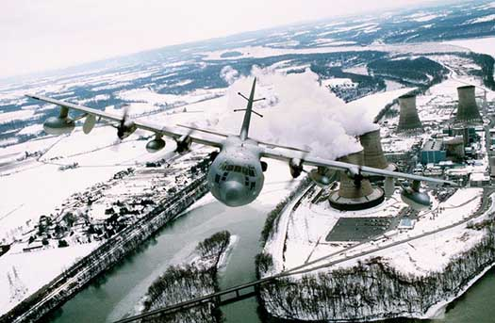
Commando Solo

Slide 6
Current US official international radio ‘services’
Radio Free Europe – Eastern Europe
Radio (and TV) Marti – Cuba
Radio Free Asia - North Korea/China
Radio Free Afghanistan
Radio Farda – Iran
Radio Sawa (‘Together’) – Middle East
Al Hurrah TV (‘The Free One’)

Slide 7
Public & Cultural Diplomacy
PUBLIC DIPLOMACY
CULTURAL
RELATIONS
INTERNATIONAL
BROADCASTING
(Long-term)
PSYCHOLOGICAL
OPERATIONS
(Short-term)

Slide 8
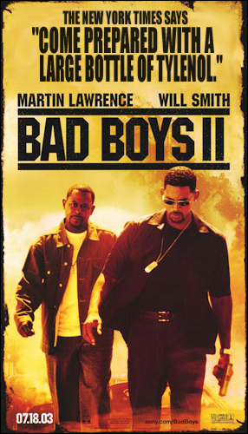

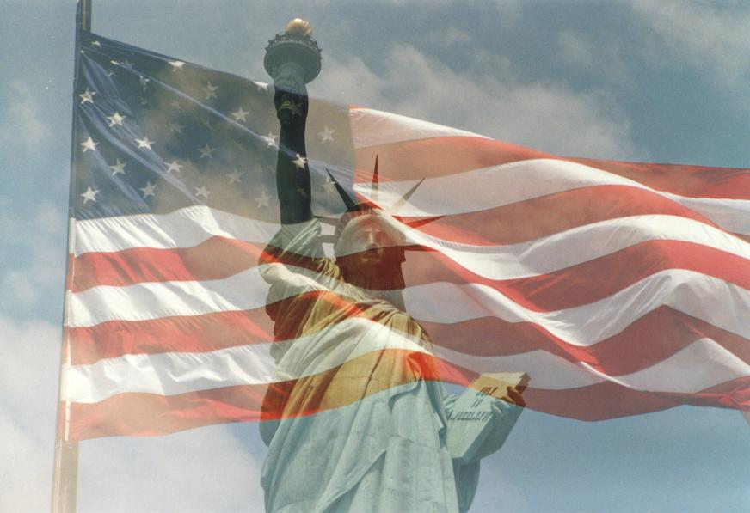

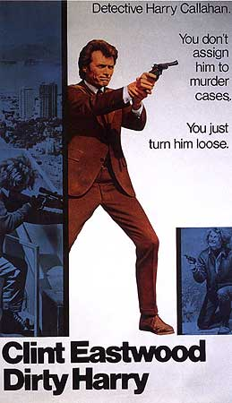
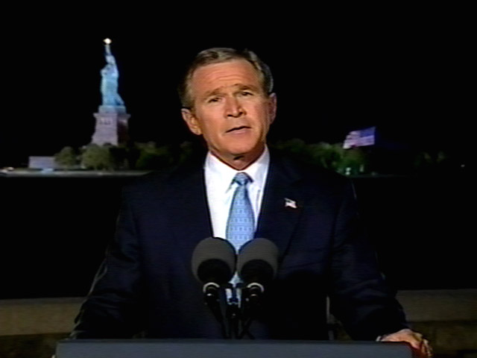
National Media Image vs National Official Image

Slide 9
Disarming words as weapons
“We have unilaterally disarmed ourselves of the
weapons of ideological warfare… And that disarmament
is all the more astonishing in light of the fact that our victory
in the Cold War was largely the product of our
victory on the ideological front.”
Comment by Joshua Muravchik, “Regaining America’s Voice
Overseas: A Conference on US Public Diplomacy,”
Heritage Lectures (No. 817, delivered July 10, 2003),
published by The Heritage Foundation, January 13, 2004
(http://www.heritage.org/Research/
GovernmentReform/hl817.cfm; Sep. 27, 2004).

Slide 10
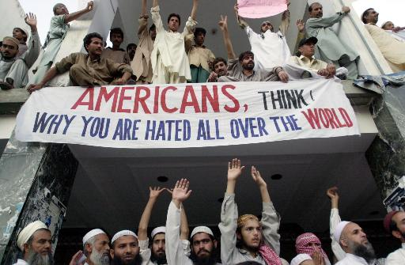
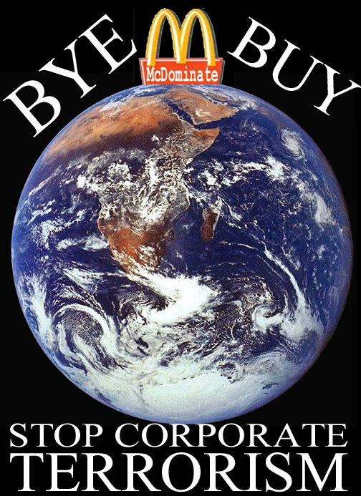
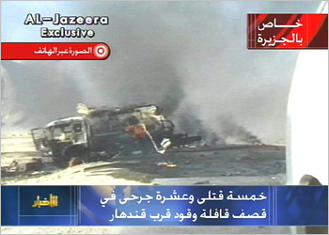

Slide 11
Hard Power
HARD = actual use of military force, economic sanctions, coercive diplomacy etc
‘Hard power is the ability to get others to do what they otherwise would not do through threats or rewards. Whether by economic carrots or military sticks, the ability to coax or coerce has long been the central element of power.’ (Keohane & Nye)

Slide 12
Soft Power
‘Soft power …is the ability to get desired outcomes because others want what you want. It is the ability to achieve goals through attraction rather than coercion. It works by convincing others to follow or getting them to agree to norms and institutions that produce the desired behavior.
Soft power can rest on the appeal of one's ideas or culture … and …depends largely on the persuasiveness of the free information that an actor seeks to transmit. If a state can [do this] it may not need to expend as many costly traditional economic or military resources.’ (Keohane & Nye)

Slide 13
A world unconvinced
Percentage drops in favourable views of US since start of year 2003 (Pew Centre, 18 March)
- France: from 63% to 31%
- Italy: from 70% to 34%
- Russia: from 61% to 28%
- Turkey: from 30% to 12%
- UK: from 75% to 48%

Slide 14
Propaganda themes which sow seeds of doubt in the Middle East
The US had planned to attack Afghanistan long before September 11
Long-term US covert plans to kill bin Laden
Taliban not ‘so bad’ as west claims
Missiles are cowardly; suicide hijackers are not
‘Evidence’ against bin Laden ‘unconvincing’
5 of the 19 hijackers still alive
No cell phone call from the hijacked planes mentioned ‘Arabs’
Followers of bin Laden in a Florida ‘strip bar’?
Passport of one found at the WTC?
Mohamed Ata’s suitcase never made the plane?

Slide 15
PD and its relationship to other official information activities
Official Information Activities
‘PERCEPTION MANAGEMENT’
Public Affairs/
PI/Media Ops
Public/Cultural
Diplomacy
International
Broadcasting
Psychological Operations
PSYOPS
Educational/Cultural
Exchanges;
International Sport;
Medical exchanges
News vs.
Views
‘Spin’;
Media
Management
POLITICAL
DIPLOMATIC
QUASI-OFFICIAL
MILITARY

