Slide 1
The Military and the Media: a tale of two cultures
Prof. Philip M. Taylor,
Institute of Communications Studies,
University of Leeds, UK

Slide 2
A climate of mutual antagonism
Everyone’s an expert on this topic!
Institutional suspicion – on both sides
Military becoming more specialised, media becoming the opposite
Anglo-American lack of conscription
Nonetheless, media tend to be ‘patriotic’ in ‘our wars’ (if the war is ‘just’ & ‘justified’)
US ‘at war’; UK in ‘an American war’

Slide 3
A Clash of Cultures?
THE MILITARY RESPECT….
Authority & Order
Tradition & Hierarchy
Co-operation and teamwork
Institutions and country
Loyalty and duty
Honour and Courage
If the military make a mistake – people die
THE MEDIA RESPECT…
No authority
Bad news
Competition
Individualism & Human Interest
Dog eat dog
Dog eat cat
If the media make a mistake – publish a correction

Slide 4
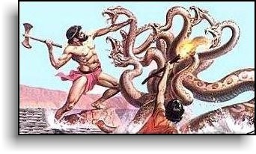
The hydra-headed media monster
Each head has no
loyalty to the other
Few controls or
regulations
Highly competitive and technology-driven
Multi-skilling and decline of specialised correspondents

Slide 5
Old media and new….
‘Old’ media understood the rules of the military-media dynamic
The ‘deal’ was in providing access and protection in return for some restrictions (OPSEC)
Civilians on the battlefield and censorship
From observer to participant….

Slide 6
Military control freakery
…..despite the historical record
The myth of Vietnam
From the Falklands & Grenada to the Pool System of Desert Storm
Our wars and other peoples’ wars
The arrival of the ‘embedded’ reporter in 2003.

Slide 7
The News Media & the New Media
The scale of the problem? From 450 to 1500 to 3800
Who are these guys?
Unembedded new kids or in bed with the enemy
Kosovo = www.1 TV was to Korea what the Internet was to Serb ‘softwar’

Slide 8
Outside of war
Media not interested – unless things go wrong (Deepcut, Abu Ghraib)
The myth of the ‘CNN Effect’ (Somalia)
Media research confirms media as a reflector of official agenda (Loch Ness monsters, WMD)
Suggests need to be pro-active outside of war

Slide 9



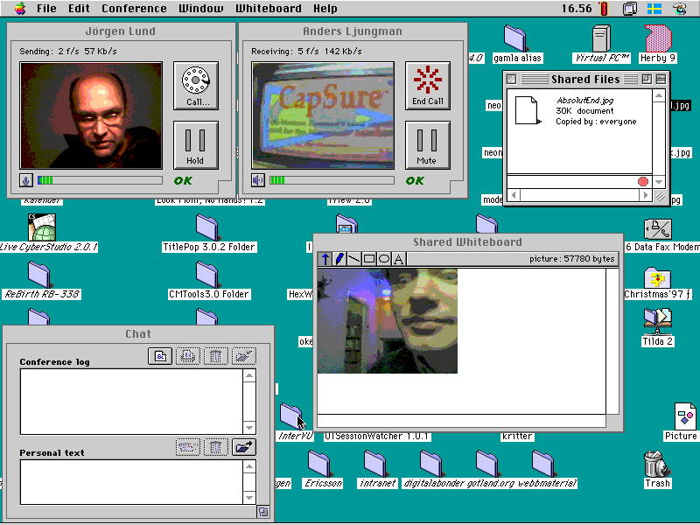
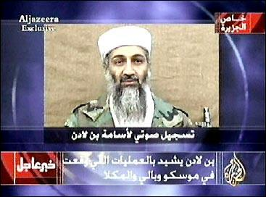
Taking Command & Control of the Information Space
Can it be done in an age of mobile phones, internet access and ‘civilian reporters’?
Is it desirable in a global information space - the Jenin vacuum?
What about the new alternative players – eg Al Jazeera?
What about the new kids on the block?

Slide 10
The Options
Ignore them – and be crucified! (Jenin)
Try to control them – and be crucified! (Grenada)
Deceive them – and be crucified! (‘The Wave’)
Shoot at them – and be crucified! (Palestine Hotel)
Educate them – and you have a chance…

