Slide 1
Public Diplomacy, Propaganda and Psychological Operations
Lecture 2:
What is Public Diplomacy?

Slide 2
Public Diplomacy
‘Public Diplomacy – the open exchange of ideas and information – is an inherent characteristic of democratic societies. Its global mission is central to … foreign policy. And it remains indispensable to … [national] interests, ideals and leadership role in the world’. (US Advisory Commission on Public Diplomacy, 1991 Report).

Slide 3
PDD 68 (1999): International Public Information
Goal: Achieve national objectives without resorting to force, or act as a force multiplier in the event force is required
Objective: ‘to enhance US security, bolster America’s economic prosperity and to promote democracy abroad’

Slide 4
Unreliable media, unreliable images
Pres. Clinton wanted to ensure a ‘correct’ image of US foreign policy overseas
‘to prevent and mitigate crises and to influence foreign audiences in ways favorable to the achievement of US foreign policy objectives’ (Washington Post)
Critics worried that it was a plan to ‘spin’ the US media

Slide 5
Instruments of International Relations
Political
Economic
Military
Informational
National Policy
Objectives

Slide 6

The Information Dimension

Slide 7
The Informational/Perceptual Environment
Mass Media
Personal Experience
Official Information
Rumors,
disinformation,
counter propaganda

Slide 8
Instruments of International Information
Information Services (‘Propaganda’)
Public & Cultural Diplomacy
International radio/television (VOA, BBC World Service etc) …. AND
RFE/RL, Radio Marti, Radio Free Asia etc
PSYOP – the military dimension
(the media)

Slide 9
US Public Diplomacy
Under the State Department's reorganization on October 1, 1999, Evelyn Lieberman became the first Under Secretary for Public Diplomacy and Public Affairs.
As she remarked in her confirmation hearing, "[P]ublic diplomacy, practiced in harmony with traditional diplomacy, will enable us to advance our interest, to protect our security, and to continue to provide the moral basis for our leadership in the world."
http://www.usinfo.state.gov

Slide 10
US Organisation
Bureau of Public Affairs (domestic) ‘to help Americans understand the importance of foreign affairs’
Bureau of Educational & Cultural Affairs (overseas) ‘fosters mutual understanding between the people of the United States and other countries’

Slide 11
Bureau of Educational & Cultural Affairs
Academic and educational exchange programmes (eg Fulbright Exchange Programme, the International Visitors Programme
The Office of International Information Programmes (IIP)

Slide 12
The Office of International Information Programmes (IIP)
The Office of Geographic Liaison is the first point of contact within IIP for missions overseas and the audiences they serve. Its teams' writer-editors, information resource officers, program officers, and translators provide regionally oriented products and services.
The Office of Thematic Programs has multifunctional teams organized in one of two ways: along subject-matter lines, such as economic security, or along product lines, such as electronic media. The thematic teams work closely with the geographic teams in preparing products and services that support Washington initiatives and mission requests.
The Office of Technology Services is responsible for developing, interpreting, and applying government-wide technology policies and procedures in support of the Under Secretary for Public Diplomacy and Public Affairs, the Bureau of Educational and Cultural Exchanges, and IIP

Slide 13
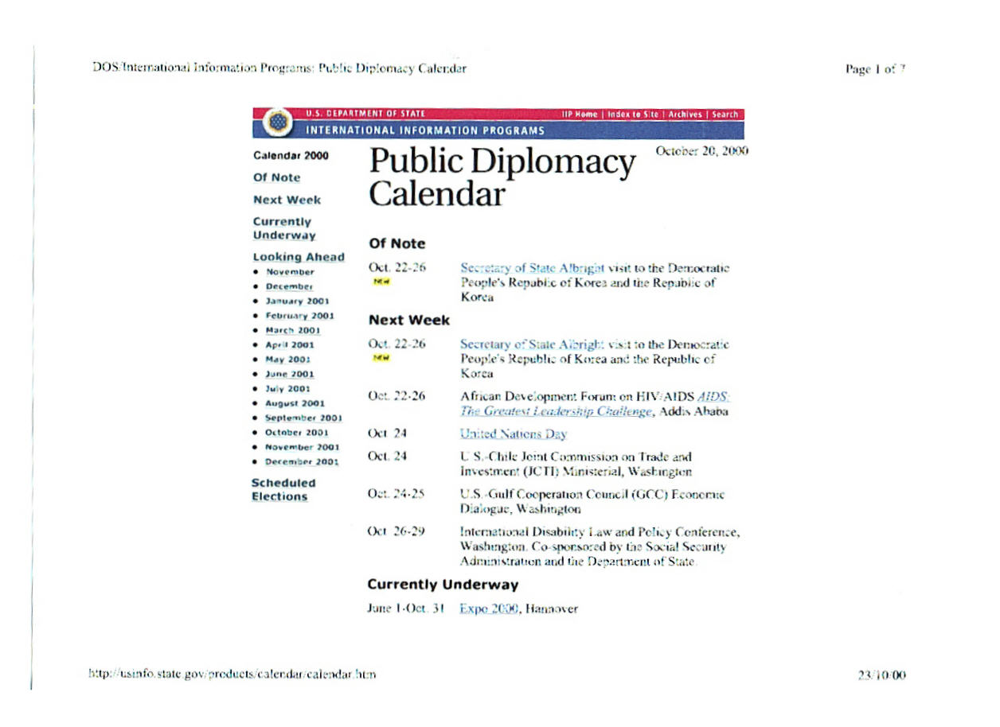

Slide 14
The Voice of America ‘family’
VOA and Worldnet TV
Radio Free Asia
Radio & TV Marti
RFE/RL
Radio Free Iraq
1750 hours of programming per week in total, reaching 100 million people in 60 languages at a cost of $1.1 billion in 1999 – BUT only 7 hours per day in Arabic

Slide 15
Some questions already
Is this propaganda?
Is it diplomacy?
What are its objectives?
What is the target audience?
Why is this activity needed?
Democracy/nation building?

Slide 16
Main themes of anti-US propaganda now
Globalisation = US imperialism and ‘arrogance’
Sponsor of Israeli ‘terrorism’
War by Christianity against Islam (US military bases in Saudi Arabia; sanctions against Iraq)
- casts doubt on effectiveness of IPI

Slide 17
The importance of a news based approach
Credibility
Countering misleading media reporting (from the horse’s mouth – directly such as VOA or Radio China International or Voice of Russia – or indirectly such as the BBC World Service)
‘News is the shocktroops of propaganda’ (Reith)

Slide 18
Education or Propaganda?
Elite audience as target (movers and shakers of the future) hence educational exchanges
Reason not emotion
Long term vs. short term
‘Soft’ power – the broad-based ability to encourage other societies to share a common vision of the future
Image vs. reality (British Council)

