Slide 1
Communications and Conflict
Lecture 10
Strategic Communication and the ‘War’
against terrorism - 2

Slide 2
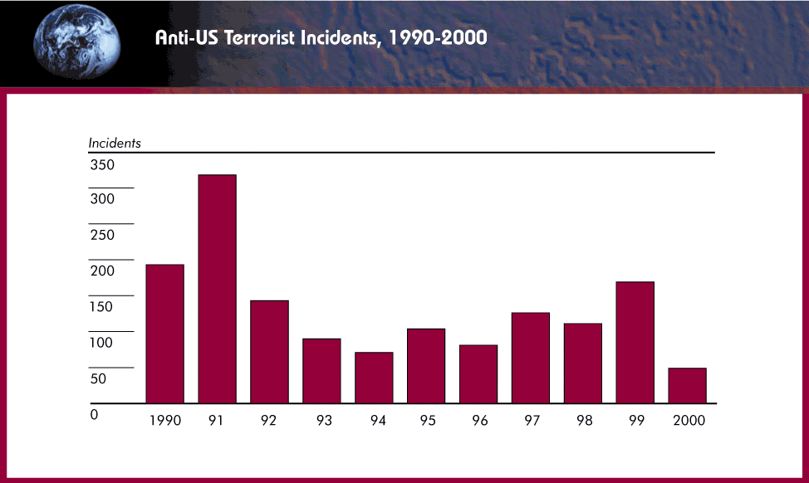
Terrorism in the 1990s
Note: increases in the years of the Gulf War and Kosovo conflict

Slide 3
Long-term vs. Short-term strategy
The military front may be a short conflict but the ‘battle for hearts and minds’ is critical
This requires a long-term strategy for ‘information’ and ‘education’
Propaganda needs to be hand-in-hand with policy and not precede it
If anything, policy needs addressing first, but with presentation in mind (not vice versa)
Only then can image reflect ‘reality’

Slide 4
Beefing up the US propaganda machine
Coalition Information Centres
Office of Strategic Influence
Office of Global Communications
Freedom Promotion Act of 2002
Radio Free Afghanistan
Increased Voice of America output

Slide 5
Information Age Conflict
INFORMATION
IN WARFARE
Intelligence
Surveillance
Reconnaissance
Weather
Geographic
Other
INFORMATION
WARFARE
Influence Attitudes
Deny/Protect
Deceive
Exploit/Attack

Slide 6
Emerging US IO ‘doctrine’
Information Operations
PA/PI
Influence Operations
Cyber Operations
PSYOP Deception
CNA CND

Slide 7
INFORMATION WARFARE
Influence Attitudes
Deny / Protect
Deceive
Exploit / Attack
(‘Perception Management’)
Public Diplomacy
Private Diplomacy
PSYOP
Media Relations (PA/PI)
Education (‘soft’)
Counter Influence/ propaganda
OPSEC
Info Assurance
CI
Spoofing
Imitation
Distortion
EW
CNA
Ballistic
EMP
Deception
There may be trouble ahead – the Office of Strategic Influence

Slide 8
Preliminary conclusions – more questions than answers
Can democracies wage long wars with public support in the ‘information age’?
What are the military objectives in Afghanistan? If it is a ‘manhunt’, then remember Somalia
How long can the media sustain their interest, especially after the military phase gets overtaken by the other fronts?
Are the media part of the problem or part of the solution?

Slide 9
Battle 2 – Iraqi Freedom
The pre-war search for a casus bellum
The IO campaign, March 20 – April 15
The PSYOP campaign
The ‘Media War’
Post-war challenges

Slide 10
Unfinished business?
From Desert Storm: ‘why didn’t we finish the job in 1991?’
From UN resolutions about WMD
From 9/11, Enduring Freedom and the ‘war’ against terrorism
Bush Doctrine of pre-emptive war and regime change
The ‘axis of evil’ and the dangers of appeasement

Slide 11
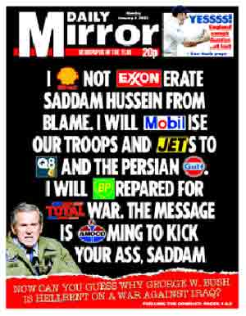
Counter-themes
Oil
Israel
Bush family revenge
Project for the New American Century
Link between Saddam and 9/11, Al Qaeda?
More time needed for weapons inspectors

Slide 12
A world unconvinced
Percentage drops in favourable views of US since start of year 2003 (Pew Centre, 18 March)
- France: from 63% to 31%
- Italy: from 70% to 34%
- Russia: from 61% to 28%
- Turkey: from 30% to 12%
- UK: from 75% to 48%

Slide 13
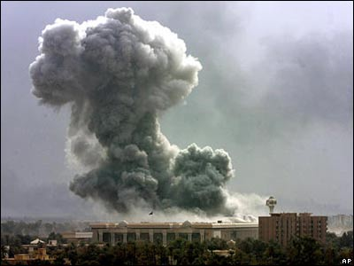
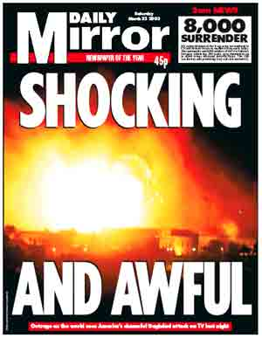
‘Shock and Awe’

Slide 14
The Battle for Iraqi ‘Hearts and Minds’, 2003
No mass surrenders on a scale similar to 1991 – why?
No wide-scale uprisings against SH, unlike 1991 – why?
Widely regarded in Arab world as ‘invaders’ not liberators – why?
= a serious failure of perception management at tactical and strategic levels (except in USA. But for how long?)

Slide 15
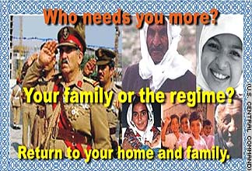
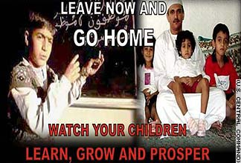
White PSYOPS, 2003
Go home/Stay at home campaign
This looks to have been a successful part of the campaign

Slide 16
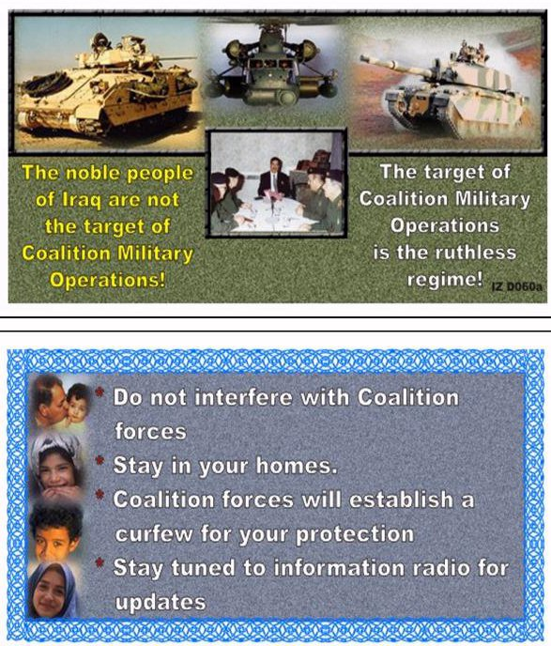
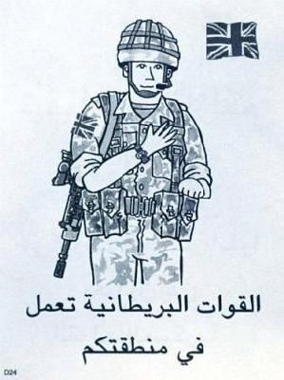
Regime change products

Slide 17
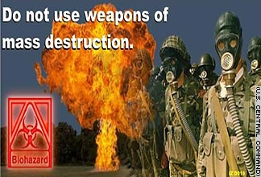

Other successes

Slide 18
IO and PSYOPS
Integration of Perception Management themes from top to bottom
‘I urge the Iraqi people being threatened in the cities to try to remember the faces and the names of the death squad enforcers. Their time will come, and we will need your help and your testimony.’ (Donald Rumsfeld, Pentagon news briefing, 28 March)
Had a press conference become a psychological operation?

Slide 19
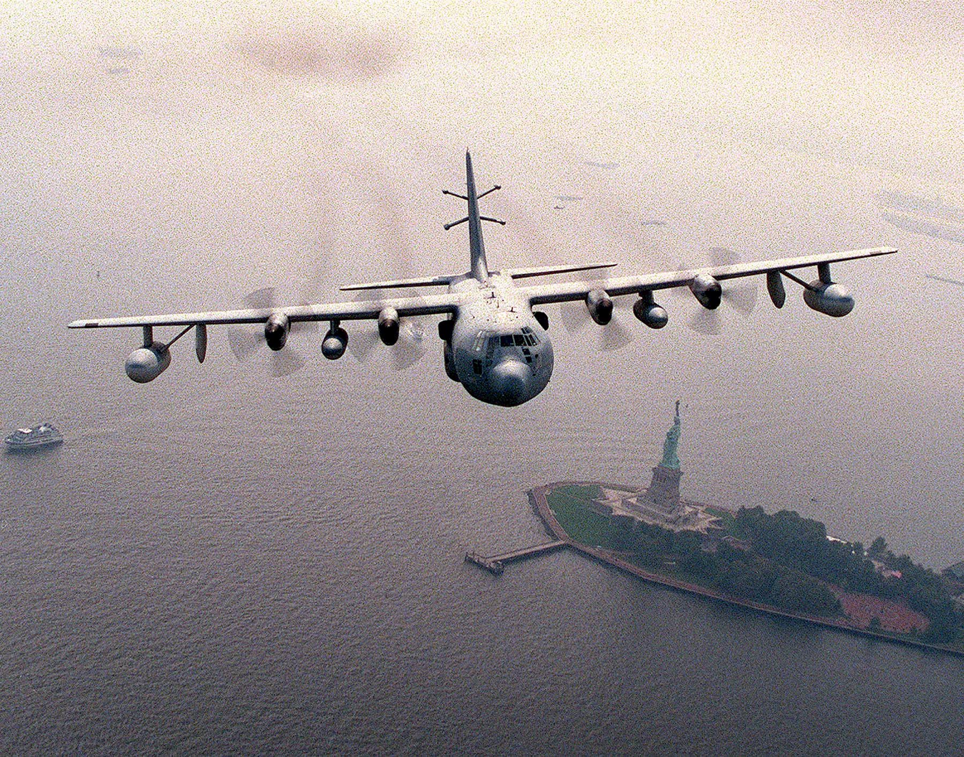
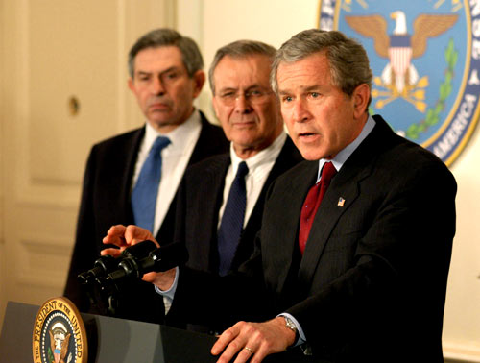
‘Towards Freedom TV’
‘The nightmare that Saddam Hussein has brought to your nation will soon be over. You are a good and gifted people – the heirs of a great civilisation that contributes to all humanity. You deserve better than tyranny and corruption and torture chambers. You deserve to live as free people. And I assure every citizen of Iraq: your nation will soon be free’ (President George W. Bush, 10 April 2003).

Slide 20
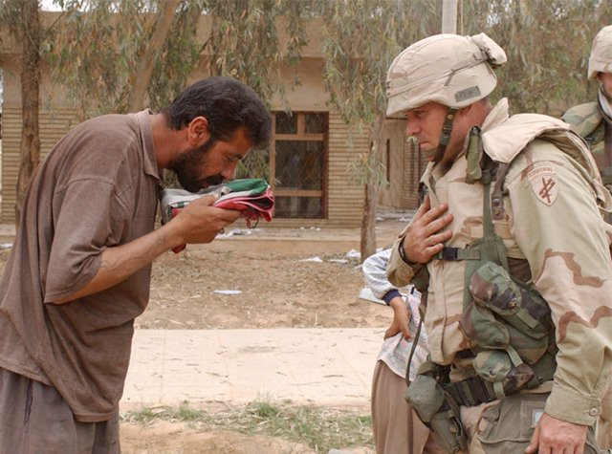
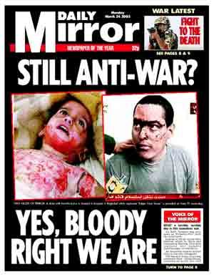
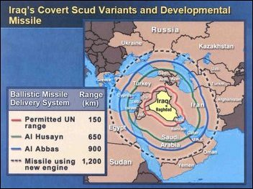

Slide 21
The legacy of 1991’s black campaign
In 1991, covert propaganda strayed from official line about liberation of Kuwait
No coalition help for Kurdish and Shi’ite uprisings
Overt 2003 policy was about regime change in Iraq - but the white PSYOPS suffered from the legacy of black PSYOPS in 1991
‘This time we won’t let you down’ (UK)
Why should Iraqis trust ‘coalition of the willing’ now when no Arab military contributions?
Anglo-USA invasion/conquest rather than liberation

Slide 22
The Media War
Embedded journalists and the snowstorm of information
Arab satellite channels as new players/alternative viewpoints (c.f. 1991 as the ‘first CNN war’)
National media support/opposition reflected national governmental positions
What about US/UK public’s morale as casualties mount?

Slide 23
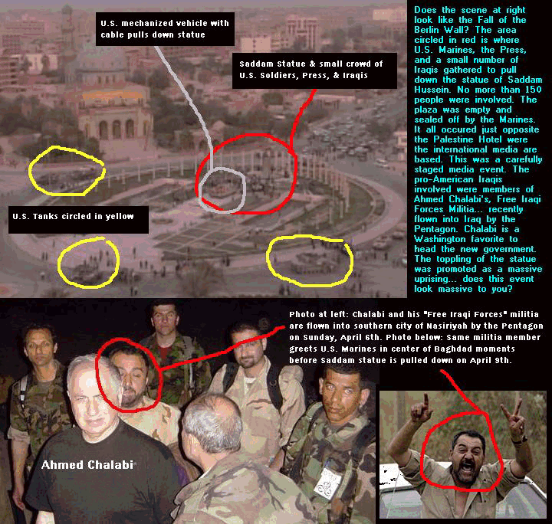
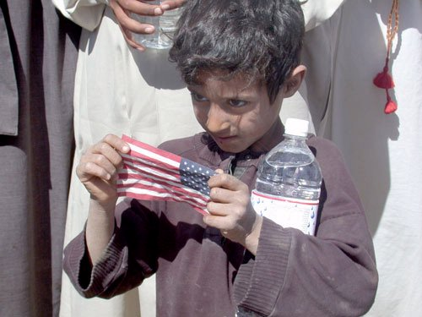
Media performance
Umm Qsar reported fallen 8 times in first week
Baghdad and elsewhere
casualties (14 killed)
Private Jessica
Toppling of Saddam statue

Slide 24

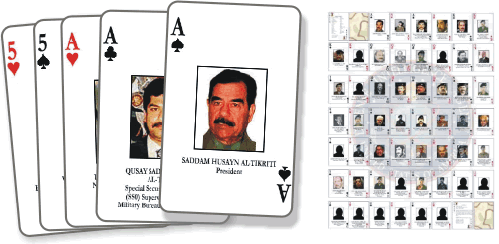
The hunt for Saddam Hussein ….
……and the WMD!
…. and bin Laden?

Slide 25
Conclusions
The go-home campaign had only short-term military benefits, but long-term unconventional warfare consequences
The ‘hearts and minds’ campaign had long-term roots of failure from 1991
Publicised wartime stunts damaged credibility of ‘liberation’ themes
Policy and presentation must go hand in hand but the presentation won’t sell the policy if the policy (‘product’) is incredible

Slide 26
Are we getting this right?
‘…in the wake of this conflict, we should ask ourselves whether we have made the mistake of believing our own propaganda, and whether we have been fighting the war on terror against the wrong enemies, in the wrong places, with the wrong weapons’.
(Rampton and Stauber, Weapons of Mass Deception – Centre for Media and Democracy, 2003).

