Slide 1
Communications & Conflict
Lecture 2
The World Wars of 1914-18 and 1939-45

Slide 2
Total War
Entire resources of nations mobilised in ‘war of national survival’ – Total War
Industrialised warfare
The advent of the bomber
Gap between fighting front and civilian front narrowed

Slide 3
World War 1
So why the image-reality gap?
Propaganda and censorship
Internationalisation of propaganda (USA & Wellington House)
Advent of psychological warfare (Crewe House)

Slide 4
Propaganda
‘Any information disseminated to a target audience, by whatever media are available, with the INTENTION of benefiting the source, either directly or indirectly’
Black, white and grey
Cohesive and Divisive

Slide 5
PROPAGANDA CATEGORIES
WHITE - overt, attributable to a definite source
BLACK - covert, deliberate deception where a false source is definitely implied
GREY - where a source is concealed and not acknowledged by the originator

Slide 6
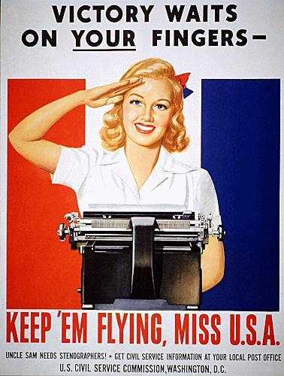
COHESIVE PROPAGANDA
CREATE GOODWILL
PROMOTE FRIENDSHIP
RAISE MORALE
STRESS COMMON
INTERESTS
GAIN CO-OPERATION

Slide 7
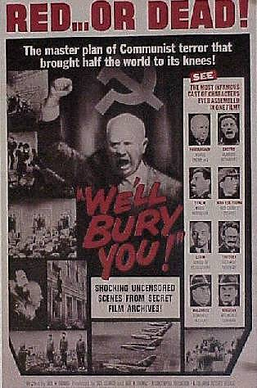
DIVISIVE PROPAGANDA
LOWER MORALE
CREATE APATHY, DEFEATISM & DISCORD
PROMOTE DISSENTION,
PANIC SUBVERSION, RESISTANCE,
DESERTION, SURRENDER
& DEFECTION

Slide 8
WW1 Cohesive Propaganda
War not over by Christmas 1914
Introduction of conscription, 1916 – new weapons needed
New allies needed – Wellington House and the USA
Rising Pacifism
US post-war reaction

Slide 9
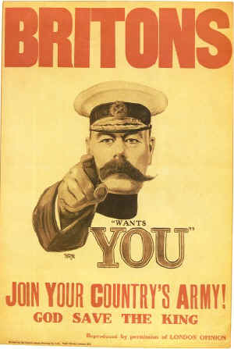
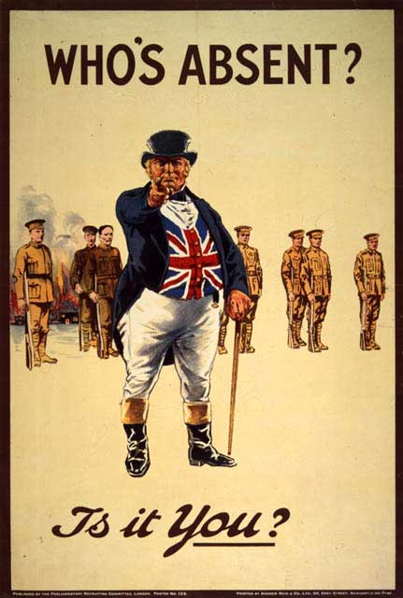
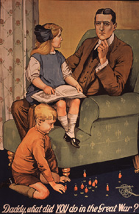
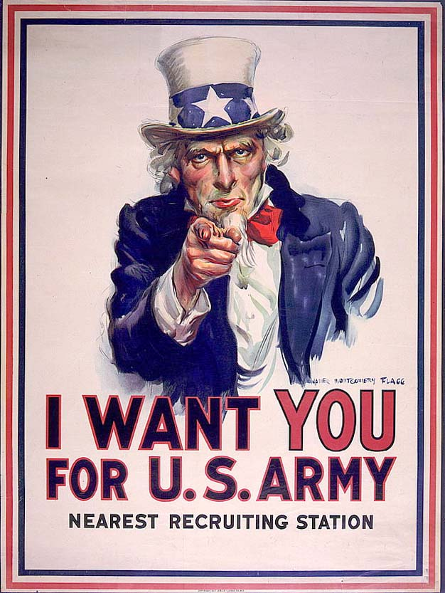


Slide 10
WW1 Divisive Propaganda
Psychological Warfare – better to persuade than perish?
Crewe House vs. Austria-Hungary and Germany
‘We were hypnotised like a rabbit by a snake’
The impact on Hitler

Slide 11
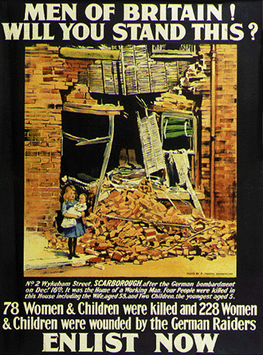
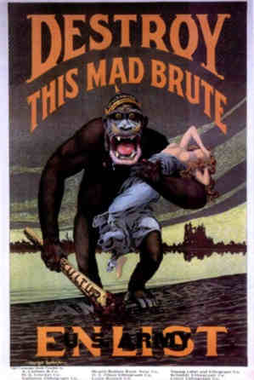

Slide 12
World War 2
The advent of sound cinema and radio
Total War = Total Propaganda
The ‘Big Lie’ vs. ‘The Strategy of Truth’
The impact of WW1 atrocity propaganda on covering the Holocaust

Slide 13
WW2 Cohesive Propaganda
Britain’s Ministry of Information
Nazi Ministry of Popular Enlightenment and Propaganda
Soviet Propaganda
US Office of War Information and the ‘Why We Fight’ films
Japanese Propaganda

Slide 14
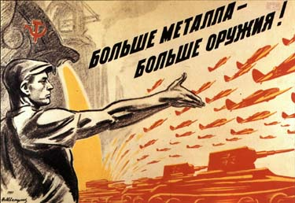
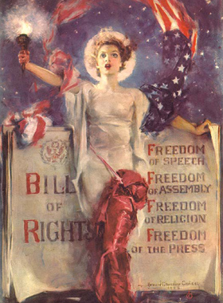


Slide 15
WW2 Divisive Propaganda
The Political Warfare Executive
Black radio and Sefton Delmer
How to reach the target audience?
The impact of Unconditional Surrender

Slide 16
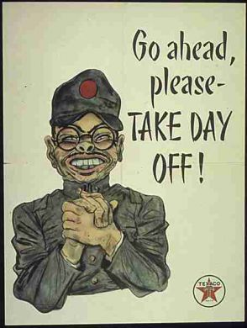
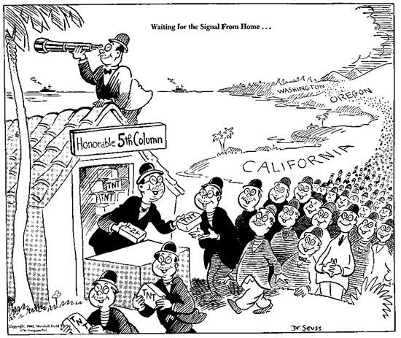

Slide 17
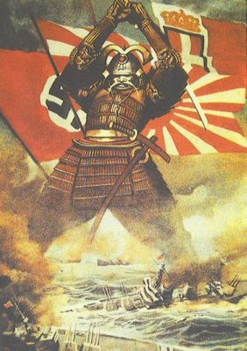


Slide 18
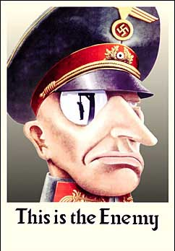


Slide 19
Conclusions
Role of propaganda in ending wars?
Emergence of two distinct propaganda models
Legacy of hatred – ‘two world wars and one world cup!’

