Slide 1
Communications & Conflict
Lecture 3
Vietnam: the first TV war (?)

Slide 2
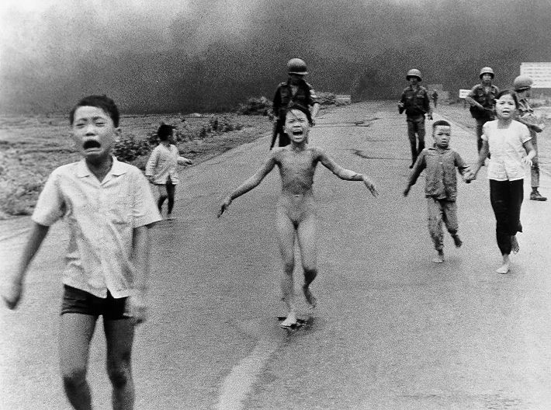

Slide 3
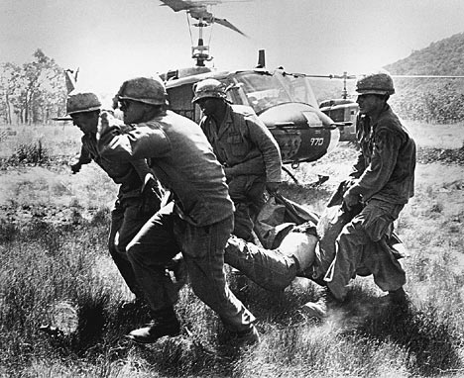
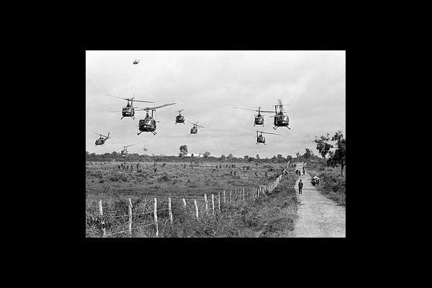

Slide 4
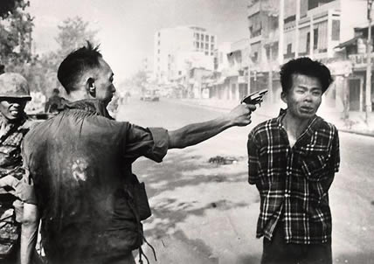

Slide 5

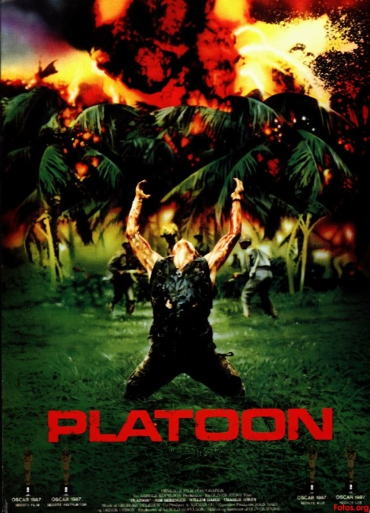

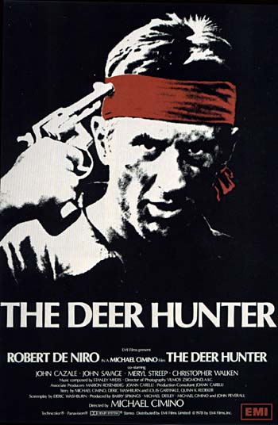
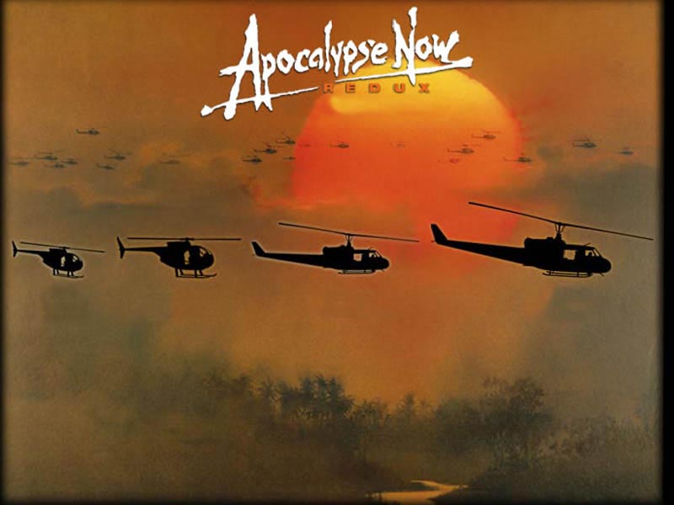


Image vs. Reality

Slide 6

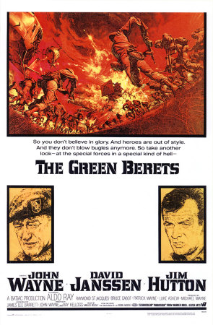



Contemporary Films

Slide 7
1945-63
Development of Cold War
Space Race & Arms Race
Korean War, 1950-53
Advent of TV
Decolonisation
Assassination of JFK
‘Rolling back’ communism

Slide 8
Vietnam, 1963-73/5
LBJ accelerates US troop involvement begun by JFK, 1963-
Arrival of satellite TV
Media War – 2 phases
- 1963-1968
- 1968 (Tet Offensive) - 1973

Slide 9
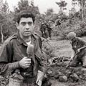
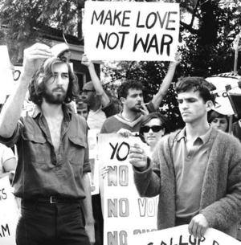
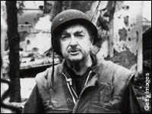

Slide 10
Media War, Phase 1
US media largely supportive of ‘our boys’
Our wars and Other People’s Wars
Media as watchdogs or lapdogs/propagandists for war?
Mounting casualties

Slide 11
The Turning Point? Tet
NVA assault on Saigon
Walter Cronckite (CBS)
LBJ’s reaction and the 1968 Presidential Election
A military victory but a defeat in the media
The ‘5 o’clock follies’
Or just reflecting Washington’s political agenda?

Slide 12
Media War, Phase 2
Richard Nixon’s Presidency
5 more years of troop involvement…..
….with a hostile media?????
The Green Berets and Wayne’s World
Nixon Re-elected 1973

Slide 13
The ‘Vietnam Syndrome’
Largely a myth?
A rationalisation for defeat
Shoot the messenger!
Used for increased post-war controls on media
War re-fought through movies (‘do we get to win this time’?)
War in the Television Age

Slide 14
Conclusions
Watergate scandal and the ‘end of confidence’ in the presidency
1970s détente in Cold War
Northern Ireland preoccupies UK
Arrival of colour TV
1979 Soviet invasion of Afghanistan

Slide 15
