Slide 1
Communications & Conflict
Lecture 6
International Conflicts in the Post Cold War Era: From the Gulf to Kosovo, 1991-99

Slide 2
Agenda
Changing nature of international crises in post Cold War environment
International media – ditto?
The ‘CNN Effect’
Some Case Studies
The impact of the ‘new media’
Some warnings for the future

Slide 3




The 21st CENTURY ENVIRONMENT?
TERRORISM
POPULATION GROWTH +
RESOURCE SCARCITY =
War over Food, Water, Fish
Changing ALLIANCES:
IMPACT OF THE EURO
ECO-ASIA
Virtual States
Global Warming +/
Ecological disaster +
Creeping Deserts =
Sub-National Groups:
Russian Mafia, FARC,
UNCERTAIN
FUTURE
UNCERTAIN
FUTURE
INFORMATION
WARFARE
WEAPONS OF
MASS DESTRUCTION
ETHNO-
Religious
PAN-NATRIONALISM
CLASH OF CIVILIZATIONS:
IMPACT OF
TECHNOLOGY
More GNP =
More Defense Spending
DISEASE
(AIDS PANDEMIC
MALARIA, EBOLA)
ASYMMETRIC
WARFARE
GLOBAL ECONOMIC
INTERDEPENDENCE

Slide 4
How did we get here?: Main Trends for Military-Media Crisis Management in the Post Cold War Era
From inter-state to intra-state conflict
From military war-fighting to peacekeeping, peace building and peace support
From military-military communications to military-civilian communications
Decline of specialised foreign and defence correspondents
Increased emphasis on ‘real-time’ reporting
From Information Warfare to Information Operations (‘electronic Pearl Harbour’)

Slide 5
Role of the International Media
Increasingly competitive, deregulated ‘infotainment’ market
Human Interest stories and the decline of the specialist/rise of the freelancer
Easier to ‘manipulate’ within certain ground rules (Gulf War and Kosovo)
More difficult to control access to communications technologies

Slide 6
The Media and Crisis
Bad news is good news
Plenty of Human Interest
Other People’s Wars and Our Wars
Ability/inability to report from dangerous places
Event driven rather than issue driven
Decline of specialised reporters

Slide 7
Television: its limitations and its power
Picture-driven snapshots (bulletins)
The tyrannical growth of real-time (and speculation)
The CNN Effect (push vs. pull)
‘Real’ crises and ‘media crises’
Audio-visual mediation not actual reality
Hence the media as a target in information warfare (RTS Serbia)

Slide 8
Media War and Real War
Real war is the nasty, brutal, terrifying business of people killing people
Media War is not the same thing: it is a mediated event, second-hand, even remote, safe, viewed from a distance
The role of the media in bridging this image-reality gap – or not – is therefore crucial to our understanding of media performance, in war but also in peace as well, and increasingly important to the success of ‘military’ operations

Slide 9
Crisis in the Balkans
1991-95: Bosnia and SFOR
1995: From the ‘safe havens’ to the Dayton Peace Agreement
1995-99: IFOR
1999: Kosovo Conflict
Post Kosovo: KFOR

Slide 10
1991-95: Bosnia and SFOR
‘The death of Yugoslavia’
Three sided civil war (Croatia, Bosnia, Serbia)
Media coverage: erratic, polarised, simplified – and anti-Serb!
Clinton administration policy – to resist the shocking images (from Europe!) especially post Somalia: the journalism of attachment
Markele market place and safe havens

Slide 11
The Road to Dayton
Srebrenica and the humiliation of the ‘safe havens’ policy
Evidence suggests the CNN effect finally came to play in influencing air strikes
Especially after the failure to intervene in Rwanda genocide
Dayton establishes IFOR
Record since 1995

Slide 12
The Road to Kosovo
Serbia removes autonomy in 1998
KLA vs. MUP and VJ forces: legacy of Bosnia media coverage identifies Serbs as villains
Serb ‘genocide’ mobilises media
Media coverage mobilises politicians to launch a war of ‘guilty conscience’ for not acting against Serbs over Bosnia

Slide 13
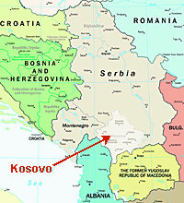
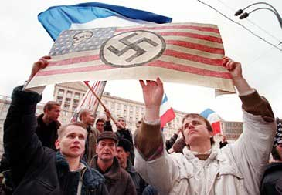
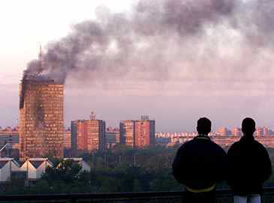

Slide 14
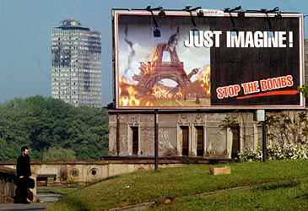

Slide 15
Some warnings for the future
Knowledge explosion
Internet has seen 8% of world population log-on WITHIN LAST TEN YEARS
Computer power up six orders of magnitude by 2025
Global interconnectivity The developed world is moving to an information based economy---BUT

Slide 16
What about the Less Developed World?
5.7 billion current population will double in our lifetime
  4.5 billion live in poor countries (average per capita GNP about $1K)
  35% of population under age 15
Population in LDCs up 143% by 2025
  Population under age 15 may exceed 50% in some countries
  Radio and TV still predominant media

Slide 17
Increasing Urbanization
Half of world population now is urban; two thirds by 2025
27 mega-cities (10M+) by 2015, 24 in less developed world
  Of 325 cities of 1M+ today, 213 are in less developed world
By 2025, Latin America 85%, Africa 58% and Asia 53% urban

Slide 18
Increasing instability, especially in the Developing World
Traditional national sovereignties eroding
Religious, tribal and ethnic conflict spreading
Guerrilla, paramilitary and criminal groups proliferating
Numbers of displaced persons growing
The ‘war’ against Terrorism

Slide 19
Crisis!
Crisis? What Crisis?
A crisis that the media covered/created?
A crisis that politicians responded to?
Media coverage of a crisis that politicians responded to?
I.e. image or reality?
What kind of world is this?

Slide 20
The Whole World is Watching!
More Complex Humanitarian Crises Are Almost Certain
Traditional infrastructures (administrative, health & sanitation, water, power, etc.) will continue to erode in third world
The global information infrastructure will continue to expand and become more robust
Urban centers in the second and third world will function as communication nodes

Slide 21
Information Age
The ability of any central authority to control information flow will diminish
First world policy makers will be increasingly unable to ignore LDC events
Global telecommunications will provide scenes that result in policy shifts and turn military operations into improvisational theater

Slide 22
How do you manage those crises?
An integrated information policy (hence IO)
Long-term communication of (‘soft’) power
Short-term but planned PSYOP and PA/PI activity close to the centre of decision-making
Professionalised information activity AND crisis management scenarios
Keep within the democratic tradition: a strength and a weakness

