Slide 1
Communications & Conflict
Lecture 4
From the Falklands to the Gulf War of 1991

Slide 2
Impact of Vietnam Syndrome
Sidle Commission and the evolution of the ‘pool’ system
Thatcher-Reagan alliance
Tested in Falklands War of 1982
Death of Soviet leaders until Gorbachev in 1985
Reagan and the ‘Evil Empire’/’Star Wars’

Slide 3
The Falklands War, 1982
Media limited and last minute
‘Bonding’ with the Task Force
Media completely reliant on military communications – delayed reports
No news is good news and late news is no news
MoD briefings and the ‘speak your weight machine’
‘I counted them all out, and I counted them all back’

Slide 4
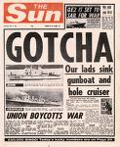
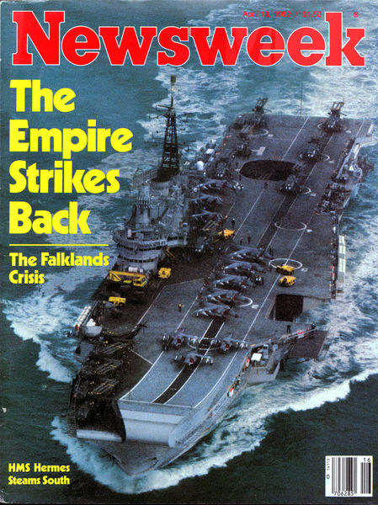
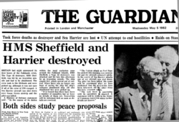
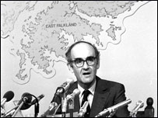
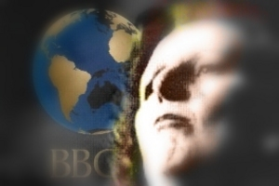

Slide 5
1980s – key developments
Arrival of satellites, CNN, fax machines, cheapish computers
Grenada, 1983
Chernobyl, 1986
Panama, 1989
Fall of the Berlin Wall
Tianaminh Square

Slide 6
What role did communications play in the end of the Cold War?
Audio cassettes and the Iranian Revolution (1979)
International broadcasting (‘the voices’) and the end of Soviet jamming
Technology (e.g. satellite TV) and the parting of the Curtain
Tanks or television?

Slide 7
The Gulf War of 1991
‘The first information war’
CNN and the impact of real-time
Media management techniques
The ‘pools’
The Unilaterals
The Baghdad Loophole

Slide 8
Key events
Khafji
The ‘baby-milk plant’
The Al Firdos bombing in Amariya
The ‘Highway of Death’
The impact of the media on the end of the war

