Slide 1
WAR AND THE MEDIA
Philip M Taylor
Prof. of International Communications

Slide 2
Real War and Media War
Not the same thing!
For non-combatants, war is a mediated event
Mediation creates distance, despite an ‘illusion of reality’
How much can be shown vs. how much should be shown?

Slide 3
Wars of national Survival
1914-18, 1939-45
‘Total War’, bombing and a narrowing of the gap between soldier and civilian
Morale of civilians as well as of soldiers
Total War = Total Propaganda

Slide 4
Propaganda Definition
The planned use of information targeted at specific audiences using any media available to achieve desired outcomes that primarily benefit the source
Persuasion by commission and omission (i.e. censorship)

Slide 5
The role of the media
Patriot or propagandist?
Lapdog or watchdog?
Observer, participant or catalyst?
The ‘CNN Effect’
Report from both sides?

Slide 6
The Clash of Cultures
THE MILITARY RESPECT….
Authority
Order
Hierarchy
Co-operation
Team-work
Continuity/Tradition
Togetherness
Institutions
THE MEDIA VALUES…
Hate authority
Chaos is a good story
Dog eat dog
Competition
Individualism
That’s history, not news
Dog eat cat
Human Interest

Slide 7
The Rise of Public Affairs
Public Information/Media Operations
Our wars and Other Peoples’ Wars
Vietnam Syndrome
From the pools to the embedded
Command and Control

Slide 8



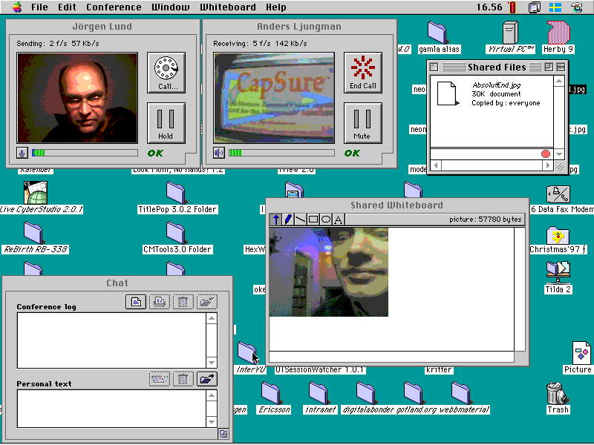
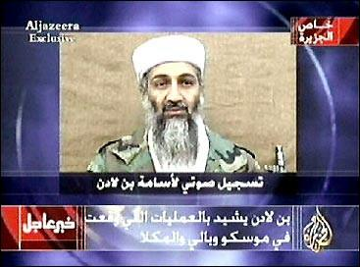
Taking Command & Control of the Information Space
Can it be done in an age of mobile phones, internet access and ‘civilian reporters’?
Is it desirable in a global information space - the Jenin vacuum?
What about the new alternative players – eg Al Jazeera?
What about the new kids on the block?

