Slide 1
Strategic Communications, PSYOPS and Asymmetrical Threats
Prof. Philip M. Taylor
ICS, University of Leeds, UK
www.leeds.ac.uk/ics
JSPOC 19, December 2006

Slide 2
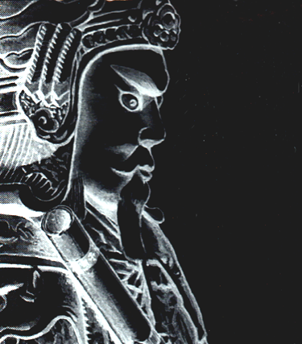
Munitions of the Mind
“To win one hundred victories in one hundred battles is not the acme of skill. To subdue the enemy without fighting is the acme of skill.” Sun Tzu, The Art of War.

Slide 3
The Cold War ‘won’
Ronald Reagan = ‘the Great Communicator’
Strategic PSYOP ‘victory’ in the ‘war of ideas’
DoD Psyop Masterplans of 1985 and 1990
Panama = the first tactical and operational test – ‘combat force multiplier’
Decline in 1990s at the strategic level (Public Diplomacy) under Clinton

Slide 4
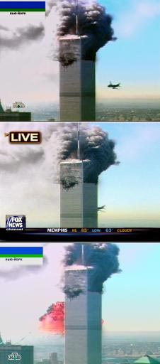
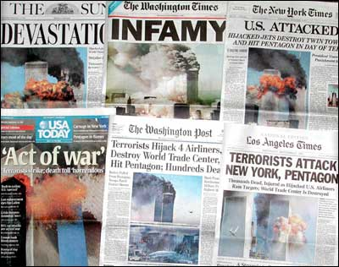
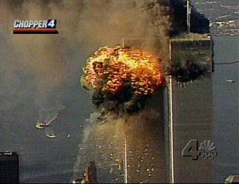
‘Propaganda of the Deed’
New York targeted because its media rich environment ensured maximum, spectacular, global media coverage (‘like watching a movie’)

Slide 5
‘Why do they hate us so much?’:
Beefing up the US propaganda machine
Coalition Information Centres
Office of Strategic Influence (failed)
Office of Global Communications (closed)
Freedom Promotion Act of 2002
Radio Free Afghanistan
Radio Farda, Radio Sawa, al-Hurrah TV, Hi magazine (suspended)
Information Operations (incl. PSYOPS)

Slide 6
The new ‘P’ word – Perception Management
‘Actions to convey and/or deny selected information and indicators to foreign audiences to influence their emotions, motives and objective reasoning; and to intelligence systems and leaders at all levels to influence official estimates, ultimately resulting in foreign behaviors and official actions favorable to the originator’s objectives.
In various ways perception management combines truth projection, operations security, cover and deception and psychological operations.’
-- Joint Pub 1-02

Slide 7
‘War’ on an idea
Kinetic weapons appropriate?
‘Minds’ or ‘hearts’?
How do you end war/negotiate a peace treaty?
Is the ‘Long War’ an ‘Eternal War’?
Where is the battlefield/space? (Iraq & Afghanistan + ?)

Slide 8
Combat force multiplier vs. terrorist adversary?
Mismatch of capabilities/goals – support for the military mission versus the terrorist mission = publicity/communicating fear
Targets of terrorism = civilians, not soldiers (except Iraq)
‘war’ against a concept, especially with suicide bombers in the equation

Slide 9
The Global Battlespace
…is the global info-space
It is populated with numerous (infinite) info-players with mobile/portable/cheap technologies
Info-players are potential (dis)info-warriors
Don’t forget the old media (a major target for terrorism of fear)

Slide 10
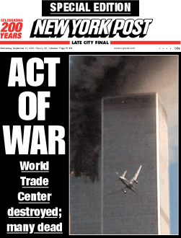
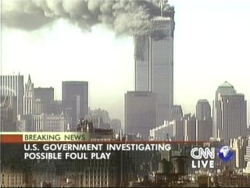
The media are a major ‘battlefront’
Asymmetric weapon
A democratic weakness
or an asset – but to whom?
A new global info-sphere
with new voices (internet,
Al Jazeera etc)
= a battlespace

Slide 11
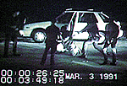
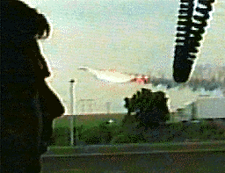
The rise of the ‘citizen journalist’
New digital communication technologies are affordable, portable and easy to use (cameras and cell phones)
The pictures and sounds are used by TV and radio stations
Most important kit (in US news media) is a helicopter

Slide 12
The News Media & the New Media
The scale of the problem? From 450 to 1500 to 3800
Who are these guys?
Unembedded new kids or in bed with the enemy
Kosovo = www.1 TV was to Korea what the Internet was to Serb ‘softwar’

Slide 13
The Information Warriors
Al Qaida understand importance of old and new media (video beheadings)
Combat cameramen accompany ‘martyrdom missions’ and snipers
The ‘martyrs’ leave video testaments
The survivors film the carnage on their mobile phone cameras
The broadcasters (old media) use the survivors’ footage and thus do the publicity the terrorists desire

Slide 14
We ourselves are an asymmetric threat!
Or have become so…
Democracy’s weaknesses
Our own soldiers are our own OPSEC violators
They have made us the enemy (Abu Ghraib)
Have we created our enemy? (9/11 came out 1990s, 7/7 bombers from Leeds came out of post 9/11 reaction)

Slide 15
The legacy of the 1991 black campaign
In 1991, covert propaganda strayed from official line about liberation of Kuwait
No coalition help for Kurdish and Shi’ite uprisings
Overt 2003 policy was about regime change in Iraq - but the white PSYOPS suffered from the legacy of black PSYOPS in 1991
‘This time we won’t let you down’ (UK)
Why should Iraqis trust ‘coalition of the willing’ now when no Arab military contributions?
Anglo-USA invasion/conquest rather than liberation

Slide 16
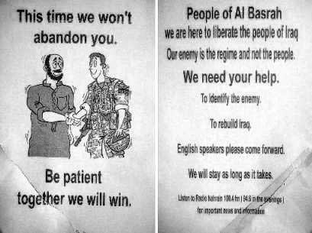
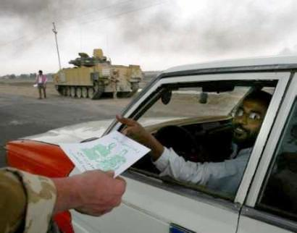

Slide 17
But they ARE good
Al Qaeda’s central leadership structure has a dedicated media and communications committee tasked with issuing reports and statements in support of its operations, including a dedicated studio, known as the Al Sahab Institute for Media Productions.
They have shown great skill in terms of timing (Katrina)
but are helped greatly by the west’s ‘own goals’.

Slide 18
Spin Laden, 27 December 2004
Bin Laden identified the insurgency in Iraq as “a golden and unique opportunity” for jihadists to engage and defeat the United States, and he characterized the insurgency in Iraq as the central battle in a “Third World War, which the Crusader-Zionist coalition began against the Islamic nation.”
Describing Baghdad as “the capital of the caliphate,” Bin Laden asserted that “jihad in Palestine and Iraq today is a duty for the people of the two countries” and other Muslims.

Slide 19
Success?
The Muslim world has not (yet) risen up in support of Al Qaeda’s strategic goals … but
Rising levels of anti-Americanism (and not just in the Arab and Muslim world) are helping them.
Is this due to their success or the west’s failure to ‘win hearts and minds’?

Slide 20
The west’s propaganda ‘own goals’
‘Crusade’ and Operation ‘Infinite Justice’
Saddam and WMD, Iraq & 9/11 – undermines credibility of US voices …
… especially as those voices in charge of US messages (Charlotte Beers, Condi Rice, Karen Hughes, Colleen Graffy) are all female!
Abu Ghraib, Guantanamo, etc etc etc etc etc

Slide 21
STRATEGIC COMMUNICATIONS
INFORMATION OPERATIONS
P
S
Y
O
P
S
C
N
O
P
U
B
L
I
C
I
N
F
O
D
E
C
E
P
T
I
O
N
S
O
F
T
P
O
W
E
R
P
U
B
L
I
C
D
I
P
L
O
M
A
C
Y
C
I
M
I
C
C
I
M
I
C

Slide 22
PD definition
‘The promotion of national interests through efforts to inform, engage, listen to, and influence foreign publics….PD seeks to communicate directly with citizens worldwide with the [aim] of making goals … easier to achieve and opposition to those goals less likely’. (K M Lord 2005)

Slide 23
5 years in….
Strategic Communications at last a recognition of need for ‘joined up’ information campaign (PD, PSYOP, IO)
For the Long War, a long-term information strategy needed
But what is the desired end-state?
And hence who is the target audience?

Slide 24



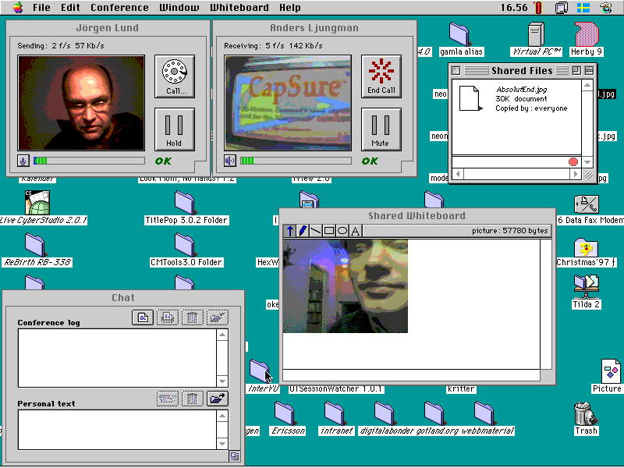
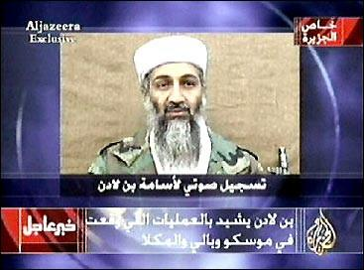
Taking Command & Control of the Information Space
Can it be done in an age of mobile phones, internet access and ‘civilian reporters’?
Is it desirable in a global information space - the Jenin vacuum?
What about the new alternative players – eg Al Jazeera?
What about the new kids on the block or blog?

Slide 25
My SE Asian experience
‘the final battle in a 1000 year crusade’
Bin Laden ‘a ghost’
9/11 a CIA/Mossad plot
Palestine and the Jews

Slide 26
The KEY issue
‘Know your
enemy but, above
all, know
yourself’

