Slide 1
Concepts of Information Warfare
Professor Philip M. Taylor,
Institute of Communications Studies,
University of Leeds, UK.
Oslo, November 2006

Slide 2
INFO-PROPAGANDA
“There’s a war out there, old friend, a world war, and it’s not about who’s got the most bullets. It’s about who controls the information - about how we see and hear, how we work, what we think. It’s all about the information…”
Cosmo
Sneakers, 1992
MCA Universal Pictures

Slide 3
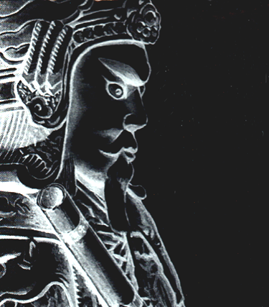
Munitions of the Mind
“For to win one hundred victories in one hundred battles is not the acme of skill. To subdue the enemy without fighting is the acme of skill.”
Sun Tzu, The Art of War.

Slide 4
War, Peace or what in the ‘Global War on Terror?
“…the infantry in trench warfare will in future be taken by revolutionary propaganda, to break down the enemy psychologically before the armies begin to function at all.”
(Hitler in Mein Kampf).

Slide 5
Agenda
Some concepts and definitions
Components of Official influence (Public Diplomacy, PSYOPS, Deception, Public Information, IO, Perception Management/Strategic Communications
Some diagnostics about where we have gone wrong and how to put it right

Slide 6
The dreaded ‘P word’: Propaganda – NATO definition
ANY INFORMATION, IDEAS, DOCTRINES OR SPECIAL APPEALS,
DISSEMINATED TO INFLUENCE THE OPINIONS, EMOTIONS, ATTITUDES OR BEHAVIOUR OF ANY SPECIFIED GROUP
IN ORDER TO BENEFIT THE SPONSOR, EITHER DIRECTLY OR INDIRECTLY
= Propaganda is always designed to benefit the source more than the recipient

Slide 7
Revolution in International Affairs – the DIME paradigm
Diplomatic/Political
Economic
Military
Informational
(hard and ‘soft’)
National Policy
Objectives

Slide 8
Hard Power
HARD = actual use of military force, economic sanctions, coercive diplomacy etc
‘Hard power is the ability to get others to do what they otherwise would not do through threats or rewards. Whether by economic carrots or military sticks, the ability to coax or coerce has long been the central element of power.’ (Keohane & Nye)

Slide 9
Soft Power
‘Soft power …is the ability to get desired outcomes because others want what you want. It is the ability to achieve goals through attraction rather than coercion. It works by convincing others to follow or getting them to agree to norms and institutions that produce the desired behaviour.
Soft power can rest on the appeal of one's ideas or culture … and …depends largely on the persuasiveness of the free information that an actor seeks to transmit. If a state can [do this] it may not need to expend as many costly traditional economic or military resources.’ (Keohane & Nye)

Slide 10

The Information Dimension:
The Global Information Battlefield or (info ‘space’)
The struggle for ‘hearts and minds’
Threat of terrorism nationally and internationally
Information is an asymmetric ‘weapon’ or ‘tool’

Slide 11
Instruments of International Power
NATIONAL FOREIGN POLICY OBJECTIVES
Diplomacy
Economic
Military
Informational
‘Propaganda’/
Perception Mgmt.
- Public Diplomacy
- Cultural Diplomacy
International
Broadcasting
Media Operations
PSYOPS
Treaties,
Contracts,
Alliances etc;
Coercive Diplomacy
threats of force,
threats
of sanctions
Trade
Agreements,
WTO, GATT,
NAFTA,
Sanctions
Threats of
Force,
Combat,
‘Kinetic
Power’

Slide 12
Instruments of International Information
‘PROPAGANDA’ or ‘PERCEPTION MANAGEMENT’
Public Affairs/
PI/Media Ops
Public/Cultural
Diplomacy
International
Broadcasting
PSYOPS
Battlefield
Consolidation (Nation building?)
Peace Support
Strategic
Educational/Cultural
Exchanges;
International Sport;
Medical exchanges
News vs.
Views
‘Spin’;
Media
Management

Slide 13
Official Information
NATIONAL POLICY OBJECTIVES
Economic
Political
Diplomatic
Military
INFORMATION OPERATIONS

Slide 14
Evolution of the terminology
Enemy or combat propaganda (WW1)
Political Warfare (UK)
Psychological Warfare (US, WW2)
Psychological Operations (1950s onwards)
Information Warfare (c. 1991-6)
Information Operations (c. 1996 to present)
Perception Management (post 9/11)
Strategic Communications (2004-)

Slide 15
INFORMATION AGE
CONFLICT
The Revolution in Military Affairs
“The current military-technical revolution, as in the case of some earlier periods of major change in military affairs, is part of a broader revolution with political, economic and social dimensions. It is being shaped by profound changes in technology, perhaps most notably in the area of information technology....”
William J. Perry, October 1994

Slide 16
From C2W to C4I
Command…
… and Control Warfare (C2W)
Communications
Computers
Intelligence (C4I)
CNN (.com)???

Slide 17
Information Age Conflict
INFORMATION
IN WARFARE
Intelligence
Surveillance
Reconnaissance
Weather
Geographic
Other
INFORMATION
WARFARE
Influence Attitudes
Deny/Protect
Deceive
Exploit/Attack

Slide 18
INFORMATION WARFARE
Influence Attitudes
Deny / Protect
Deceive
Exploit / Attack
(‘Strategic Communications’)
Public Diplomacy
Private Diplomacy
PSYOP
Media Relations (PA/PI)
Education (‘soft’)
Counter Influence/ propaganda
OPSEC
Info Assurance
Computer Network
Defence (CND)
Counter
Intelligence
Spoofing
Imitation
Distortion
Electronicwarfare
Computernetwork attack (CNA)
Ballistic
EMP
Deception

Slide 19
What is IO & IW ? –
the formal definitions
Joint Pub 3-13, Information Operations Doctrine
  - Information Warfare:
  “ Information operations conducted during time of crisis or conflict to achieve or promote specific objectives over a specific adversary or adversaries.”
  - Information Operations:
  “Actions taken to affect adversary information and information systems while defending one’s own information and information systems.”
  i.e. so vague they are almost meaningless

Slide 20
Info-Environment Shaping
STRATEGIC COMMUNICATIONS
Shaping the
Information Space
Overt Peacetime PSYOP
Deception
Covert Action
Deterrent Capabilities
Political Power
Economic Power
Public Affairs
Public Diplomacy
Information Operations
International Power
Force Disposition
PSYOP
Covert Action & Deception
Shaping the
Conflict Space
Public Diplomacy
Public Affairs
Network Security
Operational Security
Information
Warfare
Force Disposition
Fire Power
Electronic Warfare
Deception
Operational Security
PSYOP
Shaping the
Battle-Space

Slide 21
Public Diplomacy Definitions
PD ‘deals with the influence of public attitudes on the formation and execution of foreign policies. It encompasses dimensions of international relations beyond traditional diplomacy; the cultivation by governments of public opinion in other countries; the interaction of private groups and interests in one country with those of another; the reporting of foreign affairs and its impact on policy; communication between those whose job is communication, as between diplomats and foreign correspondents; and the processes of inter-cultural communications’.

Slide 22
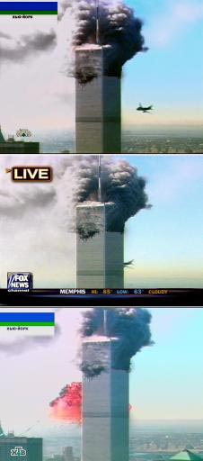
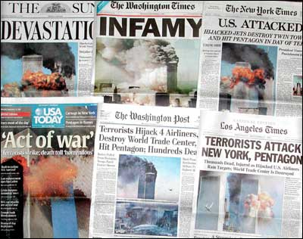
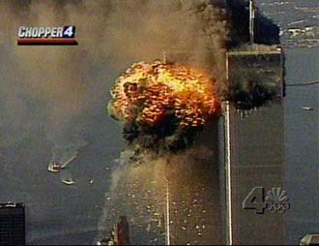
‘9/11’ and the failure of PD
‘Why do they hate us so much?’

Slide 23
Public & Cultural Diplomacy
PUBLIC DIPLOMACY
CULTURAL
RELATIONS
INTERNATIONAL
BROADCASTING
(Long-term;
Elites are main
Target audience)
?
PSYCHOLOGICAL
OPERATIONS
(Short-term)

Slide 24
Current US official international radio ‘services’ – The Voice of America
Radio Free Europe – Eastern Europe
Radio (and TV) Marti – Cuba
Radio Free Asia - North Korea/China
Radio Free Afghanistan
Radio Farda – Iran
Radio Sawa (‘Together’) – Middle East
Al Hurra TV (‘The Free One’)
= remnants of a previous ideological struggle (ie Cold War) merged
with new ‘global struggle for hearts and minds'

Slide 25
When you are ‘at war’ you need a propaganda machine….
Coalition Information Centres
Office of Strategic Influence (gone)
Office of Global Communications (gone)
Policy Co-ordinating Committee on Communications
Freedom Promotion Act of 2002
Radio Free Afghanistan
Hi magazine (gone)
Radio Sawa & Al Hurrah TV
PSYOPS and Information Operations (IO)

Slide 26
A nation ‘At War’
‘war’ declared on terrorism, but how can you fight an idea?
Bush Doctrine – pre-emptive war against ‘axis of evil’ and non-state actors
When you are at war, your warriors gain precedence over diplomats
In ‘wartime’, PSYOPS and Information Operations more important than PD or Soft Power
But you can only fight an idea with education and information, but the shock of 9/11….

Slide 27

PSYOPS
- US Definition
“Operations planned to convey selected information and indicators to foreign audiences to influence their emotions, motives, objective reasoning, and ultimately the behavior of foreign governments, organizations, groups and individuals.
The purpose of PSYOPs is to induce or reinforce foreign attitudes and behavior favourable to the originator’s objectives” - Joint Pub 3-53

Slide 28
Forms of PSYWAR/PSYOPS
Black (covert): purports to be from a source other than the true one (e.g. PWE radio). Usually conducted by intelligence services.
White (overt): emanates from the source it says it is (e.g. ‘This is Radio Moscow’). Usually conducted by military or civil-military services.
Grey: (source unknown- except by the source!).

Slide 29
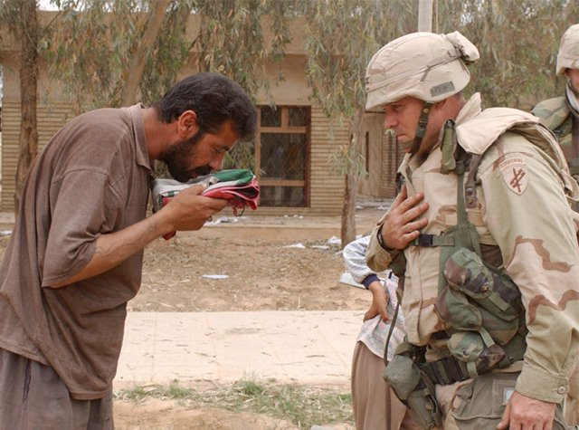
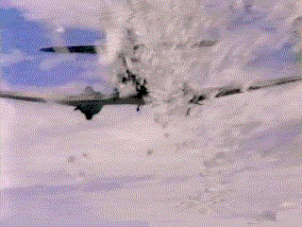
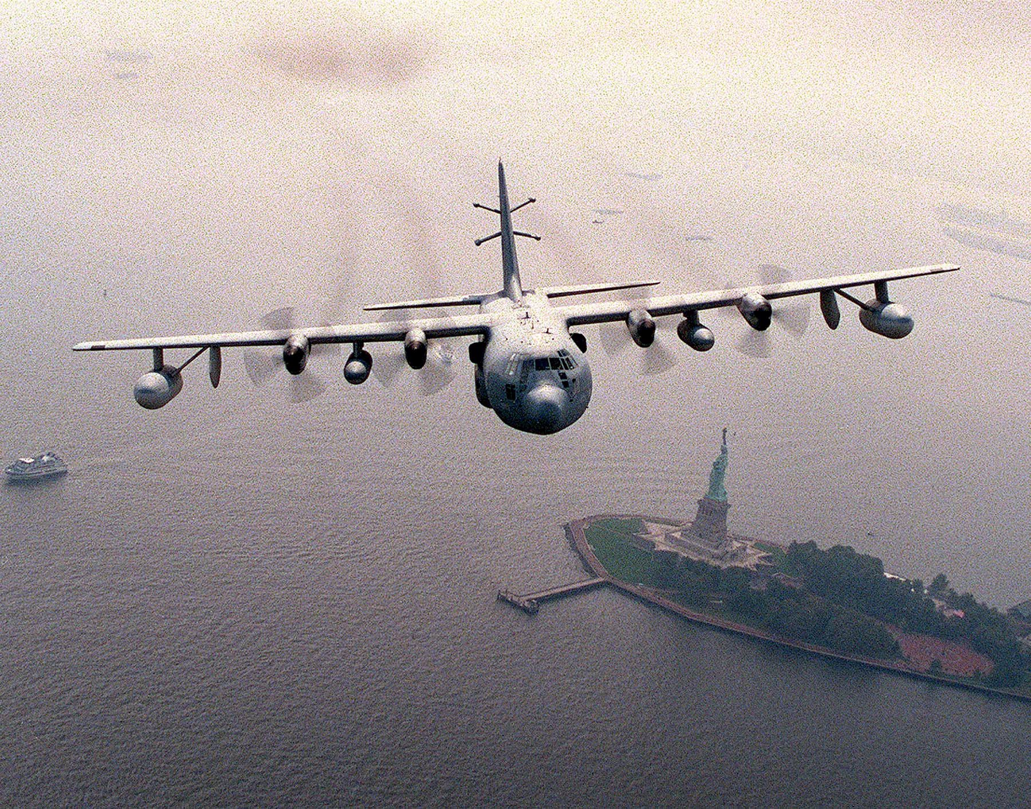
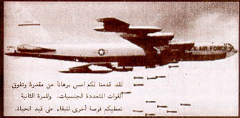
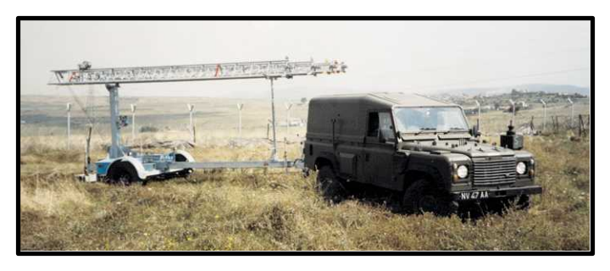
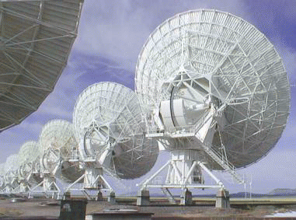
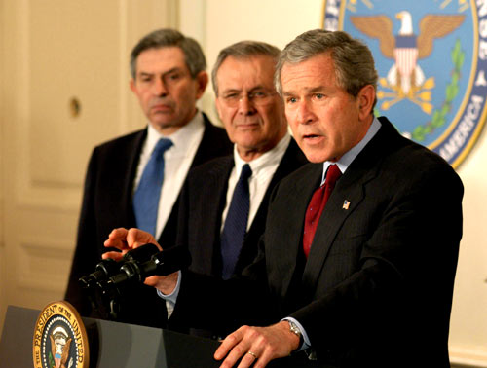
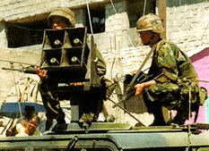
PSYOPS
media –
propaganda
for war

Slide 30
The new ‘P’ word – Perception Management
‘Actions to convey and/or deny selected information and indicators to foreign audiences to influence their emotions, motives and objective reasoning; and to intelligence systems and leaders at all levels to influence official estimates, ultimately resulting in foreign behaviors and official actions favorable to the originator’s objectives.
In various ways perception management combines truth projection, operations security, cover and deception and psychological operations.’
-- Joint Pub 1-02

Slide 31
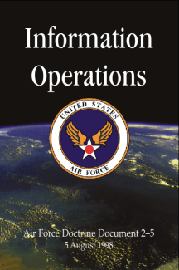
Military Deception
… actions executed to deliberately mislead adversary military decision makers as to friendly military capabilities, intentions, and operations, thereby causing the adversary to take specific actions (or inactions) that will contribute to the accomplishment of the friendly mission.
AFDD 2-5
All warfare is based on deception.
Sun Tzu, The Art of War, 500BC

Slide 32
Deception’s Primary Goals
Support the Commander’s mission and concept of operations
  Cause adversary to incorrectly employ forces
  Cause adversary to reveal strengths, weaknesses, dispositions and future intentions
  Overload adversary intelligence and analysis capability
  Condition adversary to patterns that can be exploited
  Cause adversary to waste combat power
(Cause the adversary to lose)

Slide 33
EXAMPLES OF IO OBJECTIVES
PEACE
STRATEGIC
Deter War
Affect Infrastructure
Disrupt WMD R&D Program
Support Peace Operations
Protect GCCS
OPERATIONAL
Expose Adversary deception
Isolate Enemy NCA and/or MIL
Commanders from Forces
TACTICAL
Disintegrate IADS
Degrade and/or Destroy
Tactical C2
WAR

Slide 34








The IO-Media interface
“Almost by definition . . . a war waged on live television is a
war in which political and public relations considerations
become inextricably bound up with military tactics and
strategy. . . .
… how victory is won
is almost as important
as victory itself.”
(Washington Post,
March 24, 2003)

Slide 35
Emerging US IO doctrine
Information Operations
PA/PI?
Influence Operations
Cyber Operations
PSYOP Deception
CNA CND

Slide 36
Human Factors – it’s about people, not just networks!
INFORMATION OPERATIONS
CAPABILITIES
RELATED ACTIVITIES
CNO
Deception
OPSEC
EW
PSYOP
Public Affairs
Civil Affairs
Media Relations
Public Diplomacy
Physical Destruction (Kinetic) & Leadership
Decision-Making (‘Shock & Awe’)

Slide 37
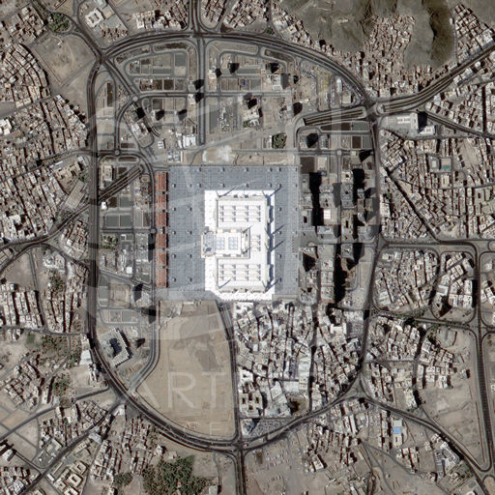

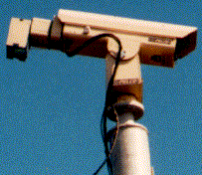
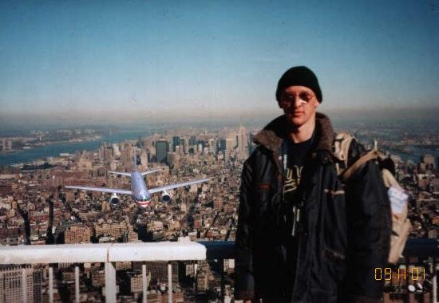
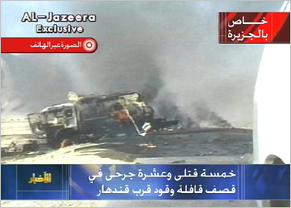

The 21st Century Information Environment
The Internet
Cameras everywhere
Satellites
IT IS FAST, POROUS,
GLOBAL, PERSONAL,
OVERLOADED &
UNSTOPPABLE
Disinformation, conspiracy
theories, rumours, etc
Mobile
Phones,
PDAs
New Info-players

Slide 38
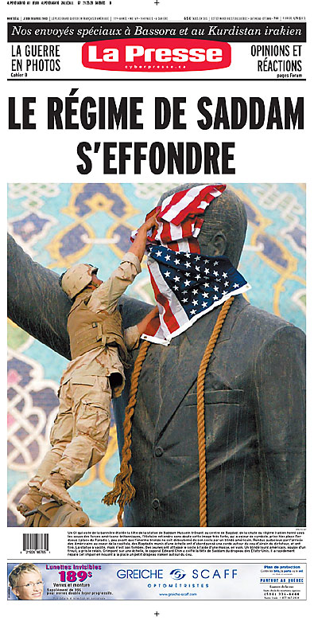
Not just a military doctrine?
Global info-sphere is influenced
by events and information to and
from the battlefield (‘space’)
Compression of tactical, operational
and strategic information
Civilian info-players and new
technologies make battle space highly porous
600 Embedded journalists as ‘combat cameramen’ in real-time vs. 1500 unembedded ‘unilaterals’

Slide 39
From Perception Management to Strategic Communications
Name change in 2005 was a recognition of
- too obsessed with systems
- it was a bad ‘P’ word
- IO was too narrow a military doctrine
- IO roadmap recognised DoD needed more strategic thought in the information war
- All instruments of official information needed greater co-ordination

Slide 40
INFORMATION OPERATIONS
“The integrated employment of the core capabilities of Electronic Warfare (EW), Computer Network Operations (CNO), Psychological Operations (PSYOP), Military Deception (MILDEC), and Operations Security (OPSEC), in concert with specified supporting and related capabilities, to influence, disrupt, corrupt, or usurp adversarial human and automated decision - making while protecting our own.”
DoD 3600.1 (Draft)

Slide 41


Strategic Communications
Conflagration
DHS
War
Coordination
DOD
Crisis
Collaboration
Peace
OGA
Capabilities
Integration
DOS
Responsibilities
PD
Offensive
Authorities
EW CNA
Homeland
Defense
PA PSYOP MILDEC
PD
Strategic IO
OPSEC
OPSEC
Defensive
War on Terrorism
CND
Counterpropaganda
Strategic Influence
Electronic
Influence

Slide 42
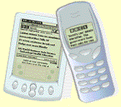

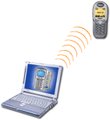
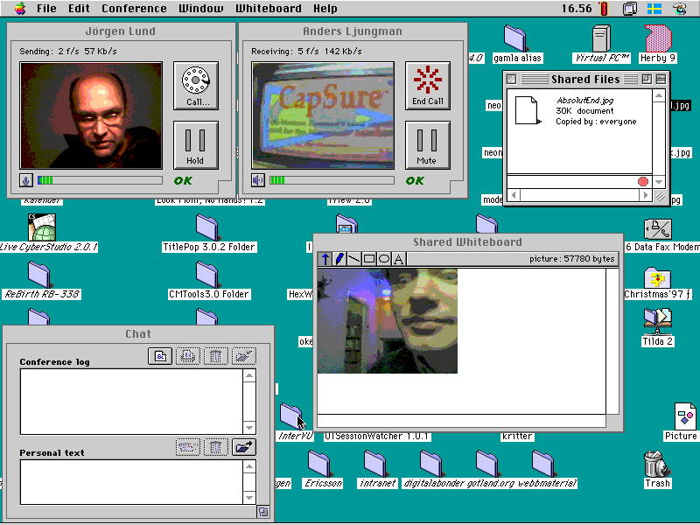
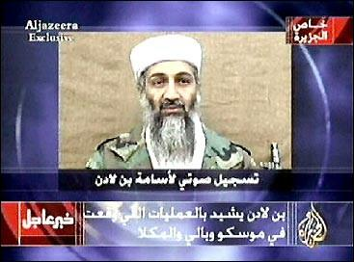
Taking Command & Control of the Information Space
Can it be done in an age of mobile phones, internet access and ‘civilian reporters’?
Is it desirable in a global information space - the Jenin/Fallujah vacuums?
What about the new alternative players – eg Al Jazeera?
What about the ‘new kids on the block’ (or rather blog)?

Slide 43
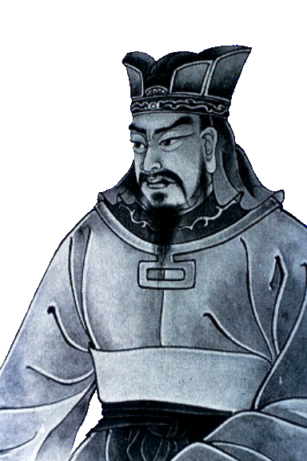
SUN TZU
“Know your enemy
and know yourself;
in a hundred battles
you will never know peril.”

