Slide 1

The Media and the ‘war’ on terror
Crisis Management & the Media
Lecture
Prof. Philip M. Taylor

Slide 2
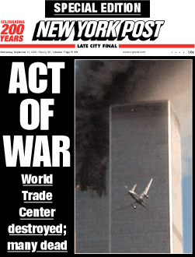
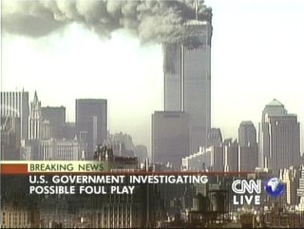
The media are a major ‘battlefront’
Asymmetric weapon
A democratic weakness
or an asset – but to whom?
A new global info-sphere
with new voices (internet,
Al Jazeera etc)

Slide 3
But there are other battlefronts as well….
The Diplomatic Front – i.e. coalition building
The Intelligence Front – the arrest and detention of terrorists and their supporters
The Financial Front – tracking and freezing money assets and laundering operations
The Law Enforcement Front – including counter-terrorist acts
The Military Front – first Afghanistan, then Iraq
The Humanitarian Front – post-conflict nation-building

Slide 4
The First Battle - Afghanistan
Largely a ‘Special Operation’ – special ops. don’t take media with them
Media nonetheless descended on Afghanistan and saw only slices of the war
Many reporters killed
Taliban only able to fight ‘media war’ on strategic front of 24/7 global news services
Coalition Information Centres to counter this

Slide 5
The Propaganda War
Plays out on all six fronts
Usually conducted through global media
On the military front, psychological operations (leaflets and radio) in support of military operations deployed.
‘Information warfare’ includes strikes against Taliban radio and supplanting of internal communications messages by outside military media (including Commando Solo aircraft)

Slide 6
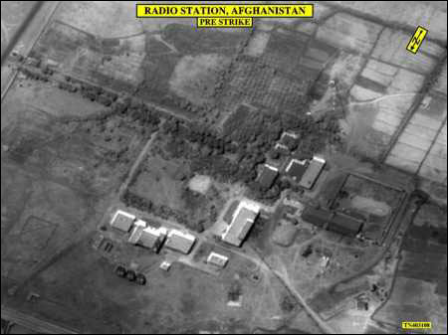
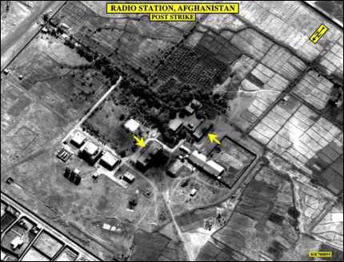
Information Warfare
Kabul, Voice of Shari’a radio Station before (left) and after air strike (below) 8 October 2001. Restored 26 Oct., destroyed hours later
Monitor developments
at
http://www.clandestineradio.com

Slide 7
Main world-wide themes of anti-USA propaganda
US ‘sponsorship’ of Israeli ‘terrorism’
US ‘hypocrisy’ of selective military interventions and selective targeting of terrorists (‘why not go after the Real IRA?’ ‘Why not wage war against Basque terrorists?’ BUT mainly Israeli terrorism)
‘Globalisation’ = ‘coca-colonialism’
Initial use of word ‘crusade’ indicates ‘reality’ of a Christian war against Islam (e.g. sanctions against Iraq, military bases in Saudi Arabia)

Slide 8
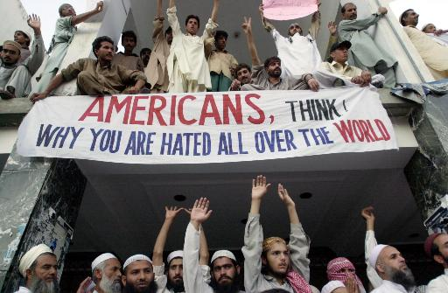

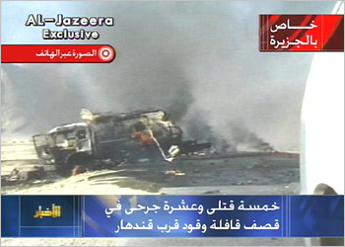

Slide 9
Propaganda themes which sow seeds of doubt in the Middle East
The US had planned to attack Afghanistan long before September 11
Long-term US covert plans to kill bin Laden
Taliban not ‘so bad’ as west claims
Missiles are cowardly; suicide hijackers are not
‘Evidence’ against bin Laden ‘unconvincing’
5 of the 19 hijackers still alive
No cell phone call from the hijacked planes mentioned ‘Arabs’
Followers of bin Laden in a Florida ‘strip bar’?
Passport of one found at the WTC?
Mohamed Ata’s suitcase never made the plane?

Slide 10
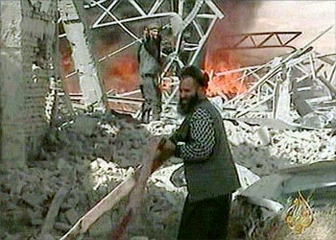
The ‘Arab CNN’ – Al Jazeera TV
Staff prefer to think of themselves as the ‘BBC World Service TV’ of the Middle East (many BBC trained)
Quatar based, it has upset just about every Middle Eastern leader by its ‘western’ style of allowing debate on any issue
Broadcast of bin Laden taped messages upsets west as well – accusation that they may contain ‘coded messages’ to terrorists ‘sleeping’ around the world.
The very fact that ‘Spin Laden’ has communications specialists indicates his value of ‘the oxygen of publicity’
Debate now extended to democratic countries – but if networks ‘self censor’ themselves, isn’t this more propaganda ammunition about western ‘hypocrisy’?

Slide 11
Caught on the back foot
Since the last presidential election, themes about the merits of democratic systems are on shaky ground.
International Public Information (i.e. ‘public diplomacy’) programmes, especially since PDD 68, clearly failing. Why?
Probably because they are targeted at elite foreign audiences, not at the street-level
Foreign elites, especially in non-democracies, not transferring US ‘justifications’ to their own people for fear (?) of being deposed at the street level.

Slide 12
Other nuts to crack
The belief that the US is ‘arrogant’, hypocritical and imperialist
The belief that this IS a clash of civilisations (e.g. attacks on mosques and Muslims in the west)
The belief that the US is using the ‘war against terrorism’ as a cover for other objectives (e.g. that Mossad was behind the September 11 attacks)

Slide 13
Beefing up the US propaganda machine
Coalition Information Centres
Office of Strategic Influence
Office of Global Communications
Freedom Promotion Act of 2002
Radio Free Afghanistan
Radio Farda, Radio Sawa, al-Hurrah TV, Hi magazine

Slide 14
Battle 2 - Iraq
From Desert Storm: ‘why didn’t we finish the job in 1991?’
From UN resolutions about WMD
From 9/11, Enduring Freedom and the ‘war’ against terrorism
Bush Doctrine of pre-emptive war and regime change
The ‘axis of evil’ and the dangers of appeasement

Slide 15
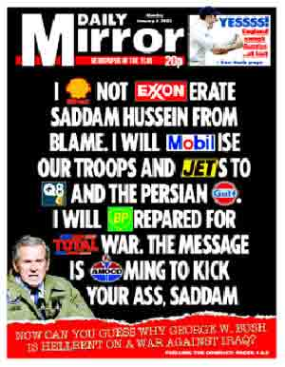
Counter- themes
Oil
Israel
Bush family revenge
Project for the New American Century
Link between Saddam and 9/11, Al Qaeda?
More time needed for weapons inspectors

Slide 16
A world unconvinced
Percentage drops in favourable views of US since start of year 2003 (Pew Centre, 18 March)
- France: from 63% to 31%
- Italy: from 70% to 34%
- Russia: from 61% to 28%
- Turkey: from 30% to 12%
- UK: from 75% to 48%

Slide 17
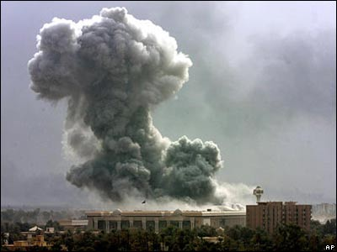
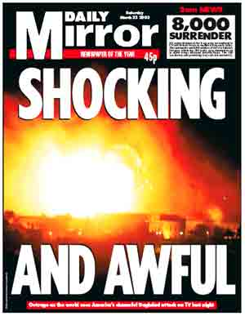
‘Shock and Awe’

Slide 18
The Battle for Iraqi ‘Hearts and Minds’, 2003
No mass surrenders on a scale similar to 1991 – why?
No wide-scale uprisings against SH, unlike 1991 – why?
Widely regarded in Arab world as ‘invaders’ not liberators – why?
= a serious failure of perception management at tactical and strategic levels (except in USA. But for how long?)

Slide 19
Information Ops and the Media
Integration of ‘Perception Management’ themes from top to bottom
‘I urge the Iraqi people being threatened in the cities to try to remember the faces and the names of the death squad enforcers. Their time will come, and we will need your help and your testimony.’ (Donald Rumsfeld, Pentagon news briefing, 28 March)
Had a press conference become a psychological operation?

Slide 20
The Media War
Embedded journalists and the snowstorm of information
Arab satellite channels as new players/alternative viewpoints (c.f. 1991 as the ‘first CNN war’)
National media support/opposition reflected national governmental positions
What about US/UK public’s morale as casualties mount?

Slide 21
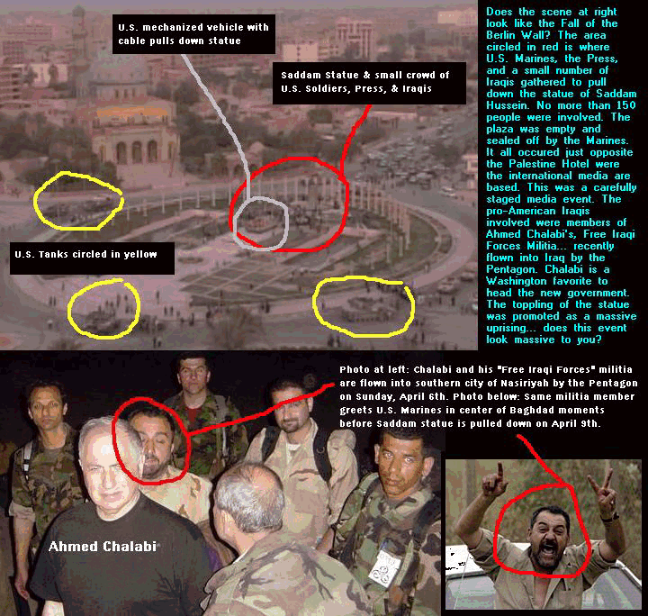
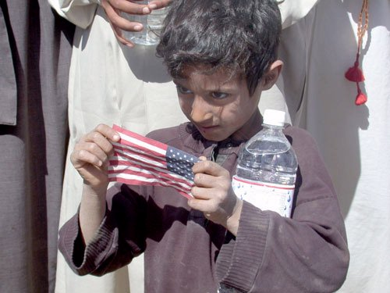
Media performance
Umm Qsar reported fallen 8 times in first week
Baghdad and elsewhere
casualties (14 killed)
Private Jessica
Toppling of Saddam
statue

Slide 22
Conclusions
The PSYOPS campaign had only short-term military benefits, but long-term unconventional warfare consequences
The ‘hearts and minds’ campaign had long-term roots of failure from 1991
Publicised wartime stunts damaged credibility of ‘liberation’ themes
Policy and presentation must go hand in hand but the presentation won’t sell the policy if the policy (‘product’) is incredible

