Slide 1
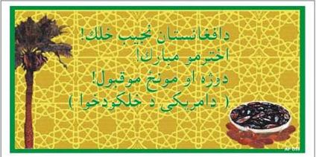
PSYOP Leaflet in support of Humanitarian Aid
Left – Front & Back
"People of Afghanistan"
"Eid Mubarakm [end of Ramadan].
We wish that God will accept
your prayers and fast.
Have a blessed holiday"
People of America

Slide 2
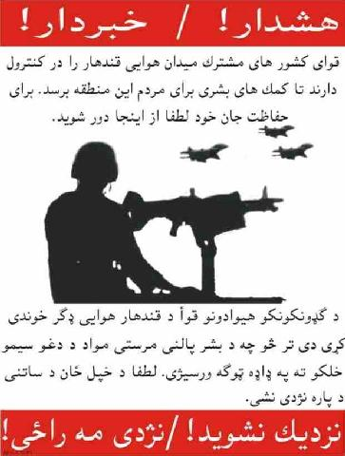
Safeguarding the Airport
Left - Front & Back
WARNING
"The Partnership of Nations
has secured the Qandahar Airport to ensure that Humanitarian Aid will reach the people of this area.
For your own safety stay away”
STAY AWAY

Slide 3
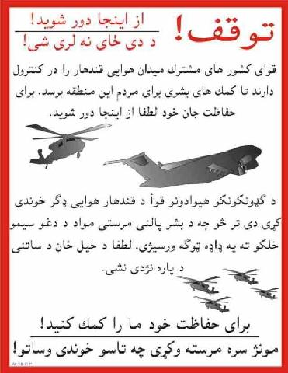
Safeguarding the Airport 2
STOP! TURN AWAY NOW!
"The Partnership of Nations
has secured the Qandahar
Airport to ensure that
Humanitarian Aid will reach the
people of this area for your
own safety please stay away“.
HELP US KEEP YOU SAFE

Slide 4
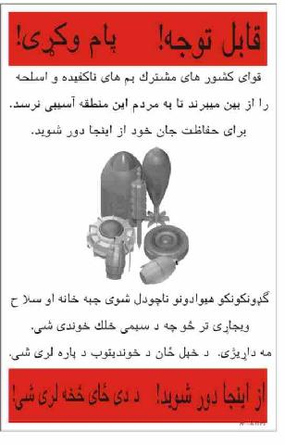
Mine Awareness campaign 1
ATTENTION
Partnership of Nations Forces
are destroying unexploded
Ordinance and weapons to keep
the citizens of this region safe.
There is no reason to be alarmed.
For your own safety, stay away!
STAY AWAY

Slide 5
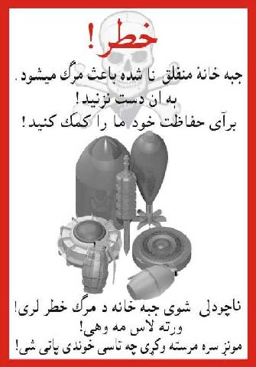
Mine Awareness campaign 2
DANGER
Unexploded ordinance can kill!
Do not touch!
Help us keep you safe!

Slide 6
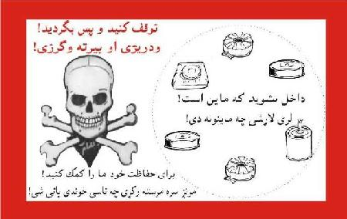
Mine Awareness campaign 3
STOP AND TURN AWAY
STAY OUT MINES!
HELP US KEEP YOU SAFE

Slide 7

Consolidation PSYOP
‘A UNITED AFGHANISTAN
OFFERS PEACE AND
PROSPERITY’

Slide 8
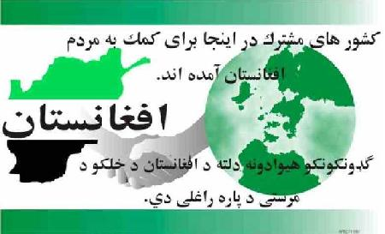
Consolidation PSYOP 2
AFGHANISTAN
"The Partnership Of Nations Is Here To Assist the People
of Afghanistan."

Slide 9
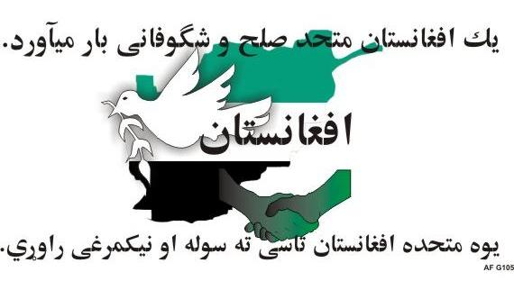
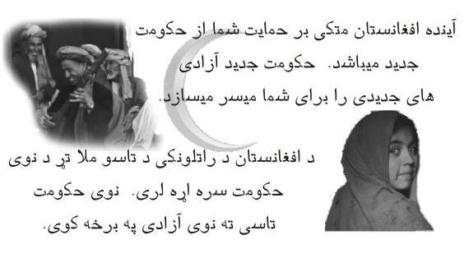
Consolidation PSYOP 3
Front – Left
"A United Afghanistan
Offers Peace and
Prosperity"
Back – Right
“A New Government Peace
Offers New Freedom"
"The Future of Afghanistan
Depends On Your Support
Of The New Government”

Slide 10
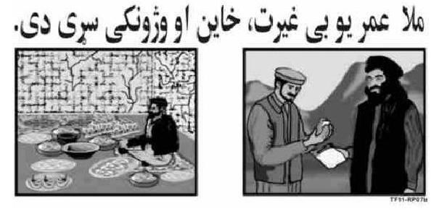
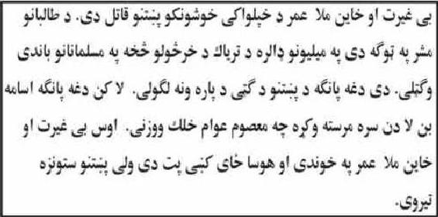
Demonisation PSYOP
Front – Left
"Mullah Omar is a
Murderer And a Coward
and a Traitor"
Back – Right
"Mullah Omar is a Murderer, a Coward and a Traitor
to the freedom loving Pushtun people. As the
leader of the Taliban he made millions of dollars
selling evil drugs to Muslims. He did not use his
fortune to help the Pushtun people. He used his
fortune to help Osama bin Laden murder
innocent civilians. Now Omar the coward and
traitor hides in safety while Pushtuns suffer."

Slide 11
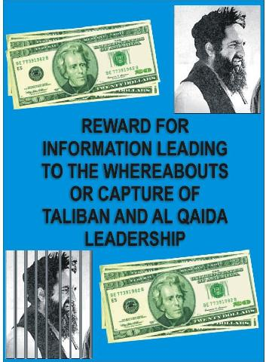
The Hunt Goes On…..
English version for approval.
The actual leaflets and posters
were printed in Pashtu and
Dari.

Slide 12
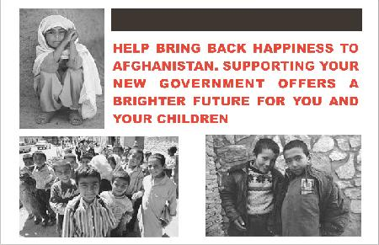
More Consolidation PSYOP
English version for approval.
The actual leaflets were printed in Pashtu and Dari.

Slide 13

And Again….
English version for approval.
The actual leaflets were printed in Pashtu and Dari.

Slide 14
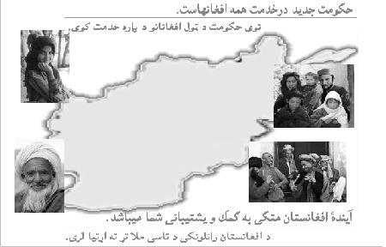
"A New Government working for all Afghans"
"The future of Afghanistan depends on your support."

Slide 15
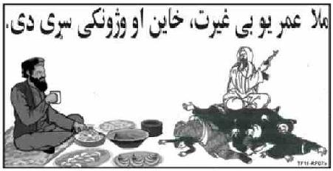
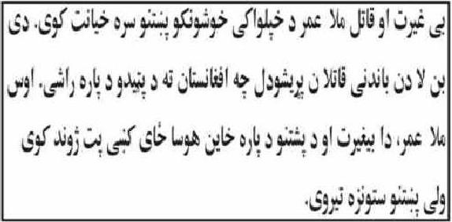
Where is that man?
Front – Left
"Mullah Omar is a
Murderer And a Coward
and a Traitor"
Back - Right
"Mullah Omar is a Murderer And a Coward
and a Traitor to the freedom-loving
Pashtun people. He let Osama bin Laden's
foreign murderers come to Afghanistan
to hide. Now Omar the coward and traitor
to the Pushtun people hides in safety and
comfort while his people suffer.”

Slide 16
