Slide 1
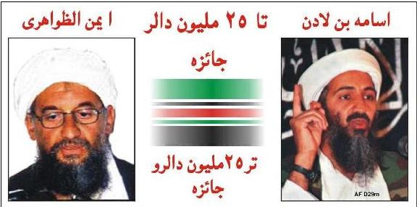
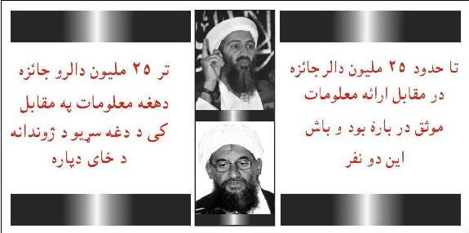
$25 million reward
Left – Front
AYMAN AL-ZAWAHIRI
USAMA BIN LADEN
Right - Back
"ANY INFORMATION LEADING
TO TO THE WHEREABOUTS
OF THESE MEN CONTACT
COALITION AUTHORITIES"

Slide 2
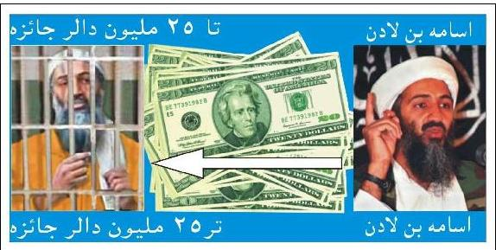
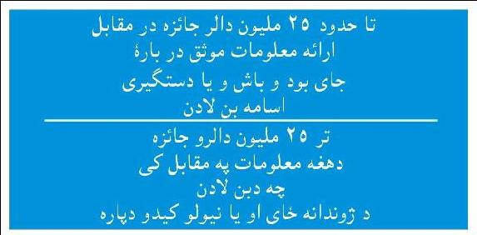
$25 million Reward 2
Left - Front
Right – Back
"$25,000,000 REWARD FOR
INFORMATION LEADING,
TO THE WHEREABOUTS OR
CAPTURE OF OSAMA BIN
LADEN.
CONTACT COALITION
AUTHORITIES"

Slide 3
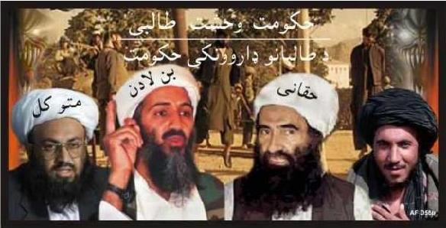
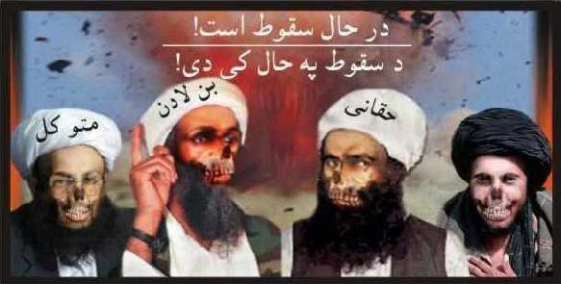
Demonising the Taliban
Left – Front
(from left to right) Muttawakil Bin Laden Haqqani
"THE TALIBAN'S REIGN OF FEAR..."
Right – Back
"...IS ABOUT TO END"

Slide 4
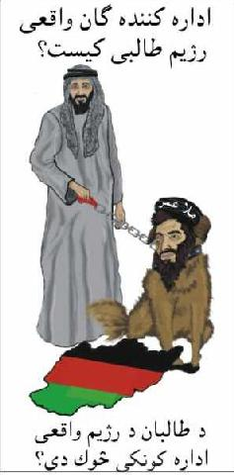
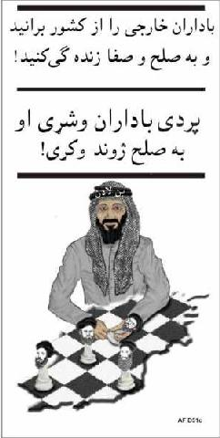
Focusing on foreign terrorists
Left – Front
WHO REALLY
RUNS THE
TALIBAN ?
Right – Back
EXPEL THE
FOREIGN
RULERS AND
LIVE IN PEACE

Slide 5
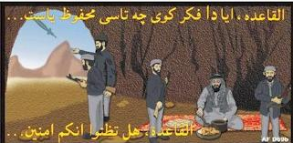
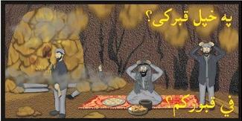
Taliban in Tora Bora
Front – Left
AL Qaeda do you
think that you
are safe...
Right – Back
...In your tomb?

Slide 6

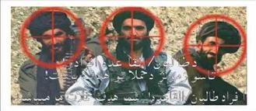
Targeting the Taliban
Left – Front
"Taliban and
Al Qaida fighters,
we know where
you are hiding."
Right – Back
"Taliban and Al
Qaida fighters,
you are our
targets."

Slide 7
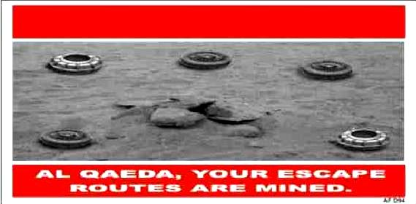
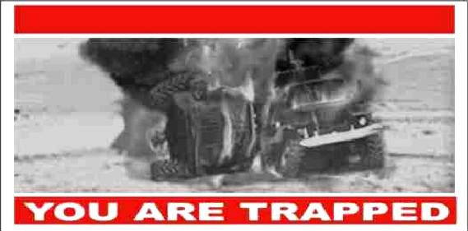
No escape for the Taliban
Left – front
Pre-translation
Right - Back

Slide 8
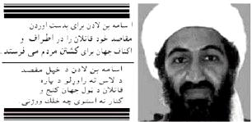
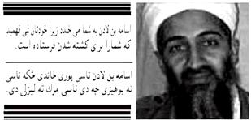
Demonising bin Laden
Left – Front
"Osama bin Laden
sends his murderers
into the world to kill
for his cause."
Right – Back
"Osama bin Laden
laughs at you as you
do not know he has
sent you to your
death"

Slide 9
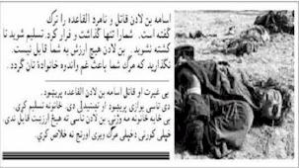

Demonising bi Laden 2
Left – Front
"Osama bin Laden the murderer and the coward has abandoned Al Qaida. He has abandoned you and run away. Give yourself up and do not
die needlessly, you mean nothing to him. Save your families the grief and pain of your death."
Right – Back
"Osama bin Laden the murderer
and coward has abandoned you”
[This is an unusual leaflet; the image of a
young bin Laden in western dress appears
designed to discredit him as a hypocrite.
NB. PSYOP should not lie - PMT.]

Slide 10
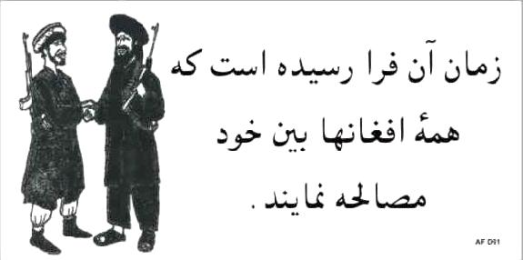
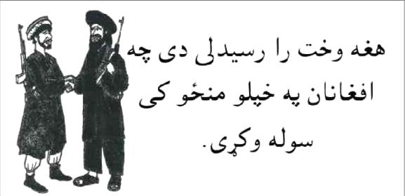
"The Time has come for all Afghans to make peace"
Left – Front
In the Dari Language
Right – Back
In Pashtu

Slide 11
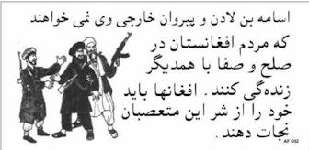
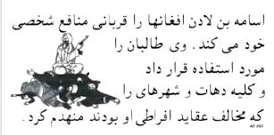
"Osama bin Laden and his foreign henchmen do not want Afghans to live in peace with each other. Afghans need to rid themselves of these fanatics."
Left – Front
In Dari
Right – Back
In Pashtu

Slide 12
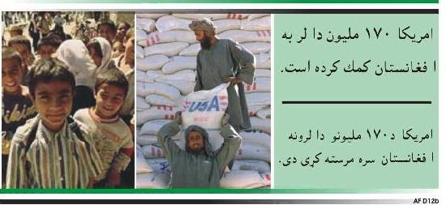
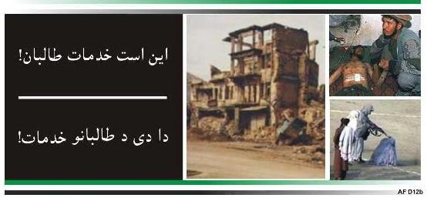
Rebuilding Afghanistan
Left – Front
“AMERICA HAS
PROVIDED OVER
$170 MILLION
IN AID TO
AFGHANISTAN"
Right - Back
"THIS IS WHAT
THE TALIBAN
HAS DONE"

Slide 13
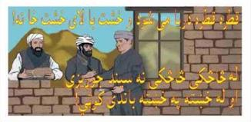
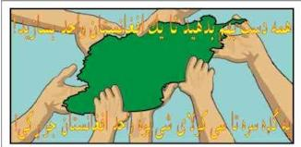
Rebuilding Afghanistan 2
Left - Front
"Brick by brick"
Right – Back
"Together you can
make one
Afghanistan".

Slide 14

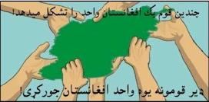
Rebuilding Afghanistan 3
Left - Front
"Many threads
make one rug"
Right – Back
"Together you can
make one
Afghanistan".

