Slide 1

Propaganda and Military Operations in the ‘War against Terrorism’
Philip M. Taylor
Professor of International Communications
University of Leeds

Slide 2
Fools rush in…..
Making snap judgements, especially when a propaganda war is ongoing, is rarely a good idea for academics
Journalists have to do it, especially under pressure of news report deadlines and the ‘tyranny of real-time television’ (Nik Gowing)
Media reports are ‘the first drafts of history’
But they are usually very rough drafts and rarely contextualised (longer the deadline, the better the context)

Slide 3
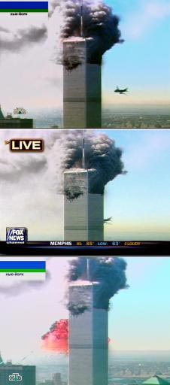
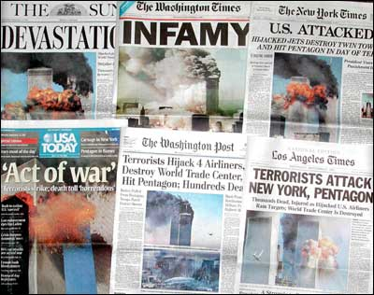
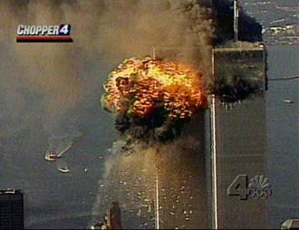
The Global Struggle for the ‘moral high ground’
New York targeted because its media rich environment ensured maximum, spectacular, global media coverage

Slide 4
A new kind of ‘war’?
‘war’ is usually defined as armed conflict between two or more nation states
This conflict is more one (so far) against an individual (although the ‘dead or alive’ line was backed off from on 25/10/01) and his organisations which transcend traditional geo-spatial boundaries
Mistake to use the word ‘crusade’ in early days because this sent the wrong signal in the Muslim world
Also Original Campaign Plan title: ‘Infinite Justice’!!!!

Slide 5
So what kind of ‘war’ is this?
Analogy with the ‘war on drugs’
War against an idea or a ‘concept’ by a non-state actor
‘Cold War’ of ideas/ideologies
How long will this last?: ‘we’re in this for the long haul’
Military front only one element; where next? (Iraq? Already a war front)
Has the public got the stomach for the casualties (‘innocent women and children’) and the longevity?

Slide 6
Enduring Freedom: A ‘war’ on Five (or Six) Fronts
The Diplomatic Front – i.e. coalition building
The Intelligence Front – the arrest and detention of terrorists and their supporters
The Financial Front – tracking and freezing money assets and laundering operations
The Law Enforcement Front – including counter-terrorist acts
The Military Front – currently focused on Afghanistan
(The Humanitarian Front – including the dropping of food relief at the same time as bombing)

Slide 7
The Propaganda War
Plays out on all six fronts
Usually conducted through global media
On the military front, psychological operations (leaflets and radio) in support of military operations deployed.
‘Information warfare’ includes strikes against Taliban radio and supplanting of internal communications messages by outside military media (including Commando Solo aircraft)

Slide 8
PSYOP - US Definition
‘Planned operations to convey selected information and indicators to foreign audiences to influence their emotions, motives, objective reasoning and ultimately the behaviour of foreign governments, organisations, groups and individuals.
The purpose of PSYOPs is to induce or reinforce foreign attitudes and behavior favourable to the originator’s objectives’

Slide 9
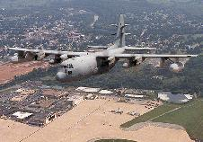
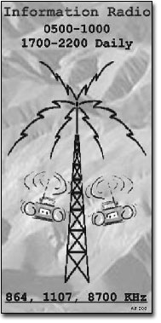
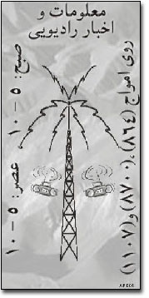
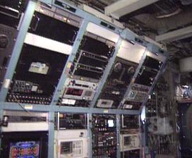
PSYOPS - Commando Solo

Slide 10
Commando Solo broadcasts
‘We have no wish to hurt you, the innocent people of Afghanistan. Stay away from military installations, government buildings, terrorist camps, roads, factories or bridges. If you are near these places, then you must move away from them. Seek a safe place, and stay well away from anything that might be a target. We do not wish to harm you.
With your help, this conflict can be over soon. And once again, Afghanistan will belong to you, and not to tyrants or outsiders. Then, you will reclaim your place among the nations of the world, and return to the honored place your country once held. Remember, we are here to help you to be free from this terrorism, despotism and the fear and pain they bring with them’.

Slide 11
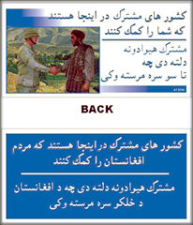
‘The Partnership of Nations is Here to Help You’

Slide 12
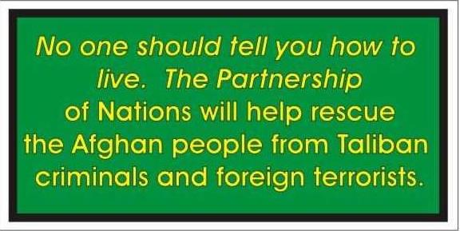
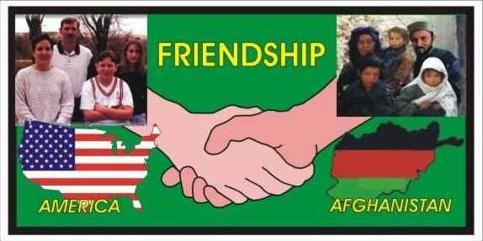
Enduring Freedom Psyops leaflets – pre-translation
Left - back
Right - front

Slide 13
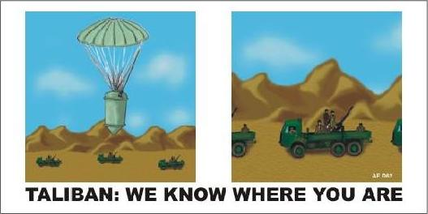
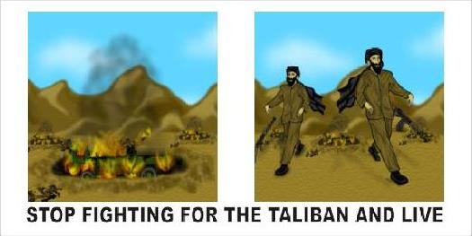
Enduring Freedom Psyops leaflets – pre-translation
Left - front
Right - back

Slide 14
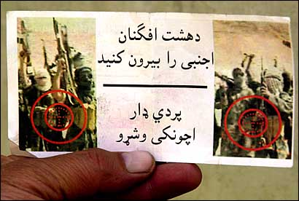
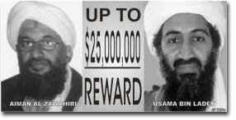
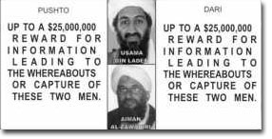
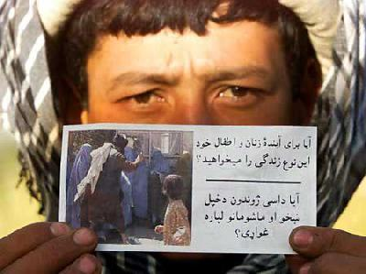
Enduring Freedom PSYOPs anti-Taliban leaflets
Left – ‘Is this the future you want
For your women and children?’

Slide 15
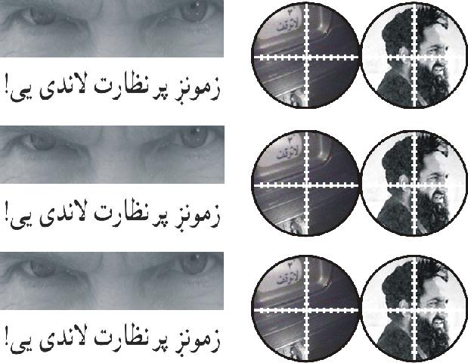
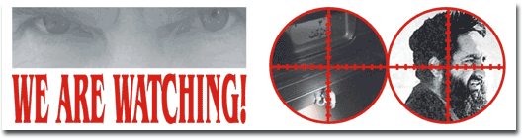
Enduring Freedom PSYOP leaflets
Warning to Mullah Omar

Slide 16
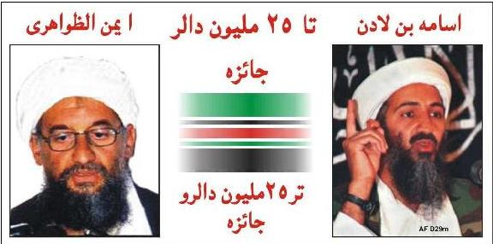
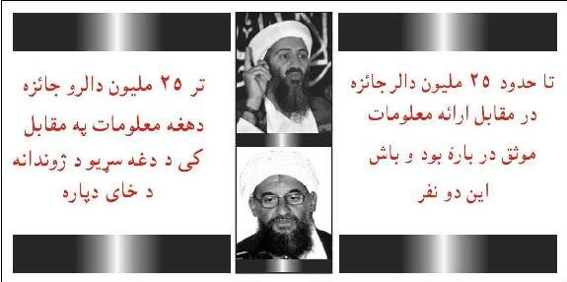
$25 million reward
Left – Front
AYMAN AL-ZAWAHIRI
USAMA BIN LADEN
Right - Back
"ANY INFORMATION LEADING
TO TO THE WHEREABOUTS
OF THESE MEN CONTACT
COALITION AUTHORITIES"

Slide 17
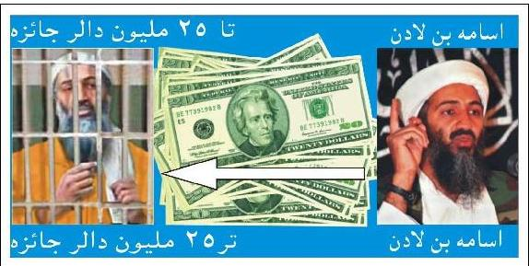
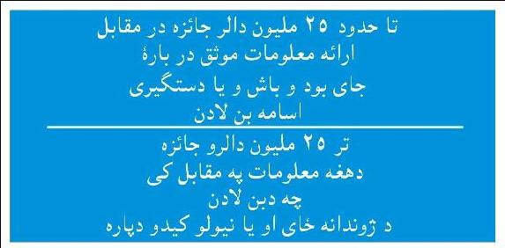
$25 million Reward 2
Left - Front
Right – Back
"$25,000,000 REWARD FOR
INFORMATION LEADING,
TO THE WHEREABOUTS OR
CAPTURE OF OSAMA BIN
LADEN.
CONTACT COALITION
AUTHORITIES"

Slide 18
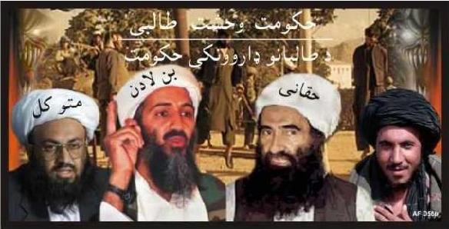
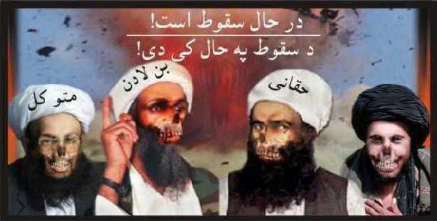
Demonising the Taliban
Left – Front
(from left to right) Muttawakil Bin Laden Haqqani
"THE TALIBAN'S REIGN OF FEAR..."
Right – Back
"...IS ABOUT TO END"

Slide 19
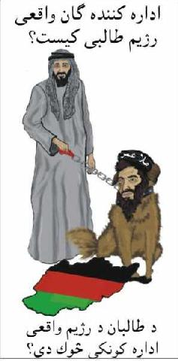
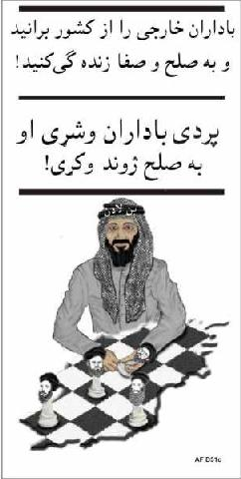
Focusing on foreign terrorists
Left – Front
WHO REALLY
RUNS THE
TALIBAN ?
Right – Back
EXPEL THE
FOREIGN
RULERS AND
LIVE IN PEACE

Slide 20
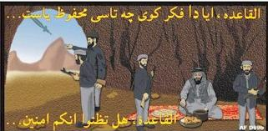
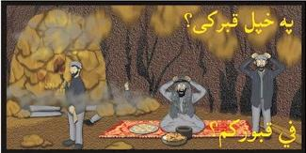
Taliban in Tora Bora
Front – Left
AL Qaeda do you
think that you
are safe...
Right – Back
...In your tomb?

Slide 21
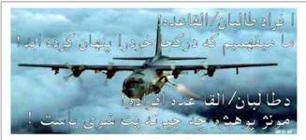
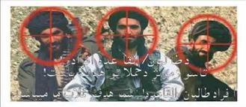
Targeting the Taliban
Left – Front
"Taliban and
Al Qaida fighters,
we know where
you are hiding."
Right – Back
"Taliban and Al
Qaida fighters,
you are our
targets."

Slide 22
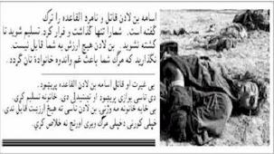
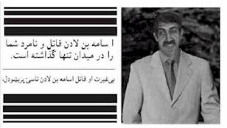
Demonising bi Laden 2
Left – Front
"Osama bin Laden the murderer and the coward has abandoned Al Qaida. He has abandoned you and run away. Give yourself up and do not
die needlessly, you mean nothing to him. Save your families the grief and pain of your death."
Right – Back
"Osama bin Laden the murderer
and coward has abandoned you”
[This is an unusual leaflet; the image of a
young bin Laden in western dress appears
designed to discredit him as a hypocrite.
NB. PSYOP should not lie - PMT.]

Slide 23
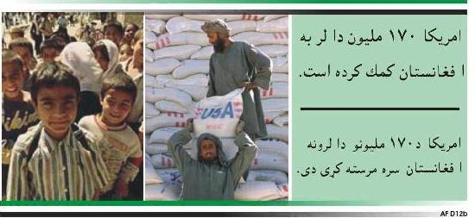
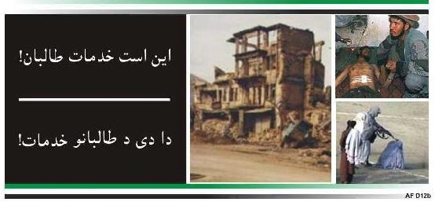
Rebuilding Afghanistan
Left – Front
“AMERICA HAS
PROVIDED OVER
$170 MILLION
IN AID TO
AFGHANISTAN"
Right - Back
"THIS IS WHAT
THE TALIBAN
HAS DONE"

Slide 24
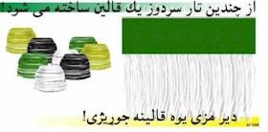
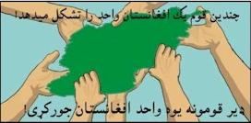
Rebuilding Afghanistan 3
Left - Front
"Many threads
make one rug"
Right – Back
"Together you can
make one
Afghanistan".

Slide 25
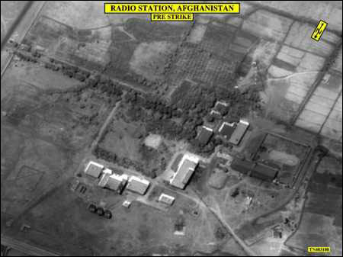
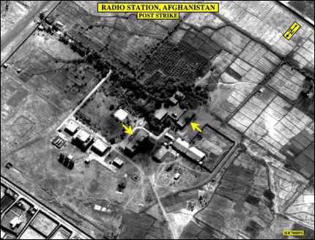
Information Warfare
Kabul, Voice of Shari’a radio Station before (left) and after air strike (below) 8 October 2001. Restored 26 Oct., destroyed hours later
Monitor latest developments
at
http://www.clandestineradio.com

Slide 26
Why don’t we see the WTC pictures anymore?
After initial saturation coverage, US networks debated wisdom of sustaining the images when victims were yet to be removed from the rubble, and the impact on relatives
Some official pressure in UK not to use them because of their ‘demoralisation’ effect on home front
From the point of view of a global propaganda struggle, this absence allows adversaries to exploit US motives, fuel dissent
Democracies always on the defensive as a result

Slide 27
Main world-wide themes of anti-USA propaganda
US ‘sponsorship’ of Israeli ‘terrorism’
US ‘hypocrisy’ of selective military interventions and selective targeting of terrorists (‘why not go after the Real IRA?’ ‘Why not wage war against Basque terrorists?’ BUT mainly Israeli terrorism)
‘Globalisation’ = ‘coca-colonialism’
Initial use of word ‘crusade’ indicates ‘reality’ of a Christian war against Islam (e.g. sanctions against Iraq, military bases in Saudi Arabia)

Slide 28
Why do they ‘hate’ the USA/West?
“September 11 was not mindless terrorism for terrorism’s sake. It was reaction and revenge, even retribution.” Pakistani newspaper, The Nation.
Betrayal, poverty, western support for corrupt royal families, fear of modernity
US support for Israel, bombing of Iraq, presence of US troops in Holy Land of Mecca

Slide 29
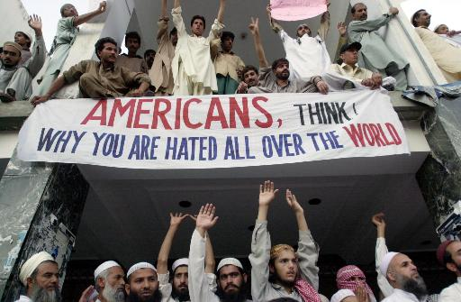

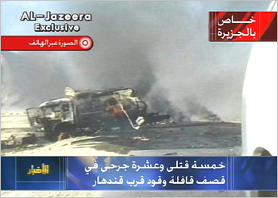

Slide 30
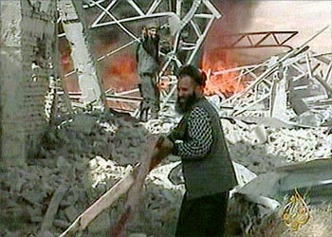
The ‘Arab CNN’ – Al Jazeera TV
Staff prefer to think of themselves as the ‘BBC World Service TV’ of the Middle East (many BBC trained)
Quatar based, it has upset just about every Middle Eastern leader by its ‘western’ style of allowing debate on any issue
Broadcast of bin Laden taped messages upsets west as well – accusation that they may contain ‘coded messages’ to terrorists ‘sleeping’ around the world.
The very fact that ‘Spin Laden’ has communications specialists indicates his value of ‘the oxygen of publicity’
Debate now extended to democratic countries – but if networks ‘self censor’ themselves, isn’t this more propaganda ammunition about western ‘hypocrisy’?

Slide 31
Is the US losing the propaganda war?
Public Opinion polls around the world still indicate strong support for US action, with opposition in a minority
As the military campaign continues, ‘collateral damage’ inevitable, fuelling opposition
Time differences mean overnight bombing and Taliban version dominates Pakistani media agenda
Politicians in the west keep insisting that this is NOT a war against Islam whereas everything they ‘do to Islam’ is interpreted as exactly this by militants

Slide 32
Caught on the back foot
Since the last presidential election, themes about the merits of democratic systems are on shaky ground.
International Public Information (i.e. ‘public diplomacy’) programmes, especially since PDD 68, clearly failing. Why?
Probably because they are targeted at elite foreign audiences, not at the street-level
Foreign elites, especially in non-democracies, not transferring US ‘justifications’ to their own people for fear (?) of being deposed at the street level.

Slide 33
Meeting the post Sept 11th propaganda challenge
The west has to confront the widespread view in some parts of the world that USA ‘got what it deserved’. Yes, but how?
Provide more convincing ‘evidence’ for bin Laden and Al Qaeda’s involvement (without jeopardising HUMINT sources). Keep the evidence coming and cumulative.
Emphasise nature of Taliban regime
Emphasise bin Laden’s recent ‘conversion’ to the Palestine cause and the source of his wealth (building US military bases in Saudi Arabia)

Slide 34
Meeting the propaganda challenge
In IPI programmes, utilise World Trade Centre footage at every opportunity Greater inter-agency co-ordination between strategic and tactical information programmes
Alistair Campbell’s ‘coalition information centres’ in Islamabad, London and Washington (1 November 2001)

Slide 35
Weapons of Mass Communication
Emphasise, with examples, that US is a ‘force for good’ in the world and that terrorism is the opposite
Address the apparent anomalies in US foreign policy, especially in the Middle East: image is shallow and unconvincing without substance
Stress US support for Muslim populations in Bosnia, Kuwait, Kosovo and East Timor
Clamp down on domestic anti-Muslim attacks in western countries; they only provide more ‘evidence’ in the Middle East of western ‘hatred’ of Arabs

Slide 36
Counter-propaganda
Terrorism plays on fear and generating anxiety – combat this with statistical ‘truths’, reassurances about likelihood of random attacks
Emphasise world-wide nature of coalition
Encourage local media (where necessary through the government departments which ‘control’ them) to cut through myths and disinformation
If ‘innocent women and children’ suffer in Afghanistan, emphasise number of women and children who died in World Trade Centre and Pentagon attacks

Slide 37
Will this work?
Probably not in the short term because we are seeing Arab street-level public opinion for the first time as expressed on stations like Al Jazeera
Clamping down on Arab media will set back democratisation
Besides, will removal of bin Laden end terrorism or merely create more?

Slide 38
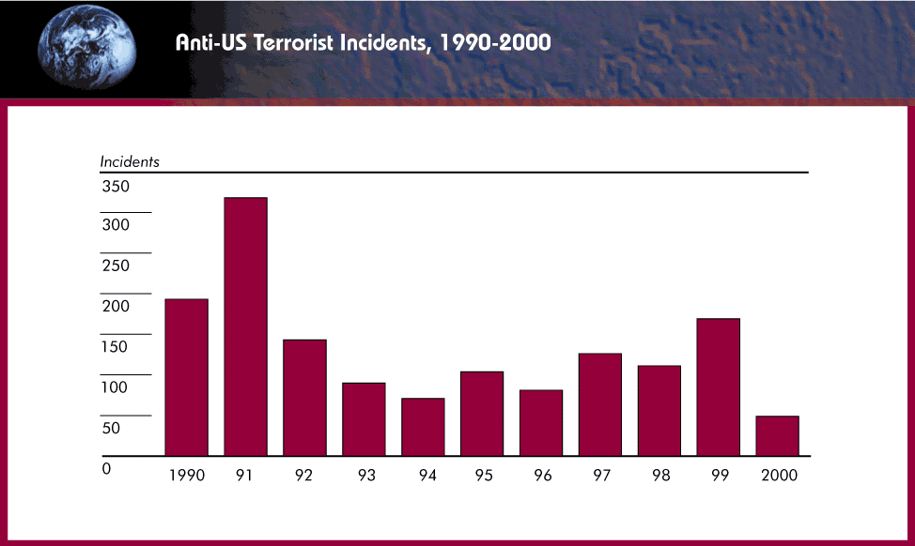
Terrorism in the 1990s
Note: increases in the years of the Gulf War and Kosovo conflict

Slide 39
Themes to watch out for
More and more western emphasis that ‘this is not a war against Islam’ nor ‘a clash of civilisations’
Western encouragement of a peaceful solution to the Palestine ‘problem’
More and more emphasis on the US as ‘a force for good in the world’ (humanitarian aid etc) – this is also a tough nut to crack (history, especially since 1983 with attacks on Lebanon, Libya, Iraq, Iran, the Sudan and now Afghanistan)
Iraqi involvement?

Slide 40
Propaganda themes which sow seeds of doubt in the Middle East
The US had planned to attack Afghanistan long before September 11
Long-term US covert plans to kill bin Laden
Taliban not ‘so bad’ as west claims
Missiles are cowardly; suicide hijackers are not
‘Evidence’ against bin Laden ‘unconvincing’
5 of the 19 hijackers still alive
No cell phone call from the hijacked planes mentioned ‘Arabs’
Followers of bin Laden in a ‘strip bar’?
Passport of one found at the WTC?
Mohamed Ata’s suitcase never made the plane?

Slide 41
Other nuts to crack
The belief that the US is ‘arrogant’, hypocritical and imperialist
The belief that this IS a clash of civilisations (e.g. attacks on mosques and Muslims in the west)
The belief that the US is using the ‘war against terrorism’ as a cover for other objectives (e.g. that Mossad was behind the September 11 attacks)

Slide 42
Trends to watch out for
Governmental pressure on media outlets not to carry ‘bin Laden’s propaganda’
A beefing up of official foreign information services (e.g. Voice of America, BBC World Service, ‘Radio Free Afghanistan’ plus covert stations)
Internet rumours and disinformation (e.g. that the footage of celebrating Palestinians was taken during the Gulf War)

Slide 43
THE IMPORTANCE OF INFORMATION TO THE MILITARY
Information In Warfare
Information Warfare
Intelligence
Surveillance
Reconnaissance
Weather
Geographic
Other
Influence Attitudes
Deny / Protect
Deceive
Exploit / Attack

Slide 44
INFORMATION WARFARE
Influence Attitudes
Deny / Protect
Deceive
Exploit / Attack
(‘Perception Management’)
Public Diplomacy
Private Diplomacy
PSYOP
Media Relations (PA/PI)
Education (‘soft’)
Counter Influence
OPSEC
Info Assurance
Counter Intelligence
CND
Spoofing
Deception
Imitation
Distortion
Electronic Warfare
CNA
Ballistic
EMP

Slide 45
Long-term vs. Short-term strategy
The military front may be a short conflict but the ‘battle for hearts and minds’ is critical
This requires a long-term strategy for ‘information’ and ‘education’
Propaganda needs to be hand-in-hand with policy and not precede it
If anything, policy needs addressing first, but with presentation in mind (not vice versa)
Only then can image reflect ‘reality’

Slide 46
Preliminary conclusions – more questions than answers
Can democracies wage long wars with public support in the ‘information age’?
What are the military objectives in Afghanistan? If it is still a ‘manhunt’, then remember Somalia
How long can the media sustain their interest, especially after the military phase gets overtaken by the other fronts?
Are the media part of the problem or part of the solution?

