Slide 1
Propaganda, Public Diplomacy & Psychological Operations
Lecture 2
WHAT IS PUBLIC DIPLOMACY?
Prof. Philip M. Taylor

Slide 2
Summary of points arising from last week
We are adopting a ‘propaganda is value-neutral’ standpoint in classes – you can take other lines in essays if you wish
That said, we recognise the word itself is probably poisoned forever and thus accept the use of alternatives/euphemisms
So we now start to think in terms of propaganda for a ‘good cause’/’bad cause’ and judge it by its motives and by its effectiveness to serve those ends, not merely as a communications process in itself
Do the ends ever justify the means?

Slide 3
Instruments of National Power (the DIME framework)
Diplomatic
Economic
Military
Informational
(‘Hard’ and ‘Soft’)
National Policy
Objectives

Slide 4

The Information Dimension:
The Global Information ‘space’ (or battlefield or battlespace)
Features: -
Propaganda vs counter propaganda
Hard Power vs Soft Power
Public Diplomacy and cultural diplomacy
International broadcasting
News management
Educational and cultural exchanges

Slide 5
Official ‘Informational’ Components
Features: -
Propaganda vs counter propaganda (by another name!)
Hard Power vs Soft Power
Public Diplomacy and cultural diplomacy
National & International broadcasting
News management at home and abroad
Educational and cultural exchanges

Slide 6
Our ‘window on the world’ and the ‘pictures inside our heads’
Mass Media
Personal Experience
Official Information
Rumors,
disinformation,
counter propaganda
The Informational/Perceptual Environment:
A Global struggle for ‘hearts and minds’?

Slide 7
Constructing our Strategic Communications ‘map’ – phase one
STRATEGIC COMMUNICATIONS
PUBLIC DIPLOMACY
PUBLIC
AFFAIRS
INFORMATION
OPERATIONS
CULTURAL
DIPLOMACY
INTERNATIONAL
BROADCASTING

Slide 8
Public & Cultural Diplomacy
PUBLIC DIPLOMACY
CULTURAL
RELATIONS/
DIPLOMACY
INTERNATIONAL
BROADCASTING
(Long-term;
Elites are main
Target audience)
PSYCHOLOGICAL
OPERATIONS
(Short-term)

Slide 9
PUBLIC DIPLOMACY
‘Soft Power’
CULTURAL
DIPLOMACY
INTERNATIONAL
BROADCASTING
Long-term;
Elites are main target audience
Short-term;
Mass Communication
(radio, TV, internet)
Reciprocal (two-way)
Mutual
Development of mutual
trust and understanding
Talking AND Listening
‘To know us is to love us’
One-way (point-to-multipoint)
Counter-propaganda with
‘news’ and ‘facts’
Needs to be fast (but not
‘real-time’) and CREDIBLE
‘Truth is the best propaganda’

Slide 10
PUBLIC DIPLOMACY
‘Soft Power’
CULTURAL
DIPLOMACY
INTERNATIONAL
BROADCASTING
Long-term;
Education
Short-term;
News & Views
British Council
Alliance Française
Dante Alighieri Society
Goethe Institute
Carnegie Foundation
Confucius Institute
BBC World Service
Radio France International
RAI International
Deutsche Welle
Voice of America
China Radio International

Slide 11
Public Diplomacy Definitions
PD ‘deals with the influence of public attitudes on the formation and execution of foreign policies. It encompasses dimensions of international relations beyond traditional diplomacy; the cultivation by governments of public opinion in other countries; the interaction of private groups and interests in one country with those of another; the reporting of foreign affairs and its impact on policy; communication between those whose job is communication, as between diplomats and foreign correspondents; and the processes of inter-cultural communications’.

Slide 12
PD – the role
‘Public Diplomacy – the open exchange of ideas and information – is an inherent characteristic of democratic societies. Its global mission is central to … foreign policy. And it remains indispensable to … [national] interests, ideals and leadership role in the world’.
(US Advisory Commission on Public Diplomacy, 1991 Report).

Slide 13
Diplomatic & Informational
‘Traditional’ Diplomacy
Government elite to foreign government elite
Professional civil services
Secrecy justified in terms of not alerting rival/adversary diplomatic alliances
Less accountable to public criticism
‘secret diplomacy leads to war’
Public Diplomacy
Government to foreign publics (elite vs. mass)
Professional media practitioners
Publicity justified in terms of democratic accountability/open government
Open to public scrutiny, thus bound by telling ‘the truth’
Public diplomacy ‘leads to greater mutual understanding and peace’

Slide 14
Hard Power
HARD = actual use of military force, economic sanctions, coercive diplomacy etc
‘Hard power is the ability to get others to do what they otherwise would not do through threats or rewards. Whether by economic carrots or military sticks, the ability to coax or coerce has long been the central element of power.’ (Keohane & Nye)

Slide 15
Soft Power
‘Soft power …is the ability to get desired outcomes because others want what you want. It is the ability to achieve goals through attraction rather than coercion. It works by convincing others to follow or getting them to agree to norms and institutions that produce the desired behavior.
Soft power can rest on the appeal of one's ideas or culture … and …depends largely on the persuasiveness of the free information that an actor seeks to transmit. If a state can [do this] it may not need to expend as many costly traditional economic or military resources.’ (Keohane & Nye)

Slide 16
Propaganda for Peace?
Is this ‘propaganda’ or ‘persuasion’?
It depends which side you are one!
Propaganda usually benefits the source
PD/CD rests on mutual understanding and mutual interests in order to benefit…..who?

Slide 17
A key element of soft power = public (and cultural) diplomacy
Long term = cultural and educational exchanges,
establishment and maintenance of credibility and
mutual trust
Short term = credible information dissemination
through all available media (espec. Broadcasting)
News based (Public Affairs/Public
Information/Media Operations) for domestic
audiences)
Public Diplomacy is (usually) for overseas audiences
But where is the line between national and
international anymore?

Slide 18
Public & Cultural Diplomacy
PUBLIC DIPLOMACY
CULTURAL
RELATIONS
INTERNATIONAL
BROADCASTING
(Long-term;
Elites are main
Target audience)
PSYCHOLOGICAL
OPERATIONS
(Short-term)

Slide 19
…And what about another line?
Is this ‘propaganda’ or ‘persuasion’?
It depends which side you are on!
Propaganda usually benefits the source
PD/CD rests on mutual understanding and mutual interests in order to benefit…..who?
News or Views?

Slide 20
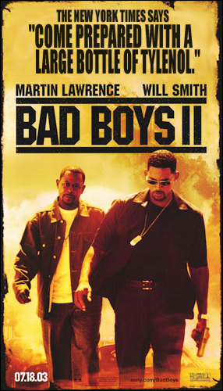

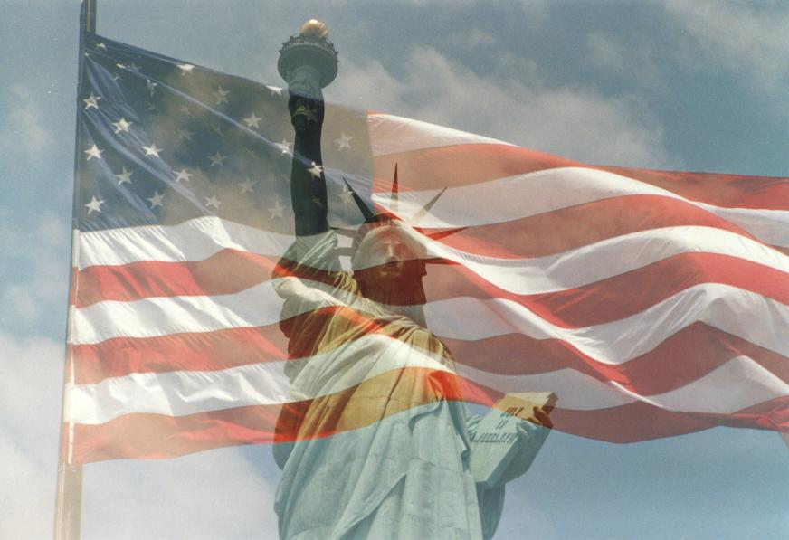


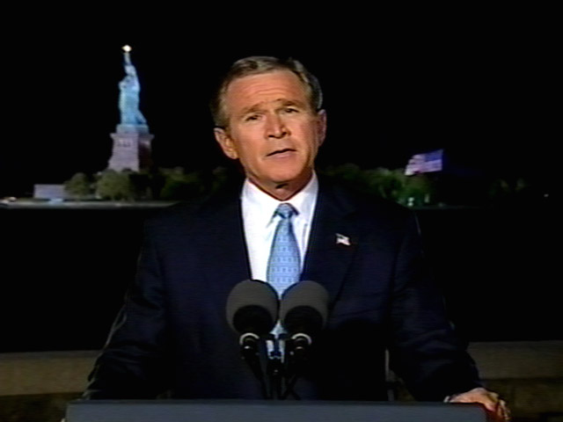
National Media Image vs National Official Image

Slide 21
PD/CD Landmarks
‘Open covenants, openly arrived at’
French invented CD – language teaching schools (Alliance Francaise)
British Council founded 1934 to provide an alternative view of the world other than totalitarianism
BBC began foreign language broadcasts in 1938
Voice of America began 1942
USIA founded 1953, closed 1999

Slide 22
The Cold War (of Words)
Competition between two ‘ways of life’
Long-term Soviet commitment to international broadcasting since 1920s
US sets up Radio Free Europe, Radio Liberty etc in 1950s
Radio Swan for Cuba
The Reagan Reinvigoration in 1980s
Radio Marti, Radio this, Radio that….
PD or Psychological Warfare?

Slide 23
The Cold War ‘won’ – then losing the peace
Gorbachev and Glassnost
Chernobyl, 1986
‘The Voices’ and their impact on Eastern Europe
The end of Soviet jamming
The arrival of new technologies (faxes, satellite TV, then the internet)
PD in decline in 1990s: US power left to speak for itself while others filled the info-space with anti-Americanism

Slide 24
PDD 68 (1999): International Public Information
Goal: Achieve national objectives without resorting to force, or act as a force multiplier in the event force is required
Objective: ‘to enhance US security, bolster America’s economic prosperity and to promote democracy abroad’
USIA incorporated into State Department 1999

Slide 25
US Public Diplomacy
Under the State Department's reorganization on October 1, 1999, Evelyn Lieberman became the first Under Secretary for Public Diplomacy and Public Affairs.
As she remarked in her confirmation hearing: "[P]ublic diplomacy, practiced in harmony with traditional diplomacy, will enable us to advance our interest, to protect our security, and to continue to provide the moral basis for our leadership in the world." http://www.usinfo.state.gov

Slide 26
US Organisation
Bureau of Public Affairs (domestic) ‘to help Americans understand the importance of foreign affairs’
Bureau of Educational & Cultural Affairs (overseas) ‘fosters mutual understanding between the people of the United States and other countries’ – Fulbright & Rhodes scholarships
Elite audiences, not masses (e.g. the Arab ‘street’) the main target audience

Slide 27
The Voice of America ‘family’
VOA and Worldnet TV
Radio Free Asia
Radio & TV Marti
RFE/RL
Radio Free Iraq
1750 hours of programming per week in total, reaching 100 million people in 60 languages at a cost of $1.1 billion in 1999 – BUT only 7 hours per day in Arabic

Slide 28
US INTERNATIONAL BROADCASTING ‘FAMILY’
VOICE OF AMERICA
Broadcasting Board of Governors
RADIO FREE EUROPE
RADIO FREE ASIA (1996)
Targets China, North Korea,
Burma, Vietnam etc
RADIO & TV MARTI
Cuba
RADIO SAWA & AL HURRA TV
‘Together’ & ‘The Free One’
Middle East
RADIO FARDA (2002)
‘Tomorrow’
Iran

Slide 29
9/11 and the failure of US PD
Charlotte Beers and the ‘branding’ of America
‘Why do they hate us so much’?
9/11 hijackers were from elite not mass
Erosion of world-wide sympathy for US immediately after 9/11 (‘we are all Americans now’)
Failure (?) of PA as well – in 2003, 70% of Americans believed Saddam was behind 9/11! Or is this what the Bush administration needed to help promote Iraqi Freedom?

Slide 30
US Diagnostics
‘The gap between who we are and how we wish to be seen, and how we are in fact seen, is frighteningly wide’. (Beers, 2003)
‘As widely known, the portrait of the United States that most people absorb through mass culture and communications is skewed, negative, and unrepresentative.’
(Christopher Ross, 2002)

Slide 31
‘A force for good in the world’? a world unconvinced
Percentage drops in favourable views of US since start of year 2003 (Pew Centre, 18 March)
- France: from 63% to 31%
- Italy: from 70% to 34%
- Russia: from 61% to 28%
- Turkey: from 30% to 12%
- UK: from 75% to 48%
EVEN WORSE IN ARAB & MUSLIM WORLD

Slide 32
Reinvigorating PA/PD since 2001
Office of Global Communications (now closed)
Office of Strategic Influence (aborted)
Freedom Promotion Act, 2002
Broadcasting Board of Governors
Radio Sawa (‘Together’) replaces VOA Arabic Service in 2002 – ‘Hi’ magazine 2003 - now closed)
Radio Farda (Iran)
Al Hurra (‘Free One’) TV/Karen Hughes/Charlotte Beers/James Glassman/McHale

Slide 33
Is PD the same as propaganda?
Propaganda benefits primarily the source
PD is mutually beneficial – but who benefits most?
Propaganda is usually one-way, PD is two-way
Key differences of PD = mutuality and reciprocity
‘To know us is to love us’?

Slide 34
Key Documents 1
“Report of the Defense Science Board Task Force on Managed Information Dissemination” (2001), by the Office of the Under Secretary of Defense for Acquisition, Technology and Logistics;
“Building America’s Public Diplomacy Through a Reformed Structure and Additional Resources” (2002), a report of the U.S. Advisory Commission on Public Diplomacy;
“Finding America’s Voice: A Strategy for Reinvigorating U.S. Public Diplomacy” (2003), the report of an independent task force sponsored by the Council on Foreign Relations;

Slide 35
Key Documents 2
“U.S. Public Diplomacy” (2003), by the U.S. General Accounting Office;
“Strengthening U.S.-Muslim Communications” (2003), from the Center for the Study of the Presidency;
“How to Reinvigorate U.S. Public Diplomacy” (2003), by Stephen Johnson and Helle Dale, published by the Heritage Foundation;
“The Youth Factor: The New Demographics of the Middle East and the implications for US Foreign Policy” by The Brookings Institute, 2003;
“Changing Minds, Winning Peace: a new strategic direction for US PD in the Arab and Muslim World” by the Advisory Group on PD, October 2003.

Slide 36
From ‘Changing Minds, Winning Peace’
‘Our adversaries’ success in the struggle of ideas is all the more stunning because American values are so widely shared. As one of our Iranian interlocutors put it, “Who has anything against life, liberty and the pursuit of happiness?” We were also told that if America does not define itself, the extremists will do it for us.’

Slide 37
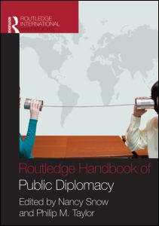
Out now

Slide 38
Conclusions
PD has never been debated as much as it is now
Would it be fair to describe it as ‘soft propaganda’ or ‘propaganda of soft power’?
‘Truth is the best propaganda’ – but whose truth?
‘Credible truths’ compete in the global info-space
PD can only work if the policy is saleable.

