Slide 1
From Information Warfare (IW) to Information Operations (IO) to the Global ‘War’ on Terrorism
Lecture 4
Prof. Phil Taylor,
ICS, University of Leeds

Slide 2
Official Information
NATIONAL POLICY OBJECTIVES
Economic
Political
Diplomatic
Military
‘national
advertisement’;
commercial
propaganda
Public and
Cultural
Diplomacy
PSYOP;
Civil-Military
Affairs
‘spin’; media
affairs; PA/PI
INFORMATION OPERATIONS

Slide 3
Official information – ‘hard’ and ‘soft’ power
Public Affairs (PI) & Public Diplomacy (PD)
International Broadcasting (radio, TV, internet)
Psychological Operations (black and white)
Cultural Diplomacy & ‘soft power’
THE LESSON OF ‘VICTORY’ IN THE COLD WAR
+ INORMATION EXPLOSION
= Power can no longer speak for itself in the global
perceptual environment; it needs to be explained…..

Slide 4




The 21st CENTURY ENVIRONMENT?
Changing ALLIANCES:
IMPACT OF THE EURO
ECO-ASIA
POPULATION GROWTH +
RESOURCE SCARCITY =
Wars over Food, Water, Fish
TERRORISM
Virtual States
Global Warming +/
Ecological disaster +
Creeping Deserts =
Sub-National Groups:
Russian Mafia, FARC,
Al Q’aida
INFORMATION
WARFARE
UNCERTAIN
FUTURE
WEAPONS OF
MASS DESTRUCTION
UNCERTAIN
FUTURE
ETHNO-
Religious
PAN-NATRIONALISM
CLASH OF CIVILIZATIONS?
IMPACT OF
TECHNOLOGY
More GNP =
More Defense Spending
DISEASE
(AIDS PANDEMIC
MALARIA, EBOLA))
ASYMMETRIC
WARFARE
GLOBAL ECONOMIC
INTERDEPENDENCE

Slide 5
New Ways of Thinking
Revolution in Military Affairs
Revolution in Diplomatic Affairs
New threats, new challenges, new types of deployments and roles
New communications technologies
New skills, new paradigms
C2W to C5I

Slide 6
Full Spectrum Dominance – C4I or C5I?
Command
Control
Communications
Computers
Intelligence and…..
….CNN(.com)?

Slide 7
Environment Shaping
Political Power
Economic Power
Public Affairs
Public Diplomacy
Shaping the
Information Space
Overt Peacetime PSYOP
Deception
Covert Action
Deterrent Capabilities
Information Operations
Shaping the
Conflict Space
Public Diplomacy
Public Affairs
Network Security
Operational Security
International Power
Force Disposition
Psychological Operations
Covert Action & Deception
Information
Warfare
Force Disposition
Fire Power
Electronic Warfare
Shaping the
Battle-Space
Deception
Operational Security
Psychological Operations

Slide 8
Evolution of Terminology
Propaganda & Political Warfare
Psychological Warfare
Psychological Operations
Information Warfare
Information Operations
Influence Attitudes / Strategic Influence / Perception Management/Strategic Comms.

Slide 9
What is IO & IW ? –
the formal definitions
Joint Pub 3-13, Information Operations Doctrine
  - Information Warfare:
  “ Information operations conducted during time of crisis or conflict to achieve or promote specific objectives over a specific adversary or adversaries.”
  - Information Operations:
  “Actions taken to affect adversary information and information systems while defending one’s own information and information system’s.”
  = So vague it can mean anything!

Slide 10
Information Age Conflict
INFORMATION
IN WARFARE
Intelligence
Surveillance
Reconnaissance
Weather
Geographic
Other
INFORMATION
WARFARE
Influence Attitudes
Deny/Protect
Deceive
Exploit/Attack

Slide 11
INFORMATION WARFARE
Influence Attitudes
Deny / Protect
Deceive
Exploit / Attack
(‘Strategic Communications’)
Public Diplomacy
Private Diplomacy
PSYOP
Media Relations (PA/PI)
Education (‘soft’)
Counter Influence/ propaganda
OPSEC
Info Assurance
Computer Network
Defence (CND)
Counter
Intelligence
Spoofing
Imitation
Distortion
Electronicwarfare
Computernetwork attack (CNA)
Ballistic
EMP
Deception

Slide 12
Human Factors – it’s about people, not just networks!
INFORMATION OPERATIONS
CAPABILITIES
RELATED ACTIVITIES
CNO
Deception
OPSEC
EW
PSYOP
Public Affairs
Civil Affairs
Media Relations
Public Diplomacy
Physical Destruction (Kinetic) & Leadership
Decision-Making (‘Shock & Awe’)

Slide 13
Emerging IO ‘doctrine’
Information Operations
PA/PI?
Influence Operations
Cyber Operations
PSYOP Deception
CNA CND

Slide 14
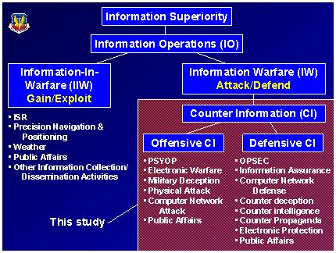
Example – USAF IO

Slide 15
Not just a military doctrine
Global info-sphere is influenced by events and information from the battlefield (‘space’)
Compression of tactical, operational and strategic information
Civilian info-players and new technologies make battlespace highly porous
Embedded journalists as ‘combat cameramen’ in real-time

Slide 16
Our Strategic Communications Map completed?
STRATEGIC COMMUNICATIONS
PUBLIC DIPLOMACY
INFORMATION
OPERATIONS
PUBLIC
AFFAIRS
CULTURAL
DIPLOMACY
INTERNATIONAL
BROADCASTING
HUMAN
FACTORS
DOMESTIC
FOREIGN
CNO
OSI
OSP
PSYOPS
CIMIC
MEDIA
INFO ASSURANCE
OPSEC
DECEPTION

Slide 17








The IO-Media interface
“Almost by definition . . . a war waged on live television is a
war in which political and public relations considerations
become inextricably bound up with military tactics and
strategy. . . .
… how victory is won
is almost as important
as victory itself.”
(Washington Post,
March 24, 2003)

Slide 18
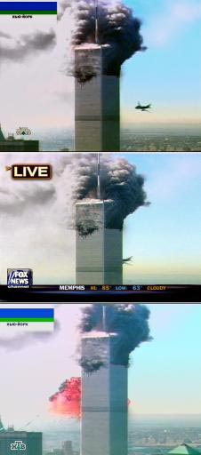
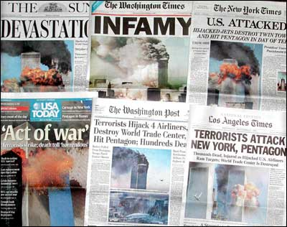
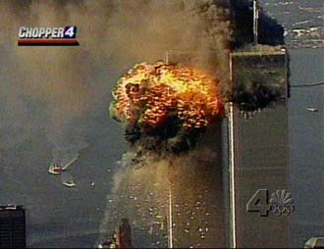
‘Propaganda of the Deed’
New York targeted because its media rich environment ensured maximum, spectacular, global media coverage

Slide 19
It’s a way of doing – and being seen to be doing it
War and the Information Age
Information in the communications revolution (saturation confusion rather than clarity?)
What role for censorship/OPSEC?
Casualties? (on both sides)
BDA/Collateral Damage
Broadcasting Damage Assessment!

Slide 20

PSYOP - US Definition
“Operations planned to convey selected information and indicators to foreign audiences to influence their emotions, motives, objective reasoning, and ultimately the behavior of foreign governments, organizations, groups and individuals.”
- Joint Pub 3-53

Slide 21
The new ‘P’ word – Perception Management
‘Actions to convey and/or deny selected information and indicators to foreign audiences to influence their emotions, motives and objective reasoning; and to intelligence systems and leaders at all levels to influence official estimates, ultimately resulting in foreign behaviors and official actions favorable to the originator’s objectives.
In various ways perception management combines truth projection, operations security, cover and deception and psychological operations.’
-- Joint Pub 1-02

Slide 22
Main world-wide themes of anti-USA propaganda
US ‘sponsorship’ of Israeli ‘terrorism’
US ‘hypocrisy’ of selective military interventions and selective targeting of terrorists (‘why not go after the Real IRA?’ ‘Why not wage war against Basque terrorists?’ BUT mainly Israeli ‘state terrorism’)
‘Globalisation’ = ‘coca-colonialism’
Initial use of word ‘crusade’ indicates ‘reality’ of a Christian war against Islam (e.g. sanctions against Iraq, military bases in Saudi Arabia)

Slide 23
The legacy of 1991’s black campaign on the 2003 Iraqi war
In 1991, covert propaganda strayed from official line about liberation of Kuwait
No coalition help for Kurdish and Shi’ite uprisings
Overt 2003 policy was about regime change in Iraq - but the white PSYOPS suffered from the legacy of black PSYOPS in 1991
‘This time we won’t let you down’ (UK)
Why should Iraqis trust ‘coalition of the willing’ now when no Arab military contributions?
Anglo-USA invasion/conquest rather than liberation
In opinion of global media, especially in Arab world

Slide 24
Pre-war INFO-STRUGGLES
Connection between 9/11 and Saddam Hussein?
Legitimacy of action under international law & need for a ‘2nd’ UN resolution
WMD and the need for ‘more time’
Oil
Moral case against an ‘evil regime’ (Iraq or the USA??!!)

Slide 25
IO and PSYOPS in ‘Iraqi Freedom’
Integration of Perception Management themes from top to bottom
‘I urge the Iraqi people being threatened in the cities to try to remember the faces and the names of the death squad enforcers. Their time will come, and we will need your help and your testimony.’ (Donald Rumsfeld, Pentagon news briefing, 28 March)
Had a press conference become a psychological operation?

Slide 26
Points of Military-Media friction in OIF
The shelling of the Palestine Hotel in Baghdad, 8 April 2003
The blandness of the Qatar briefings
The reporting of POWs/collateral damage/civilian casualties (although not in US so much at the time)
Media performance perhaps says more about the US media than the US military

Slide 27
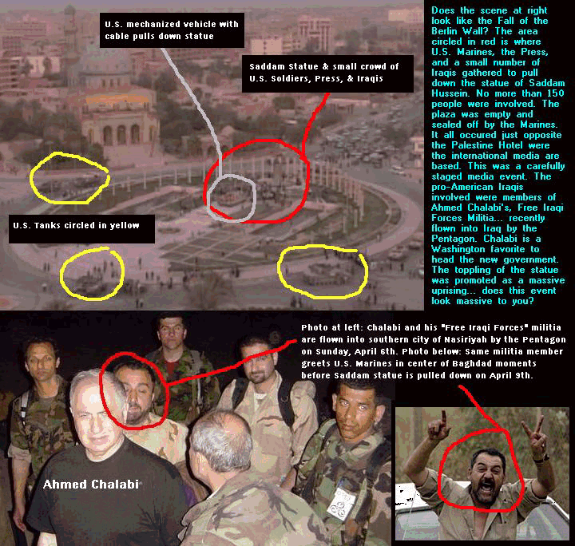
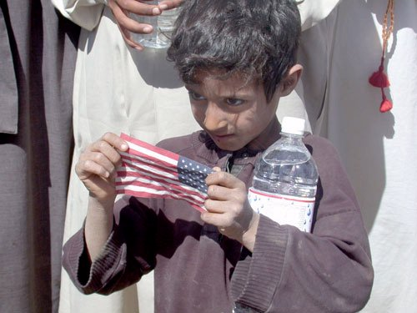
Media performance in OIF
Umm Qsar reported fallen 8 times in first week
Baghdad and elsewhere
casualties (14 killed)
Private Jessica
Toppling of Saddam statue

Slide 28
Saving Private Jessica
In the 14 days after her rescue, Pvt. Lynch drew 919 references in major US papers, according to a Nexis search.
In that same period, General Tommy Franks, who ran the war, got 639 references, Vice President Dick Cheney 549, Deputy Defense Secretary Paul Wolfowitz 389.
OK, it was the first successful rescue of a U.S. POW behind enemy lines since World War II ... BUT
‘How awkward to have to tell them she was a truck crash victim saved by the enemy and not actually rescued by the same commando unit that did not actually find those elusive weapons of mass destruction. But that's what happens when you write first and ask questions later.’ (Christopher Hanson in CJR, 2003)

Slide 29
The (Global) Media War
Embedded journalists and the snowstorm of information ©
Arab satellite channels as new players/alternative viewpoints (c.f. 1991 as the ‘first CNN war’)
Global media made alternative viewpoints (e.g. Al Jazeera) more prominent than 1991
National media support/opposition reflected national governmental positions
What about US/UK public’s morale as casualties mount?

Slide 30
It’s about Credibility not PI, nor PSYOP nor marketing….
Image and reality must go hand in hand
Can’t sell the product (the ‘Bush Doctrine’) if people find it incredulous
So it must be about something else, right? (oil, Pax Americana, etc)
Well, if it isn’t, how to persuade that the product is right?
Free debate in media will assist this; lack of one will harm it - or will it? (Hutton enquiry in UK).

Slide 31
CREDIBILITY, CREDIBILITY, CREDIBILITY
It’s ALL about credibility – not ‘the truth’ but ‘our truth’ or ‘credible truths’
– and is it like Virginity?
Can we get it back after the blunders of ‘crusade’, ‘Infinite Justice’, Al Jazeera, Saddam statues etc. etc.???
Perhaps – but it will take time, consistency, less self delusion, transparency and …. policy rectifications
And Money!!!!

Slide 32
Conclusions
Pro-war coverage in US made US media ‘cheerleaders’ in the eyes of a watching, more sceptical global media
Issues about war’s justness debated more in nations not affected by 9/11
Non-US media simply didn’t get the link between the ‘war’ on terror and the ‘axis of evil’ (nor that of Saddam and Al Qaeda) – until Iraqi Freedom provided one!
US media became part of IO campaign, global media did not – and damaged US cause outside US
Making unilateralism even more likely next time?

