Slide 1
Nodejs持续集成自动化
(node CI on jenkins)
2015.5.14

Slide 2
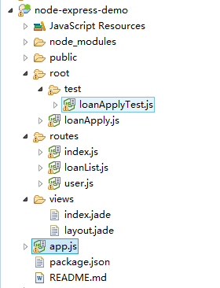
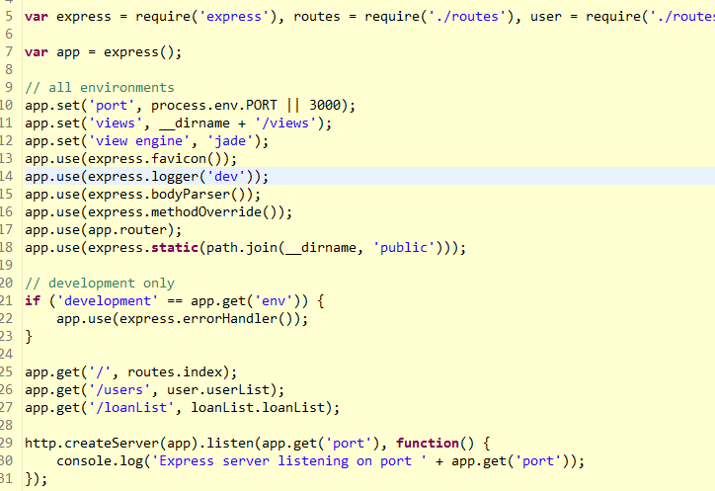
New NodeExpressProject
install the node-eclipse plugin
new node express project:

Slide 3
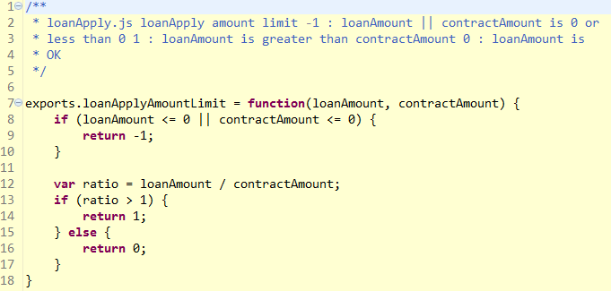
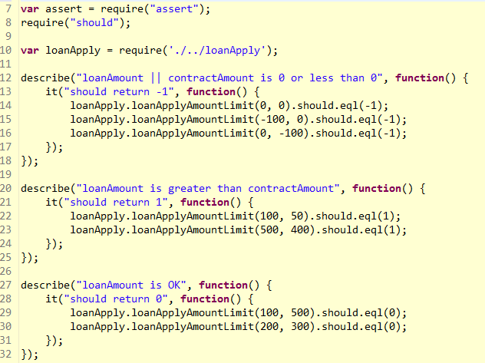
js unit test

Slide 4
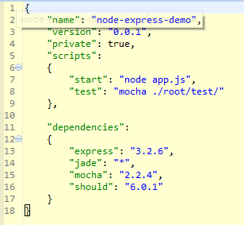
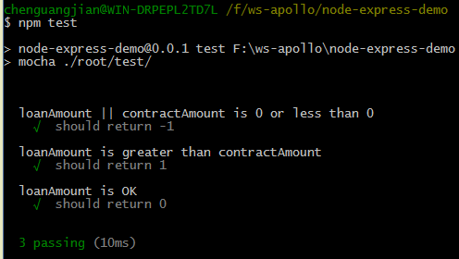
Configure the package.json
https://github.com/universsky/node-express-demo

Slide 5
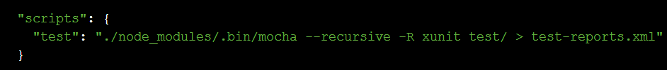
HOW TO ?
Using Jenkins to run our Mocha tests in Node
Does Mocha speak Jenkins?
Use npm to execute tests, so in package.json is something similar to this:
This will execute Mocha (the executable will always be in node_modules if it’s a dependency of your project) recursively on the “test/” directory, using the XUnit reporter, and store the output in a file named “test-reports.xml”.

Slide 6
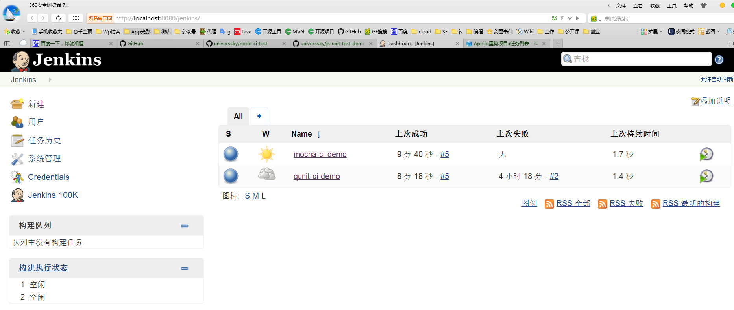
讲解花絮
https://github.com/universsky/node-ci-test
https://github.com/universsky/js-unit-test-demo

Slide 7
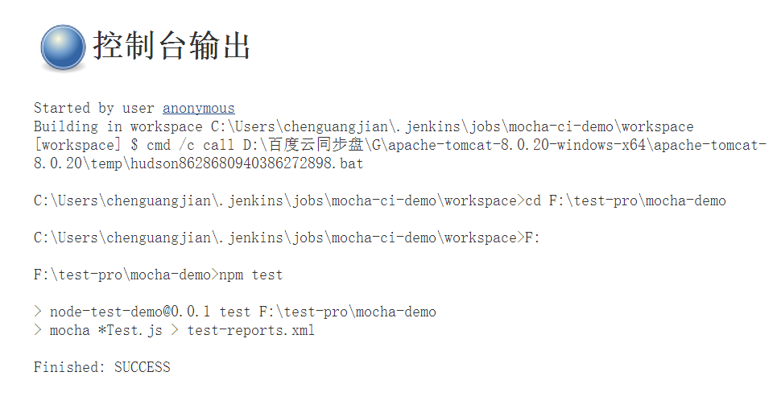
结果

Slide 8
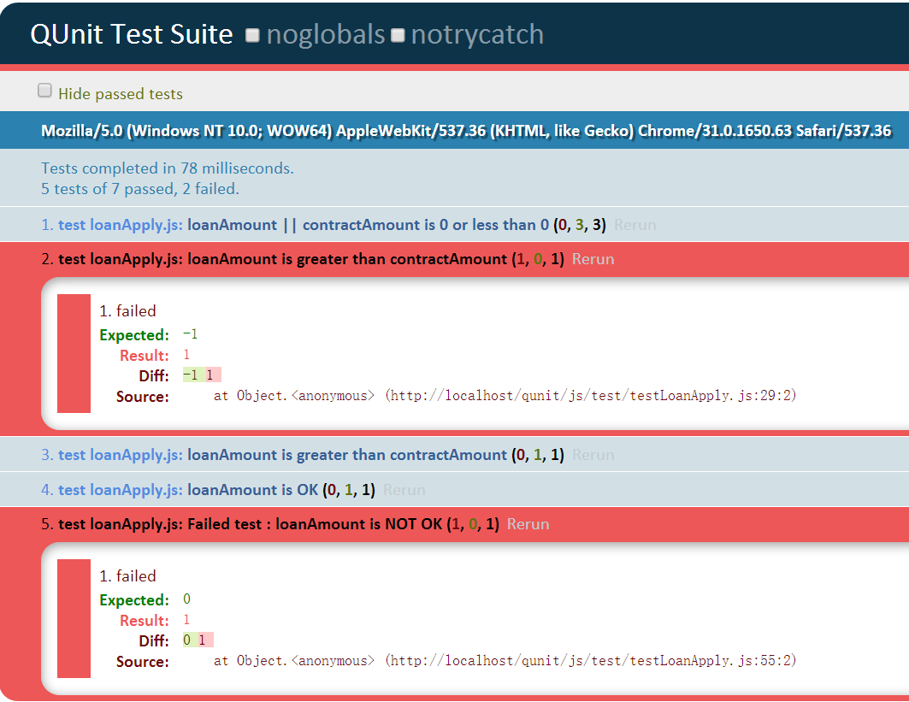

Slide 9
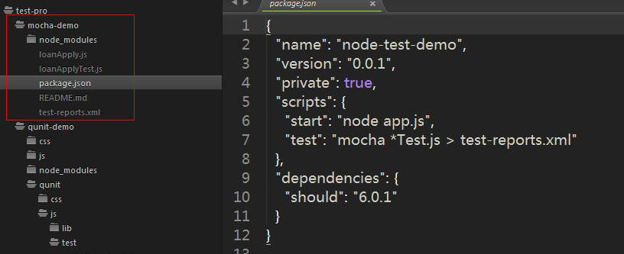
1. Using Mocha: package.json
sudo npm install -g mocha
sudo npm install should
https://github.com/universsky/mocha
Mocha is a simple, flexible, fun JavaScript test framework for node.js and the browser.

Slide 10
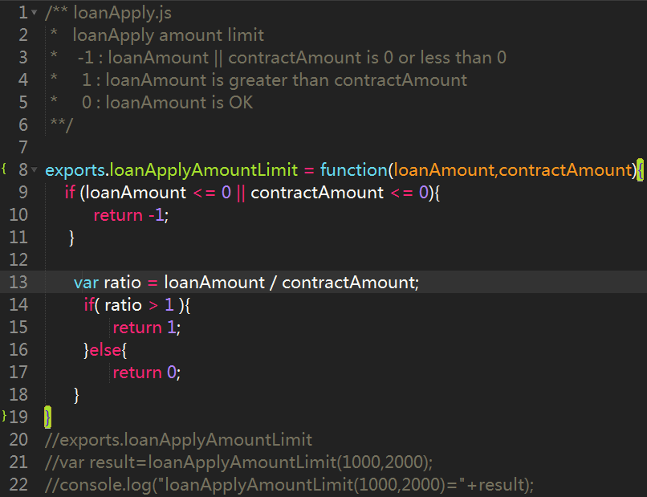
loanApply.js

Slide 11
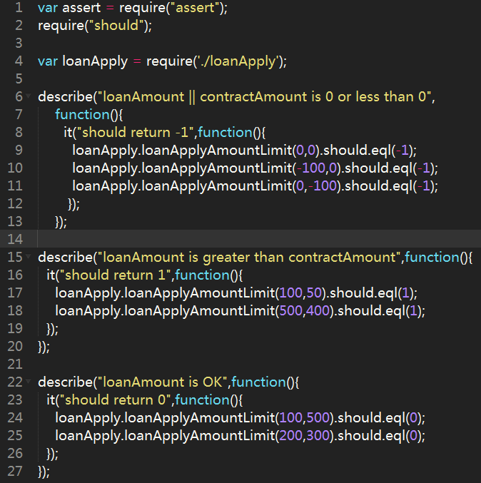
loanApplyTest.js
https://github.com/universsky/should.js
should is an expressive, readable, test framework agnostic, assertion library. Main goals of this library to be expressive and to be helpful. It keeps your test code clean, and your error messages helpful.
It extends the Object.prototype with a single non-enumerable getter that allows you to express how that object should behave, also it returns itself when required with require.

Slide 12
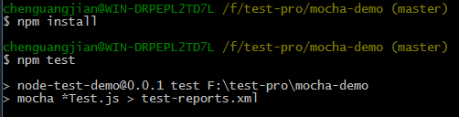
shell cmd

Slide 13
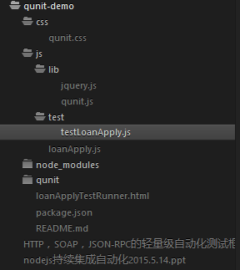
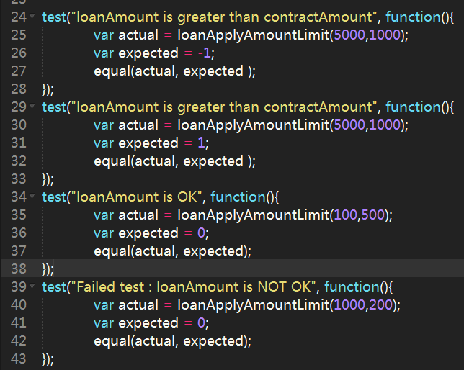
2. Using qunit
QUnit is a powerful, easy-to-use, JavaScript unit testing framework. It's used by the jQuery project to test its code and plugins but is capable of testing any generic JavaScript code (and even capable of testing JavaScript code on the server-side).
QUnit is especially useful for regression testing

Slide 14
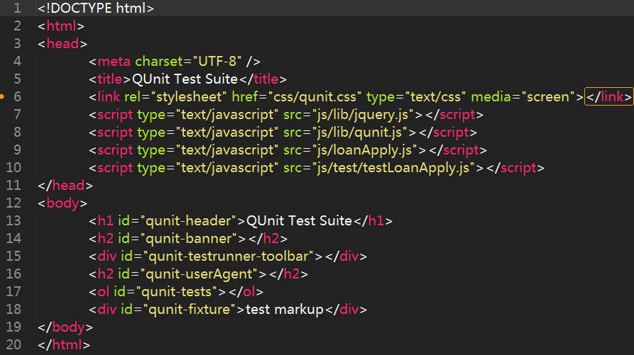
TestRunner.html

