Slide 1
Course Registration Application
Universe Shrestha, 2022203510
Vadim Choi, 2022203502
Hoon-Hui Lee, 2022203033
Donghyeok Tak, 2022203055
Team 1 App. Soft. Labs.
2024.05.17

Slide 2
Overview
01
02
03
Project Intro
Current Progress
Future Plans

Slide 3
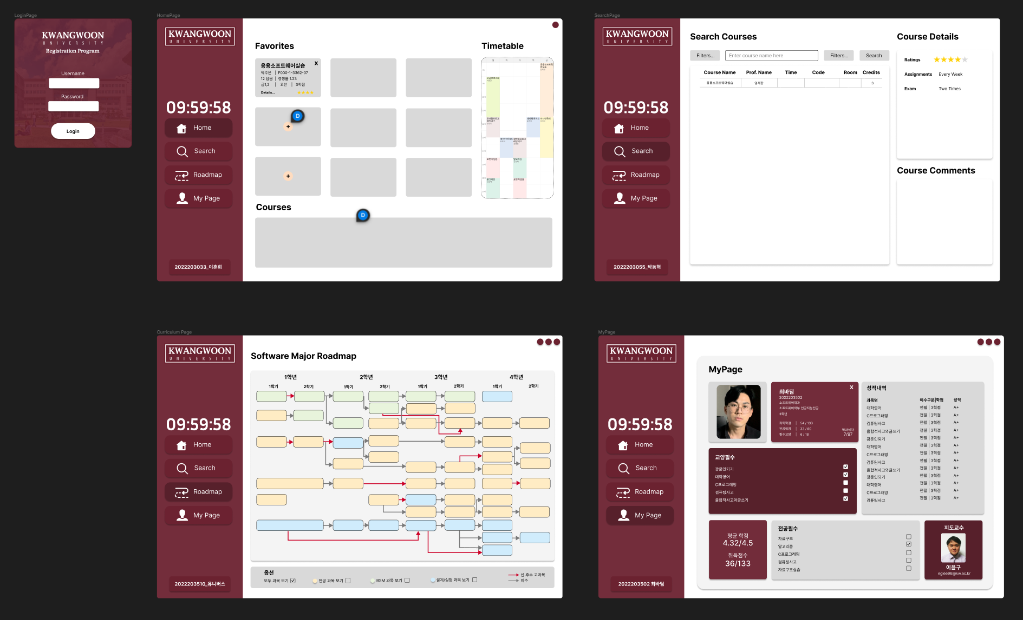
01
Project Intro

Slide 4

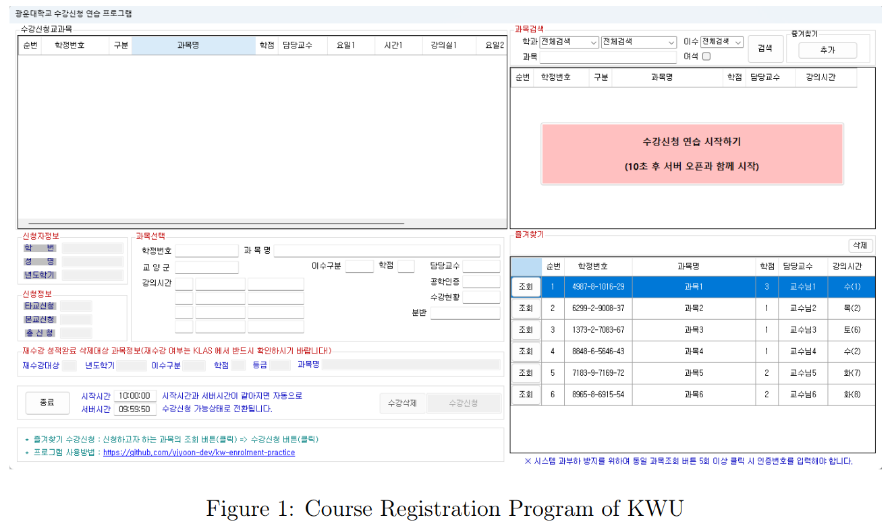
Current Course Registration Application of KWU

Slide 5
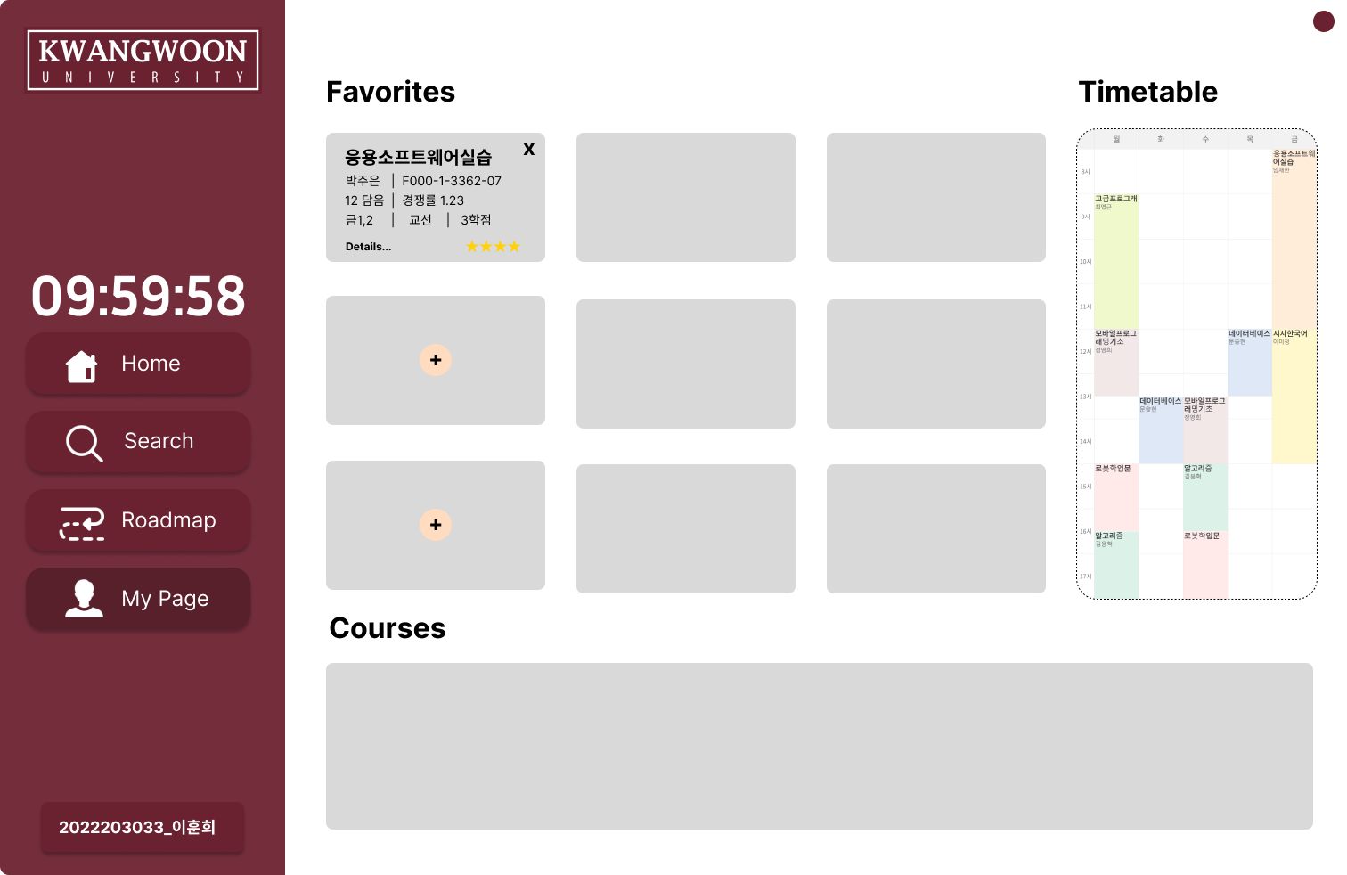
Home Page

Slide 6
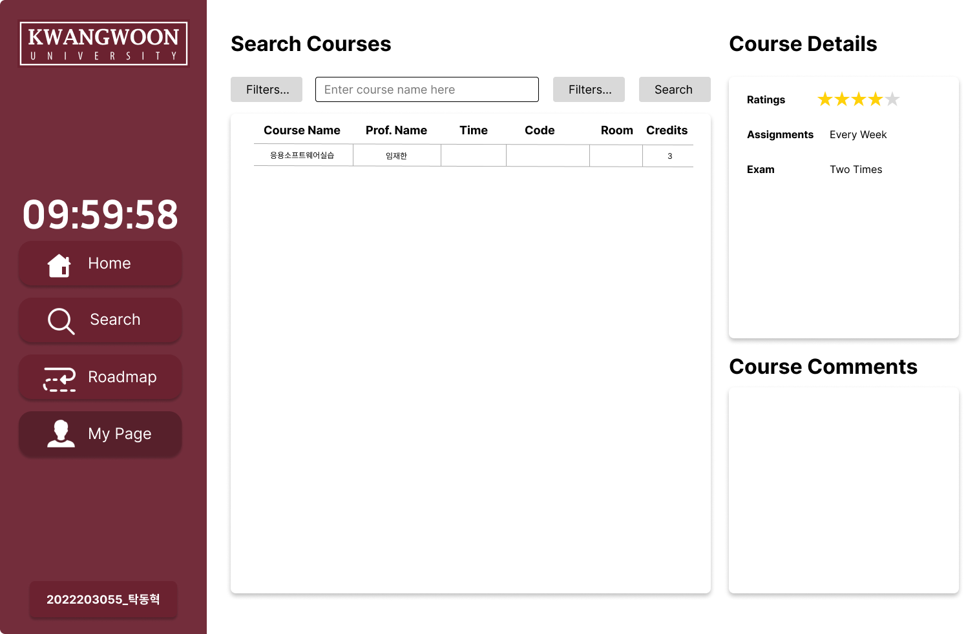
Search Page

Slide 7
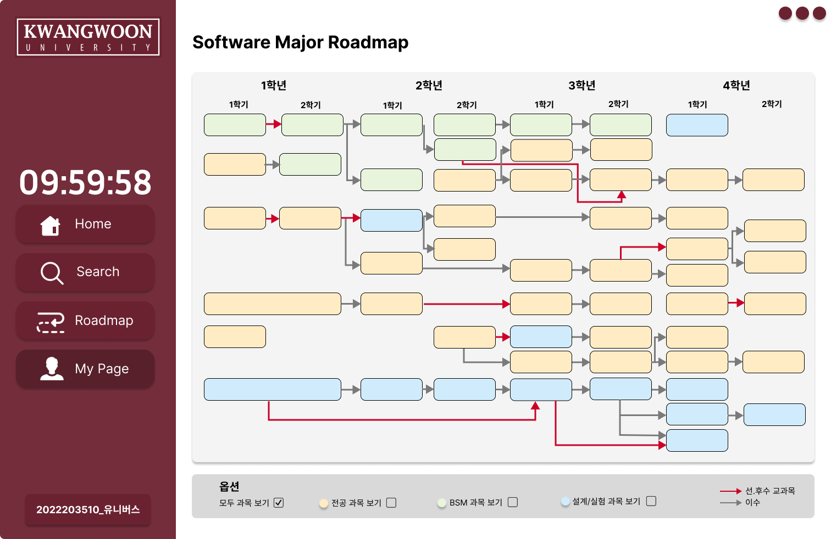
Curriculum Page

Slide 8
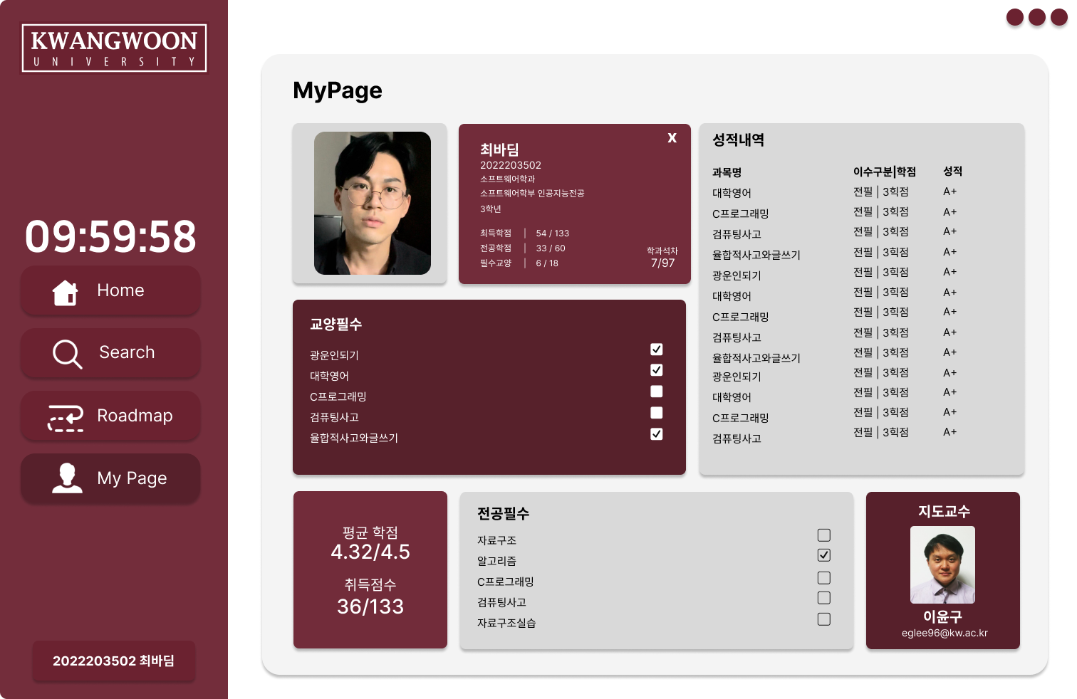
My Page

Slide 9
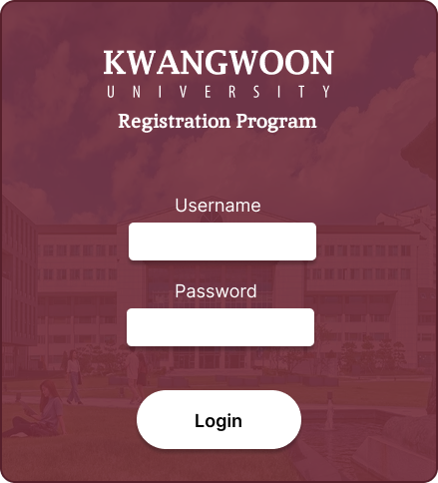
02
Current Progress

Slide 10
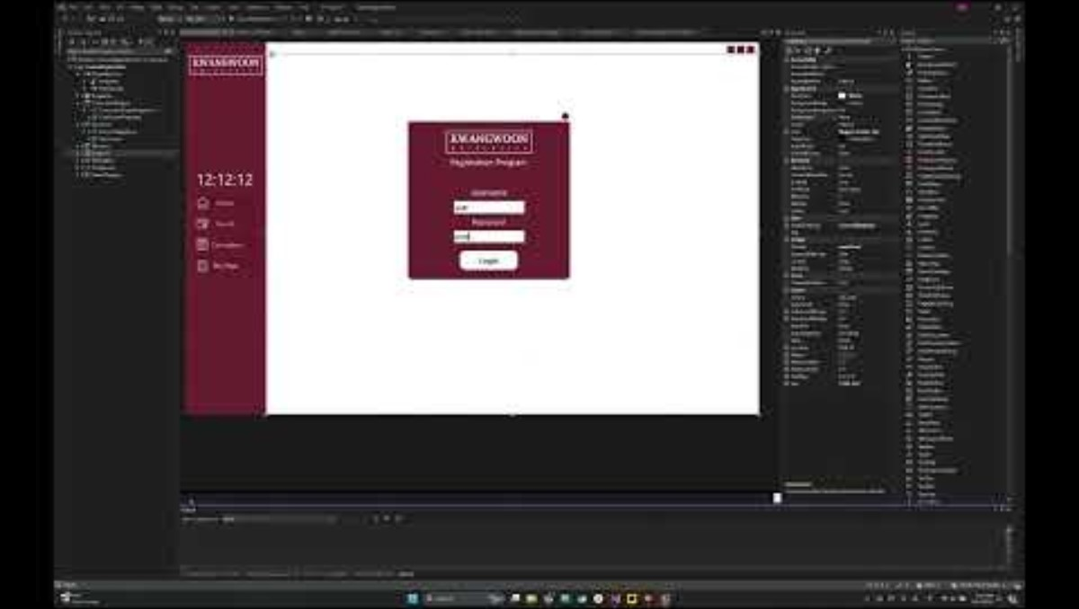
Main Layout Completed
https://github.com/univerxe/course-reg-program

Slide 11
03
Future Plans

Slide 12
Implement Each Page
Home Page
Search Page
Curriculum Page
My Page

Slide 13
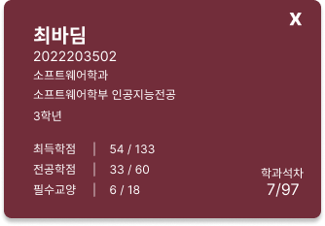
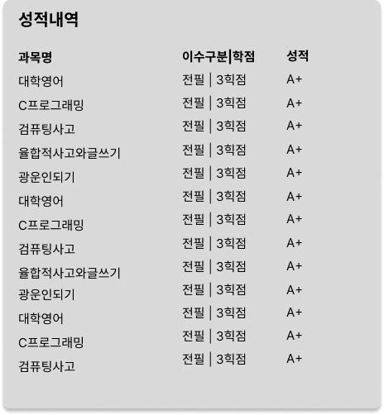
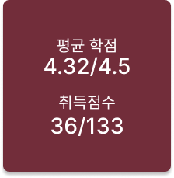
Database Management

Slide 14
Thank You

