Slide 1

Person Re-Identification with RGB-D camera in Top-view configuration
Emanuele Frontoni,
Massimo Martini,
Marina Paolanti
Sara Abbonizio,
Davide Manzoni
Università Politecnica delle Marche
Ancona, Italy
Sara Abbonizio, Davide Manzoni
21/10/2019
Notes:
Good Afternoon, I’m Massimo Martini, a PhD student of the Department of Information Engineering, from Università Politecnica delle Marche.
I will describe a work based on a collaboration with a Chinese multinational technology company, Huawei. This collaboration allowed to create the first smart Christmas tree based on an automatic emotion detection system.

Slide 2
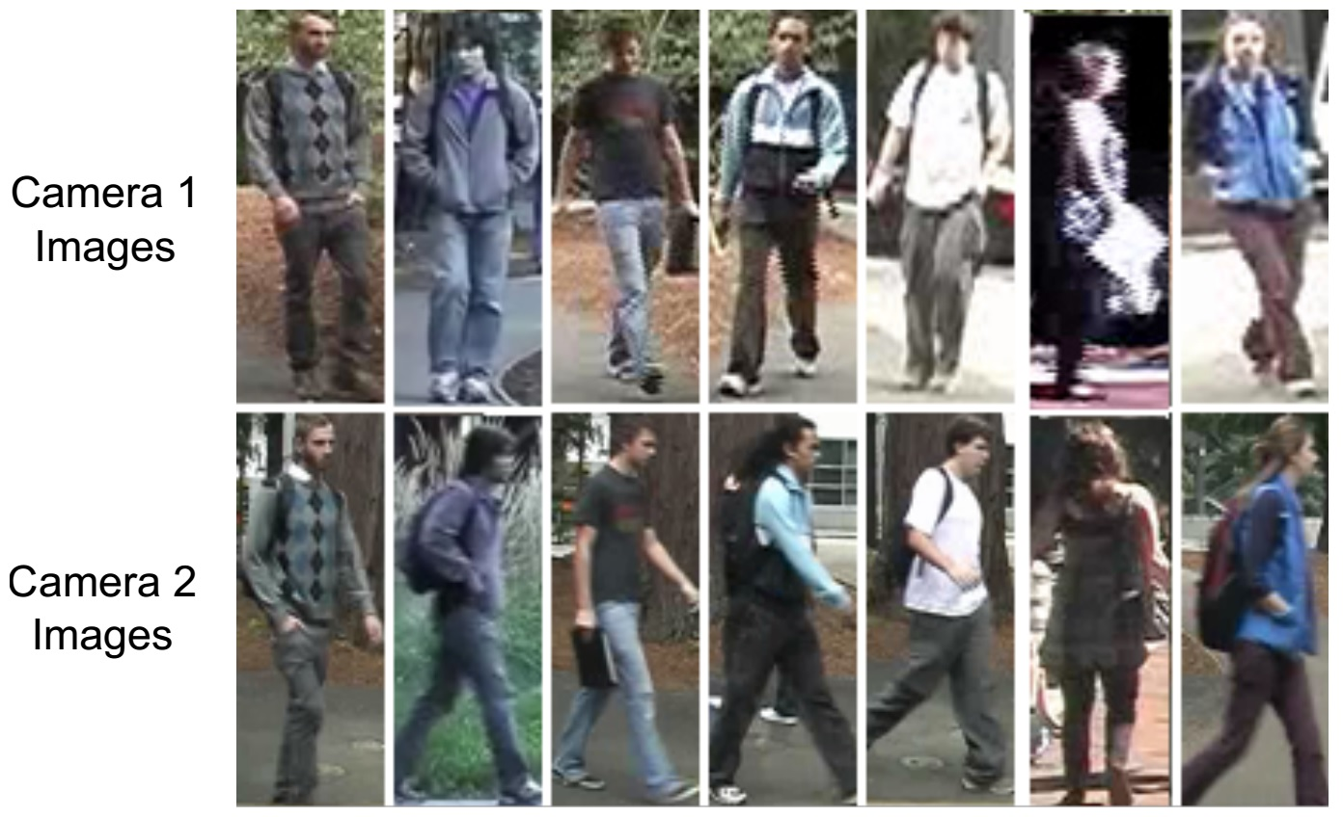
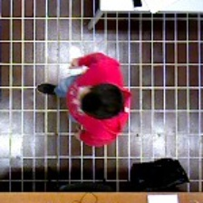
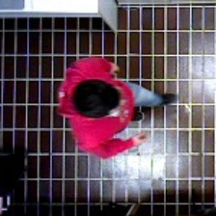
INTRODUCTION
Top-View Person Re-Identification
Person Re-ID tackles the problem of retrieving a specific person in different images or videos, possibly taken from different cameras in different environments
Top-View configuration:
Reduces the occlusion problem
Privacy preservation
Sara Abbonizio, Davide Manzoni
21/10/2019
Notes:
Facial emotions are important factors in human communication that help us to understand the intentions of others. In general, people infer the emotional states of other people, such as joy, sadness, and anger, using facial expressions and vocal tone.

Slide 3
INTRODUCTION
GOAL
Generate a neural network for person Re-Id with RGB-D camera in top-view configuration
Combining RGB and Depth information
Tests the neural network with different parameters
Analize and compare the results
Sara Abbonizio, Davide Manzoni
21/10/2019
Notes:
Facial emotions are important factors in human communication that help us to understand the intentions of others. In general, people infer the emotional states of other people, such as joy, sadness, and anger, using facial expressions and vocal tone.

Slide 4
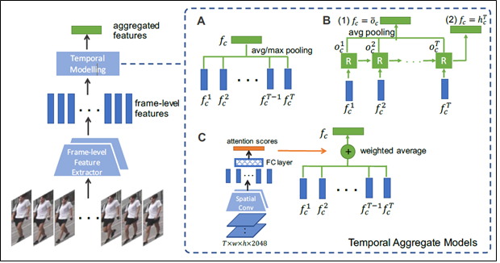
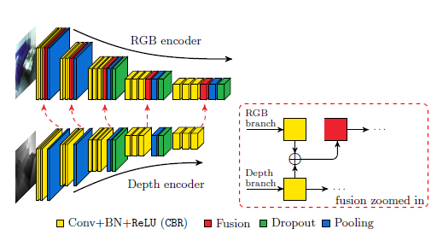
STATE OF ART
STATE OF ART
Revisiting Temporal Modeling for Video-based Person ReID
[Jyiang Gao et al. 2018
Computer Vision and Pattern Recognition]
https://arxiv.org/abs/1805.02104
Multimodal Deep Learning for Robust RGB-D Object Recognition
[Eitel A. et al. 2015]
https://arxiv.org/pdf/1507.06821.pdf
FuseNet: Incorporating Depth into Semantic Segmentation via Fusion-based CNN Architecture
[Hazirbas C. et al. 2016]
https://vision.in.tum.de/_media/spezial/bib/hazirbasma2016fusenet.pdf
Sara Abbonizio, Davide Manzoni
21/10/2019
Notes:
In this work we describe part of a system created by Huawei, that proposes the first Christmas tree based on artificial intelligence.
The system recognize facial emotions from images acquired by a mobile application
and lights up a smart tree with different colors according to the prevalent sentiment.

Slide 5
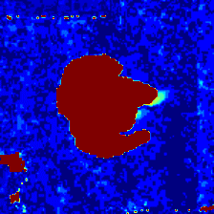
METHODS
DATASET
1000 different persons recorded
RGB-D camera with Top-view configuration
Different walking direction for training and test set
Each frame cropped in 224x224 jpeg images
Each frame has a Depth map
Sara Abbonizio, Davide Manzoni
21/10/2019
Notes:
Now we can talk about the mobile application:
For the event was used the HUAWEI MATE 20 PRO because In this phone there is kirin 980, a processor dedicated to artificial intelligence.
So, an android application has been developed for this smartphone.
It allows to take a selfie and through the implementation of the CNN model it estimates the emotion of the person.

Slide 6
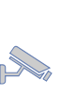
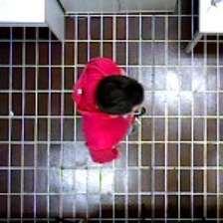
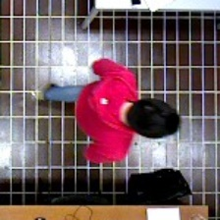
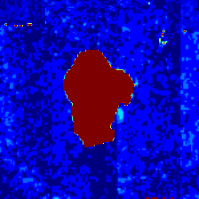
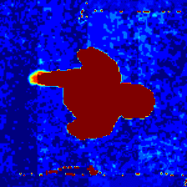
METHODS
MODEL
Temporal Pooling
ResNet50
Triplet Loss + SoftMax
Temporal Attention
Frames
Features Extractor
Temporal Modeling
Loss
Sara Abbonizio, Davide Manzoni
21/10/2019
Notes:
Now we can talk about the mobile application:
For the event was used the HUAWEI MATE 20 PRO because In this phone there is kirin 980, a processor dedicated to artificial intelligence.
So, an android application has been developed for this smartphone.
It allows to take a selfie and through the implementation of the CNN model it estimates the emotion of the person.

Slide 7
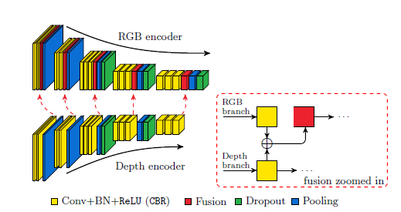
METHODS
FEATURES EXTRACTOR
Temporal Pooling
ResNet50
Triplet Loss + SoftMax
Temporal Attention
Sara Abbonizio, Davide Manzoni
21/10/2019
Notes:
Now we can talk about the mobile application:
For the event was used the HUAWEI MATE 20 PRO because In this phone there is kirin 980, a processor dedicated to artificial intelligence.
So, an android application has been developed for this smartphone.
It allows to take a selfie and through the implementation of the CNN model it estimates the emotion of the person.

Slide 8
METHODS
TEMPORAL MODELING
Temporal Pooling
ResNet50
Triplet Loss + SoftMax
Temporal Attention
Two different temporal modeling methods have been tested:
Temporal Pooling
Average pooling of N frames;
Temporal Attention
we compute temporal attention scores from for every frame, by using a temporal generation network formed by a spatial and a temporal convolutional layer; then we finally apply an attention weighted average.
Sara Abbonizio, Davide Manzoni
21/10/2019
Notes:
Now we can talk about the mobile application:
For the event was used the HUAWEI MATE 20 PRO because In this phone there is kirin 980, a processor dedicated to artificial intelligence.
So, an android application has been developed for this smartphone.
It allows to take a selfie and through the implementation of the CNN model it estimates the emotion of the person.

Slide 9
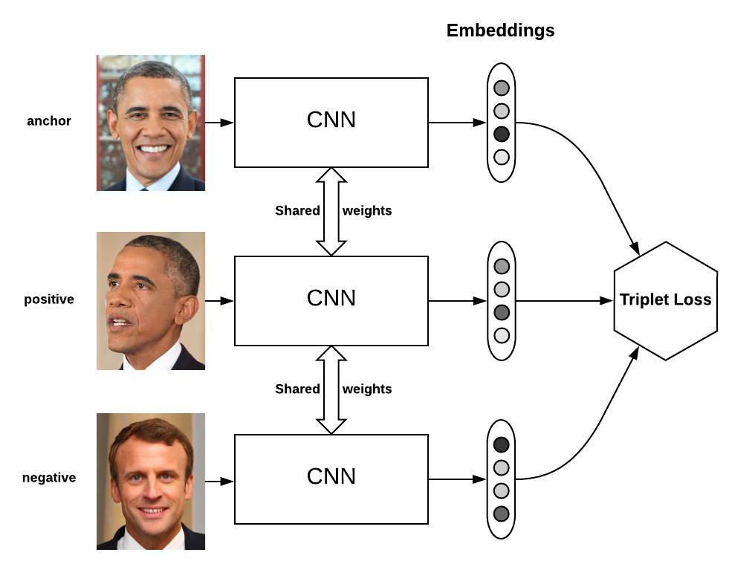
METHODS
LOSS FUNCTION
Temporal Pooling
ResNet50
Triplet Loss + SoftMax
Temporal Attention
We train our networks using a combination of a 2 type of loss function:
Triplet loss function
Softmax cross-entropy function
The total Loss is: L = Ltripl + Lsoftmax
Anchor
Positive
Negative
Max
Min
Sara Abbonizio, Davide Manzoni
21/10/2019
Notes:
Now we can talk about the mobile application:
For the event was used the HUAWEI MATE 20 PRO because In this phone there is kirin 980, a processor dedicated to artificial intelligence.
So, an android application has been developed for this smartphone.
It allows to take a selfie and through the implementation of the CNN model it estimates the emotion of the person.

Slide 10
METHODS
COMBINING RGB AND DEPTH INFORMATION
RGB
RGB and Depth pair
Depth to RGB conversion
Two features maps
Depth
[Eitel A. et al. 2015]
Sara Abbonizio, Davide Manzoni
21/10/2019
Notes:
Now we can talk about the mobile application:
For the event was used the HUAWEI MATE 20 PRO because In this phone there is kirin 980, a processor dedicated to artificial intelligence.
So, an android application has been developed for this smartphone.
It allows to take a selfie and through the implementation of the CNN model it estimates the emotion of the person.

Slide 11
EXPERIMENTAL PROTOCOL
DATA AND EVALUATION METRICS
Tests executed with Temporal Pooling and Temporal Attention, Learning Rate = 0.0003
TEST 1:
300 clips for Training, 700 for Testing, Training batch B = 6, sequence length S = 4
TEST 2:
300 clips for Training, 700 for Testing, Training batch B = 16, sequence length S = 8
TEST 3:
100 clips for Training, 900 for Testing, Training batch B = 6, sequence length S = 4
TEST 4:
100 clips for Training, 900 for Testing, Training batch B = 16, sequence length S = 8
Sara Abbonizio, Davide Manzoni
21/10/2019

Slide 12
RESULTS
RESULTS
 | mAP | CMC-1 | CMC-5 | CMC-10 | CMC-20
TP | 87.2 | 86.0 | 88.7 | 90.3 | 90.9
TA | 89.5 | 88.6 | 90.6 | 90.9 | 90.9
 | mAP | CMC-1 | CMC-5 | CMC-10 | CMC-20
TP | 76.7 | 72.3 | 81.7 | 84.1 | 87.6
TA | 93.4 | 92.9 | 94.1 | 94.4 | 94.6
Sara Abbonizio, Davide Manzoni
21/10/2019
Notes:
Here, we can see the table with all the experimental results.
In the first column are listed all the sentiment analyzed; while in the second column are specified all the available images for each sentiment, and in the third the number of images correctly classified.
The accuracy, in the last column, shows that the “happy” sentiment is the most sentiment recognized, with a rate of 87,75%.

Slide 13
RESULTS
RESULTS
 | mAP | CMC-1 | CMC-5 | CMC-10 | CMC-20
TP | 87.1 | 85.7 | 88.7 | 89.2 | 89.3
TA | 87.4 | 86.7 | 88.1 | 88.7 | 89.2
 | mAP | CMC-1 | CMC-5 | CMC-10 | CMC-20
TP | 89.9 | 88.2 | 92.0 | 93.1 | 93.1
TA | 90.3 | 89.0 | 92.0 | 92.6 | 93.3
Sara Abbonizio, Davide Manzoni
21/10/2019
Notes:
Here, we can see the table with all the experimental results.
In the first column are listed all the sentiment analyzed; while in the second column are specified all the available images for each sentiment, and in the third the number of images correctly classified.
The accuracy, in the last column, shows that the “happy” sentiment is the most sentiment recognized, with a rate of 87,75%.

Slide 14
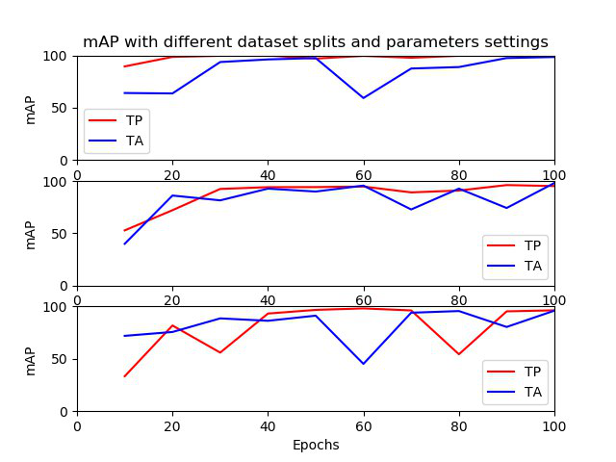
RESULTS
RESULTS
Sara Abbonizio, Davide Manzoni
21/10/2019
Notes:
Here, we can see the table with all the experimental results.
In the first column are listed all the sentiment analyzed; while in the second column are specified all the available images for each sentiment, and in the third the number of images correctly classified.
The accuracy, in the last column, shows that the “happy” sentiment is the most sentiment recognized, with a rate of 87,75%.

Slide 15
CONCLUSION
DISCUSSION
Temporal Attention perfoms better
High performances even with a small training set
Increasing the batch size increases performances in Temporal Attention, while Temporal Pooling performs less efficiently.
Sara Abbonizio, Davide Manzoni
21/10/2019
Notes:
Future works are devoted
to improve the performances of our approach, getting better performances in recognizing emotions that could be ambiguous and difficult to evaluate.
To test and compare new architectures (e.g. LSTM)
To increase the dataset size for the evaluation.
To evaluate different kinds of sentiment

Slide 16
CONCLUSION
CONCLUSION
We developed a network that uses both RGB and Depth inputs and tested it with different parameters configurations, examining and comparing the results.
FUTURE WORKS
Test the network with different datasets.
Implement the other two networks (RNN and 3DCNN)
Sara Abbonizio, Davide Manzoni
21/10/2019
Notes:
Future works are devoted
to improve the performances of our approach, getting better performances in recognizing emotions that could be ambiguous and difficult to evaluate.
To test and compare new architectures (e.g. LSTM)
To increase the dataset size for the evaluation.
To evaluate different kinds of sentiment

