Slide 1
ESP8266 Pin Controller

Slide 2
User requirements
Controlling simple devices using ethernet (wifi, gsm)
Saves your time

Slide 3
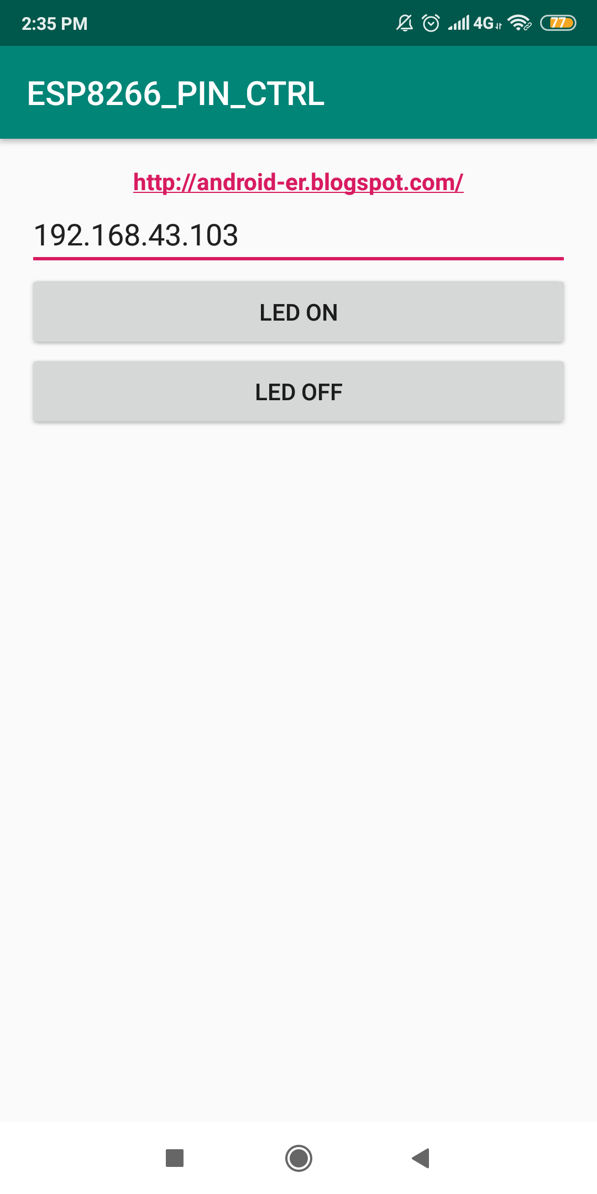
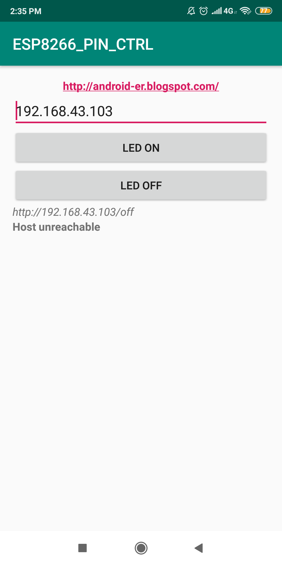
Επείδηξη

Slide 4
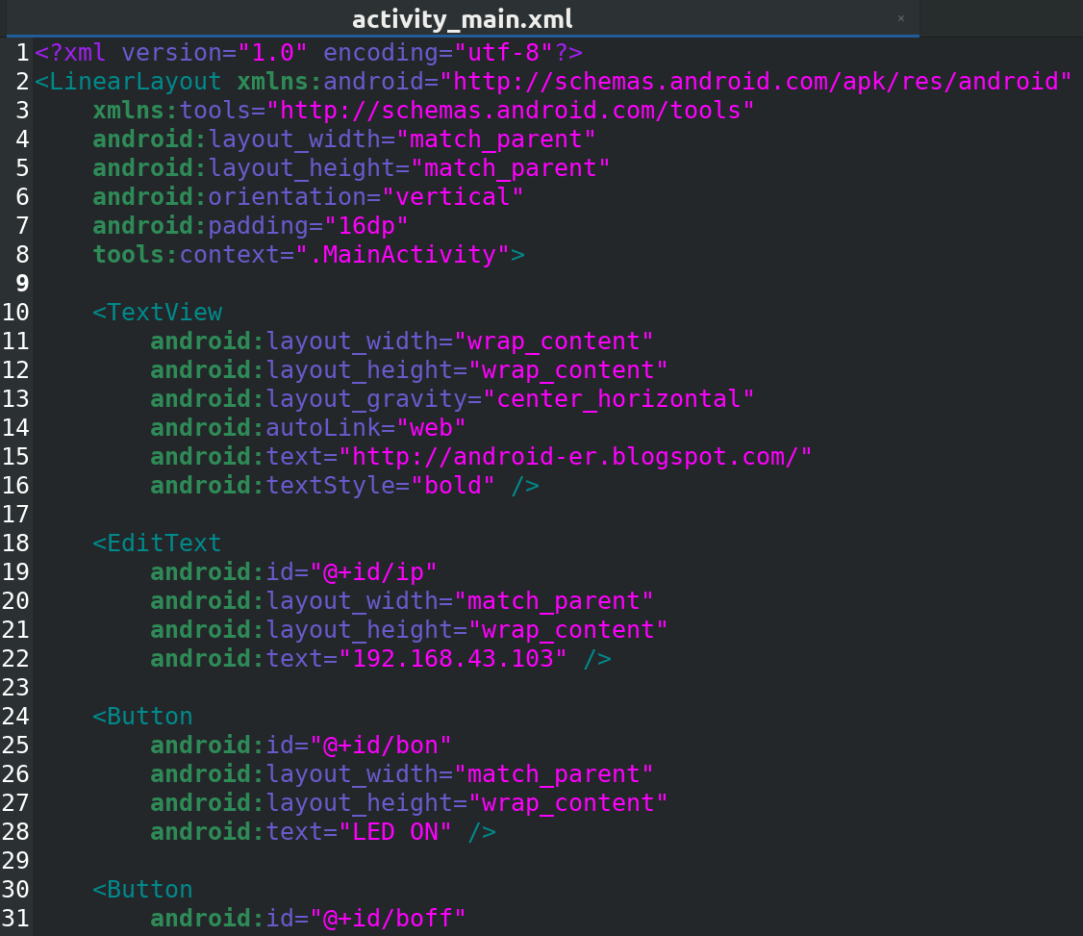
Layout

Slide 5
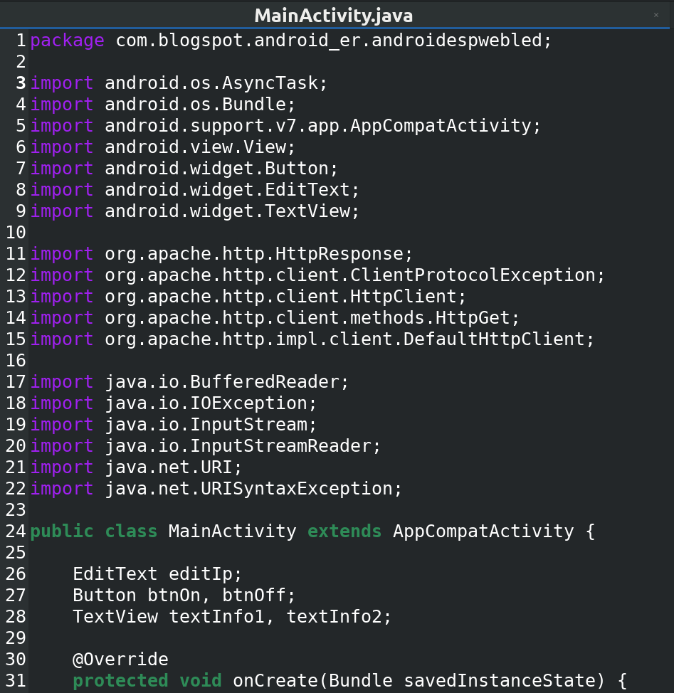
Activity

Slide 6
Future project updates
Provide environmental feedback (temperature

