Slide 1
JavaScript walkthrough

Slide 2
Execution Context
Global execution context or Global environment
Function execution context
Functional executional context has variables, this and reference to outer environment
Functional execution context only gets created on function call
Multiple calls to a function will create multiple execution context

Slide 3
Execution Stack
Execution stack initially have Global execution context
Upon calling a function, execution context of the function is created and pushed to execution stack

Slide 4
Declaring function in Js
Function expression VS Function declaration
Passing argument to function
Hoisting difference between Function expression and Function Declaration

Slide 5
Scope
Types: Functional scope (lexical scope) and Global scope
Where the variable is accessible
Function within function scoping (explain by example)

Slide 6
Closures
A closure is a function having access to the parent scope, even after the parent function has closed.
Combination of function and its lexical environment (inner function preserve the scope chain of outer function). (explain by example)

Slide 7
Hoisting
Variable and Function hoisting
Hoisting:- Definition moves up
In function declaration, whole function moves up, hence is accessible before declaration
In function expression, only function name hoisted up, and it will be null. Hence cannot be used before its declaration

Slide 8
This keyword
The JavaScript this keyword refers to the object it belongs to.
In most cases, the value of this is determined by how a function is called (runtime binding)
Arrow functions doesn’t have their own ‘this’ binding

Slide 9
Arrow functions
Arrow functions allow us to write shorter function syntax
Arrow functions there are no binding of this.
With arrow functions the this keyword always represents the object that defined the arrow function.

Slide 10
Constructors
A constructor function is used to create objects.
Binds this to the calling object.

Slide 11
Prototype
All JavaScript objects inherit properties and methods from a prototype. i.e. Prototype is blueprint for function.
Class in Js uses prototype for inheritence
Resolution order. Object context > Prototype

Slide 12
Var and Let
Var is function scoped
Let is block scoped.
Behind the scenes Let is converted to Var

Slide 13
Classes
Classes is syntatical sugar over prototype to achieve the inheritence.
In case of class, hoisting will not take place
Only works with contructor mode, i.e. object can be created only using new keyword
Also works with class Expression
Inheritence using extends keyword

Slide 14
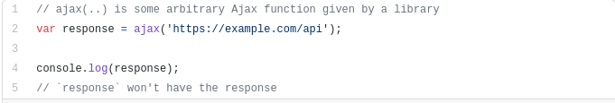
Asynchronous Javascript
Js is single threaded language.
To avoid blockage, asynchronous programming kicks in
until ES6, JavaScript itself has actually never had any direct notion of asynchronicity built into it

Slide 15

A simple way of “waiting” for an asynchronous function to return its result is to use a function called callback:

Slide 16
Event loop
Node environment has a built-in mechanism called the event loop, which handles the execution of multiple chunks of your program over time, each time invoking the JS Engine
JS Engine is just an on-demand execution environment for any arbitrary JS code. It’s the surrounding environment that schedules the events (the JS code executions)
JS Engine tells the hosting environment:
“Hey, I’m going to suspend execution for now, but whenever you finish with that network request, and you have some data, please call this function back.”

Slide 17
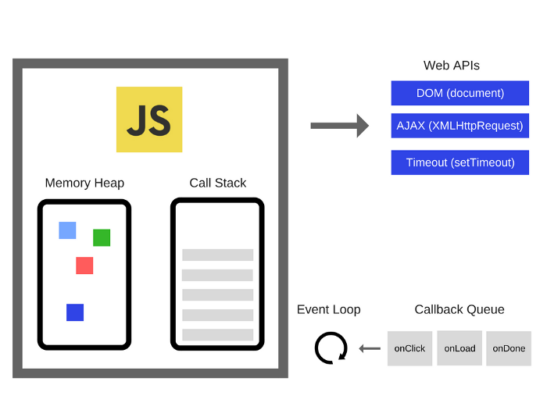
The Event Loop has one simple job — to monitor the Call Stack and the Callback Queue. If the Call Stack is empty, the Event Loop will take the first event from the queue and will push it to the Call Stack, which effectively runs it.

Slide 18
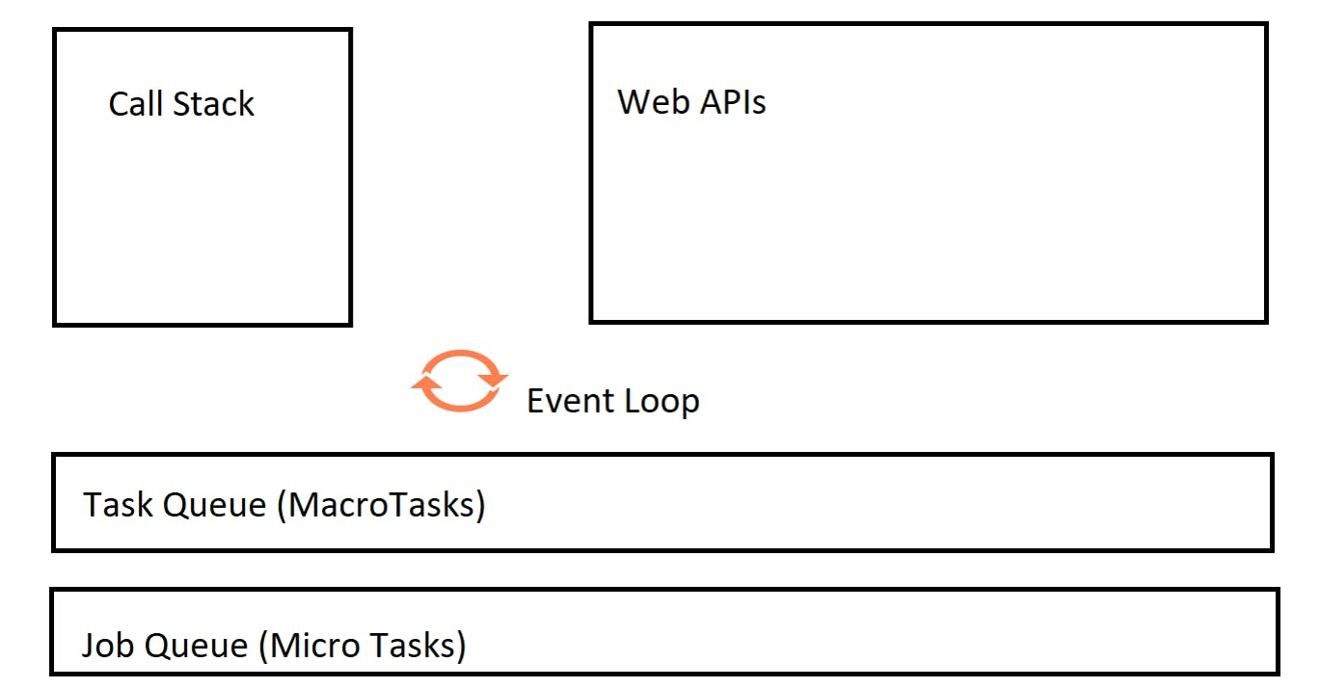
Jobs in ES6
“Job Queue” was introduced in ES6.

Slide 19
Few Important points to note
Not all the tasks are created of the same priority. There are macrotasks and microtasks.
MacroTasks are called, Tasks and MicroTasks are called, Jobs.
Examples of Macrotasks are setTimeout, setInterval, setImmediate, I/O tasks, etc.
Examples of Microtasks are, Promises, process.nextTick, etc
The Queue in Event Loop Model holds the Tasks(or the MacroTasks) called, TaskQueue.
The Queue in Event Loop Model holds the Jobs(or the MicroTasks) called, JobQueue.
For example, Promises are in Job Queue and the functions for setTimeOut are in TaskQueue.

Slide 20
Working
For each loop of the 'event loop' one macrotask(Task) is completed out of the macrotask(Task) queue
Once that task is complete, the event loop visits the microtask(Job) queue. The entire microtask(Job) queue is completed before the 'event loop' looks into the next thing.
At any point in time if both the queues got entries, JobQueue gets higher precedence than TaskQueue

Slide 21
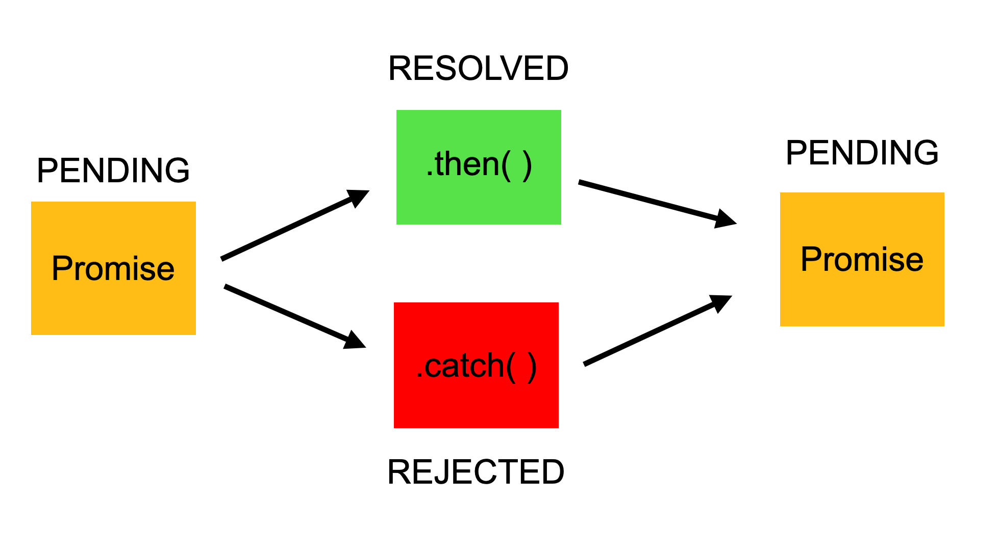
Promise
A promise is an object which can be returned synchronously from an asynchronous function

