Slide 1


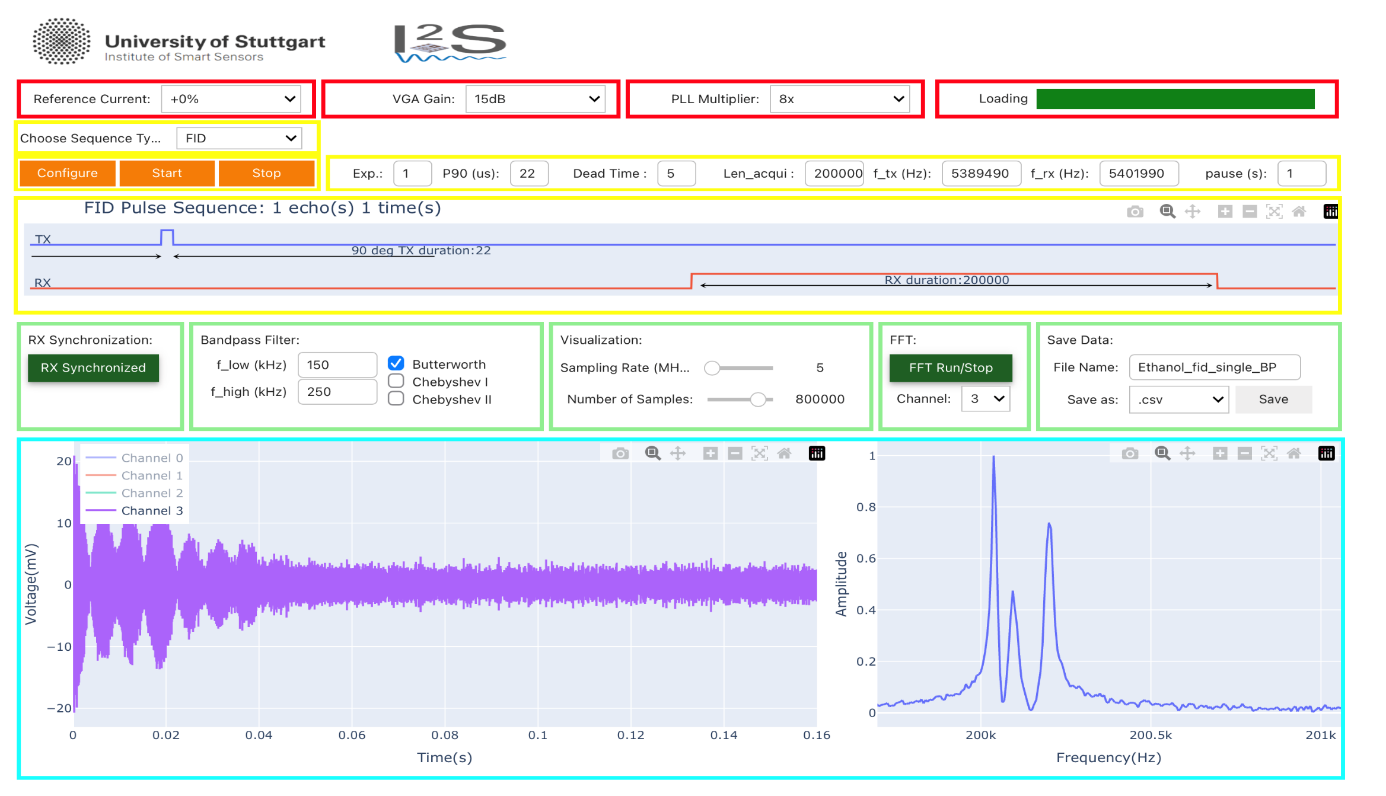

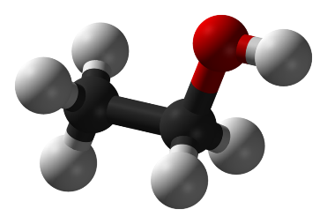

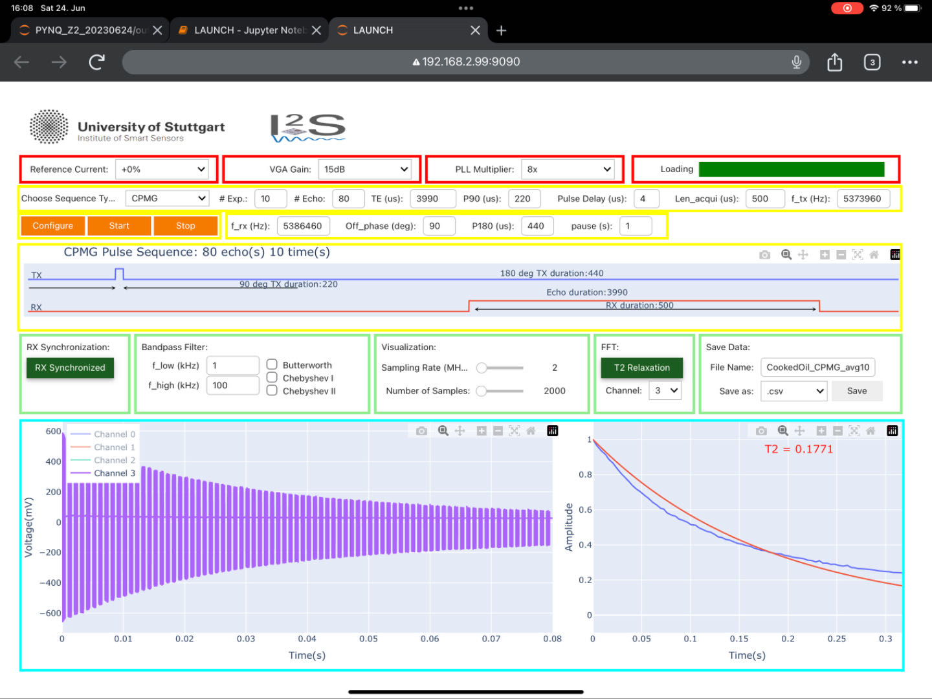

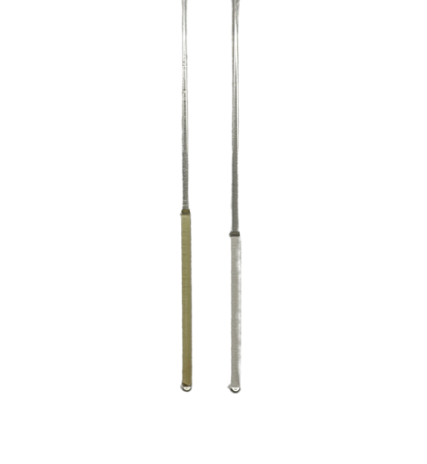


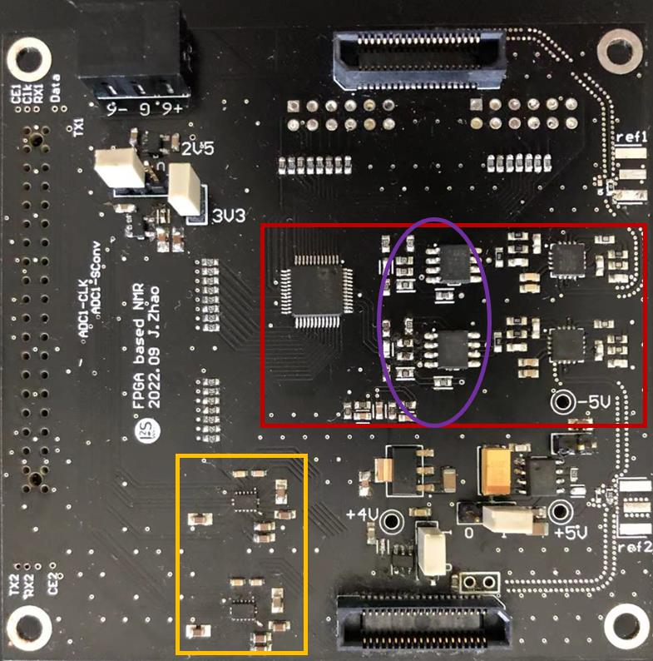
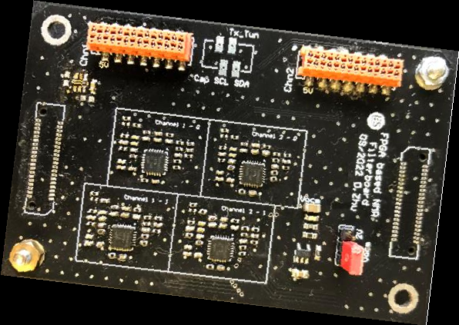
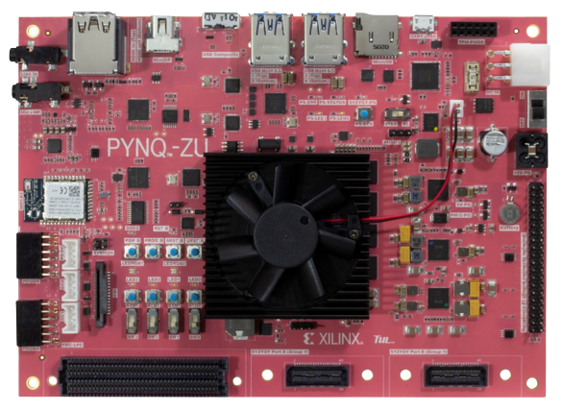
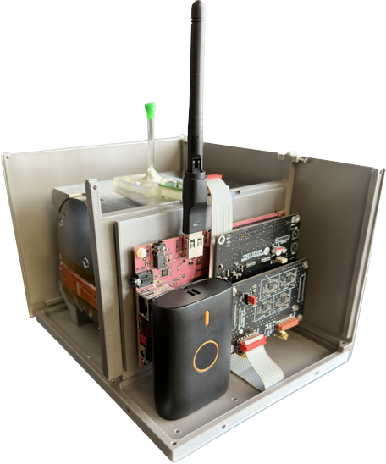
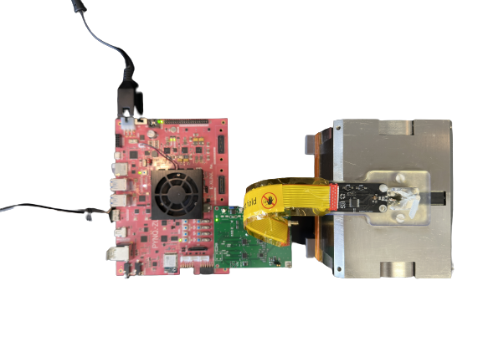
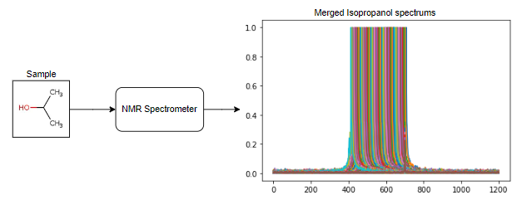
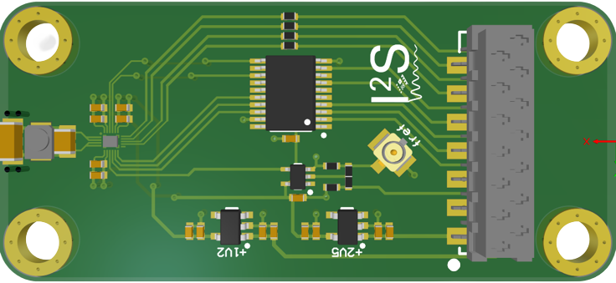
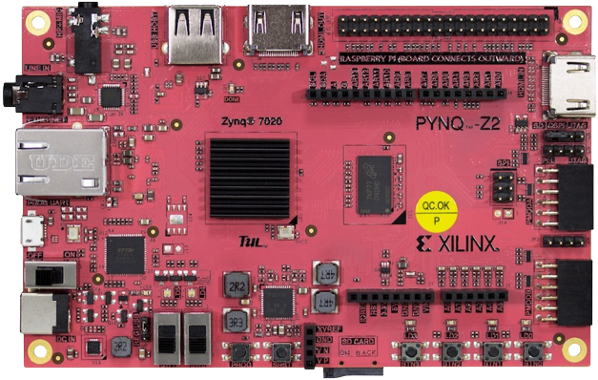
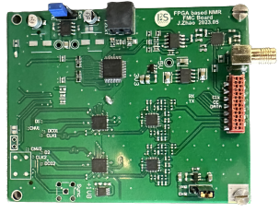
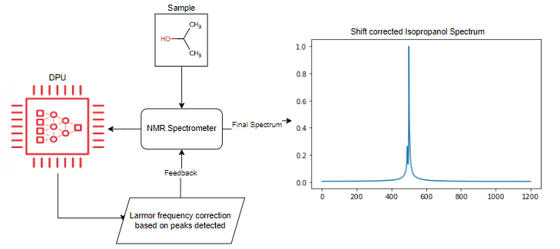
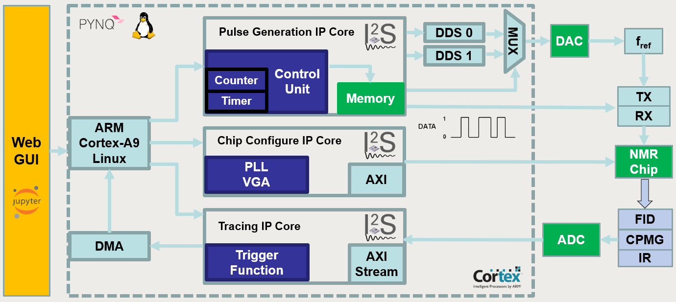
Quantum Sensing
PYNQ-based Portable Nuclear Magnetic Resonance Spectrometer Powered by Deep Learning from AMD Xilinx
Z. Zhao, Z. Jianyu, S. Pratyush, P. Yichao, M. Hima
Indroduction and Applications
NMR (Nuclear Magnetic Resonance) is a powerful quantum sensing technique that utilizes the quantum state changes of atomic nuclei in an applied magnetic field to probe, analyze, and image the structure and properties of a sample.
Experiments Result Illustration on Ipad*
FID time-domain signal and frequency spectrum from the Ethanol
CPMG time-domain signal and T₂ – relaxometry for cocking oil
NMR Spectroscopy aids in the medical field for the early disease detection and characterization by analyzing tissues and bodily fluids. Additionally, it contributes to drug development by investigating drug-target interactions.
$$CH_{3}$$
$$CH_{2}$$
Ethanol
NMR Spectroscopy has widespread applications in the chemical industry. It is used for analyzing compound structures, identifying purity, studying reaction kinetics, and exploring metabolic processes. NMR Spectroscopy plays a vital role in the development of new materials, quality control, and process optimization. Additionally, it finds extensive use in areas such as catalyst research and polymer analysis.
$$OH_{}$$
NMR Spectroscopy is extensively used for food product control, analyzing composition, quality, and safety. It ensures accurate analysis of nutritional components, additives, contaminants, and authenticity verification. This non-destructive technique ensures food quality, compliance, and detects fraud, protecting consumer rights and industry reputation.
NMR Spectroscopy is applied in quantum computing, utilizing nuclear spins as qubits. It offers precise qubit control, measurement, and some fault tolerance. While limited in scalability, it provides a platform for experimental and algorithmic validation, contributing to the advancement of quantum computing technology.
used and fresh oil
Software Architecture
High-speed data flow enables real-time data collection, transmission, visualization,
storage and processing, forming a robust data ecosystem powered by PYNQ.
* Please refer to the experimental section for more information
System Configuration
Hardware Components
Custom-designed PCB boards for portable NMR experiments are mounted on PYNQ board. Convenient control and visualization possibility with Wifi module.
Deep Learning Based Material Analysis
AMD's Xilinx Deep Learning Unit will provide significant assistance for material spectrum identification in NMR spectroscopy. Here, we apply it in spectrum detection and in the spectral correction of the transmission frequency of the ASIC, to ensure signals resulting from spin are perfectly averaged to reduce noise. We also continually adjust based on feedback from the deep learning unit to ensure samples are excited at the correct Larmor frequency.
FPGA-based NMR Filterboard
PYNQ ZU
FPGA-based ADC and DAC Board
Without AI based correction
PYNQ ZU based portable NMR Set
PYNQ-Z2 based portable NMR Set
NMR Frontend Board
PYNQ Z2
FMC board
With AI based Larmor frequency correction
Conclusion
In our experiments, AMD's Xilinx ZYNQ series FPGA perfectly met the
demands of high-performance computing and control systems for quantum
sensing. In the future, if our team can secure funding support, we believe our
NMR spectroscopy based on a distributed AI system will make significant
contributions to medicine, the chemical industry, food quality
control, and quantum computing.
Prof. Dr. Jens Anders
Tel: +49 (0)711 685 67250
Email: jens.anders@ite.uni-stuttgart.de
Contact
Institute of Smart Sensors
Pfaffenwaldring 47
70569 Stuttgart, Germany
https://www.iis.uni-stuttgart.de/

