Slide 1
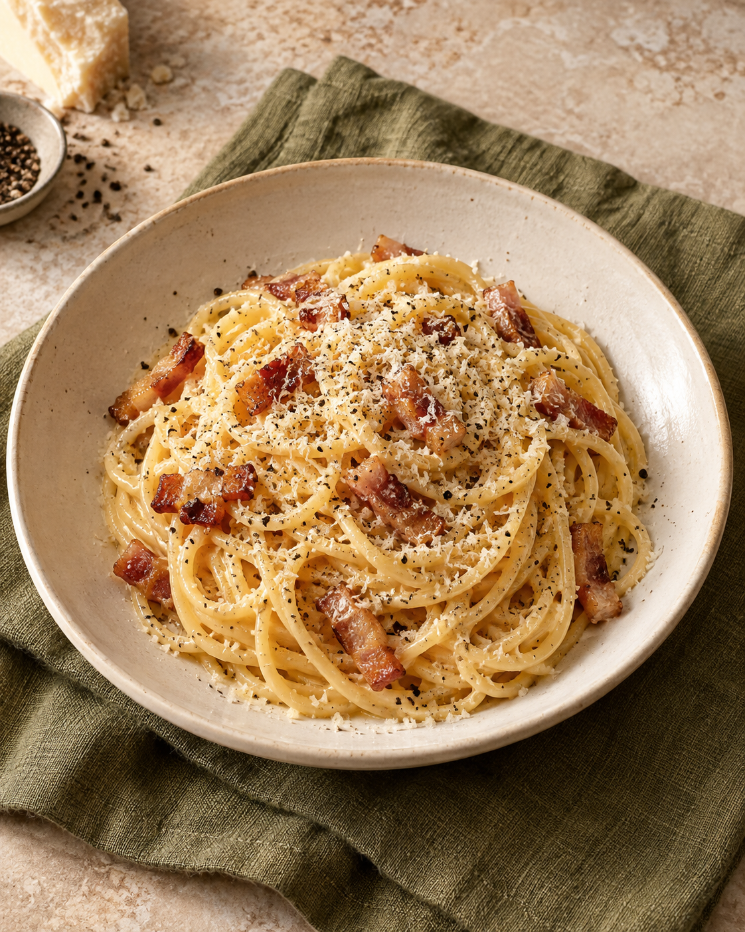
Carbonara
for two
A Roman pasta with a silky egg-and-cheese sauce, guanciale and black pepper.
2 generous servings
About 25–30 minutes
01
Notes:
This recipe uses egg, Pecorino and a little starchy water for creaminess. Quantities are a practical adaptation for two generous main-course portions. Time is an estimate and depends on water heating and the pasta used.
Sources:
https://www.giallozafferano.com/recipes/Spaghetti-Carbonara-Bacon-and-egg-spaghetti.html
https://www.seriouseats.com/pasta-carbonara-sauce-recipe
Visual: AI-generated culinary illustration.

Slide 2
Ingredients for two
Ingredient | Quantity | Preparation notes
Spaghetti | 200 g | Cook until al dente.
Guanciale | 100 g | Remove rind. Cut into short, even strips.
Large eggs | 1 whole egg + 2 yolks | Use pasteurized eggs for this lightly cooked sauce.
Pecorino Romano | 50 g | Finely grate. Use 40 g in sauce and 10 g to finish.
Black pepper | ½ tsp, plus to finish | Freshly grind. Adjust to taste.
Salt | A small amount | Lightly salt the pasta water. Cheese and pork are salty.
Pasta cooking water | Reserve 250 mL | Add only as needed, a little at a time.
Pancetta can replace guanciale if needed, with a slightly different flavor.
02
Notes:
Guanciale is cured pork cheek. The whole egg plus yolks gives a rich but workable sauce. Reserve the full 250 mL so water is available, but do not add it all. These proportions make two generous servings. FDA recommends pasteurized eggs or egg products for recipes served raw or undercooked.
Sources:
https://www.giallozafferano.com/recipes/Spaghetti-Carbonara-Bacon-and-egg-spaghetti.html
https://www.seriouseats.com/pasta-carbonara-sauce-recipe
https://www.fda.gov/food/buy-store-serve-safe-food/what-you-need-know-about-egg-safety

Slide 3
The cooking sequence
Follow the numbered arrows. Cook the pasta while the guanciale renders.
1 Prepare
Cut pork. Whisk eggs,
cheese and pepper.
2 Render
Cook guanciale gently
until golden.
3 Boil
Cook spaghetti
until al dente.
4 Reserve
Save 250 mL
of pasta water.
8 Serve
Plate immediately.
Add cheese and pepper.
7 Make sauce
Add eggs. Toss and
loosen with water.
6 Off the heat
Move the pan away
from the burner.
5 Toss
Coat drained pasta
with pork and fat.
The critical transition: the pan leaves the burner before the eggs go in.
03
Notes:
Steps 2 and 3 overlap in real cooking. The numbered path shows the order of the key actions. Keep the egg mixture ready before the pasta finishes cooking.
Sources:
https://www.giallozafferano.com/recipes/Spaghetti-Carbonara-Bacon-and-egg-spaghetti.html
https://www.seriouseats.com/pasta-carbonara-sauce-recipe

Slide 4
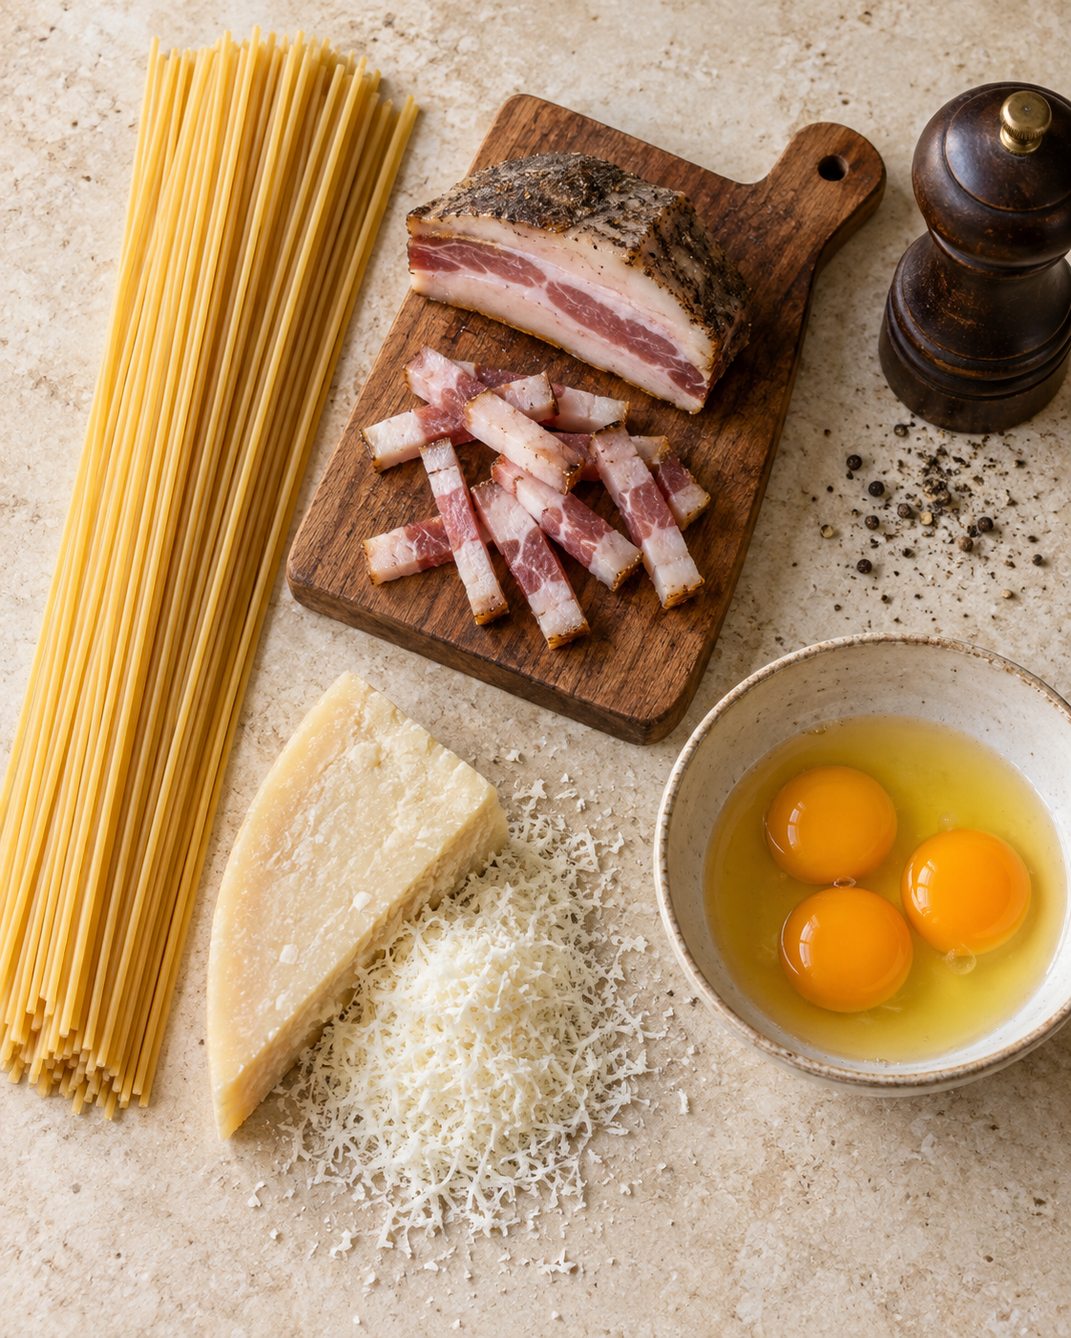
Preparation
01
Everything ready before cooking
Trim and cut the guanciale into strips about 5–10 mm thick.
Whisk 1 whole egg, 2 yolks, 40 g finely grated Pecorino and ½ tsp pepper in a bowl.
Keep the remaining 10 g cheese for serving.
Equipment: pot, wide pan, bowl, whisk, tongs, grater and a heatproof cup.
04
Notes:
Finely grated cheese combines more easily with the egg mixture than coarse shreds. Begin heating the lightly salted pasta water during preparation. Use the stated measured quantities rather than judging quantities from the illustration.
Sources:
https://www.giallozafferano.com/recipes/Spaghetti-Carbonara-Bacon-and-egg-spaghetti.html
https://www.seriouseats.com/pasta-carbonara-sauce-recipe
Visual: AI-generated ingredient illustration.

Slide 5
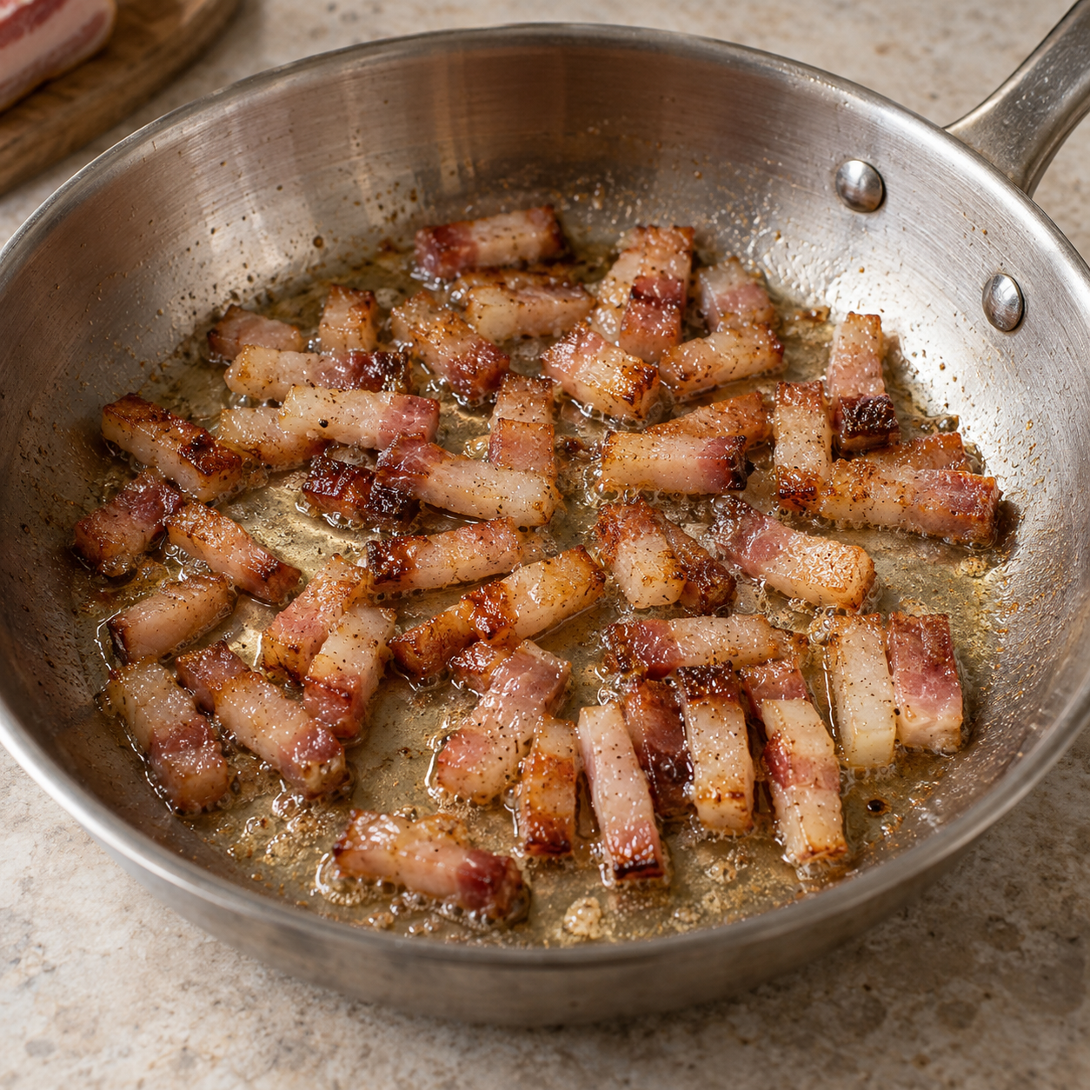
Guanciale and pasta
02
Slow rendering
Start guanciale in a cool, dry pan. Cook over medium-low heat for about 8–10 minutes, stirring, until golden.
Keep the rendered fat. Move the pan off the heat if the pork is ready first.
03
Al dente spaghetti
Meanwhile, boil the spaghetti in lightly salted water. Follow the packet time and taste for a firm center.
05
Notes:
Rendering means gently melting fat out of the pork. No added oil is needed. The exact time depends on strip size and pan temperature. Avoid letting guanciale become very dark or hard. Begin the pasta once the water boils.
Sources:
https://www.giallozafferano.com/recipes/Spaghetti-Carbonara-Bacon-and-egg-spaghetti.html
https://www.seriouseats.com/pasta-carbonara-sauce-recipe
Visual: AI-generated cooking illustration.

Slide 6
Pasta water and heat control
04
Save the water
250 mL
Keep a heatproof cup beside the pot so you remember before draining.
Pasta water to reserve
05
Toss with the guanciale
Transfer the pasta to the pan. Toss with the pork and its rendered fat.
Scoop it out before draining.
You will use only what the sauce needs.
06
Move the pan off the burner
Let vigorous sizzling subside before adding the egg mixture.
06
Notes:
The cup of starchy cooking water is an adjustable ingredient. Use it to loosen the sauce gradually. Pan temperature varies, so a fixed waiting time is less useful than allowing strong sizzling to subside. Residual heat is not a validated food-safety guarantee, which is why pasteurized eggs are recommended.
Sources:
https://www.giallozafferano.com/recipes/Spaghetti-Carbonara-Bacon-and-egg-spaghetti.html
https://www.seriouseats.com/pasta-carbonara-sauce-recipe
https://www.fda.gov/food/buy-store-serve-safe-food/what-you-need-know-about-egg-safety

Slide 7
The silky finish
Off the heat
07
Toss and adjust
Add reserved pasta water 1 tablespoon at a time as needed. Keep tossing until smooth.
Pour in the egg mixture while tossing continuously.
08
Serve straight away
The sauce should cling to each strand and still look glossy.
Divide between two warm bowls. Finish with the remaining 10 g cheese and more pepper.
07
Notes:
Egg, cheese, fat and a little water combine into the sauce. Stop adding water as soon as the sauce coats the pasta. Carbonara thickens while standing, so leave it slightly loose and serve promptly. If the pan is too hot, eggs can curdle. Do not return to a strong flame.
Sources:
https://www.giallozafferano.com/recipes/Spaghetti-Carbonara-Bacon-and-egg-spaghetti.html
https://www.seriouseats.com/pasta-carbonara-sauce-recipe

Slide 8
Tips and common mistakes
Helpful habits
Common mistakes
Finely grate the cheese
Coarse or clumped cheese
It mixes more evenly into the eggs.
It can leave a lumpy sauce.
Add water gradually
Pouring in the whole cup
Stop when the pasta looks glossy.
The sauce becomes watery.
Taste before adding salt
Heavy salting at every stage
Pecorino and guanciale add plenty.
The finished dish may be too salty.
Keep the eggs off direct heat
A hot burner under the sauce
Toss continuously and serve promptly.
The eggs can scramble.
08
Notes:
Do not rinse the pasta. Keep the cooking water available until plating. Add a small splash if the sauce becomes too thick. A fully scrambled egg sauce cannot reliably be restored to its original texture. The tips on egg heat and water adjustment follow the cited methods.
Sources:
https://www.giallozafferano.com/recipes/Spaghetti-Carbonara-Bacon-and-egg-spaghetti.html
https://www.seriouseats.com/pasta-carbonara-sauce-recipe

