Slide 1
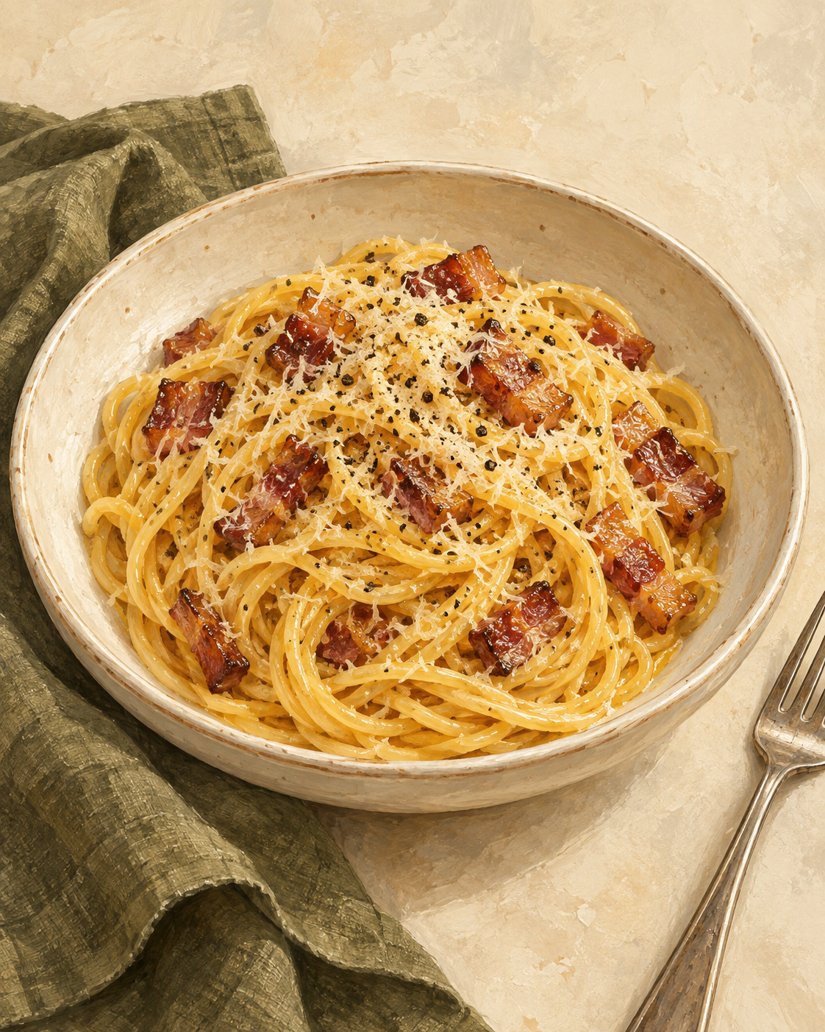
Carbonara
for two
A Roman pasta with crisp guanciale
and a silky egg-and-cheese sauce.
2 servings
About 25 minutes
Notes:
A home-cooking version for two generous servings. Allow about 25 minutes, depending on the pasta and stove. The creaminess comes from eggs, cheese, rendered pork fat and starchy cooking water. Technique reference: Claire Saffitz, Spaghetti Carbonara, Bon Appétit. https://www.bonappetit.com/recipe/simple-spaghetti-carbonara (accessed 3 October 2026).

Slide 2
Ingredients for two
Measure everything before the pasta goes in.
Ingredient | Quantity | Preparation notes
Spaghetti | 200 g | Cook until al dente
Guanciale | 100 g | Trim rind and cut into small strips
Large eggs | 1 whole + 2 yolks | Use 3 eggs total. Save extra whites
Pecorino Romano | 50 g | Grate finely. Reserve a little to finish
Black pepper | ½ tsp, plus to taste | Freshly grind
Salt | As needed | Salt the pasta water lightly
Pasta cooking water | Reserve 250 mL | Add only as needed for the sauce
Guanciale is cured pork jowl. Pancetta is a useful substitute.
02
Notes:
Recipe quantities are a practical two-serving formulation. The 50 g cheese includes a small amount held back for serving. Reserve 250 mL of cooking water, but do not add it all. Guanciale and Pecorino already contribute salt. Substitution reference: Technique reference: Claire Saffitz, Spaghetti Carbonara, Bon Appétit. https://www.bonappetit.com/recipe/simple-spaghetti-carbonara (accessed 3 October 2026).

Slide 3
The cooking sequence
The sauce comes together at the end, away from direct heat.
1 Prep ingredients
Cut and grate
2 Render guanciale
Medium-low heat
3 Mix egg base
Eggs, cheese, pepper
4 Cook spaghetti
Until al dente
8 Serve at once
Use warm bowls
7 Add egg mixture
Toss and loosen
6 Take off heat
Let sizzling subside
5 Reserve & toss
Save water. Coat pasta
While the guanciale cooks, whisk the egg base and bring the pasta water to a boil.
03
Notes:
The numbered arrows define the full sequence. Preparations can overlap: whisk the egg base and heat the water while rendering the guanciale. Keep the guanciale pan off heat once crisp, and remove it again before adding eggs if it has been reheated. Technique reference: Classic Carbonara, La Cucina Italiana. https://www.lacucinaitaliana.com/recipe/pasta/classic-carbonara (accessed 3 October 2026).

Slide 4
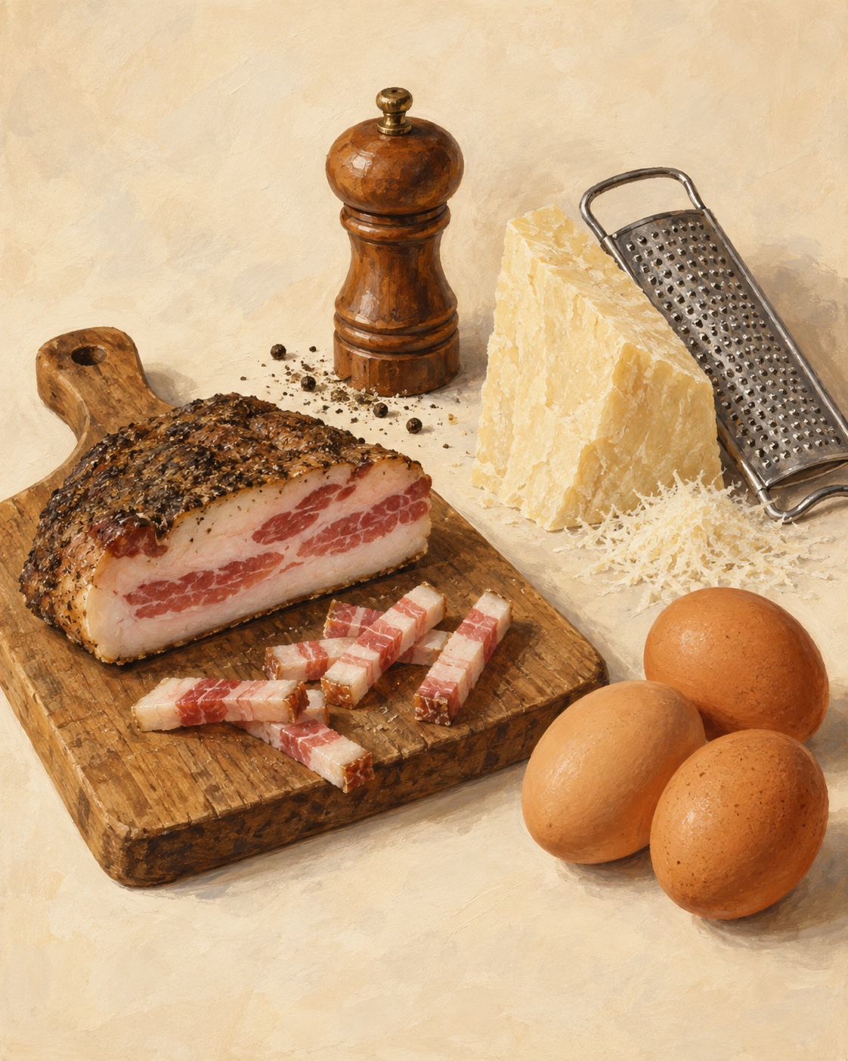
Preparation and guanciale
01
Prep the ingredients
Trim the guanciale rind and cut small strips. Finely grate the cheese and set aside a little for serving.
02
Render gently
Start guanciale in a cold pan. Cook over medium-low heat for 7–10 minutes, stirring, until golden and crisp.
Keep the flavorful fat in the pan.
Turn off the heat once the guanciale is ready.
04
Notes:
Equipment: large pot, wide frying pan, mixing bowl, whisk or fork, tongs, fine grater and a heatproof cup. A cold pan helps the guanciale fat render gradually. Judge doneness by golden crisp edges rather than the timer alone. A very fatty piece may produce more fat than needed. If it forms a deep pool, spoon some into a heatproof container, leaving about 1–2 tablespoons in the pan.

Slide 5
Egg base and pasta
03
04–05
The egg base
The pasta
Whisk 1 whole egg and 2 yolks with most of the Pecorino and ½ tsp black pepper.
Cook spaghetti in lightly salted boiling water until al dente. Stir occasionally and taste near the end.
Reserve 250 mL cooking water.
Transfer pasta to the guanciale pan and toss to coat with fat.
A thick, even paste is expected.
05
Notes:
Whisk the base while the guanciale cooks. Al dente means tender with a little bite in the center. Use package timing as a guide, then taste. Do not rinse the spaghetti. Keep the reserved water warm. The slide sequence puts the egg base before the pasta so everything is ready for the final toss.

Slide 6
The silky sauce
OFF
HEAT
6
Take the pan off the burner
Let strong sizzling subside before the eggs go in.
7
Add the egg mixture
Toss the hot pasta continuously to coat every strand.
The crucial moment
Adjust the consistency
Gentle residual warmth
thickens the egg mixture.
Add warm pasta water 1 tablespoon at a time, tossing until glossy.
06
Notes:
The pan should remain warm but should not be fiercely sizzling when eggs are added. A heavy pan holds heat longer. If it still feels too hot, combine the pasta and egg base in a warm mixing bowl instead. Adding water little by little gives better control of the texture. Heat-control reference: Technique reference: Claire Saffitz, Spaghetti Carbonara, Bon Appétit. https://www.bonappetit.com/recipe/simple-spaghetti-carbonara (accessed 3 October 2026).

Slide 7
Common mistakes and better habits
What goes wrong
What to do
Scrambled egg bits
Remove the pan from heat before adding eggs.
If still very hot, finish in a warm mixing bowl.
Sauce too thick
Toss in warm pasta water, 1 tablespoon at a time.
Sauce too watery
Add water gradually and stop as soon as it coats.
Clumps of cheese
Grate finely and whisk thoroughly into the eggs.
Too salty
Salt the pasta water lightly. Taste before adding more.
07
Notes:
These are prevention tips. Once the eggs scramble, the smooth texture cannot be fully restored. If sauce becomes too thin, keep tossing briefly off heat before adding anything else. A sauce that is a little loose in the pan will thicken as it cools on the plate. The method uses no cream.

Slide 8
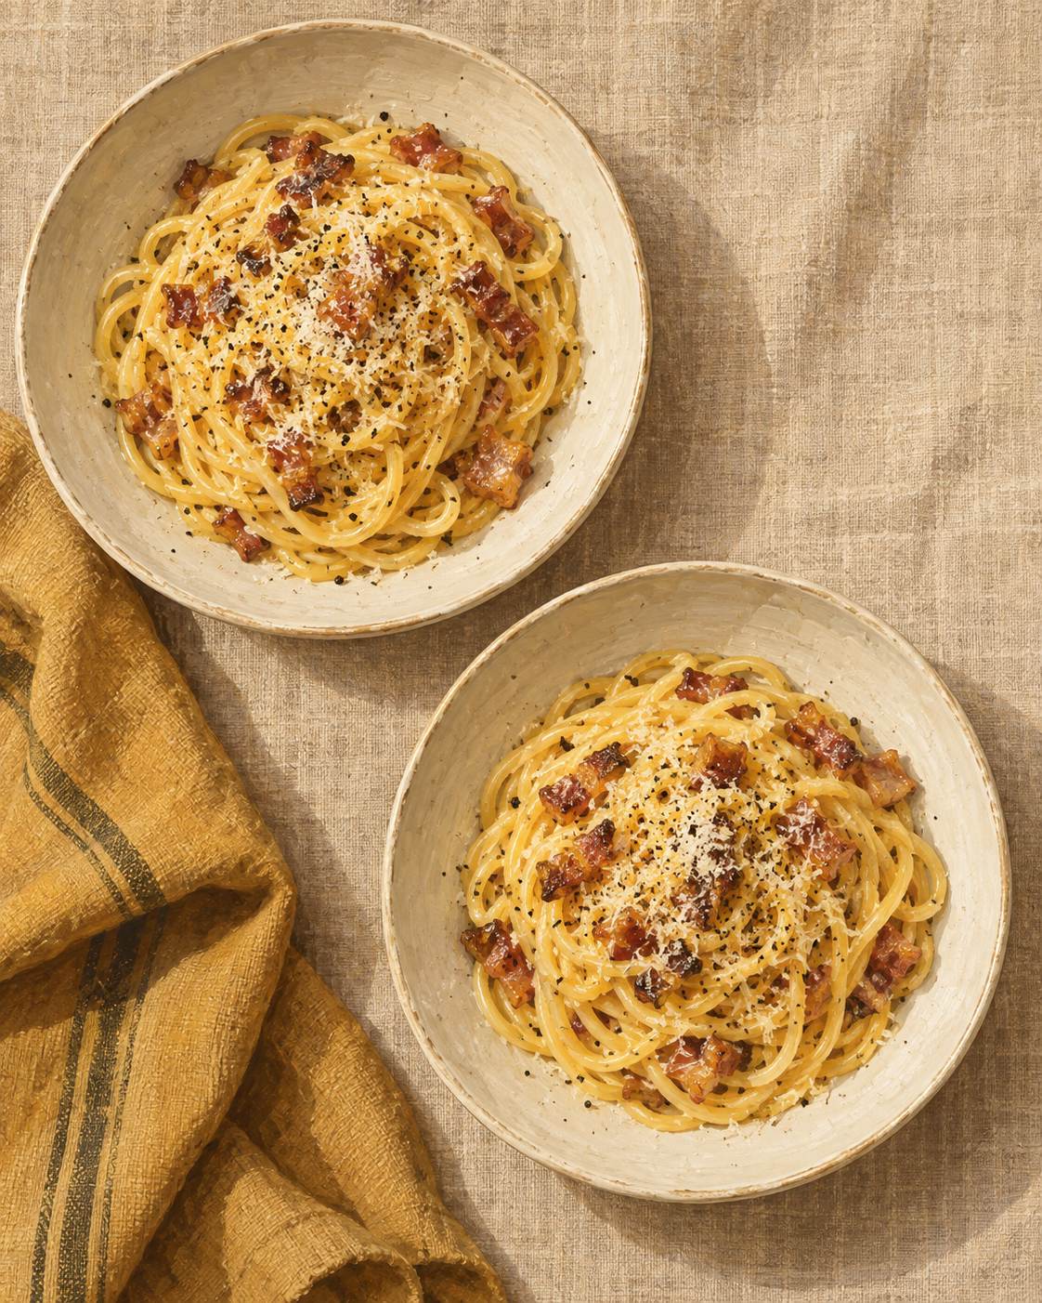
Ready for the table
8 Serve immediately
Divide between two warm bowls.
Finish with the reserved cheese
and freshly ground pepper.
Look for
Glossy sauce that clings to the pasta,
a little bite, and crisp guanciale.
08
Notes:
Warm the bowls with hot water, then dry them just before serving. Carbonara tightens as it stands, so bring both portions to the table promptly. Serving reference: Technique reference: Classic Carbonara, La Cucina Italiana. https://www.lacucinaitaliana.com/recipe/pasta/classic-carbonara (accessed 3 October 2026).

