Slide 1
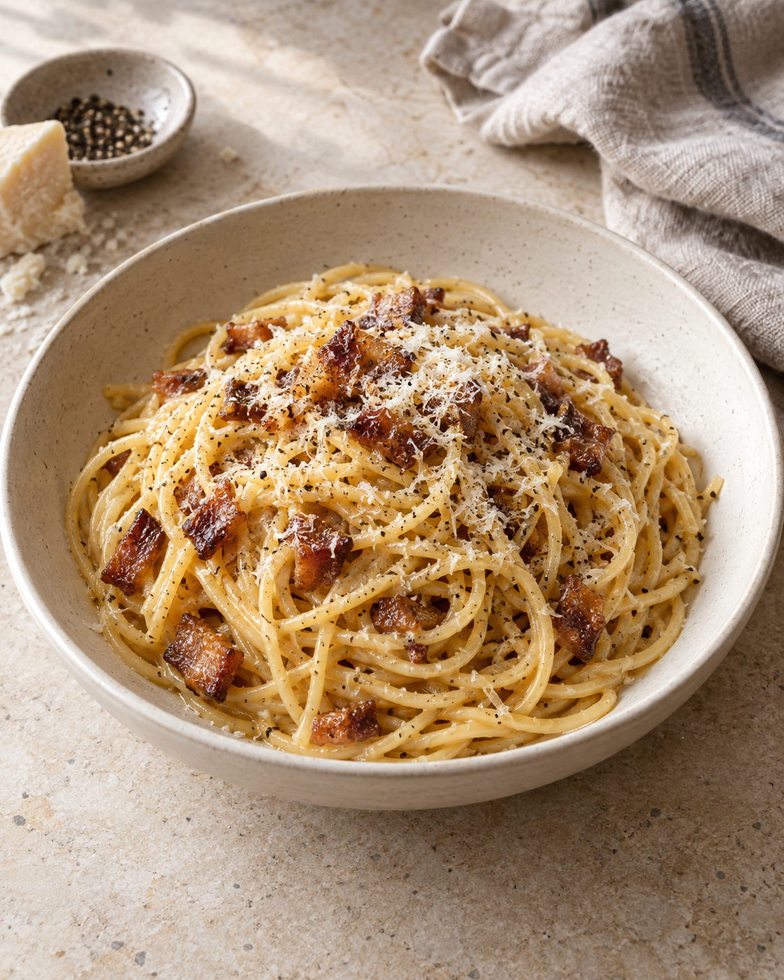
Carbonara
for two
A Roman pasta classic with crisp
guanciale and a silky egg-and-cheese
sauce.
2 servings / About 25–30 minutes
Notes:
Introduction: egg, cheese, rendered guanciale fat and a little starchy water form the sauce. No cream is needed. Total time is an estimate, with pasta cooking while the guanciale renders. Cover image is an AI-generated culinary illustration made with the built-in ImageGen tool. Prompt: editorial cookbook photograph of authentic spaghetti carbonara in an ivory bowl on pale stone, glossy egg-and-Pecorino sauce, crisp guanciale and black pepper, soft window light, cream and gold palette, portrait crop, no herbs or cream, no text.
Recipe adapted for two servings. Technique references: BBC Good Food, Ultimate spaghetti carbonara, https://www.bbcgoodfood.com/recipes/ultimate-spaghetti-carbonara-recipe ; Serious Eats, Pasta Carbonara, https://www.seriouseats.com/pasta-carbonara-sauce-recipe .

Slide 2
Ingredients for two
Ingredient | Quantity | Preparation notes
Spaghetti | 200 g | Cook until al dente.
Guanciale | 100 g | Remove tough rind. Cut into small strips.
Large egg | 1 whole + 2 yolks | Use 2 yolks in addition to the whole egg.
Pecorino Romano | 50 g | Finely grate: 40 g for sauce, 10 g to finish.
Black pepper | ½ tsp, plus to taste | Freshly ground.
Salt | A modest amount | For the pasta water. Taste before adding more.
Pasta cooking water | Reserve 250 mL | Add by the tablespoon. You may not need it all.
The guanciale and Pecorino already add plenty of salt.
02
Notes:
These are adapted quantities for two generous servings, not a verbatim reproduction of either source. The 2 yolks are additional to the whole egg. Divide the 50 g cheese into 40 g for the sauce and 10 g for finishing. Reserve 250 mL water as a working supply and add only what the sauce needs. Guanciale is cured pork jowl. Pancetta is a useful substitute if guanciale is unavailable, with a different flavor.
Recipe adapted for two servings. Technique references: BBC Good Food, Ultimate spaghetti carbonara, https://www.bbcgoodfood.com/recipes/ultimate-spaghetti-carbonara-recipe ; Serious Eats, Pasta Carbonara, https://www.seriouseats.com/pasta-carbonara-sauce-recipe .

Slide 3
The cooking sequence
Follow the arrows. Steps 2 and 3 can overlap.
1 Prepare
Cut, grate and whisk
2 Render guanciale
Cook until golden
3 Cook pasta
Save the cooking water
6 Finish and serve
Serve in warm bowls
5 Add egg mixture
Off the heat, keep tossing
4 Toss in fat
Coat the hot pasta
03
Notes:
Read the top row from left to right, follow the vertical connector down, and read the bottom row from right to left. The six numbered boxes are native editable PowerPoint shapes. For efficient timing, begin the pasta while the guanciale renders. Prepare the egg mixture before either is ready.
Recipe adapted for two servings. Technique references: BBC Good Food, Ultimate spaghetti carbonara, https://www.bbcgoodfood.com/recipes/ultimate-spaghetti-carbonara-recipe ; Serious Eats, Pasta Carbonara, https://www.seriouseats.com/pasta-carbonara-sauce-recipe .

Slide 4
1. Preparation
Egg-and-cheese base
Everything within reach
Beat 1 whole egg and 2 extra yolks
with 40 g finely grated Pecorino
and ½ tsp black pepper.
Cut the guanciale into small strips.
Bring a pot of water to the boil.
Set out a wide pan, mixing bowl,
tongs and a mug for saving
pasta water.
Keep the remaining 10 g cheese
for serving.
Finely grated cheese melts into the sauce more easily.
04
Notes:
Prepare before the pasta finishes because the final sauce comes together quickly. Grate cheese as finely as possible. The mug is for reserving pasta water before draining.
Recipe adapted for two servings. Technique references: BBC Good Food, Ultimate spaghetti carbonara, https://www.bbcgoodfood.com/recipes/ultimate-spaghetti-carbonara-recipe ; Serious Eats, Pasta Carbonara, https://www.seriouseats.com/pasta-carbonara-sauce-recipe .

Slide 5
2–3. Guanciale and pasta
7–10 min
Al dente
Guanciale
Spaghetti
Start in a dry pan over medium-low
heat. Stir until the fat renders and
the edges turn golden.
Lightly salt the boiling water.
Cook the pasta for the package time,
checking for a firm center.
Reserve 250 mL cooking water before draining.
The pasta can cook while the guanciale renders.
05
Notes:
Guanciale timing is approximate and depends on the size of the pieces and the pan. Use medium-low heat and judge by rendered fat and golden edges rather than the clock alone. If the guanciale is ready first, take its pan off the heat. Pasta timing depends on its shape and brand. Keep the cooking water and do not rinse the pasta.
Recipe adapted for two servings. Technique references: BBC Good Food, Ultimate spaghetti carbonara, https://www.bbcgoodfood.com/recipes/ultimate-spaghetti-carbonara-recipe ; Serious Eats, Pasta Carbonara, https://www.seriouseats.com/pasta-carbonara-sauce-recipe .

Slide 6
4–5. Bringing the sauce together
4
5
Coat the pasta
Finish off the heat
Add the hot pasta to the guanciale
and rendered fat. Toss to coat.
Move the pan off the burner. Let
active sizzling subside, then add
the egg mixture and keep tossing.
Add pasta water a tablespoon at a time. Toss until glossy.
06
Notes:
Residual heat warms and thickens the egg mixture. A pan that is still fiercely hot may scramble it, so remove it from the burner and let active sizzling stop before adding eggs. Toss continuously. Use only enough reserved water to loosen and emulsify the sauce.
Recipe adapted for two servings. Technique references: BBC Good Food, Ultimate spaghetti carbonara, https://www.bbcgoodfood.com/recipes/ultimate-spaghetti-carbonara-recipe ; Serious Eats, Pasta Carbonara, https://www.seriouseats.com/pasta-carbonara-sauce-recipe .

Slide 7
Common mistakes and simple fixes
What goes wrong | How to prevent or adjust it
Eggs scramble | Let the pan cool off the burner before adding the egg mixture.
Cheese clumps | Grate it finely and beat it into the eggs before cooking.
Sauce is too thick | Toss in warm pasta water, one tablespoon at a time.
Sauce is too thin | Pause the water additions. Keep tossing as the sauce settles.
Dish tastes too salty | Salt the cooking water lightly. Taste before adding more salt.
Cream is unnecessary. The eggs, cheese, fat and water make the sauce.
07
Notes:
If eggs have already formed firm curds, the sauce will not return to a perfectly smooth texture. Prevent excess heat rather than trying to fix it. Sauce naturally thickens a little as it cools, so serve promptly. Avoid adding the full reserve of pasta water at once.
Recipe adapted for two servings. Technique references: BBC Good Food, Ultimate spaghetti carbonara, https://www.bbcgoodfood.com/recipes/ultimate-spaghetti-carbonara-recipe ; Serious Eats, Pasta Carbonara, https://www.seriouseats.com/pasta-carbonara-sauce-recipe .

Slide 8
6. Finish and serve
Two warm bowls.
Straight to the table.
The finishing touch
The texture check
Divide the pasta between warm bowls.
Add the remaining 10 g Pecorino
and a little black pepper.
Look for glossy, lightly coated strands.
If the sauce tightens, toss in a small
splash of pasta water.
08
Notes:
Serve immediately. Warm bowls help keep the sauce fluid. Finish with the remaining 10 g Pecorino and freshly ground pepper. The sauce should lightly coat the pasta without a pool of watery liquid.
Recipe adapted for two servings. Technique references: BBC Good Food, Ultimate spaghetti carbonara, https://www.bbcgoodfood.com/recipes/ultimate-spaghetti-carbonara-recipe ; Serious Eats, Pasta Carbonara, https://www.seriouseats.com/pasta-carbonara-sauce-recipe .

