Slide 1
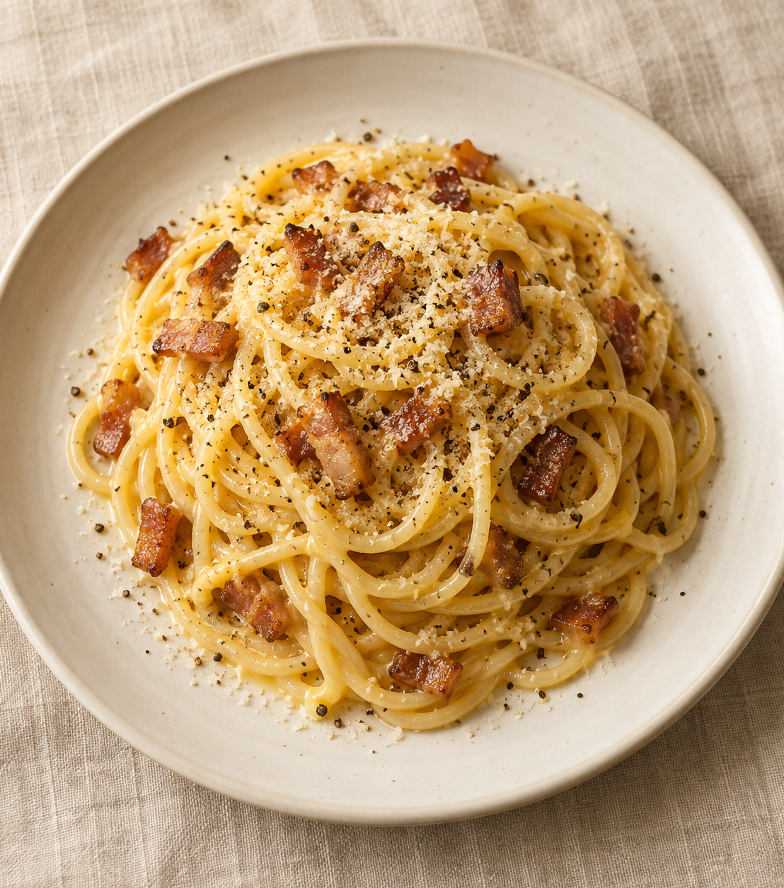
Carbonara
for two
A Roman pasta with golden guanciale and a glossy egg-and-cheese sauce.
2 generous servings
About 25 minutes
Notes:
Carbonara combines pasta, guanciale, eggs, Pecorino and black pepper. The cooking time is an estimate and assumes overlapping the guanciale and pasta cooking. Cover illustration created with OpenAI Image Generation for this deck; it is an illustrative food image.
Recipe technique references:
https://www.giallozafferano.com/recipes/Spaghetti-Carbonara-Bacon-and-egg-spaghetti.html
https://www.lacucinaitaliana.com/italian-food/how-to-cook/spaghetti-carbonara-recipe-and-tips-by-the-pasta-queen
Quantities are a practical adaptation for two generous servings.

Slide 2
Ingredients for two
Measure everything before the pasta goes into the pot.
Ingredient | Quantity | Preparation notes
Spaghetti | 200 g | Cook until al dente
Guanciale | 100 g | Remove rind and cut into short strips
Large eggs | 1 whole egg + 2 yolks | Whisk together in a bowl
Pecorino Romano | 50 g | Finely grate and save 5 g for serving
Black pepper | ½ tsp, plus to finish | Freshly grind
Salt | To taste | Lightly salt the pasta water
Pasta cooking water | Reserve 250 mL | Add gradually as needed
02
Notes:
Use 45 g of the 50 g Pecorino in the egg mixture and reserve 5 g for finishing. The 250 mL pasta water is a reserve, not a required addition. Guanciale and Pecorino provide salt, so salt the water modestly.
Recipe technique references:
https://www.giallozafferano.com/recipes/Spaghetti-Carbonara-Bacon-and-egg-spaghetti.html
https://www.lacucinaitaliana.com/italian-food/how-to-cook/spaghetti-carbonara-recipe-and-tips-by-the-pasta-queen
Quantities are a practical adaptation for two generous servings.

Slide 3
The cooking sequence
Follow the numbered arrows. Steps 2 and 3 can overlap.
1. Prepare
Cut pork. Whisk eggs
with cheese and pepper
2. Render guanciale
Cook gently until golden
and the fat releases
3. Boil spaghetti
Cook al dente. Reserve
250 mL pasta water
6. Serve immediately
Finish with Pecorino
and black pepper
5. Mix off heat
Add eggs. Toss and loosen
with pasta water
4. Coat the pasta
Toss hot spaghetti
with guanciale and fat
03
Notes:
Read the top row from left to right, then follow the downward arrow and the lower row from right to left. Move the pan off the burner before adding the egg mixture.
Recipe technique references:
https://www.giallozafferano.com/recipes/Spaghetti-Carbonara-Bacon-and-egg-spaghetti.html
https://www.lacucinaitaliana.com/italian-food/how-to-cook/spaghetti-carbonara-recipe-and-tips-by-the-pasta-queen
Quantities are a practical adaptation for two generous servings.

Slide 4
1. Preparation
About 5 minutes. Start heating the pot of water as you prepare.
Guanciale
Tools within reach
Remove any tough rind.
Cut 100 g into short strips.
Use a wide skillet, pasta pot, bowl, whisk, tongs and a heatproof cup.
Egg mixture
Fine cheese, smooth sauce
Whisk 1 whole egg and 2 yolks with 45 g Pecorino and ½ tsp pepper.
Grate the Pecorino very finely.
Set aside the remaining 5 g.
04
Notes:
Have the egg mixture ready before the pasta finishes. This keeps the final toss quick and controlled. Finely grated cheese disperses more easily.
Recipe technique references:
https://www.giallozafferano.com/recipes/Spaghetti-Carbonara-Bacon-and-egg-spaghetti.html
https://www.lacucinaitaliana.com/italian-food/how-to-cook/spaghetti-carbonara-recipe-and-tips-by-the-pasta-queen
Quantities are a practical adaptation for two generous servings.

Slide 5
2–3. Guanciale and pasta
The pork can cook while the water comes to a boil.
2. Render the guanciale
3. Cook the spaghetti
About 8–10 minutes
Use the packet as a guide
Start in a dry skillet over medium-low heat. Stir until golden and the fat has rendered.
Move the pan off the burner. Keep the guanciale and its fat.
Boil in lightly salted water, stirring occasionally. Taste near the end: the centre should keep a slight bite.
Before draining, reserve
250 mL pasta water.
05
Notes:
Timing varies with the guanciale strip size and the pan. Look for golden colour and rendered fat, and avoid burning the pork. Pasta cooking time varies by shape and brand. Reserve water before draining and do not rinse the pasta.
Recipe technique references:
https://www.giallozafferano.com/recipes/Spaghetti-Carbonara-Bacon-and-egg-spaghetti.html
https://www.lacucinaitaliana.com/italian-food/how-to-cook/spaghetti-carbonara-recipe-and-tips-by-the-pasta-queen
Quantities are a practical adaptation for two generous servings.

Slide 6
4–5. The glossy sauce
The heat of the pasta gently thickens the egg mixture.
OFF
HEAT
Coat
Toss the hot spaghetti with the guanciale and its rendered fat.
Combine
When fierce sizzling has stopped, add the egg mixture and toss continuously.
Move the skillet away
from the burner before
adding the eggs.
Loosen
Add pasta water 1 tablespoon at a time until the sauce coats every strand.
06
Notes:
Residual pan heat varies. Let an excessively hot pan settle before adding the egg mixture. Keep tossing continuously and use small additions of reserved pasta water. The finished sauce should cling to the pasta and remain fluid. Do not pour in all 250 mL.
Recipe technique references:
https://www.giallozafferano.com/recipes/Spaghetti-Carbonara-Bacon-and-egg-spaghetti.html
https://www.lacucinaitaliana.com/italian-food/how-to-cook/spaghetti-carbonara-recipe-and-tips-by-the-pasta-queen
Quantities are a practical adaptation for two generous servings.

Slide 7
Common mistakes to avoid
Small adjustments make the final toss much easier.
Mistake
Better approach
Eggs meet a very hot pan
Move off the burner and let fierce sizzling stop.
Sauce turns thick or sticky
Add reserved water a spoonful at a time.
Too much water at once
Toss after each spoonful before adding more.
The dish tastes too salty
Salt the pot lightly. Taste before seasoning.
Pasta waits before serving
Have warm bowls ready and serve straight away.
07
Notes:
If the egg mixture scrambles, adding water will not restore a perfectly smooth sauce. Prevention depends on controlling the pan heat. Guanciale and Pecorino add salt, so taste before adding more.
Recipe technique references:
https://www.giallozafferano.com/recipes/Spaghetti-Carbonara-Bacon-and-egg-spaghetti.html
https://www.lacucinaitaliana.com/italian-food/how-to-cook/spaghetti-carbonara-recipe-and-tips-by-the-pasta-queen
Quantities are a practical adaptation for two generous servings.

Slide 8
6. Ready for the table
Divide the carbonara between two warm bowls and serve immediately.
Glossy sauce.
A little bite.
Plenty of pepper.
The final touch
Scatter over the reserved 5 g Pecorino and a little more black pepper.
Before the first forkful
The sauce should cling to the spaghetti without pooling in the bowl.
If the sauce tightens, toss in one more spoonful of warm pasta water.
08
Notes:
Serve promptly because the sauce thickens as it cools. Finish with the reserved cheese and freshly ground black pepper.
Recipe technique references:
https://www.giallozafferano.com/recipes/Spaghetti-Carbonara-Bacon-and-egg-spaghetti.html
https://www.lacucinaitaliana.com/italian-food/how-to-cook/spaghetti-carbonara-recipe-and-tips-by-the-pasta-queen
Quantities are a practical adaptation for two generous servings.

