Slide 1
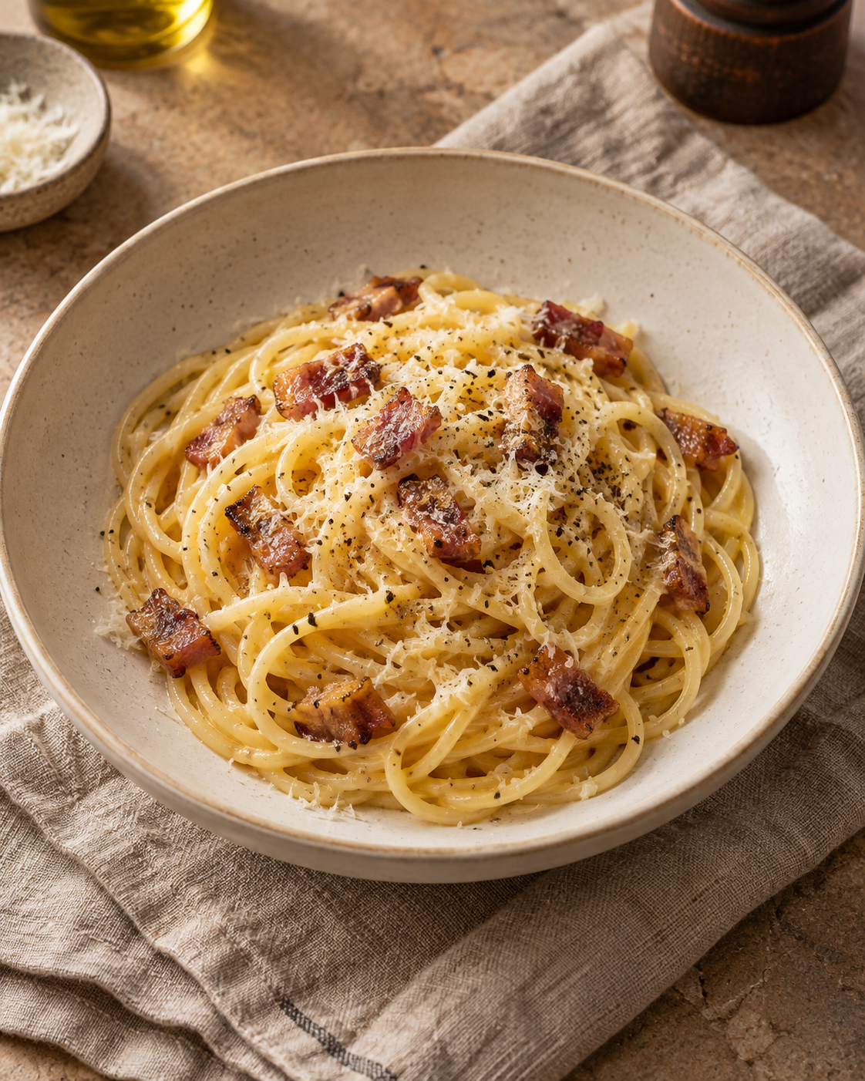
Carbonara
for two
A Roman pasta dish with a silky egg
and cheese sauce, crisp guanciale
and plenty of black pepper.
2 generous servings
About 25 minutes
Notes:
Method reference: GialloZafferano, Spaghetti Carbonara. https://www.giallozafferano.com/recipes/Spaghetti-Carbonara-Bacon-and-egg-spaghetti.html . Quantities are a practical two-serving adaptation, not an exact scaling of the source.
Cover image: AI-generated food illustration using the built-in Image Generation tool. No cream is used in this recipe.

Slide 2
Ingredients for two servings
Have everything measured before the pasta goes in.
Ingredient | Quantity | Preparation notes
Spaghetti | 200 g | Use dried spaghetti.
Guanciale | 100 g | Remove rind. Cut into short strips.
Eggs | 1 whole + 2 yolks | Whisk together in a bowl.
Pecorino Romano | 50 g | Finely grate: 40 g for sauce, 10 g to finish.
Black pepper | ½ tsp, or to taste | Freshly grind. Keep extra for serving.
Salt | As needed | Salt the pasta water moderately.
Pasta cooking water | Reserve 250 mL | Add to the sauce only as needed.
Pancetta can replace guanciale, with a different flavor. No cream is needed.
02
Notes:
Method reference: GialloZafferano, Spaghetti Carbonara. https://www.giallozafferano.com/recipes/Spaghetti-Carbonara-Bacon-and-egg-spaghetti.html . Quantities are a practical two-serving adaptation, not an exact scaling of the source.

Slide 3
The cooking sequence
Follow the arrows. The egg mixture goes in after the pan leaves the burner.
01 Prep
Measure ingredients.
Cut and grate.
02 Render
Cook guanciale
until golden.
03 Cook pasta
Boil spaghetti
until al dente.
04 Whisk
Mix eggs, 40 g
cheese and pepper.
08 Serve
Finish with cheese
and pepper.
07 Sauce
Move pan off heat.
Add eggs and toss.
06 Coat
Toss pasta in
guanciale fat.
05 Reserve
Save pasta water,
then drain.
Whisk the egg mixture while the pasta cooks.
03
Notes:
Method reference: GialloZafferano, Spaghetti Carbonara. https://www.giallozafferano.com/recipes/Spaghetti-Carbonara-Bacon-and-egg-spaghetti.html . Quantities are a practical two-serving adaptation, not an exact scaling of the source.

Slide 4
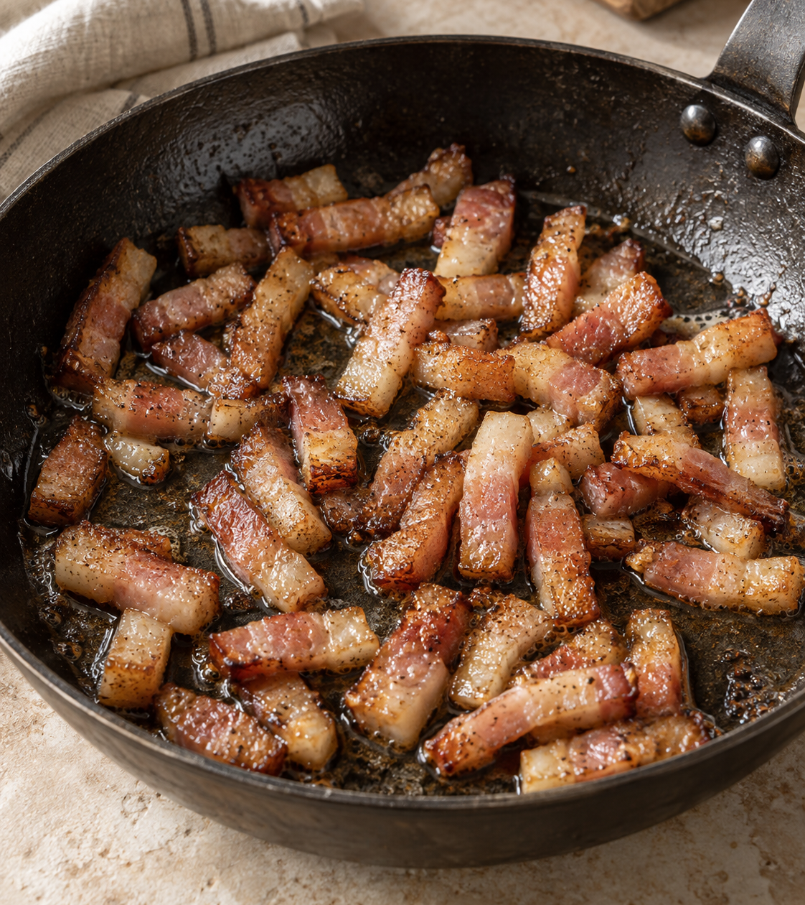
Prep and render
01 Prep the ingredients
Put a pot of water on to boil.
Finely grate the cheese and cut
the guanciale into short strips.
02 Render the guanciale
Start in a dry, wide pan. Cook over
medium-low heat for 7–10 minutes,
stirring, until the edges turn golden.
Keep the rendered fat for the sauce.
Lower the heat if the meat browns too fast.
04
Notes:
Method reference: GialloZafferano, Spaghetti Carbonara. https://www.giallozafferano.com/recipes/Spaghetti-Carbonara-Bacon-and-egg-spaghetti.html . Quantities are a practical two-serving adaptation, not an exact scaling of the source.
Timing is approximate and depends on strip thickness and heat. No added oil is needed for fatty guanciale. Image: AI-generated illustrative food image using the built-in Image Generation tool.

Slide 5
Pasta and egg mixture
03 Cook the spaghetti
04 Whisk while pasta cooks
Salt the boiling water moderately.
Cook 200 g spaghetti until al dente,
using the packet timing as a guide.
Stir so the strands stay separate.
Combine 1 whole egg, 2 yolks,
40 g finely grated Pecorino
and the black pepper.
Whisk into a thick, even mixture.
250 mL
05 Reserve water before draining
Scoop out a mugful, then drain the pasta.
Keep the starch on the pasta. Do not rinse.
05
Notes:
Method reference: GialloZafferano, Spaghetti Carbonara. https://www.giallozafferano.com/recipes/Spaghetti-Carbonara-Bacon-and-egg-spaghetti.html . Quantities are a practical two-serving adaptation, not an exact scaling of the source.

Slide 6
A glossy sauce, off the heat
06 Coat the pasta
Add the drained spaghetti to the pan.
Toss with the guanciale and rendered fat.
OFF
HEAT
07 Add the egg mixture
Move the pan off the burner. If it sizzles
fiercely, let it settle briefly.
Add the egg mixture and toss continuously.
Add pasta water 1 tbsp at a time until glossy.
The sauce should flow and coat the strands. It thickens as it cools.
06
Notes:
Method reference: GialloZafferano, Spaghetti Carbonara. https://www.giallozafferano.com/recipes/Spaghetti-Carbonara-Bacon-and-egg-spaghetti.html . Quantities are a practical two-serving adaptation, not an exact scaling of the source.

Slide 7
Common mistakes and better habits
Common mistake
Better habit
Eggs over direct heat
Move the pan off the burner before adding eggs
to keep the sauce smooth.
Too much water at once
Add a tablespoon at a time. Stop when the
sauce coats the pasta with a glossy sheen.
Too much salt
Salt the water moderately. Taste the finished
sauce before adding any more.
Waiting to serve
Have bowls ready. Carbonara thickens
quickly as it cools.
07
Notes:
Method reference: GialloZafferano, Spaghetti Carbonara. https://www.giallozafferano.com/recipes/Spaghetti-Carbonara-Bacon-and-egg-spaghetti.html . Quantities are a practical two-serving adaptation, not an exact scaling of the source.

Slide 8
The final minute
08
Finish and serve immediately
Divide between two warm bowls.
Add the remaining 10 g Pecorino
and extra freshly ground black pepper.
Ready when…
The sauce looks glossy, the strands stay loose,
and the guanciale has crisp edges.
If the pasta tightens before plating, toss in one more spoonful of warm pasta water.
08
Notes:
Method reference: GialloZafferano, Spaghetti Carbonara. https://www.giallozafferano.com/recipes/Spaghetti-Carbonara-Bacon-and-egg-spaghetti.html . Quantities are a practical two-serving adaptation, not an exact scaling of the source.

