Slide 1
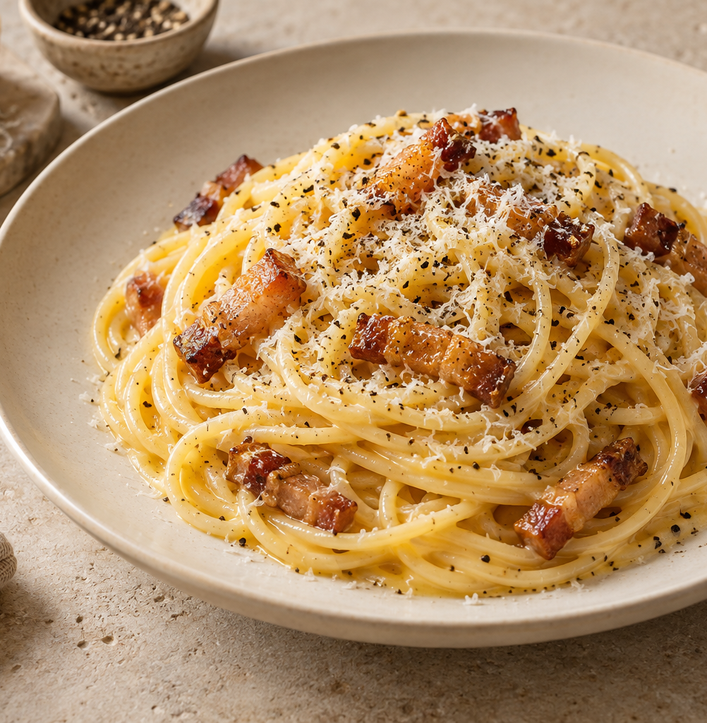
Carbonara
for two
A Roman pasta classic with a silky egg-and-cheese sauce, crisp guanciale and black pepper.
2 servings
About 30 minutes
Notes:
A practical two-serving recipe. The 30-minute total is an estimate and depends on pasta type, burner output and preparation speed. Guanciale is cured pork jowl. The sauce uses egg, cheese, rendered pork fat and a little pasta water.
Recipe references (accessed 3 October 2026):
https://pinabresciani.com/authentic-carbonara/
https://www.seriouseats.com/pasta-carbonara-sauce-recipe
Visual: AI-generated editorial food image, created for this presentation. Illustrative, not a photograph of a documented cooking session.

Slide 2
Ingredients for two servings
Ingredient | Quantity | Preparation notes
Dried spaghetti | 200 g | Cook until just al dente
Guanciale | 100 g | Remove rind. Cut into 5 mm strips
Large eggs | 1 whole + 2 yolks | Whisk together in a bowl
Pecorino Romano | 50 g | Finely grate. Keep 10 g for serving
Black pepper | ½ tsp + extra | Freshly grind
Salt | To taste | Lightly salt the pasta water
Pasta water | Reserve 250 mL | Add a little at a time as needed
The eggs and cheese give this version its creamy texture.
02
Notes:
Ingredient quantities are a practical two-serving adaptation, not an exact reproduction of one named recipe. Use 40 g of the Pecorino in the egg mixture and reserve 10 g for the two finished portions. Reserved pasta water is a working supply, not an amount to add in full.
Recipe references (accessed 3 October 2026):
https://www.lacucinaitaliana.com/recipe/pasta/classic-carbonara
https://pinabresciani.com/authentic-carbonara/
https://www.seriouseats.com/pasta-carbonara-sauce-recipe

Slide 3
The cooking sequence
Follow the numbered arrows. The eggs go in after the pan leaves the heat.
1 Prepare
Cut pork. Whisk
eggs and cheese.
2 Render pork
Cook gently
until golden.
3 Cook pasta
Boil until
just al dente.
4 Reserve & coat
Save pasta water.
Toss pasta in fat.
8 Serve
Divide into bowls.
Add cheese, pepper.
7 Loosen sauce
Add warm water
a spoon at a time.
6 Add eggs
Pour in mixture.
Toss constantly.
5 Take off heat
Move the pan.
Let sizzling stop.
The pork and pasta can cook at the same time once everything is prepared.
03
Notes:
Steps 2 and 3 can overlap. Heat the water during preparation. Follow the numbered sequence through the hot cooking stages and finish by adding the egg mixture off heat.
Recipe references (accessed 3 October 2026):
https://www.lacucinaitaliana.com/recipe/pasta/classic-carbonara
https://pinabresciani.com/authentic-carbonara/

Slide 4
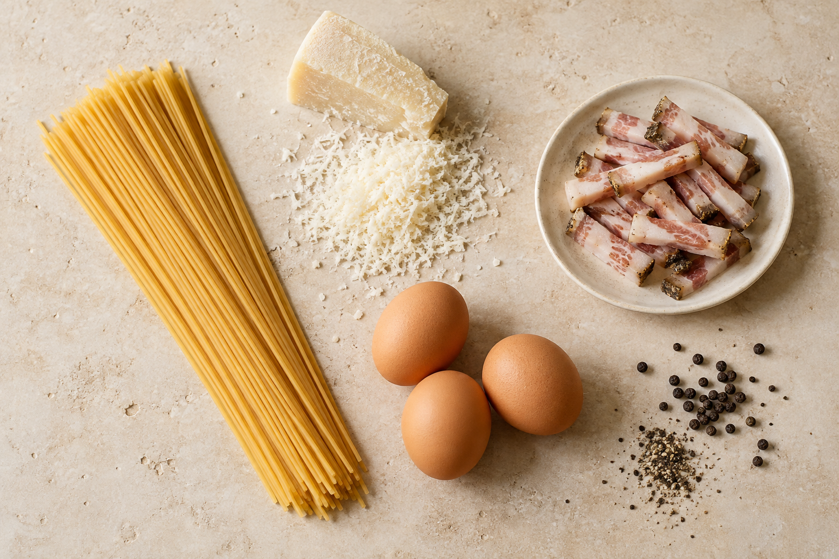
Preparation before cooking
Cut the guanciale
Remove the tough rind. Slice into short strips about 5 mm thick.
Whisk the egg mixture
Mix 1 whole egg, 2 yolks, 40 g cheese and ½ tsp black pepper.
Start heating the water
Bring a pot of water to a boil. Salt lightly because the pork and cheese are salty.
Have ready: a wide pan, tongs, a bowl, a fine grater and a heatproof mug.
04
Notes:
Fine grating helps cheese blend into the sauce. Set out equipment and measure ingredients before starting so the hot pasta does not have to wait. Keep the remaining 10 g cheese for serving. The three pictured eggs supply one whole egg plus two yolks.
Recipe references (accessed 3 October 2026):
https://pinabresciani.com/authentic-carbonara/
https://www.seriouseats.com/pasta-carbonara-sauce-recipe
Visual: AI-generated editorial food image, created for this presentation. Illustrative, not a photograph of a documented cooking session.

Slide 5
Guanciale and spaghetti
GUANCIALE
SPAGHETTI
8–10 min
Just al dente
Start in a cold, dry pan. Cook over medium-low heat, stirring occasionally, until golden with crisp edges.
Use the package time as a guide. Stir during cooking and taste a strand near the end.
Keep the rendered fat in the pan. Take the pan off heat if the pasta is not ready.
Before draining, scoop out 250 mL of the starchy cooking water.
05
Notes:
Timing is approximate: follow the pork’s color and crispness, and taste the pasta for doneness. A cold pan lets the guanciale fat render gradually. No added oil is needed for this guanciale version. The pork and pasta can cook in parallel.
Recipe references (accessed 3 October 2026):
https://pinabresciani.com/authentic-carbonara/

Slide 6
The sauce comes together off heat
4
Coat the hot pasta
Toss spaghetti with the guanciale and its fat.
5
Move the pan off the burner
Let strong sizzling stop. Keep the pasta hot.
6
Add the egg mixture
Pour it over the pasta and toss continuously.
Gentle residual heat helps the sauce thicken without scrambling the eggs.
06
Notes:
The skillet should be warm but no longer aggressively sizzling when the egg mixture is added. Keep tossing so the sauce contacts the hot pasta evenly. Carbonara is sensitive to pan heat: moving a pan off an electric burner means moving it to an unheated surface, not simply turning the burner dial off.
Recipe references (accessed 3 October 2026):
https://www.lacucinaitaliana.com/recipe/pasta/classic-carbonara
https://pinabresciani.com/authentic-carbonara/

Slide 7
A glossy finish, then straight to the table
7
Adjust with pasta water
Add warm reserved water 1 tablespoon at a time, tossing after each addition. Stop when the sauce lightly coats every strand.
8
Serve immediately
Divide between two warm bowls. Finish with the reserved cheese and extra pepper.
Aim for a slightly loose sauce. It continues to thicken on the plate.
07
Notes:
Do not add all 250 mL of reserved water automatically. It is a supply for adjustments; the actual quantity varies with the pasta and heat. The desired texture is smooth and glossy, with no puddle of thin liquid. Carbonara thickens as it cools, so plate and eat immediately.
Recipe references (accessed 3 October 2026):
https://www.lacucinaitaliana.com/recipe/pasta/classic-carbonara
https://pinabresciani.com/authentic-carbonara/
https://www.seriouseats.com/pasta-carbonara-sauce-recipe

Slide 8
Common mistakes and better habits
COMMON MISTAKE
BETTER HABIT
Eggs hit a very hot pan
Move the pan off heat and let strong sizzling stop before adding eggs.
Cheese forms lumps
Finely grate the cheese and whisk it into the eggs before cooking.
The dish tastes too salty
Salt the pasta water lightly. Taste before adding any more salt.
The sauce turns watery
Add pasta water a tablespoon at a time, then toss and reassess.
Have bowls ready before mixing the sauce so the carbonara reaches the table hot.
08
Notes:
Practical reminders for a first attempt. Excessive heat can curdle the eggs, coarse cheese may resist mixing, and guanciale plus Pecorino already contribute substantial salt. Add water gradually and serve promptly.
Recipe references (accessed 3 October 2026):
https://www.lacucinaitaliana.com/recipe/pasta/classic-carbonara
https://pinabresciani.com/authentic-carbonara/
https://www.seriouseats.com/pasta-carbonara-sauce-recipe

