Slide 1
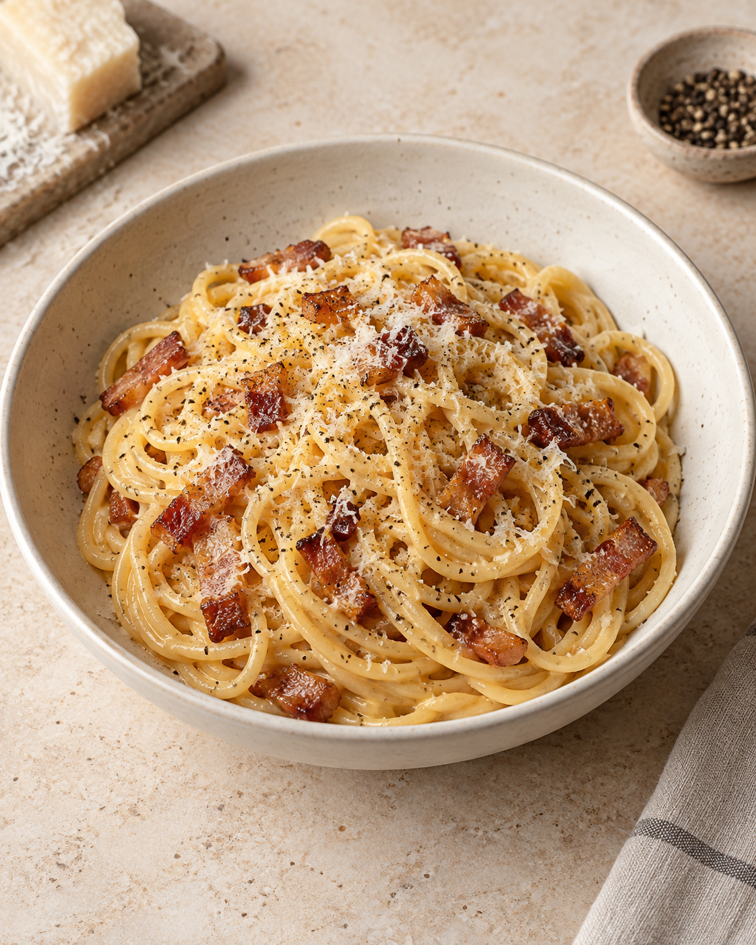
Carbonara
for two
A Roman pasta classic with eggs,
Pecorino, guanciale and black pepper.
About 30 minutes
Two generous servings
Notes:
An approachable, adapted recipe for two generous servings. The time is an estimate and depends on the pasta and pan. Egg and cheese proportions vary among established recipes. The creamy sauce comes from eggs, cheese, rendered pork fat and starchy cooking water.
Cover visual: AI-generated culinary illustration, created for this presentation with OpenAI imagegen. Prompt: editorial cookbook photo of carbonara in an ivory bowl, glossy golden sauce, guanciale, pepper and Pecorino, warm stone surface, natural light, no herbs or text.
Sources:
https://www.giallozafferano.com/recipes/Spaghetti-Carbonara-Bacon-and-egg-spaghetti.html
https://www.seriouseats.com/pasta-carbonara-sauce-recipe

Slide 2
Ingredients for two
Ingredient | Quantity | Preparation notes
Spaghetti | 200 g | Dry pasta
Guanciale | 100 g | Remove rind. Cut into short strips.
Eggs | 1 large egg + 2 yolks | Whisk together in a bowl.
Pecorino Romano | 50 g | Finely grate. Use 45 g in sauce, 5 g to finish.
Black pepper | ½ tsp, plus to taste | Freshly grind. Save a little for serving.
Salt | As needed | Lightly salt the pasta water.
Pasta cooking water | Reserve 250 mL | Add only a little at a time, as needed.
Guanciale is cured pork cheek. Pancetta is a useful substitute.
02
Notes:
All quantities are for two generous servings. This is an adapted recipe, not a verbatim scaling of a single source. Use 45 g Pecorino in the egg mixture and reserve the remaining 5 g to finish. The 250 mL water is a reserve, not an amount to pour into the pan. Pancetta changes the flavor but works as a substitute.
Sources:
https://www.giallozafferano.com/recipes/Spaghetti-Carbonara-Bacon-and-egg-spaghetti.html
https://www.seriouseats.com/pasta-carbonara-sauce-recipe

Slide 3
The cooking sequence
Six steps, with the egg mixture added off the heat
1 Prepare ingredients
Whisk the egg mixture
2 Render guanciale
Cook until golden
3 Cook the pasta
Reserve 250 mL water
6 Adjust and serve
Loosen, finish and plate
5 Add eggs off heat
Keep tossing the pasta
4 Toss in pork fat
Coat the hot spaghetti
Have the egg mixture ready before the pasta finishes cooking.
03
Notes:
Follow the numbered path across the top row, down at the right, then back across the bottom row. In practice, the water can heat while the guanciale cooks. The essential sequence is to reserve the water before draining and remove the pan from direct heat before adding eggs.
Sources:
https://www.giallozafferano.com/recipes/Spaghetti-Carbonara-Bacon-and-egg-spaghetti.html
https://www.seriouseats.com/pasta-carbonara-sauce-recipe

Slide 4
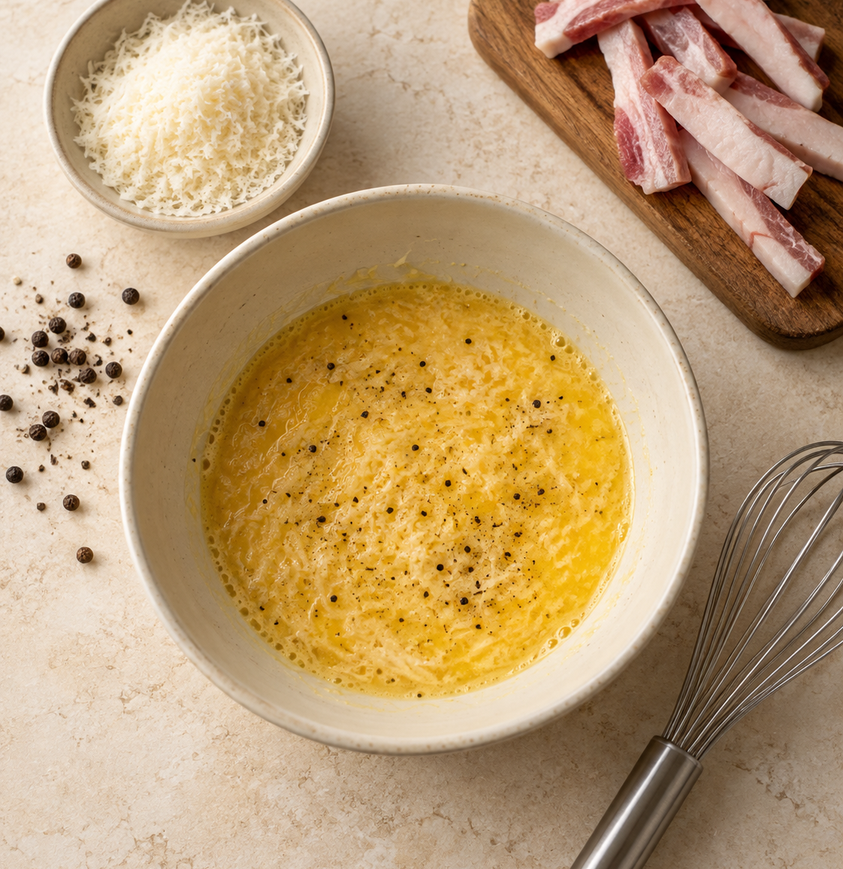
Preparation before cooking
01
Grate and cut
Finely grate the cheese. Remove the guanciale rind and cut short strips.
02
Whisk the egg mixture
Combine 1 whole egg, 2 yolks, 45 g Pecorino and ½ tsp pepper.
03
Set out the tools
Use a pot, wide pan, bowl, tongs and a cup for the pasta water.
04
Notes:
Fine cheese melts into the sauce more evenly. Reserve 5 g Pecorino for the finish. Begin heating a pot of water while preparing the ingredients. Have two serving dishes ready.
Visual: AI-generated culinary illustration, created for this presentation with OpenAI imagegen. Prompt: warm neutral cookbook photo of whisked egg, Pecorino and pepper, grated cheese dish, raw guanciale strips and whisk on cream stone, no text, herbs or hands.
Sources:
https://www.giallozafferano.com/recipes/Spaghetti-Carbonara-Bacon-and-egg-spaghetti.html
https://www.lacucinaitaliana.com/recipe/pasta/classic-carbonara

Slide 5
Rendering the guanciale
01
Start in a dry pan
6–8
Add the guanciale to a cool pan. Its own fat will melt as it heats.
minutes, approximately
02
Cook gently
Stir often until the edges turn golden and the fat collects in the pan.
Medium-low heat
03
Keep the rendered fat
Turn off the heat when ready. Leave the pork and its fat in the pan.
05
Notes:
Timing varies with the cut and pan. Use the appearance of the guanciale as the main cue: golden edges and rendered fat, without dark burnt pieces. Moderate heat gives the fat time to render. No added oil is needed. If the guanciale finishes before the pasta, take the pan off the burner.
Sources:
https://www.giallozafferano.com/recipes/Spaghetti-Carbonara-Bacon-and-egg-spaghetti.html
https://www.seriouseats.com/pasta-carbonara-sauce-recipe

Slide 6
Cooking the spaghetti
01
Lightly salt boiling water
The guanciale and Pecorino already contribute plenty of salt.
250 mL
02
Cook until al dente
pasta water to reserve
Follow the packet timing and taste. The center should stay slightly firm.
Keep it beside the stove.
You will use only as much
as the sauce needs.
03
Reserve, then transfer
Save water before draining. Toss the hot spaghetti in the guanciale fat.
06
Notes:
Reserve a full cup (250 mL) as a convenient buffer. The sauce normally uses only a fraction of that amount. Transfer the pasta without rinsing so it retains surface starch. Toss it with the pork fat before the egg mixture goes in. If the pan has cooled completely, briefly warm the pasta and fat together, then move the pan off the burner.
Sources:
https://www.giallozafferano.com/recipes/Spaghetti-Carbonara-Bacon-and-egg-spaghetti.html
https://www.seriouseats.com/pasta-carbonara-sauce-recipe

Slide 7
Making the silky sauce
Off
heat
01
Let strong sizzling subside
Keep the pasta hot, but give an overheated pan a moment to cool.
02
Add the egg mixture
Pour it over the pasta and toss continuously to coat the strands.
Move the pan off the burner
before the eggs go in.
03
Loosen gradually
Add warm pasta water 1 tablespoon at a time until the sauce turns glossy.
07
Notes:
The exact cooling pause depends on the pan material and its temperature. Keep tossing as the egg mixture meets the hot pasta. The desired sauce lightly coats every strand, with no visible egg curds or watery puddle. If needed, add reserved water a spoonful at a time, tossing after each addition. Avoid strong direct heat once eggs are in the pan.
Sources:
https://www.giallozafferano.com/recipes/Spaghetti-Carbonara-Bacon-and-egg-spaghetti.html
https://www.lacucinaitaliana.com/recipe/pasta/classic-carbonara
https://www.seriouseats.com/pasta-carbonara-sauce-recipe

Slide 8
Common mistakes to avoid
What to avoid
What helps
Scrambled eggs
Take the pan off the burner. Add the eggs only after strong sizzling stops.
Thick, sticky sauce
Toss in pasta water a tablespoon at a time until the strands move freely.
Watery sauce
Add water gradually. Pause and toss before adding another spoonful.
Too much salt
Salt the cooking water lightly. Taste the finished sauce before adding salt.
Serve immediately
Finish with the remaining 5 g Pecorino and a little pepper.
08
Notes:
Serve carbonara as soon as the sauce is glossy because it thickens as it stands. Aim for a slightly loose sauce in the pan. Fine grating, restrained salting and small additions of pasta water improve control. Scrambling cannot be fully reversed once the eggs form firm curds, so heat control is preventive.
Sources:
https://www.giallozafferano.com/recipes/Spaghetti-Carbonara-Bacon-and-egg-spaghetti.html
https://www.seriouseats.com/pasta-carbonara-sauce-recipe
https://www.lacucinaitaliana.com/recipe/pasta/classic-carbonara

