Slide 1
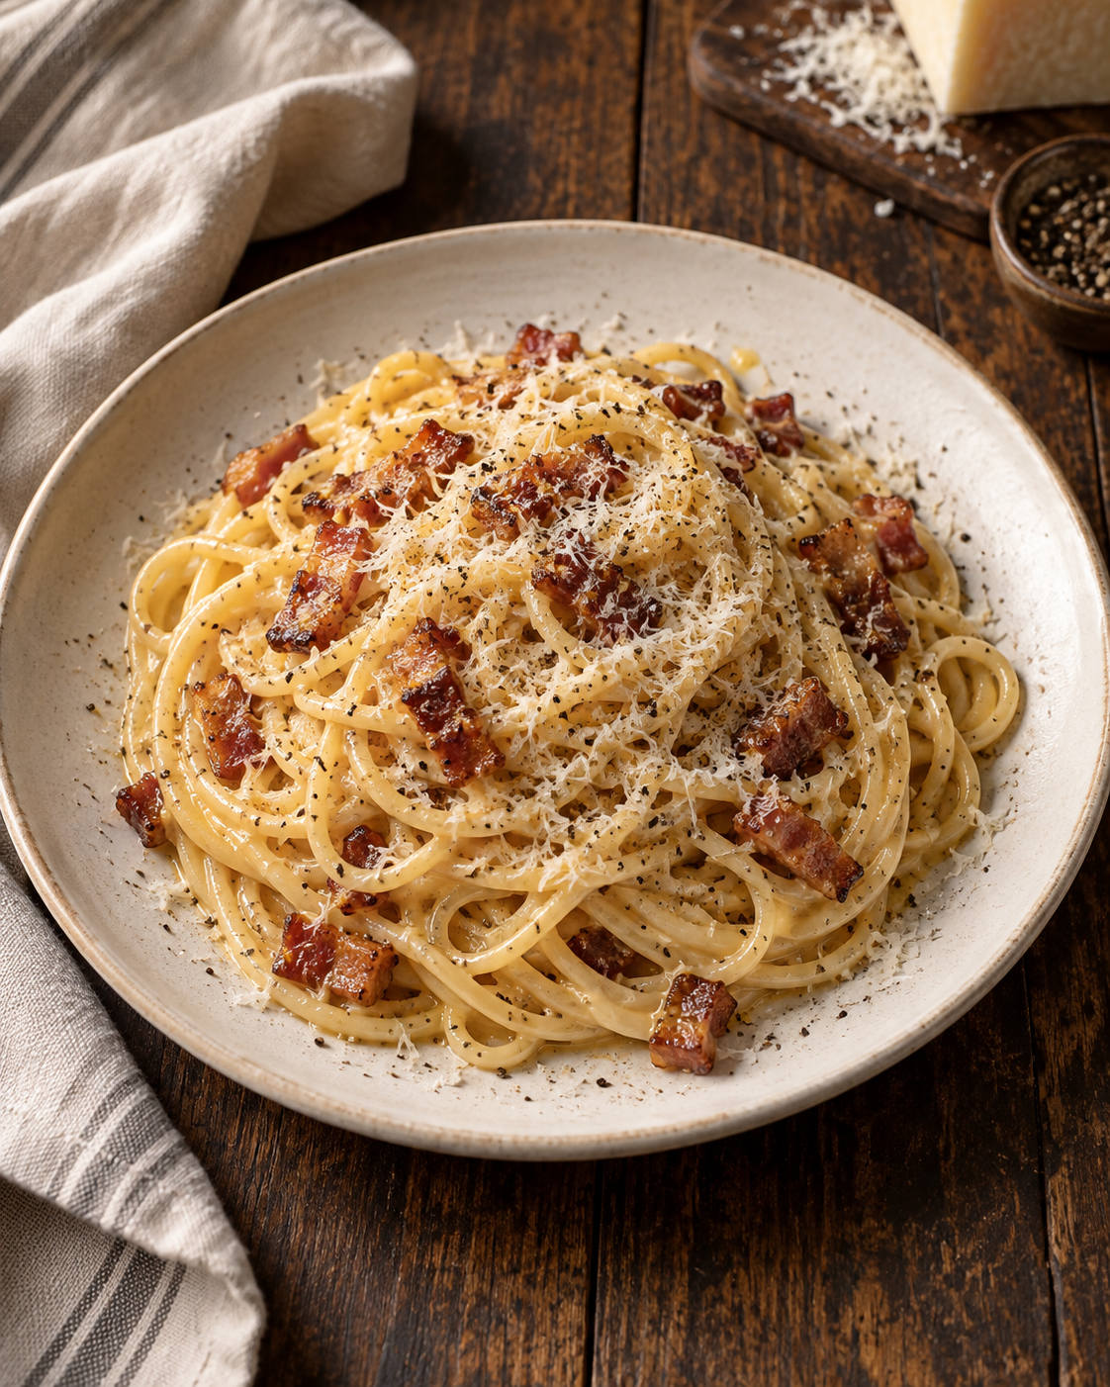
Carbonara
for two
A Roman pasta dish with crisp guanciale, Pecorino, eggs and black pepper.
2 generous servings
About 25–30 minutes
Notes:
Recipe references: https://www.lacucinaitaliana.it/ricetta/primi/carbonara-classica/ ; https://www.recipesfromitaly.com/spaghetti-carbonara-original-recipe/ ; https://www.seriouseats.com/pasta-carbonara-sauce-recipe . Quantities adapted for two generous servings. Cooking times are approximate; follow visual and texture cues. The sauce gets its creamy texture from eggs, cheese, rendered fat and starchy pasta water. Cream is not an ingredient in this recipe.

Slide 2
Ingredients for two servings
Ingredient | Quantity | Preparation notes
Spaghetti | 200 g | Cook until just firm in the center.
Guanciale | 100 g | Remove tough rind. Cut into small strips.
Large eggs | 1 egg + 2 yolks | Use 1 whole egg and 2 additional yolks.
Pecorino Romano | 50 g | Grate finely. Sauce: 40 g. Finish: 10 g.
Black pepper | ½ tsp + extra | Freshly grind, with extra for serving.
Water and salt | About 2 L + salt | Salt lightly. Save 250 ml before draining.
Guanciale is cured pork jowl. Pancetta works as a substitute.
02
Notes:
Recipe references: https://www.lacucinaitaliana.it/ricetta/primi/carbonara-classica/ ; https://www.recipesfromitaly.com/spaghetti-carbonara-original-recipe/ ; https://www.seriouseats.com/pasta-carbonara-sauce-recipe . Quantities adapted for two generous servings. Cooking times are approximate; follow visual and texture cues.

Slide 3
The cooking sequence
The eggs go in only after the pan leaves the heat.
1 Prepare
Chop guanciale.
Grate cheese.
2 Crisp guanciale
Render until crisp.
Set pan aside.
3 Mix sauce base
Whisk eggs,
cheese and pepper.
4 Cook pasta
Cook until just firm.
Reserve 250 ml water.
8 Serve
Add cheese and pepper.
Eat immediately.
7 Toss the sauce
Add egg mixture.
Loosen with water.
6 Leave the heat
Move pan off burner.
Let sizzling subside.
5 Coat pasta
Warm pan gently.
Toss pasta in fat.
03
Notes:
Recipe references: https://www.lacucinaitaliana.it/ricetta/primi/carbonara-classica/ ; https://www.recipesfromitaly.com/spaghetti-carbonara-original-recipe/ ; https://www.seriouseats.com/pasta-carbonara-sauce-recipe . Quantities adapted for two generous servings. Cooking times are approximate; follow visual and texture cues.

Slide 4
Preparation, guanciale and eggs
1
Preparation
Start heating the pasta water. Cut the guanciale into small strips and grate the cheese finely.
2
Guanciale
Start in a cold, dry skillet. Cook over medium-low heat for 6–10 minutes until golden and crisp. Take off heat and keep the fat.
3
Egg mixture
Whisk 1 whole egg, 2 yolks, 40 g Pecorino and ½ tsp pepper into a thick mixture. Save 10 g cheese for serving.
04
Notes:
Recipe references: https://www.lacucinaitaliana.it/ricetta/primi/carbonara-classica/ ; https://www.recipesfromitaly.com/spaghetti-carbonara-original-recipe/ ; https://www.seriouseats.com/pasta-carbonara-sauce-recipe . Quantities adapted for two generous servings. Cooking times are approximate; follow visual and texture cues.

Slide 5
Pasta and rendered fat
4 Cook the spaghetti
250 ml
Use lightly salted boiling water. Follow the packet timing, then taste for a firm center.
Pasta water to reserve
before draining
5 Coat with guanciale fat
Reserve the water. Briefly warm the skillet over low heat, add the hot pasta and toss with the guanciale and fat.
Keep the water beside the pan. Add only what the sauce needs.
05
Notes:
Recipe references: https://www.lacucinaitaliana.it/ricetta/primi/carbonara-classica/ ; https://www.recipesfromitaly.com/spaghetti-carbonara-original-recipe/ ; https://www.seriouseats.com/pasta-carbonara-sauce-recipe . Quantities adapted for two generous servings. Cooking times are approximate; follow visual and texture cues.

Slide 6
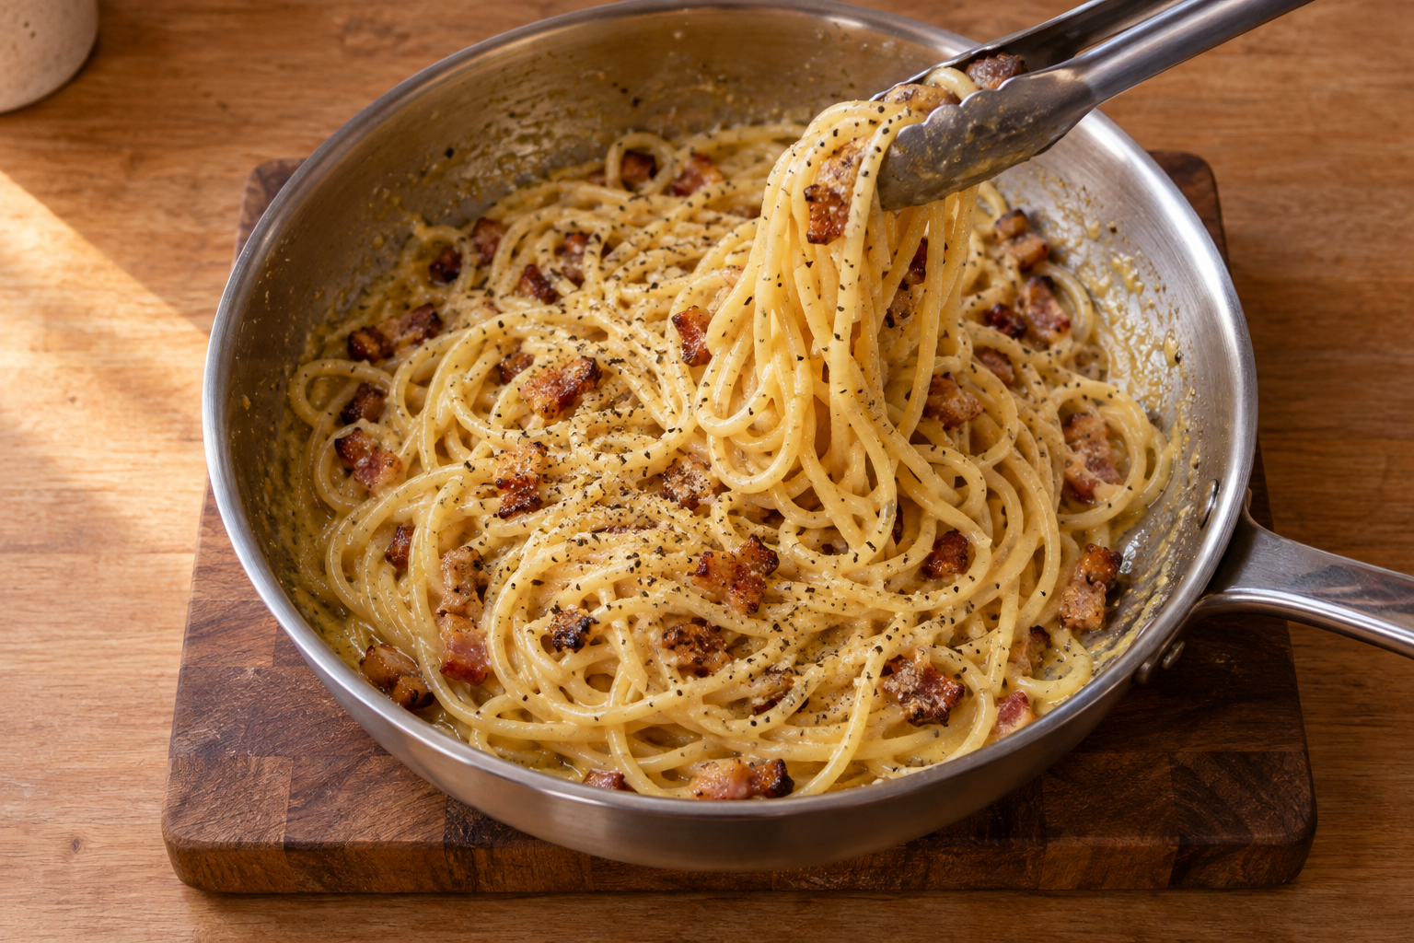
A smooth sauce off the heat
6 Move the pan off the burner
Set the pan on a cool surface. Let strong sizzling subside.
7 Add eggs and loosen sauce
Add the egg mixture while tossing. Then add warm pasta water 1 tablespoon at a time until the sauce turns glossy.
You will not need all 250 ml.
06
Notes:
Recipe references: https://www.lacucinaitaliana.it/ricetta/primi/carbonara-classica/ ; https://www.recipesfromitaly.com/spaghetti-carbonara-original-recipe/ ; https://www.seriouseats.com/pasta-carbonara-sauce-recipe . Quantities adapted for two generous servings. Cooking times are approximate; follow visual and texture cues.

Slide 7
Finishing and serving
8 Serve immediately
Divide between two warm bowls. Finish with the remaining 10 g Pecorino and freshly ground black pepper.
Taste before salting
Keep the sauce loose
Guanciale and Pecorino already bring plenty of salt.
The sauce thickens as it stands. Have bowls ready before the final toss.
07
Notes:
Recipe references: https://www.lacucinaitaliana.it/ricetta/primi/carbonara-classica/ ; https://www.recipesfromitaly.com/spaghetti-carbonara-original-recipe/ ; https://www.seriouseats.com/pasta-carbonara-sauce-recipe . Quantities adapted for two generous servings. Cooking times are approximate; follow visual and texture cues.

Slide 8
Common mistakes and better habits
Scrambled egg sauce
Move the pan off the burner before adding eggs. Keep tossing. Excess heat sets the eggs into curds.
Dry or sticky pasta
Add reserved warm water a tablespoon at a time. Toss after each addition and stop when glossy.
Thin, watery sauce
Add less water at first. Toss for 20–30 seconds before deciding whether the sauce needs more.
Salty or greasy finish
Salt the water lightly, taste before seasoning, and skip extra oil. Do not rinse away the pasta’s starch.
08
Notes:
Recipe references: https://www.lacucinaitaliana.it/ricetta/primi/carbonara-classica/ ; https://www.recipesfromitaly.com/spaghetti-carbonara-original-recipe/ ; https://www.seriouseats.com/pasta-carbonara-sauce-recipe . Quantities adapted for two generous servings. Cooking times are approximate; follow visual and texture cues.

