Slide 1
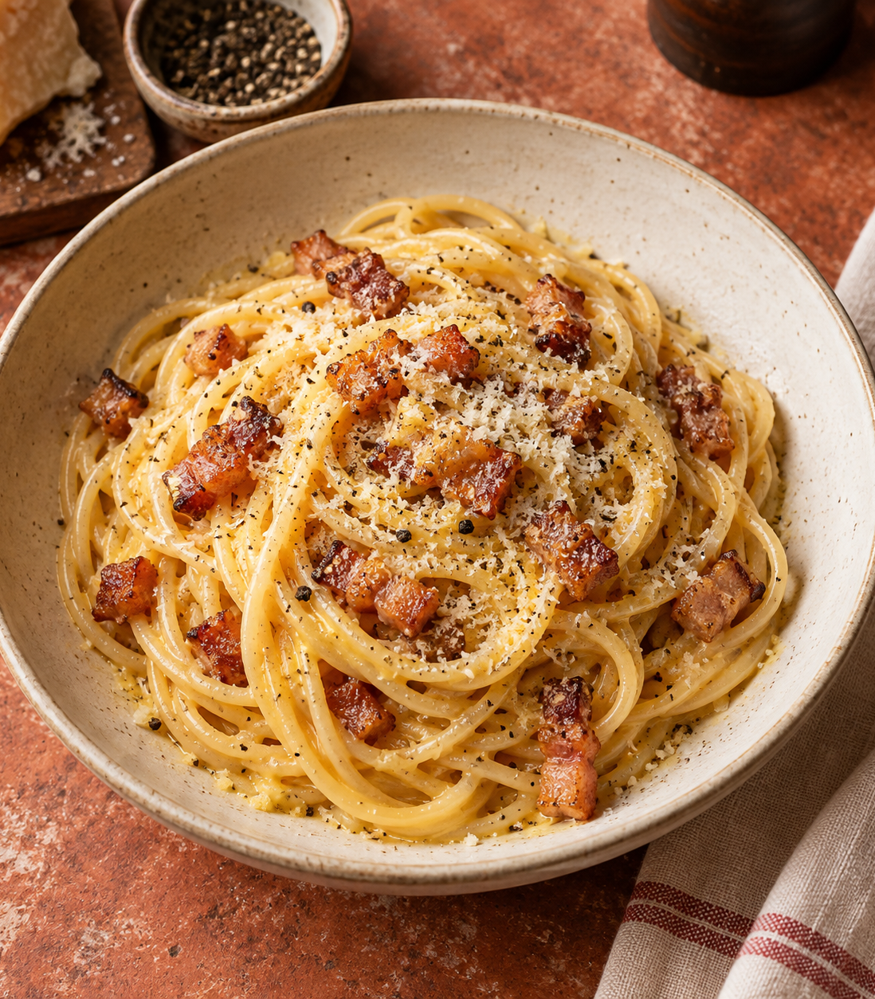
Carbonara
for two
A Roman pasta classic with a silky
egg-and-cheese sauce, crisp guanciale
and freshly ground black pepper.
2 SERVINGS
ABOUT 25 MINUTES
Notes:
Recipe proportions and core technique: GialloZafferano, Spaghetti Carbonara. https://www.giallozafferano.com/recipes/Spaghetti-Carbonara-Bacon-and-egg-spaghetti.html (accessed 3 October 2026). Ingredient quantities are half of its four-serving recipe. Reserve 150 ml of pasta water as a practical working amount, adding only as needed.
Cover visual: generated cookbook illustration using OpenAI ImageGen, 3 October 2026. It depicts the dish rather than a documented cooking result.

Slide 2
Ingredients for two
Ingredient | Quantity | Preparation notes
Spaghetti | 160 g | Cook until al dente.
Guanciale | 75 g | Remove rind. Cut into small strips.
Egg yolks | 3 medium | Separate before cooking.
Pecorino Romano | 25 g | Finely grate. Extra for serving is optional.
Black pepper | To taste | Freshly grind.
Salt | To taste | Lightly season the pasta water.
Pasta water | Reserve 150 ml | Add a spoonful at a time, only as needed.
The sauce uses yolks, cheese, rendered fat and starchy water. No cream is needed.
02
Notes:
Recipe proportions and core technique: GialloZafferano, Spaghetti Carbonara. https://www.giallozafferano.com/recipes/Spaghetti-Carbonara-Bacon-and-egg-spaghetti.html (accessed 3 October 2026). Ingredient quantities are half of its four-serving recipe. Reserve 150 ml of pasta water as a practical working amount, adding only as needed.
Additional texture and serving technique: BBC Good Food, Next level spaghetti carbonara. https://www.bbcgoodfood.com/recipes/next-level-spaghetti-carbonara ; Serious Eats, Pasta Carbonara. https://www.seriouseats.com/pasta-carbonara-sauce-recipe (accessed 3 October 2026).

Slide 3
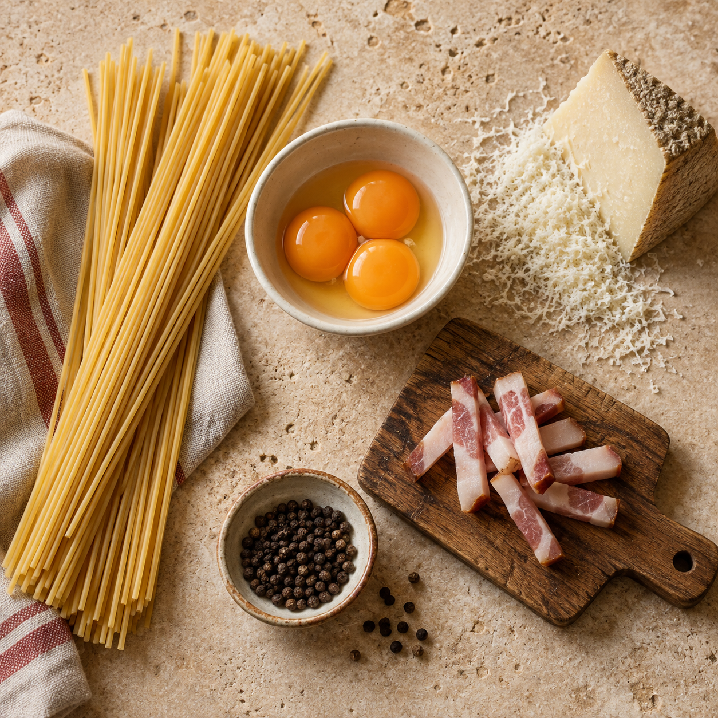
Before cooking
Cut and grate
Cut the guanciale into small strips.
Finely grate the Pecorino.
Whisk the yolk mixture
Mix the yolks, cheese and pepper
in a bowl. Set it beside the stove.
Set up the equipment
Use a pot, a wide frying pan, a bowl,
a whisk, tongs and a cup for pasta water.
03
Notes:
Recipe proportions and core technique: GialloZafferano, Spaghetti Carbonara. https://www.giallozafferano.com/recipes/Spaghetti-Carbonara-Bacon-and-egg-spaghetti.html (accessed 3 October 2026). Ingredient quantities are half of its four-serving recipe. Reserve 150 ml of pasta water as a practical working amount, adding only as needed.
Start heating the lightly salted pasta water while preparing the ingredients. Ingredient visual: generated with OpenAI ImageGen, 3 October 2026.

Slide 4
The cooking flow
1 Prepare
Cut, grate and whisk
2 Render guanciale
Cook until golden
3 Cook pasta
Save 150 ml water
6 Serve immediately
Finish with black pepper
5 Add yolk mixture
Toss and loosen with water
4 Toss in the fat
Then remove from heat
Cook the pasta while the guanciale renders. Keep the yolk mixture ready.
04
Notes:
Recipe proportions and core technique: GialloZafferano, Spaghetti Carbonara. https://www.giallozafferano.com/recipes/Spaghetti-Carbonara-Bacon-and-egg-spaghetti.html (accessed 3 October 2026). Ingredient quantities are half of its four-serving recipe. Reserve 150 ml of pasta water as a practical working amount, adding only as needed.
Additional texture and serving technique: BBC Good Food, Next level spaghetti carbonara. https://www.bbcgoodfood.com/recipes/next-level-spaghetti-carbonara ; Serious Eats, Pasta Carbonara. https://www.seriouseats.com/pasta-carbonara-sauce-recipe (accessed 3 October 2026).

Slide 5
The pan and pot
02
03
Guanciale in the pan
Spaghetti in the pot
Cook over medium heat for about
8–10 minutes, stirring occasionally.
The fat should melt out and the
edges turn golden.
Cook in lightly salted boiling water.
Stir occasionally and taste near the
packet’s cooking time. The pasta
should have a slight bite.
Turn off the heat when it is ready.
Keep the rendered fat in the pan.
Reserve 150 ml cooking water
before draining. Keep it close.
The guanciale and Pecorino already bring plenty of salt.
05
Notes:
Recipe proportions and core technique: GialloZafferano, Spaghetti Carbonara. https://www.giallozafferano.com/recipes/Spaghetti-Carbonara-Bacon-and-egg-spaghetti.html (accessed 3 October 2026). Ingredient quantities are half of its four-serving recipe. Reserve 150 ml of pasta water as a practical working amount, adding only as needed.
Additional texture and serving technique: BBC Good Food, Next level spaghetti carbonara. https://www.bbcgoodfood.com/recipes/next-level-spaghetti-carbonara ; Serious Eats, Pasta Carbonara. https://www.seriouseats.com/pasta-carbonara-sauce-recipe (accessed 3 October 2026).

Slide 6
The sauce comes together off the heat
1 Coat the hot pasta
Toss the drained spaghetti with the
guanciale and rendered fat.
Gentle heat
The pasta’s warmth
helps thicken the yolks.
Too much heat turns
them into curds.
2 Move the pan off the burner
Let sizzling subside, then add the
yolk-and-cheese mixture while tossing.
3 Toss until glossy
Keep tossing as you add pasta water,
one tablespoon at a time.
06
Notes:
Recipe proportions and core technique: GialloZafferano, Spaghetti Carbonara. https://www.giallozafferano.com/recipes/Spaghetti-Carbonara-Bacon-and-egg-spaghetti.html (accessed 3 October 2026). Ingredient quantities are half of its four-serving recipe. Reserve 150 ml of pasta water as a practical working amount, adding only as needed.
Additional texture and serving technique: BBC Good Food, Next level spaghetti carbonara. https://www.bbcgoodfood.com/recipes/next-level-spaghetti-carbonara ; Serious Eats, Pasta Carbonara. https://www.seriouseats.com/pasta-carbonara-sauce-recipe (accessed 3 October 2026).

Slide 7
Texture and serving
If the pasta feels sticky
A glossy coating
on every strand
Toss in another small spoonful of
reserved pasta water.
Taste before seasoning
Pecorino and guanciale add salt.
Add more pepper to suit your taste.
The sauce should coat each strand
and stay fluid enough to toss.
Serve straight away
Divide between warm bowls. Add
a little extra cheese if you like.
07
Notes:
Recipe proportions and core technique: GialloZafferano, Spaghetti Carbonara. https://www.giallozafferano.com/recipes/Spaghetti-Carbonara-Bacon-and-egg-spaghetti.html (accessed 3 October 2026). Ingredient quantities are half of its four-serving recipe. Reserve 150 ml of pasta water as a practical working amount, adding only as needed.
Additional texture and serving technique: BBC Good Food, Next level spaghetti carbonara. https://www.bbcgoodfood.com/recipes/next-level-spaghetti-carbonara ; Serious Eats, Pasta Carbonara. https://www.seriouseats.com/pasta-carbonara-sauce-recipe (accessed 3 October 2026).

Slide 8
Common mistakes to avoid
What goes wrong | A better habit
Scrambled egg sauce | Add the yolk mixture off the heat, once sizzling subsides.
Watery sauce | Add pasta water a tablespoon at a time while tossing.
Clumps of cheese | Grate Pecorino finely and whisk it into the yolks first.
Too much salt | Lightly salt the water. Taste after adding pork and cheese.
Dry, sticky pasta | Save the cooking water, loosen as needed and serve promptly.
The key habit: have everything ready before the pasta is done.
08
Notes:
Recipe proportions and core technique: GialloZafferano, Spaghetti Carbonara. https://www.giallozafferano.com/recipes/Spaghetti-Carbonara-Bacon-and-egg-spaghetti.html (accessed 3 October 2026). Ingredient quantities are half of its four-serving recipe. Reserve 150 ml of pasta water as a practical working amount, adding only as needed.
Additional texture and serving technique: BBC Good Food, Next level spaghetti carbonara. https://www.bbcgoodfood.com/recipes/next-level-spaghetti-carbonara ; Serious Eats, Pasta Carbonara. https://www.seriouseats.com/pasta-carbonara-sauce-recipe (accessed 3 October 2026).

