Slide 1
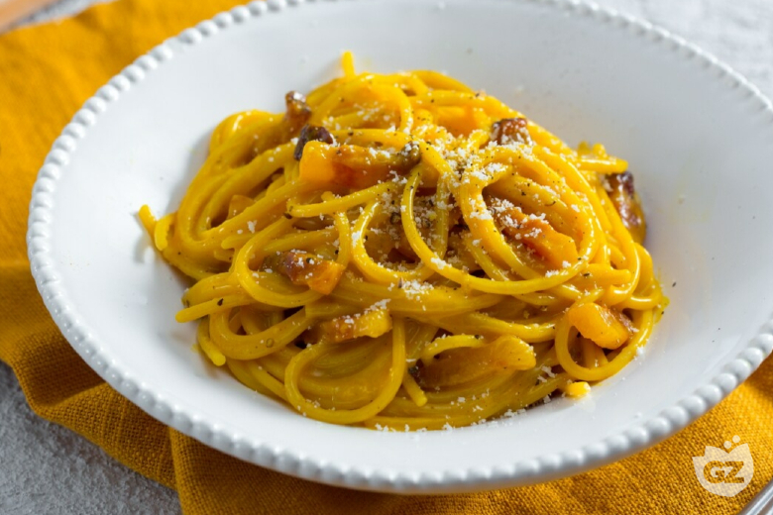
Carbonara
for two
A Roman pasta with a silky egg-and-cheese sauce and savory guanciale.
About 25 minutes
01
Notes:
Recipe and cover photograph: https://www.giallozafferano.com/recipes/Spaghetti-Carbonara-Bacon-and-egg-spaghetti.html
Photo: https://www.giallozafferano.com/images/228-22819/Spaghetti-Carbonara-Bacon-and-egg-spaghetti_780x520_wm.jpg

Slide 2
Ingredients for two
Ingredient | Quantity | Preparation notes
Spaghetti | 160 g | Weigh before cooking
Guanciale | 75 g | Remove rind, cut into small strips
Egg yolks | 3 medium | Separate into a mixing bowl
Pecorino Romano | 25 g + extra | Grate finely, save extra for serving
Black pepper | To taste | Freshly grind
Water and salt | As needed | Salt lightly, reserve 250 ml cooking water
Guanciale is cured pork cheek. Pancetta works as a substitute, with a different flavor.
02
Notes:
Recipe reference: https://www.giallozafferano.com/recipes/Spaghetti-Carbonara-Bacon-and-egg-spaghetti.html
Quantities scaled to two servings. Additional practical guidance and organization adapted for this presentation.

Slide 3
Cooking flow
1 Prepare
ingredients
2 Brown
guanciale
3 Boil pasta
Save water
6 Adjust sauce
and serve
5 Mix in eggs
off the heat
4 Toss pasta
with pork fat
Read across the top, then follow the arrows back along the bottom.
03
Notes:
Recipe reference: https://www.giallozafferano.com/recipes/Spaghetti-Carbonara-Bacon-and-egg-spaghetti.html
Quantities scaled to two servings. Additional practical guidance and organization adapted for this presentation.

Slide 4
Preparation
01
Pork and cheese
Cut the guanciale into even strips. Finely grate the Pecorino so it blends smoothly.
02
Egg mixture
Whisk the yolks with the cheese and black pepper in a bowl.
03
Everything within reach
Set out a large pot, wide frying pan, tongs, whisk and a mug for pasta water.
04
Notes:
Recipe reference: https://www.giallozafferano.com/recipes/Spaghetti-Carbonara-Bacon-and-egg-spaghetti.html
Quantities scaled to two servings. Additional practical guidance and organization adapted for this presentation.

Slide 5
Guanciale and pasta
01
Brown the guanciale
Cook in a dry pan over medium heat for about 8–10 minutes. Keep the rendered fat.
02
Cook the spaghetti
Use lightly salted boiling water. Follow the package timing and taste for al dente.
03
Save the cooking water
Scoop out 250 ml before draining. Toss the pasta in the pan with the guanciale and fat.
05
Notes:
Recipe reference: https://www.giallozafferano.com/recipes/Spaghetti-Carbonara-Bacon-and-egg-spaghetti.html
Quantities scaled to two servings. Additional practical guidance and organization adapted for this presentation.

Slide 6
The sauce comes together off the heat
OFF THE HEAT
Keep tossing
Add the egg mixture and toss immediately to coat every strand.
Move the pan away from the burner. Let fierce sizzling subside before adding the egg mixture.
Add water gradually
Mix in reserved cooking water a tablespoon at a time until the sauce looks glossy.
The finished sauce should cling to the pasta without visible egg curds.
06
Notes:
Recipe reference: https://www.giallozafferano.com/recipes/Spaghetti-Carbonara-Bacon-and-egg-spaghetti.html
Quantities scaled to two servings. Additional practical guidance and organization adapted for this presentation.

Slide 7
Serving and practical tips
01
Warm bowls, ready to go
Warm two bowls with hot water, then dry them before plating. This helps the pasta stay warm.
02
Taste before adding salt
Guanciale and Pecorino are already salty. Finish with pepper and a little extra grated cheese.
03
Serve immediately
Divide between the bowls while the sauce is still loose and glossy. It thickens as it stands.
07
Notes:
Recipe reference: https://www.giallozafferano.com/recipes/Spaghetti-Carbonara-Bacon-and-egg-spaghetti.html
Quantities scaled to two servings. Additional practical guidance and organization adapted for this presentation.

Slide 8
Common mistakes to avoid
Mistake
Better approach
Eggs hit a very hot pan
Move off the burner and wait for sizzling to subside.
Sauce becomes too thick
Toss in pasta water, one tablespoon at a time.
Guanciale turns dark or bitter
Lower the heat and remove it once golden.
Pasta water goes down the drain
Fill a mug before you drain the spaghetti.
Too much salt
Salt the water lightly and taste the finished sauce.
08
Notes:
Recipe reference: https://www.giallozafferano.com/recipes/Spaghetti-Carbonara-Bacon-and-egg-spaghetti.html
Quantities scaled to two servings. Additional practical guidance and organization adapted for this presentation.

