Slide 1
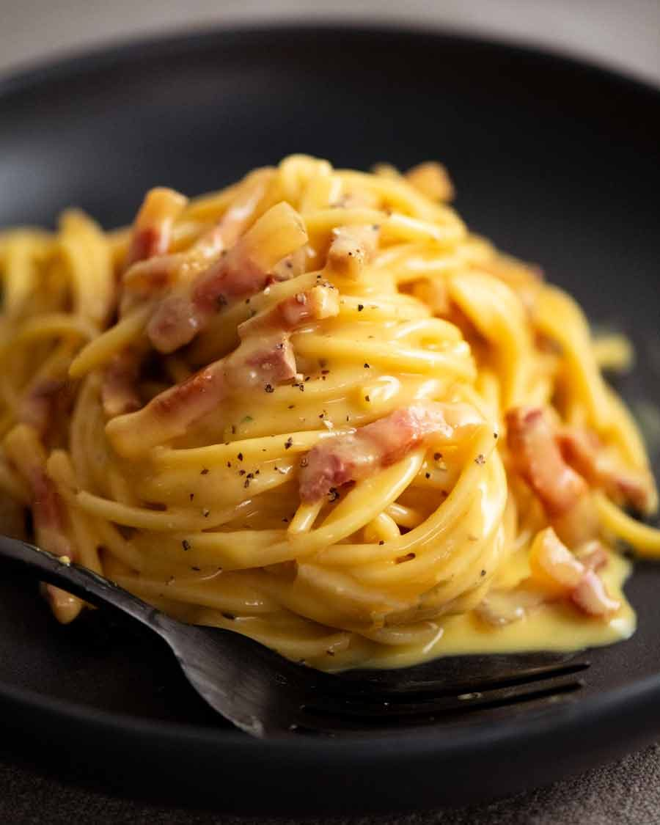
CARBONARA
for two
A creamy pasta supper made with eggs,
cheese, guanciale and black pepper.
About 25 minutes
01
Notes:
Recipe method reference: https://www.recipetineats.com/carbonara/ ; https://www.bbcgoodfood.com/recipes/two-step-carbonara . Quantities adapted for two servings. Photo: Nagi Maehashi, RecipeTin Eats, https://www.recipetineats.com/tachyon/2023/01/Carbonara_6a.jpg . Timing is approximate.

Slide 2
Ingredients for two servings
Ingredient | Quantity | Preparation notes
Spaghetti | 200 g | Dried pasta
Guanciale | 80 g | Cut into short strips. Pancetta also works.
Eggs | 1 whole + 2 yolks | Use large eggs. Whisk together.
Pecorino Romano | 50 g | Finely grate. Reserve 10 g for serving.
Black pepper | ½ tsp, plus to finish | Freshly grind. Adjust to taste.
Salt | For the pasta water | Use lightly. Pork and cheese add salt.
Pasta cooking water | Reserve 250 ml | Add only as needed to loosen the sauce.
Parmesan can replace some or all of the pecorino for a milder sauce.
02
Notes:
Recipe method reference: https://www.recipetineats.com/carbonara/ ; https://www.bbcgoodfood.com/recipes/two-step-carbonara . Quantities adapted for two servings.

Slide 3
The cooking sequence
1 Prepare
Cut pork. Grate cheese.
2 Crisp the pork
Render gently in a pan.
3 Cook the pasta
Keep 250 ml cooking water.
6 Adjust and serve
Loosen with water. Plate at once.
5 Combine off the heat
Toss pasta, pork and egg mixture.
4 Mix the sauce base
Whisk eggs, cheese and pepper.
Follow the arrows. Mix the egg base while the pasta cooks.
03
Notes:
Recipe method reference: https://www.recipetineats.com/carbonara/ ; https://www.bbcgoodfood.com/recipes/two-step-carbonara . Quantities adapted for two servings.

Slide 4
Preparation before the pan
A few minutes of preparation
make the final toss easier.
01
Cut the guanciale into roughly 1 cm strips.
Grate the cheese finely so it blends smoothly.
Set out a pot, wide pan, bowl, whisk, tongs
and a mug for saving the pasta water.
Have two warm bowls ready for serving.
04
Notes:
Recipe method reference: https://www.recipetineats.com/carbonara/ ; https://www.bbcgoodfood.com/recipes/two-step-carbonara . Quantities adapted for two servings.

Slide 5
Crisp guanciale and cook spaghetti
02
Golden pork
Start guanciale in a cool, dry pan. Cook over medium-low
heat for about 6–8 minutes, until golden. Keep the rendered fat.
03
Pasta with a little bite
Boil spaghetti in lightly salted water. Follow the packet time
and taste for al dente. Before draining, save 250 ml of water.
Toss the hot pasta with the guanciale and its fat.
05
Notes:
Recipe method reference: https://www.recipetineats.com/carbonara/ ; https://www.bbcgoodfood.com/recipes/two-step-carbonara . Quantities adapted for two servings. Cooking times vary with strip size, pan and pasta.

Slide 6
The egg and cheese mixture
04
1 whole egg + 2 yolks
Whisk with 40 g finely grated pecorino
and ½ teaspoon black pepper.
Mix while the spaghetti cooks.
The mixture will be thick. Pasta water will loosen it
during the final toss.
The remaining 10 g of cheese goes on top.
06
Notes:
Recipe method reference: https://www.recipetineats.com/carbonara/ ; https://www.bbcgoodfood.com/recipes/two-step-carbonara . Quantities adapted for two servings.

Slide 7
A glossy sauce, off the heat
05
Move the pan off the burner
Let fierce sizzling stop. Add the egg mixture to the hot
pasta and toss immediately with tongs.
Add warm pasta water a tablespoon at a time.
Keep tossing until the sauce lightly coats every strand.
06 Serve straight away
Divide between two bowls. Finish with cheese and pepper.
07
Notes:
Recipe method reference: https://www.recipetineats.com/carbonara/ ; https://www.bbcgoodfood.com/recipes/two-step-carbonara . Quantities adapted for two servings. Residual heat gently thickens the eggs. Do not put the pan over high heat after adding them.

Slide 8
Practical tips and common mistakes
Scrambled eggs
An overheated pan sets eggs into curds. Remove it from
the burner before adding the egg mixture. Toss continuously.
Sauce too thick
Add reserved warm pasta water, one tablespoon at a time.
Stop when the sauce looks glossy and loose enough to coat.
Too salty or grainy
Salt the cooking water lightly. Taste before adding more salt.
Use freshly, finely grated cheese to help it blend.
Dry pasta on the plate
Serve immediately. Carbonara thickens as it cools.
Save a little pasta water until both bowls are ready.
08
Notes:
Recipe method reference: https://www.recipetineats.com/carbonara/ ; https://www.bbcgoodfood.com/recipes/two-step-carbonara . Quantities adapted for two servings.

