Slide 1
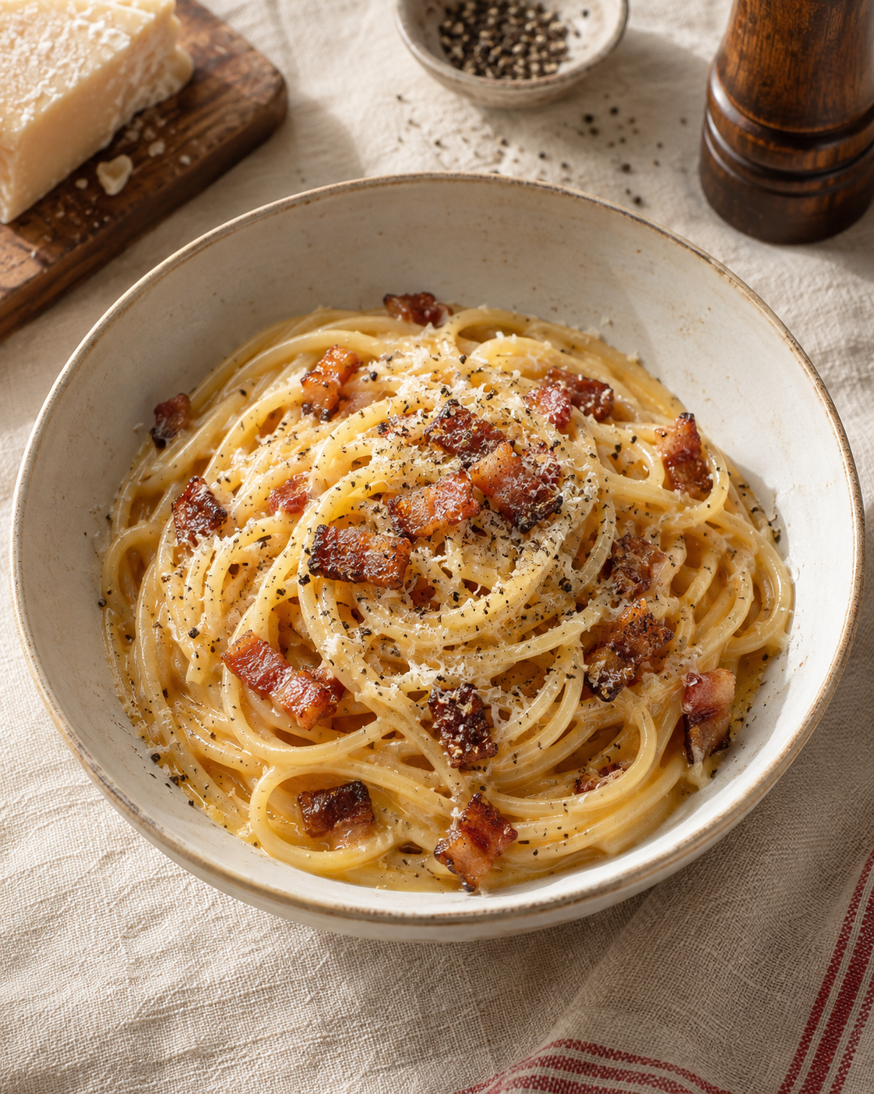
Carbonara
for two
A Roman pasta classic with guanciale,
eggs, Pecorino Romano and pepper.
The sauce turns creamy with gentle
heat and starchy pasta water.
2 servings / About 25 minutes
Notes:
Technique references: https://www.giallozafferano.com/recipes/Spaghetti-Carbonara-Bacon-and-egg-spaghetti.html
https://www.lacucinaitaliana.it/ricetta/primi/carbonara-classica/
The ingredient proportions and approximate rendering time are a practical adaptation for two generous servings. Times depend on the pasta, pan, and thickness of the guanciale.
Visual: AI-generated illustrative cookbook image, created with ImageGen. It depicts the dish rather than an actual cooked result.

Slide 2
Ingredients for two servings
Measure everything before you turn on the heat.
Ingredient | Quantity | Preparation notes
Spaghetti | 200 g | Cook al dente.
Guanciale | 100 g | Trim the rind. Cut into 5 mm strips.
Eggs | 1 large whole egg + 2 yolks | Whisk together in a mixing bowl.
Pecorino Romano | 50 g | Finely grate. Keep a little for serving.
Black pepper | ½–1 tsp, to taste | Freshly grind.
Pasta cooking water | Reserve 250 ml | Add to the sauce only as needed.
Salt | For boiling water | Use lightly. Meat and cheese add salt.
Guanciale is cured pork cheek. Pancetta is a practical substitute.
02
Notes:
Technique references: https://www.giallozafferano.com/recipes/Spaghetti-Carbonara-Bacon-and-egg-spaghetti.html
https://www.lacucinaitaliana.it/ricetta/primi/carbonara-classica/
The ingredient proportions and approximate rendering time are a practical adaptation for two generous servings. Times depend on the pasta, pan, and thickness of the guanciale.

Slide 3
The cooking sequence
Follow the numbered arrows. Add the egg sauce after removing the pan from the heat.
01
Prep ingredients
Cut and grate
02
Whisk egg base
Eggs, cheese, pepper
03
Render guanciale
Turn heat off
04
Boil pasta
Cook al dente
08
Serve at once
Cheese and pepper
07
Toss egg sauce
Off heat, add water
06
Transfer pasta
Coat in warm fat
05
Reserve water
Save 250 ml
A warm pan and small additions of water help the sauce coat the pasta.
03
Notes:
Technique references: https://www.giallozafferano.com/recipes/Spaghetti-Carbonara-Bacon-and-egg-spaghetti.html
https://www.lacucinaitaliana.it/ricetta/primi/carbonara-classica/
The ingredient proportions and approximate rendering time are a practical adaptation for two generous servings. Times depend on the pasta, pan, and thickness of the guanciale.

Slide 4
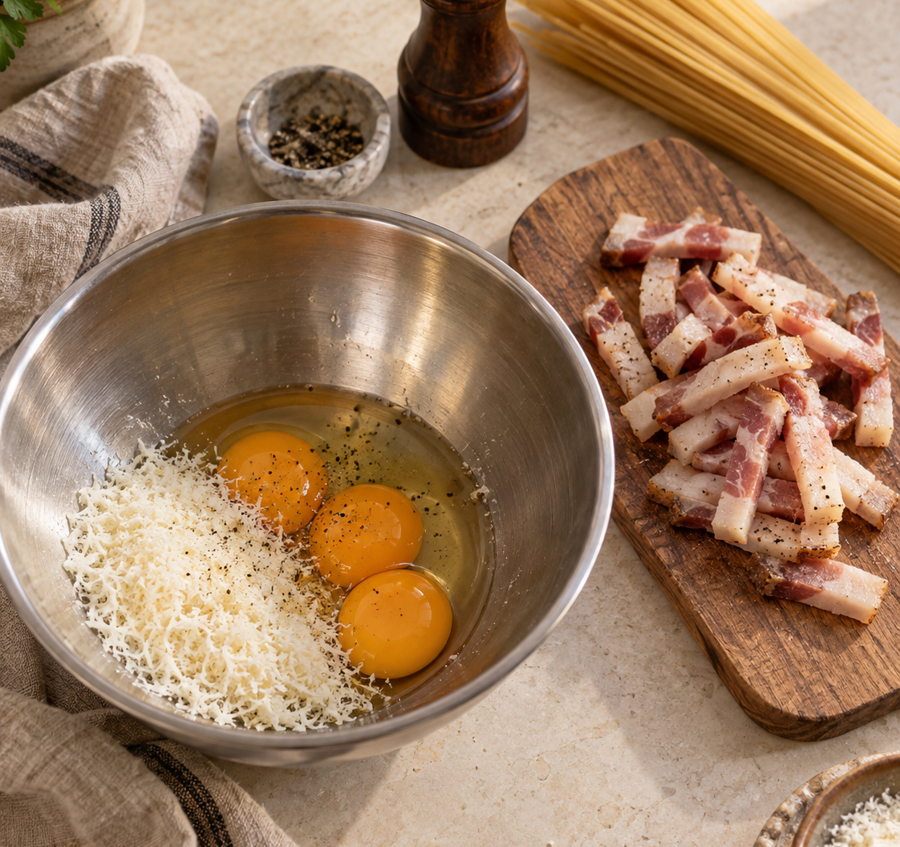
Preparation and egg base
Steps 1–2
Even pieces
Cut the guanciale into thin strips.
Finely grate the Pecorino Romano.
A thick egg paste
Whisk the whole egg and yolks with
most of the cheese and the pepper.
Tools within reach
Set out tongs, a mixing bowl and a mug
for the pasta cooking water.
04
Notes:
Technique references: https://www.giallozafferano.com/recipes/Spaghetti-Carbonara-Bacon-and-egg-spaghetti.html
https://www.lacucinaitaliana.it/ricetta/primi/carbonara-classica/
The ingredient proportions and approximate rendering time are a practical adaptation for two generous servings. Times depend on the pasta, pan, and thickness of the guanciale.
Whisk the egg base separately from the hot pan. Reserve roughly 5 g of the total 50 g cheese for serving.
Visual: AI-generated illustrative ingredient scene created with ImageGen.

Slide 5
Rendering the guanciale
Step 3. Gentle heat draws out the fat and crisps the edges.
Cold pan, no extra oil
6–10
Put the guanciale in a cold, dry frying pan.
Cook gently and stir occasionally.
Golden with crisp edges
minutes, approximately
Stop when the pieces turn golden.
Avoid dark brown or burnt edges.
Medium-low heat
Heat off
Keep the rendered fat.
It carries the guanciale flavor.
Let the pan cool while the pasta cooks.
Keep the guanciale and fat in the pan.
05
Notes:
Technique references: https://www.giallozafferano.com/recipes/Spaghetti-Carbonara-Bacon-and-egg-spaghetti.html
https://www.lacucinaitaliana.it/ricetta/primi/carbonara-classica/
The ingredient proportions and approximate rendering time are a practical adaptation for two generous servings. Times depend on the pasta, pan, and thickness of the guanciale.

Slide 6
Pasta and cooking water
Steps 4–6. Cook the pasta, reserve water, then transfer it to the pan.
Boil and taste
250 ml
Cook the spaghetti in lightly salted water.
Follow the packet time and taste for al dente.
Reserve before draining
Transfer while hot
Lift or drain the pasta into the warm
guanciale pan. Toss briefly to coat in the fat.
Save a mugful.
Add only as much as
the sauce needs.
Keep the pan off the burner before adding the egg mixture.
06
Notes:
Technique references: https://www.giallozafferano.com/recipes/Spaghetti-Carbonara-Bacon-and-egg-spaghetti.html
https://www.lacucinaitaliana.it/ricetta/primi/carbonara-classica/
The ingredient proportions and approximate rendering time are a practical adaptation for two generous servings. Times depend on the pasta, pan, and thickness of the guanciale.

Slide 7
The sauce comes together off heat
Step 7. Residual warmth thickens the egg mixture as you toss.
Add the egg base
OFF
HEAT
Move the pan away from the burner.
Pour the egg mixture over the hot pasta.
Toss continuously
Use tongs to coat every strand.
Keep the guanciale mixed through the pasta.
Warm pan.
No vigorous sizzling.
Loosen one spoonful at a time
Add cooking water 1 tablespoon at a time.
Toss until the sauce looks smooth and glossy.
07
Notes:
Technique references: https://www.giallozafferano.com/recipes/Spaghetti-Carbonara-Bacon-and-egg-spaghetti.html
https://www.lacucinaitaliana.it/ricetta/primi/carbonara-classica/
The ingredient proportions and approximate rendering time are a practical adaptation for two generous servings. Times depend on the pasta, pan, and thickness of the guanciale.
Use approximately 15 ml for each tablespoon. Reserved water is a reserve, not a fixed amount to add. Stop adding water once the sauce coats the strands without pooling. Very hot pans can scramble the eggs even after the burner is turned off, so let the pan cool before combining.

Slide 8
Practical tips and common mistakes
Small adjustments make a smoother sauce and a better finish.
Common mistake
What helps
Scrambled egg sauce
Cool the pan and add the eggs off the heat.
Dry or sticky pasta
Toss in another spoonful of cooking water.
Watery sauce
Add water gradually. Keep tossing before adding more.
Scorched guanciale
Use gentle heat and stop at golden edges.
Too much salt
Salt the pasta water lightly. Taste before seasoning.
Serve immediately on warm plates with the remaining cheese and pepper.
08
Notes:
Technique references: https://www.giallozafferano.com/recipes/Spaghetti-Carbonara-Bacon-and-egg-spaghetti.html
https://www.lacucinaitaliana.it/ricetta/primi/carbonara-classica/
The ingredient proportions and approximate rendering time are a practical adaptation for two generous servings. Times depend on the pasta, pan, and thickness of the guanciale.

