Slide 1
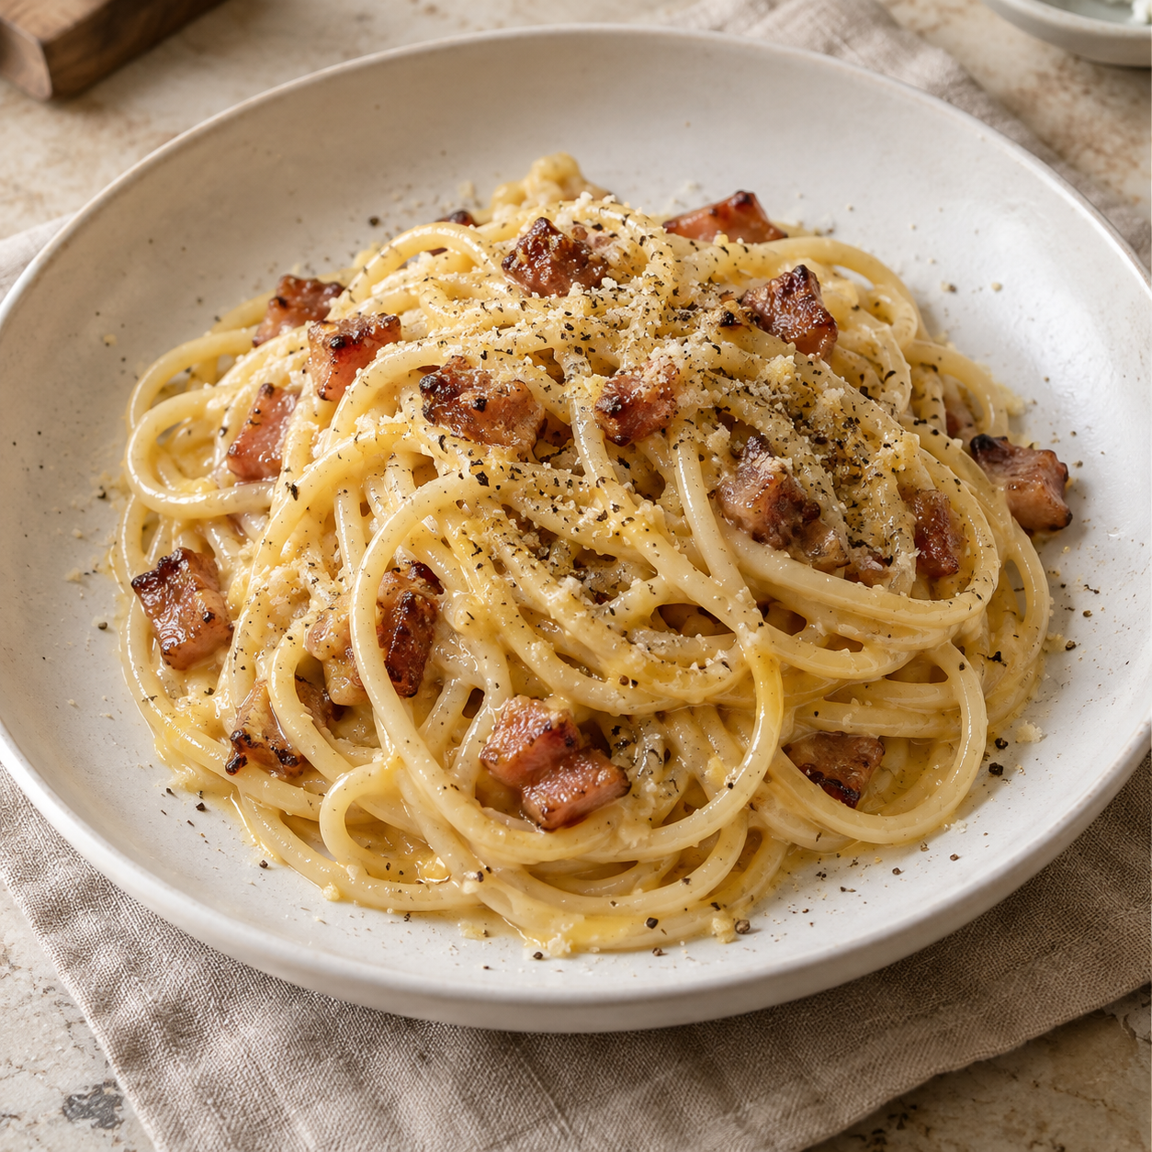
Carbonara
for two
A Roman pasta dish with a silky
egg and cheese sauce, crisp
guanciale, and black pepper.
2 servings
About 25–30 minutes
Notes:
This recipe makes two generous servings. The quantities are an adapted formulation. Carbonara uses eggs, cheese, cured pork, black pepper, pasta, and cooking water. The food image is an AI-generated illustration.
Sources:
https://www.giallozafferano.com/recipes/Spaghetti-Carbonara-Bacon-and-egg-spaghetti.html
https://www.bonappetit.com/recipe/simple-spaghetti-carbonara

Slide 2
Ingredients for two servings
Measure everything before the final toss.
Ingredient | Quantity | Preparation notes
Spaghetti | 200 g | Cook to the package’s al dente time
Guanciale | 100 g | Cut into strips. Pancetta also works
Eggs (large) | 1 egg + 2 yolks | Whisk together
Pecorino Romano | 50 g | Finely grate. 40 g sauce, 10 g finish
Black pepper | About 1 tsp | Freshly grind. Adjust to taste
Salt | Modest amount | Pork and cheese already add salt
Pasta water | Reserve 250 ml | Add only as needed
02
Notes:
Recipe quantities are an adapted two-serving formulation, not a literal half-batch of either source. Guanciale and Pecorino are salty, so use modest salt in the pasta water. Reserve about 250 ml water, but use only the amount required for a glossy sauce.
Sources:
https://www.giallozafferano.com/recipes/Spaghetti-Carbonara-Bacon-and-egg-spaghetti.html
https://www.bonappetit.com/recipe/simple-spaghetti-carbonara

Slide 3
The cooking flow
Follow the numbered arrows. Rendering and boiling can overlap.
1. Prepare
ingredients
2. Render
guanciale
3. Boil
spaghetti
4. Reserve
pasta water
8. Loosen
and serve
7. Add eggs
and toss
6. Move pan
off heat
5. Coat pasta
in pork fat
The pan should stop sizzling before the egg mixture goes in.
03
Notes:
Steps 2 and 3 may run concurrently. Reserve cooking water before draining. Remove the pan from the burner before incorporating the eggs.
Sources:
https://www.giallozafferano.com/recipes/Spaghetti-Carbonara-Bacon-and-egg-spaghetti.html
https://www.bonappetit.com/recipe/simple-spaghetti-carbonara

Slide 4
Preparation and the egg mixture
The sauce base
01
Cut the guanciale
1 whole egg
2 yolks
40 g Pecorino
Slice it into small, even strips.
02
Grate the cheese finely
Keep 10 g aside for serving.
03
Whisk the sauce base
Plus most of the freshly
ground black pepper
Mix until thick and evenly combined.
Keep the bowl beside the stove.
04
Notes:
Whisk one whole egg plus two yolks, 40 g finely grated Pecorino, and most of the pepper. Reserve the remaining 10 g cheese and some pepper for finishing. Have ingredients and tools ready before draining the pasta.
Sources:
https://www.giallozafferano.com/recipes/Spaghetti-Carbonara-Bacon-and-egg-spaghetti.html
https://www.bonappetit.com/recipe/simple-spaghetti-carbonara

Slide 5
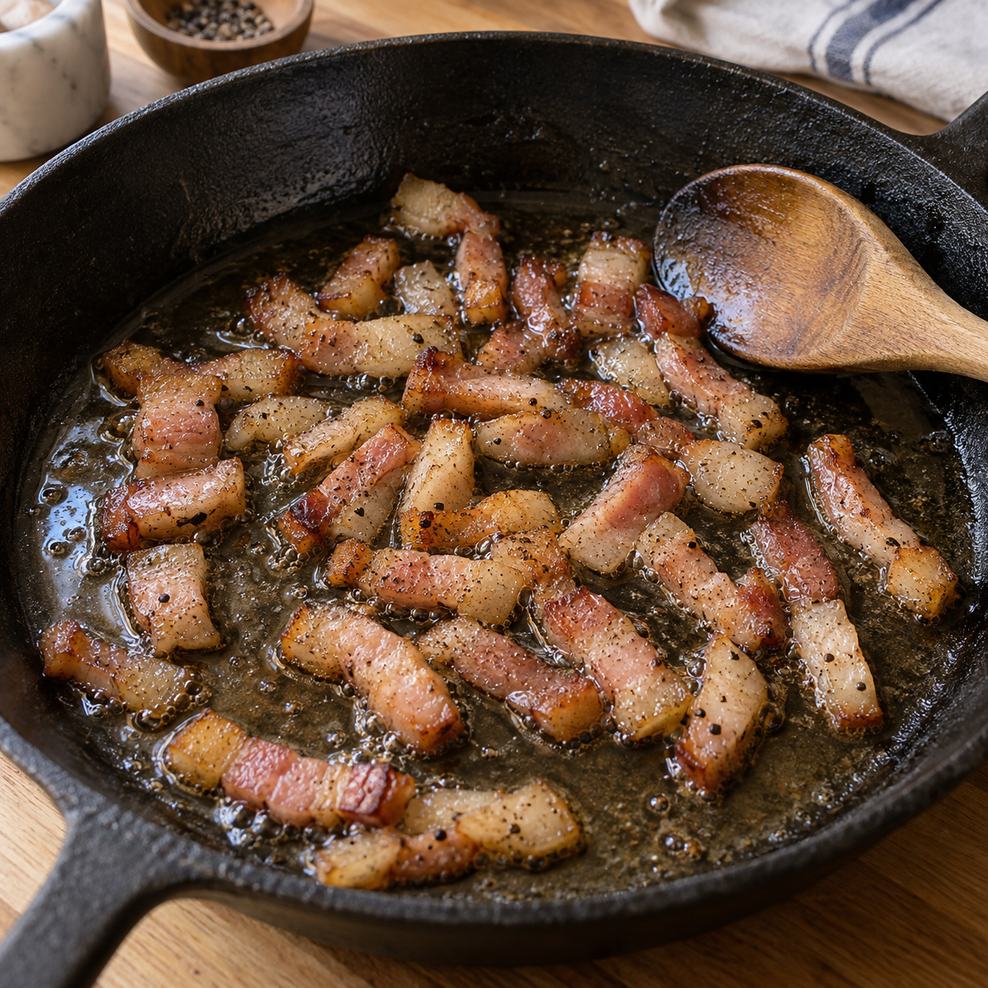
Guanciale and spaghetti
01
Render the guanciale
Use a dry skillet over medium-low heat.
Cook about 7–10 minutes until golden.
02
Cook the spaghetti
Boil in modestly salted water until
al dente. Follow the package timing.
03
Save the cooking water
Scoop out 250 ml before draining.
Keep it close by. Skip rinsing.
05
Notes:
Times are approximate and depend on strip size, cookware, and heat. Cook guanciale gently until its fat renders and the edges turn golden. Pasta cooking may overlap. The skillet photograph is an AI-generated illustration.
Sources:
https://www.giallozafferano.com/recipes/Spaghetti-Carbonara-Bacon-and-egg-spaghetti.html
https://www.bonappetit.com/recipe/simple-spaghetti-carbonara

Slide 6
The silky sauce
01
Coat the pasta
Toss hot spaghetti with the guanciale
and its rendered fat.
Off the heat
02
Move the pan off the heat
Gentle residual warmth
thickens the egg sauce.
A hot burner can turn
it into scrambled eggs.
Set it away from the burner.
Let the sizzling stop.
03
Add the egg mixture
Toss constantly. Add warm pasta water
a tablespoon at a time until glossy.
Serve promptly
06
Notes:
Temperature control is the central technique. Adding eggs over active heat risks curdling. Remove the pan fully from the burner, stop sizzling, add the mixture, and toss constantly. Add cooking water gradually until sauce coats the strands. Do not add the full reserved amount automatically.
Sources:
https://www.giallozafferano.com/recipes/Spaghetti-Carbonara-Bacon-and-egg-spaghetti.html
https://www.bonappetit.com/recipe/simple-spaghetti-carbonara

Slide 7
Practical cooking tips
Fine cheese blends more easily
Pasta water controls texture
Grate Pecorino finely so it disperses
through the egg mixture.
Add small splashes while tossing.
The sauce should coat each strand.
Warm bowls help
Finish and eat immediately
Warm the bowls with hot water,
then empty and dry them before plating.
Top with the reserved cheese and pepper.
Carbonara thickens as it cools.
Aim for glossy pasta with no heavy pool of sauce.
07
Notes:
These tips support a smooth sauce and prompt service. Finely grated cheese disperses more easily. Reserve pasta water and add it gradually. Warm bowls slow cooling during plating. Finish with the reserved cheese and pepper.
Sources:
https://www.giallozafferano.com/recipes/Spaghetti-Carbonara-Bacon-and-egg-spaghetti.html
https://www.bonappetit.com/recipe/simple-spaghetti-carbonara

Slide 8
Common mistakes to avoid
Problem
Cause and better approach
Scrambled eggs
Pan too hot. Add the egg mixture off the heat.
Dry, sticky pasta
Too little moisture. Toss in a small splash of pasta water.
Thin, watery sauce
Too much water at once. Add it one tablespoon at a time.
Over-salted pasta
Pork and cheese are salty. Salt the water modestly.
Cold, stiff sauce
Carbonara thickens as it cools. Plate and eat promptly.
Serve as soon as the sauce coats the pasta.
08
Notes:
Prevention matters most: control heat, preserve cooking water, and serve promptly. If the eggs have already scrambled, the sauce cannot return to a completely smooth texture. Small water additions can loosen a dry sauce.
Sources:
https://www.giallozafferano.com/recipes/Spaghetti-Carbonara-Bacon-and-egg-spaghetti.html
https://www.bonappetit.com/recipe/simple-spaghetti-carbonara

