Slide 1
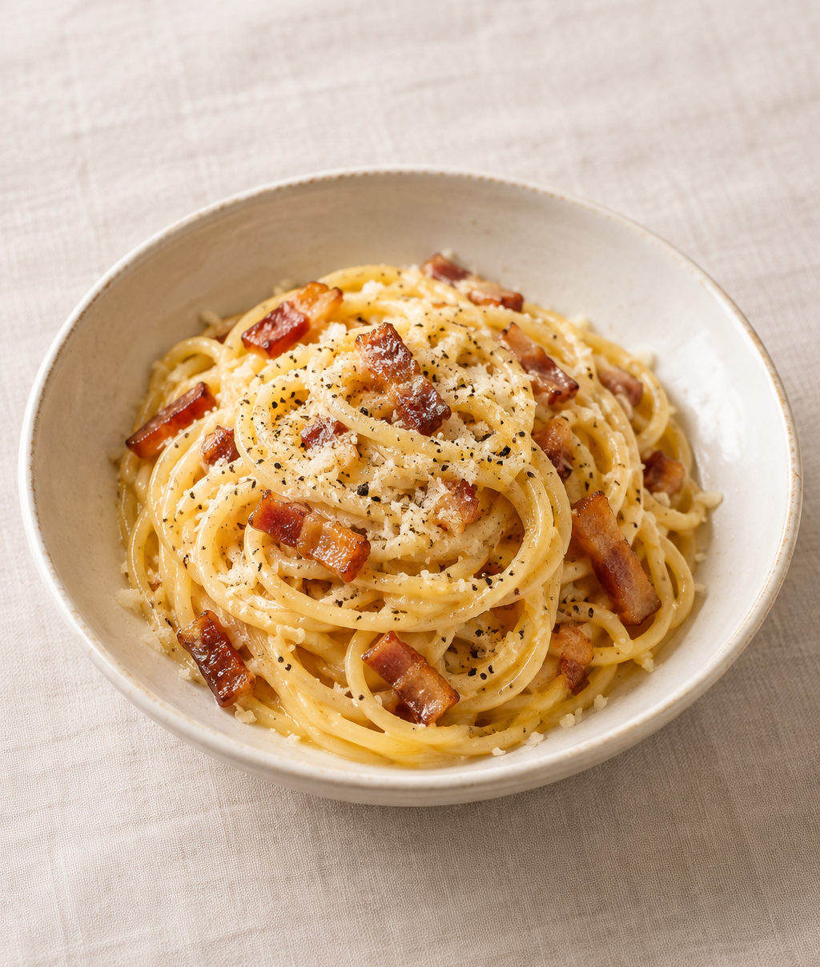
Carbonara
for two
Roman-style spaghetti with
guanciale, Pecorino and a
silky egg sauce.
2 generous servings
About 25 minutes
Notes:
Introduction: Carbonara combines eggs, cheese, rendered pork fat and a little starchy pasta water to create a sauce that coats the spaghetti. The timing is an approximate planning estimate and depends on the pasta and water-heating time. Cover image: AI-generated illustrative food photograph, created for this deck.
Recipe adapted for two servings. Sources: GialloZafferano test kitchen, https://www.giallozafferano.com/recipes/Spaghetti-Carbonara-Bacon-and-egg-spaghetti.html ; Eataly, https://eataly.co.uk/news/create-eatalys-ultimate-carbonara/ .

Slide 2
Ingredients for two
Measure everything before cooking.
Ingredient | Quantity | Preparation notes
Spaghetti | 200 g | Cook until al dente.
Guanciale | 100 g | Remove tough rind. Cut into short strips.
Eggs | 1 whole + 2 yolks | Whisk together in a mixing bowl.
Pecorino Romano | 50 g | Grate finely. Reserve 5 g to finish.
Black pepper | ½ tsp, to taste | Grind freshly. Add more when serving.
Salt | To taste | Use for pasta water. Taste before adding more.
Pasta water | Reserve 250 mL | Scoop out before draining. Use as needed.
02
Notes:
The ingredient quantities are an adapted formulation for two generous servings. Use 45 g of the Pecorino in the egg mixture and reserve 5 g for the final garnish. Guanciale is cured pork cheek. Pancetta is a practical substitute with a different flavor. The 250 mL of pasta water is a reserve, not a required amount to add.
Recipe adapted for two servings. Sources: GialloZafferano test kitchen, https://www.giallozafferano.com/recipes/Spaghetti-Carbonara-Bacon-and-egg-spaghetti.html ; Eataly, https://eataly.co.uk/news/create-eatalys-ultimate-carbonara/ .

Slide 3
Cooking flowchart
Follow the arrows. Cook the pasta while the guanciale finishes.
1 Prepare
Cut, grate
and whisk
2 Render pork
Golden guanciale
and rendered fat
3 Boil pasta
Stir until
al dente
4 Save water
Scoop out
250 mL
8 Finish
Taste and serve
immediately
7 Add sauce
Toss eggs in.
Add water slowly.
6 Heat off
Move the pan
off the burner
5 Toss in fat
Coat the
hot spaghetti
The egg mixture goes in after the pan leaves the heat.
03
Notes:
Read the upper row from left to right, then follow the downward arrow and read the lower row from right to left. Every cooking step is an editable PowerPoint shape. The arrows attach to the step shapes. Preparation includes whisking the egg and cheese mixture. Start the guanciale, then boil the pasta while the pork finishes cooking.
Recipe adapted for two servings. Sources: GialloZafferano test kitchen, https://www.giallozafferano.com/recipes/Spaghetti-Carbonara-Bacon-and-egg-spaghetti.html ; Eataly, https://eataly.co.uk/news/create-eatalys-ultimate-carbonara/ .

Slide 4
Preparation
Everything should be ready before the pasta leaves the pot.
Cut and grate
Whisk the sauce
Guanciale
Egg mixture
Cut 100 g into short strips.
Remove any tough rind.
Whisk 1 whole egg and 2 yolks
with 45 g cheese and ½ tsp pepper.
Pecorino Romano
A thick paste is normal
Finely grate 50 g. Set 5 g aside
for the final garnish.
Pasta water will loosen the
mixture during the final toss.
Equipment: large pot, wide skillet, mixing bowl, tongs and a heatproof mug.
04
Notes:
Begin heating a large pot of water while preparing the ingredients. Finely grated cheese disperses into the egg mixture more readily. The sauce is deliberately thick before cooking water is added.
Recipe adapted for two servings. Sources: GialloZafferano test kitchen, https://www.giallozafferano.com/recipes/Spaghetti-Carbonara-Bacon-and-egg-spaghetti.html ; Eataly, https://eataly.co.uk/news/create-eatalys-ultimate-carbonara/ .

Slide 5
Guanciale and spaghetti
The pork and pasta can cook at the same time.
2 Render the guanciale
3–4 Cook and save water
Start in a cold skillet. Cook over
medium-low heat for about
8–10 minutes, stirring often.
Lightly salt boiling water. Add
200 g spaghetti and stir. Cook
to al dente using the pack timing.
Look for golden edges and
rendered fat. Keep the fat
in the pan for the pasta.
Before draining, scoop out
250 mL of the starchy water.
Keep the pasta hot.
Tip: pork and cheese already add salt, so season carefully.
05
Notes:
The guanciale cooking time is approximate. Thickness and stove heat vary, so use golden color and rendered fat as the endpoint. Al dente pasta retains a slight bite. Reserve cooking water before draining. Do not rinse the spaghetti, because surface starch helps the sauce cling.
Recipe adapted for two servings. Sources: GialloZafferano test kitchen, https://www.giallozafferano.com/recipes/Spaghetti-Carbonara-Bacon-and-egg-spaghetti.html ; Eataly, https://eataly.co.uk/news/create-eatalys-ultimate-carbonara/ .

Slide 6
The pan leaves the heat
Hot pasta and gentle residual warmth bring the sauce together.
5
Toss the pasta in the pork fat
Add the hot spaghetti to the guanciale pan.
Toss to coat the strands in the rendered fat.
6
Move the pan off the burner
Wait until vigorous sizzling subsides before adding eggs.
A hot, actively frying pan can scramble the sauce.
06
Notes:
After tossing the pasta with the guanciale and its fat, remove the skillet completely from the hot burner. Give an especially heavy pan more time to cool. There is no universal waiting time because pan material and burner strength differ. The pasta should remain warm. The next slide describes adding the egg mixture.
Recipe adapted for two servings. Sources: GialloZafferano test kitchen, https://www.giallozafferano.com/recipes/Spaghetti-Carbonara-Bacon-and-egg-spaghetti.html ; Eataly, https://eataly.co.uk/news/create-eatalys-ultimate-carbonara/ .

Slide 7
A smooth sauce and the final plate
The sauce should gloss the spaghetti and cling to every strand.
7 Add the egg mixture
8 Finish and serve
Pour in the egg mixture with
the pan off the heat. Toss
continuously with tongs.
Taste before adding salt.
Divide between two warm
plates or bowls.
Add warm pasta water one
tablespoon at a time until
the sauce looks glossy.
Finish with the reserved 5 g
of cheese and more pepper.
Serve immediately.
Tip: leave the sauce slightly loose. It thickens as the pasta cools.
07
Notes:
The 250 mL pasta water is a reserve, not a target amount to use. Add it in small increments while tossing. Starch, fat and the egg-cheese mixture form the coating. A little extra cooking water can loosen an overly thick sauce. A glossy texture is a culinary cue, not a guarantee of egg pasteurization. Warm serving dishes help keep the finished pasta at a pleasant temperature.
Recipe adapted for two servings. Sources: GialloZafferano test kitchen, https://www.giallozafferano.com/recipes/Spaghetti-Carbonara-Bacon-and-egg-spaghetti.html ; Eataly, https://eataly.co.uk/news/create-eatalys-ultimate-carbonara/ .

Slide 8
Common mistakes and useful fixes
Small adjustments keep the sauce creamy and the seasoning balanced.
Mistake
What helps
Scrambled eggs
Remove the pan from the burner before adding eggs.
Dry or clumpy sauce
Grate cheese finely. Add a spoonful of water and toss.
Watery sauce
Add water gradually and stop when the sauce coats pasta.
Overly salty pasta
Lightly salt the cooking water. Taste the finished sauce.
Bitter guanciale
Cook gently until golden. Stir often to prevent burning.
08
Notes:
Troubleshooting: fully curdled egg cannot reliably be restored to a smooth carbonara sauce. Prevent scrambling by reducing the pan temperature before adding the egg mixture. For a sauce that thickens but has not curdled, add warm pasta water gradually while tossing. Serve immediately and avoid reheating the finished pasta over strong direct heat. GialloZafferano recommends eating it immediately.
Recipe adapted for two servings. Sources: GialloZafferano test kitchen, https://www.giallozafferano.com/recipes/Spaghetti-Carbonara-Bacon-and-egg-spaghetti.html ; Eataly, https://eataly.co.uk/news/create-eatalys-ultimate-carbonara/ .

