Slide 1
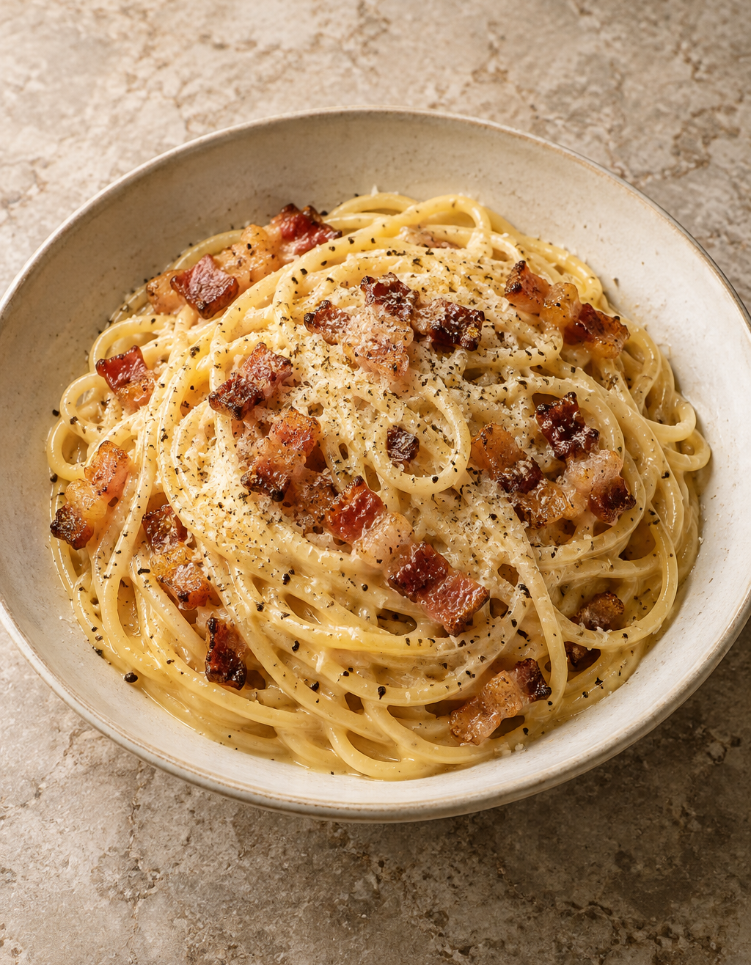
Carbonara
for two
A Roman pasta dish with crisp guanciale and a silky egg-and-cheese sauce.
2 servings
About 25 minutes
Notes:
Carbonara uses eggs, cheese, guanciale and pasta water to make a creamy sauce without added cream. Timing is approximate and depends on the pasta and stove. Image credit: AI-generated food illustration.
Recipe adapted for two servings. Sources: https://www.recipetineats.com/carbonara/ ; https://www.giallozafferano.com/recipes/Spaghetti-Carbonara-Bacon-and-egg-spaghetti.html ; https://www.seriouseats.com/pasta-carbonara-sauce-recipe

Slide 2
Ingredients for two servings
02
Ingredient | Quantity | Preparation notes
Spaghetti | 200 g | Use dried spaghetti.
Guanciale | 100 g | Trim the rind. Cut into short strips.
Large eggs | 1 whole + 2 yolks | Whisk together in a bowl.
Pecorino Romano | 50 g | Grate finely for a smooth sauce.
Black pepper | ½ tsp, plus to finish | Freshly grind. Add to the egg mixture.
Water | 2 L | Reserve 250 mL before draining.
Salt | About 10 g | Lightly salt the water. Taste at the end.
Pancetta can replace guanciale if needed. This version uses no cream or extra oil.
Notes:
Amounts are for two generous servings. Salt quantity is intentionally light because guanciale and Pecorino add salt. Reserve 250 mL pasta water as a backup, but add only a little as needed. Pancetta is an accessible substitute, with a different flavor.
Recipe adapted for two servings. Sources: https://www.recipetineats.com/carbonara/ ; https://www.giallozafferano.com/recipes/Spaghetti-Carbonara-Bacon-and-egg-spaghetti.html ; https://www.seriouseats.com/pasta-carbonara-sauce-recipe

Slide 3
The cooking sequence
03
Follow the arrows. The egg mixture goes in after the pan leaves the heat.
01 Prepare
Cut guanciale.
Mix eggs and cheese.
02 Render guanciale
Low to medium heat
until golden.
03 Cook spaghetti
Boil until
al dente.
04 Coat the pasta
Reserve water.
Toss pasta in the fat.
08 Serve immediately
Warm bowls.
Finish with pepper.
07 Adjust the sauce
Add pasta water
1 tbsp at a time.
06 Add egg mixture
Toss continuously
off the heat.
05 Cool the pan
Move off the burner.
Let sizzling subside.
Notes:
Read left to right along the top row, down at step 4, then right to left along the bottom row. Start boiling the water during preparation. The sequence groups tasks for clarity; pasta can cook while the guanciale finishes. Each step is one native PowerPoint shape with editable text.
Recipe adapted for two servings. Sources: https://www.recipetineats.com/carbonara/ ; https://www.giallozafferano.com/recipes/Spaghetti-Carbonara-Bacon-and-egg-spaghetti.html ; https://www.seriouseats.com/pasta-carbonara-sauce-recipe

Slide 4
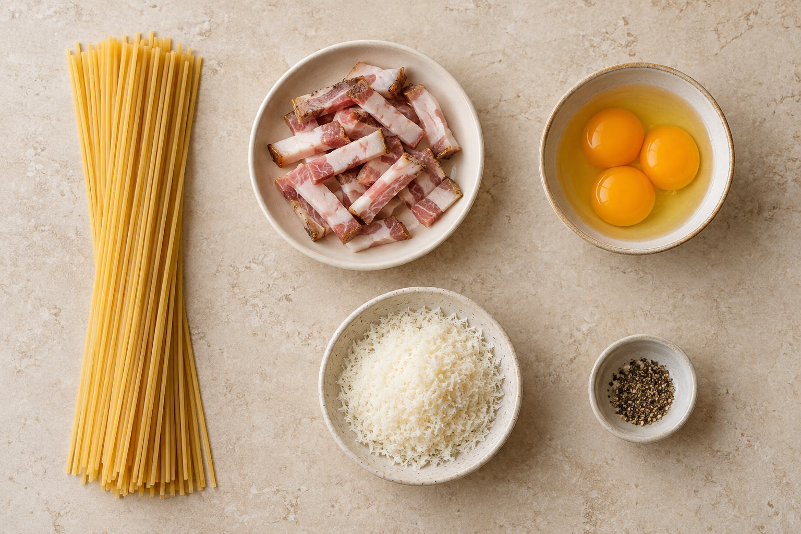
Preparation
04
Guanciale
Trim the tough rind and cut 100 g into short strips.
Egg mixture
Whisk 1 whole egg and 2 yolks with 50 g finely grated Pecorino and ½ tsp pepper.
Water and tools
Bring 2 L lightly salted water to a boil. Keep tongs and a mug nearby.
Everything ready before the pasta finishes
Notes:
The three yolks in the illustration represent one whole egg plus two additional yolks. Prepare the egg mixture in advance so the hot pasta does not sit while you grate cheese. Image credit: AI-generated food illustration.
Recipe adapted for two servings. Sources: https://www.recipetineats.com/carbonara/ ; https://www.giallozafferano.com/recipes/Spaghetti-Carbonara-Bacon-and-egg-spaghetti.html ; https://www.seriouseats.com/pasta-carbonara-sauce-recipe

Slide 5
Guanciale and spaghetti
05
02 Render the guanciale
03 Cook the spaghetti
Put the strips in a dry pan.
Cook over low to medium heat for
about 6 to 10 minutes. Stir occasionally.
Aim for golden edges and released fat. Leave the fat in the pan.
Add the spaghetti to boiling water.
Follow the packet timing and taste for al dente: tender with a slight bite.
Reserve 250 mL water, then drain. Keep the pasta hot and do not rinse.
The pasta can cook while the guanciale finishes. Use the texture cues as your guide.
Notes:
Guanciale thickness and pan heat change the cooking time. Stop before it becomes dark and hard. Dried pasta timing varies, so use the packet and taste for doneness. The reserved water contains starch that helps the sauce coat the pasta.
Recipe adapted for two servings. Sources: https://www.recipetineats.com/carbonara/ ; https://www.giallozafferano.com/recipes/Spaghetti-Carbonara-Bacon-and-egg-spaghetti.html ; https://www.seriouseats.com/pasta-carbonara-sauce-recipe

Slide 6
The silky sauce
06
Egg mixture: off the heat
04 Coat
Toss the hot pasta with the guanciale and its fat.
05 Cool
Turn off the heat and move the pan off the burner. Wait for vigorous sizzling to stop.
06 Combine
Add the egg mixture and toss continuously so the residual heat gently thickens it.
07 Adjust
Add warm pasta water 1 tbsp (15 mL) at a time. Stop when the sauce is glossy and clings.
250 mL is the reserve. You will usually need only a few tablespoons.
Notes:
Avoid a fixed temperature promise: pan material and residual heat vary. Move the pan away from the burner and allow vigorous sizzling to stop before adding the eggs. Toss constantly and add reserved cooking water gradually. The goal is a flowing, glossy coating, without visible egg curds or a pool of water.
Recipe adapted for two servings. Sources: https://www.recipetineats.com/carbonara/ ; https://www.giallozafferano.com/recipes/Spaghetti-Carbonara-Bacon-and-egg-spaghetti.html ; https://www.seriouseats.com/pasta-carbonara-sauce-recipe

Slide 7
Practical cooking tips
07
A fine grate
Finely grated cheese blends into the egg mixture more easily.
Small splashes
Add water gradually. Toss well before deciding whether the sauce needs more.
A final taste
Guanciale and Pecorino provide salt. Taste the finished pasta before adding any.
Warm bowls
Divide between two warm bowls. Add pepper and serve immediately while the sauce flows.
Notes:
The sauce thickens as the dish sits. Warm bowls help maintain the serving temperature. Prepare the table before the final toss so the carbonara can go straight to the table.
Recipe adapted for two servings. Sources: https://www.recipetineats.com/carbonara/ ; https://www.giallozafferano.com/recipes/Spaghetti-Carbonara-Bacon-and-egg-spaghetti.html ; https://www.seriouseats.com/pasta-carbonara-sauce-recipe

Slide 8
Common mistakes to avoid
08
Scrambled eggs
A pan that is too hot makes curds. Move it off the burner and let sizzling subside before adding eggs.
Clumpy or sticky sauce
Coarse cheese and too little water can make lumps. Grate finely and loosen the sauce a spoonful at a time.
Watery sauce
Too much water at once dilutes the sauce. Add small amounts and toss between additions.
Too much salt
Heavily salted water adds to the cured pork and cheese. Salt the water lightly and taste at the end.
Notes:
Scrambled egg curds cannot be made smooth by adding water, so prevention is the useful advice. Overcooked guanciale can also become tough: remove it from heat once golden. The table suggests lightly salted water as a practical starting point, with the finished dish tasted before adding more salt.
Recipe adapted for two servings. Sources: https://www.recipetineats.com/carbonara/ ; https://www.giallozafferano.com/recipes/Spaghetti-Carbonara-Bacon-and-egg-spaghetti.html ; https://www.seriouseats.com/pasta-carbonara-sauce-recipe

